Slide 1
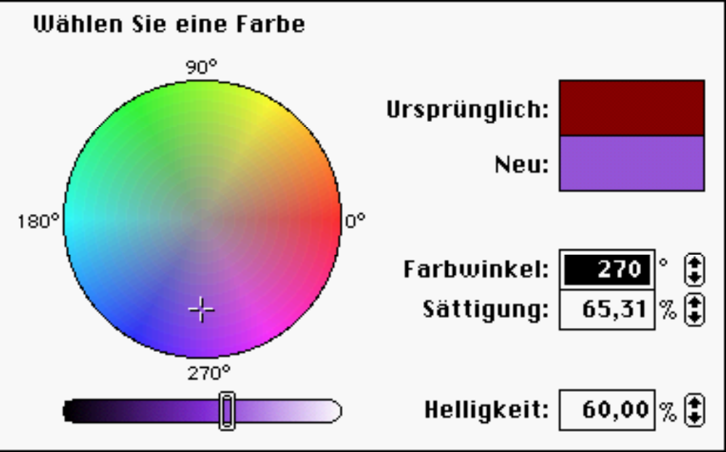
Color

Slide 2
Color Uses
Use color to assist in formatting a screen:
  Relate or tie elements into groupings.
  Break apart separate groupings of information.
  Associate information that is widely separated on the screen.
  Highlight or call attention to important information by setting it off from the other information.
Use color as a visual code to identify:
  Screen components.
  The logical structure of ideas, processes, or sequences.
  Sources of information.
  Status of information.
Other color uses:
  Realistically portray natural objects.
  Increase screen appeal.

Slide 3
Choosing Categories of Information for Color - examples
IundG:
Word Korrekturen
Some examples how information can be used:
  If different parts of the screen are attended to separately, color code the different parts to focus selective attention on each in turn.
  If decisions are made based on the status of certain types of information on the screen, color code the types of status the information may possess.
  If screen searching is performed to locate information of a particular kind or quality, color code these kinds or qualities for contrast.
  If the sequence of information use is constrained or ordered, use color to identify the sequence.
  If the information displayed on a screen is packed or crowded, use color to provide visual groupings.
Some examples how information can be used:
  If different parts of the screen are attended to separately, color code the different parts to focus selective attention on each in turn.
  If decisions are made based on the status of certain types of information on the screen, color code the types of status the information may possess.
  If screen searching is performed to locate information of a particular kind or quality, color code these kinds or qualities for contrast.
  If the sequence of information use is constrained or ordered, use color to identify the sequence.
  If the information displayed on a screen is packed or crowded, use color to provide visual groupings.

Slide 4
Einfarbigkeit sollte der Ausgangspunkt sein!
Das erlaubt die effektive Nutzung in
folgenden Fällen:
By people with a color-viewing deficiency.
On monochrome displays.
In conditions where ambient lighting distorts the perceived color.
If the color ever fails.

Slide 5


Discrimination and Harmony
For best absolute discrimination, select no more than four or five colors widely spaced on the color spectrum.
  Good colors: red, yellow, green, blue, brown.
For best comparative discrimination, select no more than six or seven colors widely spaced on the color spectrum.
  Other acceptable colors: orange, yellow-green, cyan, violet, or magenta.
Choose harmonious colors:
  One color plus two colors on either side for its complement.
  Three colors in equidistant points around the color circle.
For older viewers or extended viewing, use brighter colors.

Slide 6

Farbdifferenzierung

Slide 7
Emphasis
To draw attention or to emphasize, use bright or highlighteed colors. To de-emphasize, use less bright colors.
  The perceived brightness of colors from most to least is white, yellow, green, blue, red.
To emphasize separation, use contrasting colors.
  Red and green, blue and yellow.
To convey similarity, use similar colors.
  Orange and yellow, blue and violet.

Slide 8
Common Meanings
To indicate that actions are necessary, use warm colors.
  Red, orange, yellow.
To provide status or background information, use cool colors.
  Green, blue, violet, purple.
Conform to human expectancies.
  In the job.
  In the world at large.

Slide 9
Color Associations
Red-Stop, fire, hot, danger.
Yellow-Caution, slow, test.
Green-Go, OK, clear, vegetation, safety.
Blue-Cold, water, calm, sky, neutrality.
Gray-Neutrality.
White-Neutrality.
Warm colors-Action, response required, spatial closeness.
Cool colors-Status, background information, spatial remoteness.

Slide 10
Typical Implication of Colors
High illumination-Hot, active, comic situations.
Low illumination-Emotional, tense, tragic, melodramatic, romantic situations.
High saturation-Emotional, tense, hot, melodramatic, comic situations.
Warm colors-Active, leisure, recreation, comic situations.
Cool colors-Efficiency, work, tragic and romantic situations.

Slide 11
Location & Ordering
Location
In the center of the visual field, use red and green.
For peripheral viewing, use blue, yellow, black, and white.
Use adjacent colors that differ by hue and value or lightness.
Ordering
Order colors by their spectral position.
  Red, orange, yellow, green, blue, indidgo, violet.

Slide 12
Foregrounds
Use colors as different as possible from background colors.
Use warmer, more active colors.
Use colors that possess the same saturation and lightness.
For text or data, use desaturated or spectrum center colors.
  White, yellow, green.
To emphasize, highlight in a light value of the foreground color, pure white, or yellow.
To de-emphasize, lowlight in a dark value of the foreground color.

Slide 13
Backgrounds
Use a background color to organize a group of elements into a unified whole.
Use colors that do not compete with the foreground.
Use cool, dark colors.
  Blue, black.
Use colors at the extreme end of the color spectrum.
  Red, magenta.
Use desaturated colors.

Slide 14
Three-Dimensional Look
Use at least five colors or color values to create a 3-D look an a screen.
  Background: The control itself and the window on which it appears.
  Foreground: Captions and lines for buttons, icons, and other objects.
    Usually black or white.
  Selected mode: The color used when the item is selected.
  Top shadow: The bezel on the top and left of the control.
  Bottom shadow: The bezel on the bottom and right of the control.

Slide 15
Color Palette and Default
Provide a default set of colors for all screen components.
Provide a palette of six or seven foreground colors.
  Provide two to five values or lightness shades for each foreground color.
Provide a palette of six or seven background colors.

Slide 16
Gray Scale
For fine discriminations use a black-gray-white scale.
  Recommended values are white, light gray, medium gray, dark gray, black.

Slide 17
Text in Color
When switching text from black to color:
  Double the width of lines.
  Use bold or larger type:
    If originally 8-12 points, increase by 1-2 points.
    If originally 14-24 points, increase by 2-4 points.
Check legibility by squinting at text.
  Too-light type will recede or even disappear.

Slide 18
Choosing Colors For Textual Graphic Screens
Use effective foreground/ background combinations.
Use effective foreground combinations.
Display no more than four colors at one time.
Choose the background color first.
Test the chosen colors.

Slide 19
Effective Foreground/ Background Combinations
Background
Black Blue Green Cyan Red Magenta Brown White
Foreground
Black x Good Good Good
Blue x Poor Good
H.I. Blue Poor Poor Poor Poor
Cyan Good Poor x Poor
H.I. Cyan Good Good Good Good Good
Green Good Good x Poor Good Poor Poor
H.I. Green Good
Yellow Good Good Good Good
Red Poor x Poor Poor
H.I. Red Poor
Magenta Poor Poor x Poor
H.I. Magenta Good Good Poor
Brown Poor Poor x
Gray Poor Poor Poor
White Good Poor x
H.I. White Good Good Good

Slide 20
For dark on light polarity:
Any foreground color is acceptable if the background color is chosen properly.
Increased saturation of the foreground only marginally affected ratings, implying that any dark, saturated, foreground color is satisfactory.
Saturated backgrounds yield unsatisfactory ratings.
Less saturated backgrounds generally receive high ratings with any foreground color.

Slide 21
For light on dark polarity:
Combinations involving saturated colors tend to be unsatisfactory.
As foreground color saturation increases; the number of background colors yielding high ratings diminishes.
Generally, desaturated foreground/ background color combinations yielded the best ratings
Short wavelength, cool colors were preferred for backgrounds (blue, bluish cyan, cyan).

Slide 22
Two-Color Combinations
Good Poor
White / Green Red / Blue
Gold / Cyan Red / Green
Gold / Green Red / Purple
Green / Magenta Red / Yellow
Green / Lavender Red / Magenta
Cyan / Red White / Cyan
White / Yellow
Blue / Green
Blue / Purple
Green / Cyan
Cyan / Lavender

Slide 23
Three-Color Combinations
Good Poor
White / Gold / Green Red / Yellow / Green
White / Gold / Blue Red / Blue / Green
White / Gold / Magenta Red / Magenta / Blue
White / Red / Cyan White / Cyan / Yellow
Red / Cyan / Gold Green / Cyan / Blue
Cyan / Yellow / Lavender
Gold / Magenta / Blue
Gold / Magenta / Green
Gold / Lavender / Green

Slide 24
Use Color To Avoid (1):
Relying exclusively on color.
Too many colors at one time.
Highly saturated, spectrally extreme colors together:
  Red and blue, yellow and purple.
Low-brightness colors for extended viewing or older viewers.
Colors of equal brightness.
Colors lacking contrast:
  For example, yellow and white, black and brown, reds, blues, and browns against a light background.
Using colors in unexpected ways.

Slide 25
Use Color To Avoid (2):
Fully saturated colors for text or other frequently read screen components.
Pure blue for text, thin lines, and small shapes.
Colors in small areas.
Color for fine details.
Red and green in the periphery of large-scale displays.
Adjacent colors only differing in the amount of blue they possess.
Color to improve legibility of densely packed text.
Too many colors at one time (again).

