Slide 1
Create Meaningful Icons

Slide 2
The following factors influence an icon’s usability:
Familiarity
Clarity
Simplicity
Consistency
Directness of link
Context in which used
Complexity of task
Expectancies of users
Efficiency
Discriminability

Slide 3
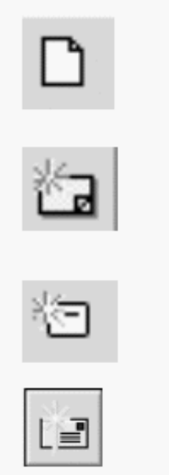

A Successful Icon
Looks different from all other icons.
Is obvious what it does or represents.
Is recognizable when no larger than 16 pixels square.
Looks as good in black and white as in color

Slide 4
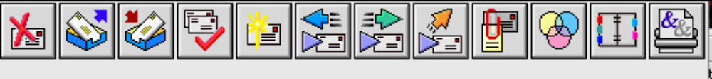
Choosing Images
Use existing icons when available.
Use images for nouns, not verbs.
Use traditional images.

Slide 5

Creating Images
Create familiar and concrete shapes.
Create visually and conceptually distinct shapes.
  Incorporate unique features of an object.
  Do not display within a border.
Clearly reflect objects represented.
Simply reflect objects represented, avoiding excessive detail.
Create as a set, communicating relationships to one another through common shapes.
Provide consistency in icon type.
Create shapes of the proper emotional tone.

Slide 6
Drawing Images
Provide consistency in shape over varying sizes.
Do not use triangular arrows in design to avoid confusion with other system symbols.
When icons are used to reflect varying attributes, express these attributes as meaningfully as possible.
Provide proper scale and orientation.
Use perspective and dimension whenever possible.
Accompany icon with a label to assure intended meaning.

Slide 7
Animation and Audition
Animation
Use:
  To provide feedback.
  For visual interest.
Make interruptible or independent of user’s primary interaction.
Do not use for decoration.
Permit it to be turned off by the user.
For fluid animation, present images at 16 or more frames per second.
Audition
Consider auditory icons.

Slide 8

The Design Process
Define the icon’s purpose and use.
Collect, evaluate, and sketch ideas.
Draw in black and white.
Draw using an icon-editing utility or drawing package.
Test for user:
  Expectations.
  Recognition.
  Learning.
Test for legibility.
Register new icons in the system’s registry.

