Slide 1
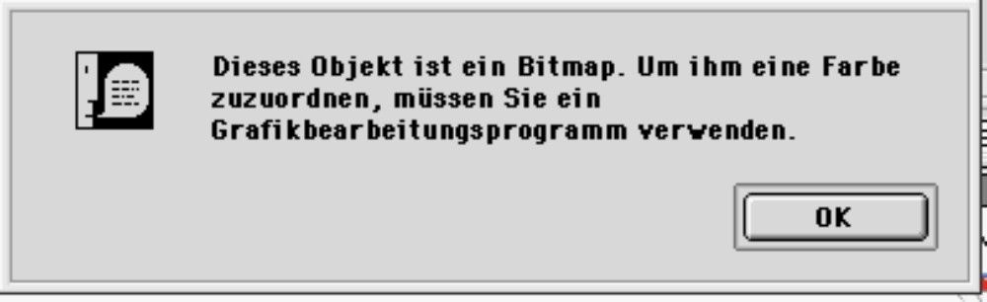
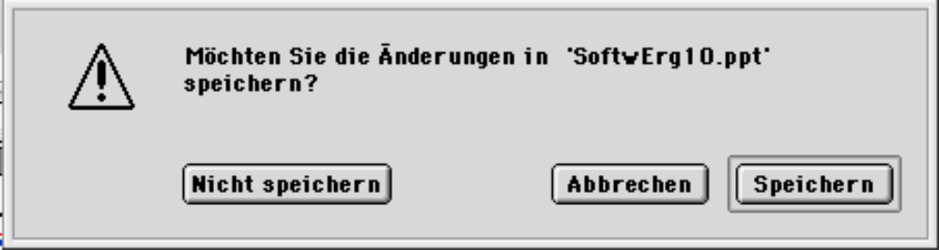
Arten von Messages
System messages
Status messages
Notification/ Informational Messages
Warning Messages
Action/ Critical Messages
Question Messages

Slide 2
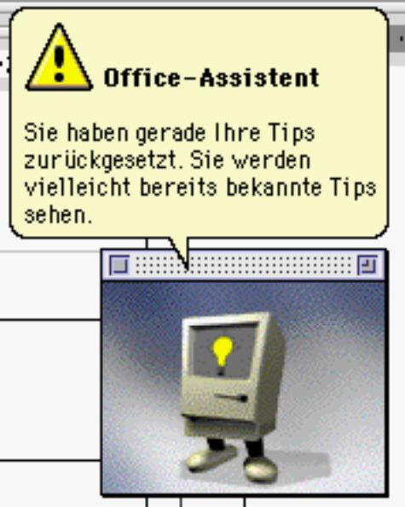
Stil einer Message (1)
Sentences must be:
Brief, simple, and clear.
Directly and immediately usable.
Affirmative.
In an active voice.
Nonauthoritarian.
Nonthreatening.
Nonanthropomorphic.
Nonpatronizing.
In the temporal sequence of events.
Structured so that the main topic is near the beginning.
Cautious in the use of humor.
Nonpunishing.

Slide 3
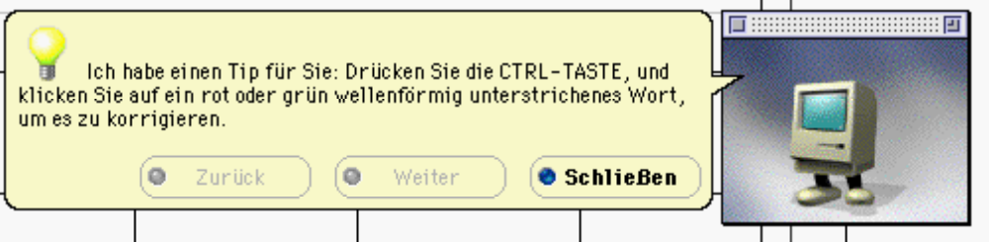
Stil einer Message (2)
Other Considerations
Abbreviated, more concise versions of messages should be available.
Something that must be remembered should be at the beginning of the text.

Slide 4
Text Presentation
Include no more than 40-60 characters on each line.
  A double column of 30-35 characters separated by 5 spaces is also acceptable.
Do not right-justify.
Use headings to introduce a new topic.
Separate paragraphs by at least one blank line.
Start a fresh topic on a new page.
Emphasize important things by:
  Positioning.
  Boxes.
  Bold typefaces.
  Indented margins.
Use lists to present facts.
Use paging (not scrolling).
Provide a screen design philosophy consistent with other parts of the system.

Slide 5
Sequence Control Guidance
Consider providing a guidance message telling how to continue at points in the dialogue where:
  A decision must be made.
  A response needs to be made to continue.
Consider indicating what control options exist at points in the dialogue where several alternatives may be available.
Permit these prompts to be turned on or off by the user

Slide 6
Response Time (RT)
System responsiveness should match the speed and flow of human thought processes.
  RT< 2 sec. if continuity of thinking is required and information must be remembered.
  RT< 4 sec. if human task closures exists.
  RT< 15 sec. if major task closures exists.
  When the user is free to do other things and return when convenient, response time can be greater than 15 seconds.
Constant delays are preferable to variable delays.

Slide 7
Einsichten bzgl. Response Time
The optimum response time is dependent upon the task.
Satisfaction with response time is a function of expectations.
Dissatisfaction with response time is a function of one’s uncertainty about delay.
People will change work habits to conform to response time.
Constant delays are preferable to variable delays.
More experienced people prefer shorter response times.
Very fast or slow response times can lead to symptoms of stress.

Slide 8
Dealing with time delays (1)
General
If an operation takes five seconds or less to complete, present a “busy” signal until the operation is complete.
  For example, display an hourglass pointer.
If an operation takes longer than five seconds to complete, display a progress indicator or message in addition to an hourglass pointer.
If an operation is very time-consuming:
  Consider breaking the operation into subtasks and providing progress Indicators for each subtask.
  Consider using a separate base window.
  Users can close the window to an icon and start a new activity while waiting.
When an operation not visible to the user is completed, present an acknowledgment message that is completed.

Slide 9
Dealing with time delays (2)
Use Progress Indicators and Percent Complete Messages
Use Elapsed Time Messages, if
  The length of the operation is not known in advance.
  A particular part of the task takes an unusually long time.

Slide 10
Blinking for Attention
Attract attention by flashing when an application is inactive but must display a message to the user.
  If a window, flash the title bar.
  If minimized, flash its icon.
To provide an additional message indication, also provide an auditory signal (one or two beeps).
  Very useful if:
    The window or icon is hidden.
    The user’s attention is frequently directed away from the screen.
When the application is activated, display the message.
Do not display the message until requested by the user.
  Preserves the user’s control over the work environment.
  Ensures that the message is not accidentally closed through an inadvertent key press.

Slide 11
Use of Sound (1)
Always use in conjunction with a visual indication.
Use no more than six different tones.
  Assure that people can discriminate among them.
Do not use:
  Jingles or tunes.
  Loud signals.
Use consistently.
  Provide unique but similar tones for similar situations.
Provide signal frequencies between 500 and 1,000 Hz.
Allow the user to adjust the volume or turn the sound off altogether.

Slide 12
Use of Sound (2)
Test the sounds with users over extended trial periods.
Use sparingly because sounds:
  Are annoying to many people, including users and nonusers in the vicinity.
  Can easily be overused, increasing the possibility that they will be ignored.
  Are not reliable because:
    Some people are hard of hearing.
    If they are not heard, they leave no permanent record of having occurred.
    They can be turned off by the user.

