Slide 1
SYST
TDAT
Systemtestdaten Generierung
Approaches to Software Testing
Quellen der Testdaten
Testdaten aus dem Fachkonzept
Testdaten aus dem Systementwurf
Testdaten aum dem ProgrammCode
Testdaten aus der Produktion
Testdaten aus dem Test
Testdaten Tabellen
Testdaten Dateien
Testdaten Assertions
Beispiel einer Assertionsprozedur
Beispiel einer XML File
Testdaten Objekttypen
Datenbanken
Systemschnittstellen
Benutzeroberflächen
Generierung von Testdaten
Funktionenen eines Testdatengenerators
Eingaben zum Testdatengenerator
Ausgaben vom Testdatengenerator
Generierung der Datenbanken
Generierung der Systemschnittstellen
Generierung der Benutzeroberflächen
Recycling Testdaten
1
13
2
14
3
15
4
16
5
17
6
18
7
19
8
20
9
21
10
22
11
23
12
24

Slide 2
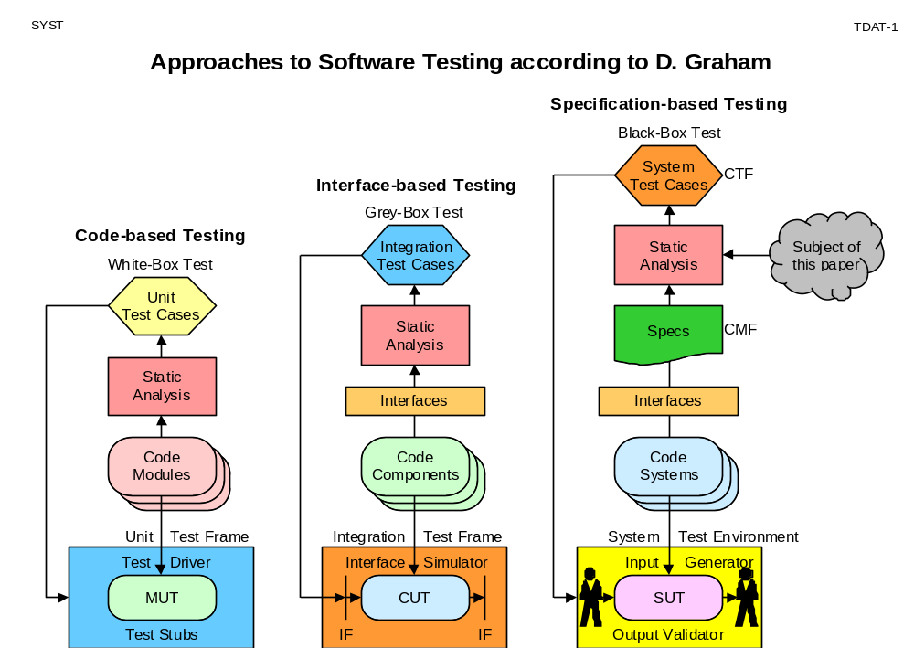

Slide 3
SYST
TDAT-2
Quellen der Testdaten
Fachkonzept
Req. Specs
Entwurfs
dokumente
(UML)
Programm
Quell
Code
IT
Produktion
KEY
NAME
RACE
IQ
AGE
QUAL
4711
4713
4715
4717
4720
Jones
Goldbery
Li
Zlotek
Lopez
Black
Jew
Chink
Polack
Spic
50
125
140
120
90
25
35
28
32
24
0.6
0.95
0.9
0.92
0.7
Testdaten

Slide 4
SYST
TDAT-3
Testdaten aus dem Fachkonzept
Anforderungsspecifikation
Job_Candidate = E Set (Candidates)
<Candidates>
<Candidate id= „key”>
<Name type = „string”/>
<Race type = „char”/>
<IQ type = „dec”/>
<Age type = „dec”/>
<Qual type = „Real”/>
</Candidate>
<Candidates>
Select Candidate
if (Race = Minority &
IQ > 120 &
(Age > 25 & < 35) &
Qual > 0.9)
Symbolische Testdaten
KEY
NAME
RACE
IQ
AGE
QUAL
0
100
200
300
400
500
600
700
800
AAAAA
BBBBB
CCCCC
DDDDD
EEEEE
FFFFF
GGGGG
HHHHH
IIIII
Majority
Minority
Minority
Minority
Minority
Minority
Minority
Minority
Minority
125
120
125
125
125
125
121
130
150
30
30
35
30
30
28
26
34
30
0.95
0.95
0.95
0.90
0.95
0.95
0.91
0.99
1.00

Slide 5
SYST
TDAT-4
Testdaten aus dem Systementwurf
Klassendiagramm
Random Testdatentabelle
Class: Candidate
Attributes:
Int Key range (4710:4720)
String Name;
Char Race enum (0,1,2,3,4,5);
Dec IQ range (70:150);
Int Age range (25:35);
Real Qual range (0.8:0.99);
KEY
NAME
RACE
IQ
AGE
QUAL
4710
4711
4712
4713
4714
4715
4716
4717
4718
AAAAAA
BBBBBB
CCCCCC
DDDDDD
EEEEEE
FFFFFF
GGGGGG
HHHHHH
IIIIII
0
1
1
1
1
2
2
2
2
70
150
110
70
150
110
70
150
110
25
26
35
34
25
26
35
34
25
0.8
0.99
0.9
0.8
0.99
0.9
0.8
0.99
0.9
Methods:
Hire (Candidate, Hiring_Rule);
Promote (Employee, Performance);
Fire (Employee, Age_Limit, Performance);

Slide 6
SYST
TDAT-5
Testdaten aus dem ProgrammCode
Class_Candidate: Person
{
int Key;
string Name;
enum Race (0,1,2,3,4,5);
long IQ;
int Age;
real Qual;
Hire (struc, string);
Hire (Candidate,Hiring_Rule)
{
select Candidate from Candidates
where (Race > 0 & Race < 6)
and (IQ > 120)
and (Age > 25 & Age < 35)
and (Qual > 0.9)
}
Testdaten für Zweigüberdeckung
KEY
NAME
RACE
IQ
AGE
QUAL
9999
9999
XXXXX
YYYYYY
0
1
120
121
25
26
0.90
0.91

Slide 7

SYST
TDAT-6
Testdaten aus der Produktion
Datenerfassung
Beispieldaten
KEY
NAME
RACE
IQ
AGE
QUAL
Echt
Daten
4711
4712
4713
4714
4715
4716
4717
4720
Jones
Meyer
Goldberg
Bush
Li
Smith
Zlotek
Lopez
Black
Aryian
Jew
Aryian
Chink
Aryian
Polack
Spic
50
120
125
90
140
110
90
90
25
30
35
55
28
36
32
24
0.6
0.9
0.8
0.7
0.9
0.85
0.92
0.7
Filter
Produktions
Umgebung

Slide 8


SYST
TDAT-7
Test Data from the Test
automatische
Test
wiederholung
Tester gibt Daten ein:
Name = Li
Race = Chink
IQ = 140
Age = 28
Qual = 0.9
Li
Chink
140
28
0.9
Daten-
strom =
Test
Daten
Log
Capture/Replay Tool
zeichnet Testdaten
von der
Benutzeroberfläche auf
Rückspiel der
aufgezeichneten
Testdaten fur die
Testwiederholung

Slide 9
SYST
TDAT-8
Testdatentabellen
Pers_ID
Name
Race
IQ
Age
Qual
Experience
4711
4712
4713
4714
4715
4716
4717
4718
4719
4720
-
-
-
Jones, Leroy
Meyer, Hermann
Goldberg, Hian
Bush, George
Li, Yang
Smith, Larry
Zlotek, Vaclav
Brown, Charlie
Nelson, Willie
Lopez, Jennifer
-
-
-
Black
Aryian
Jew
Aryian
Chink
Aryian
Polack
Black
Aryian
Spic
-
-
-
50
100
125
70
140
110
90
60
120
90
-
-
-
25
30
35
55
28
36
32
29
65
24
-
-
-
0.6
0.9
0.8
0.7
0.9
0.85
0.92
0.75
0.8
0.7
-
-
-
Low
High
Medium
Low
High
Medium
Low
Low
High
Medium
-
-
-

Slide 10
SYST
TDAT-9
Testdaten Dateien
<Candidates>
<Candidate id= ”4711”>
<Name>Jones, Leroy</Name>
<Race>Black</Race>
<IQ>50</IQ>
<Age>25</Age>
<Qual>0.6</Qual>
<Experience>Low<Experience>
</Candidate>
<Candidate id= ”4712”>
<Name>Meyer, Hermann</Name>
<Race>Aryian</Race>
<IQ>100</IQ>
<Age>30</Age>
<Qual>0.6</Qual>
<Experience>High<Experience>
</Candidate>
<Candidates>
<Candidate id= ”4719”>
<Name>Nelson, Willie</Name>
<Race>Aryian</Race>
<IQ>120</IQ>
<Age>65</Age>
<Qual>0.8</Qual>
<Experience>High<Experience>
</Candidate>
<Candidate id = ”4720”>
<Name>Lopez, Jennifer</Name>
<Race>Spic</Race>
<IQ>90</IQ>
<Age>24</Age>
<Qual>0.7</Qual>
<Experience>Medium<Experience>
<Candidate>

Slide 11
SYST
TDAT-9
Testdaten Assertions
File Candidates;
assert Key = range(4711:4750,+1);
if(Key = ”4711”)
assert Name = ”Jones, Leroy”;
assert Race = ”Black”;
assert IQ = ”50”;
assert Age = ”25”;
assert Qual = ”0.6”;
assert Experience = ”Low”;
end;
if(Key = ”4712”)
assert Name = ”Meyer Hermann”;
assert Race = ”Aryian”;
assert IQ = ”100”;
assert Age = ”30”;
assert Qual = ”0.6”;
assert Experience = ”High”;
end;
Assert Name = Set(”Jones, Leroy”,
”Meyer, Harmann”,
”Goldberg, Hiam”,
”Li, Yang”,
Assert Race = Set(”Black”,
”Aryian”,
”Jew”,
”Chink”,
”Polack”,
”Spic”);
Assert IQ = range(60:150);
Assert Age = range(20:65);
Assert Qual = range(0.5:1.0);
Assert Experience = Set(„Low”,
„Medium”,
„High”,
„Top”);

Slide 12
SYST
Beispiel einer Assertionprozedur
TDAT-11
file: SALZBURG;
when (new.Datum[9:2] = "24") then replace new.Datum[9:2] by "21";
when (new.Datum[9:2] = "22") then replace new.Datum[9:2] by "21";
if ( object = "Mitglied" &
new.MitgliedsNummer = old.MitgliedsNummer &
new.SubNummer = old.SubNummer );
assert new.Name[1:8] = old.Name[1:8];
assert new.Datum[1:8] = old.Datum[1:8];
assert new.Datum[9:2] = old.Datum[9:2];
assert new.Geburtsdatum = old.Geburtsdatum;
assert new.RechnungsBetrag = old.RechnungsBetrag;
assert new.Kundendatenfeld = old.Kundendatenfeld;
assert new.Ocr_Zeile = old.Ocr_Zeile;
endObject;
when (new.Fachgruppe = "03") then skip;
if ( object = "Forderung" &
new.MitgliedsNummer = old.MitgliedsNummer &
new.Fachgruppe = old.Fachgruppe ! "15" &
new.Jahr = old.Jahr );
assert new.Standort = old.Standort;
assert new.Betrag = old.Betrag;
assert new.Fachgruppe = old.Fachgruppe;
endObject;
end;

Slide 13
SYST
<rechnungsposten> ´Beispiel einer XML File
<RECHNUNGSKOPF>
<STATUS-CODE>00</STATUS-CODE>
<SATZKZ>RK</SATZKZ-LP>
<AUFTRAGNR>000111</AUFTRAGNR>
<KUNDENNR>000222</KUNDENNR>
<KUNDENBONITAET>02</KUNDENBONITAET>
<KUNDENDATEN>
<KUNDENNAME>Franz Lechner</KUNDENNAME>
<KUNDENANSCHRIFT>
<KUNDEN-LAND>BAYERN</KUNDENLAND>
<KUNDEN-PLZ>82054</KUNDEN-PLZ>
<KUNDEN-ORT>Arget/Sauerlach</KUNDEN-ORT>
<KUNDEN-STRASSE>Prellerweg 7</KUNDEN-STRASSE>
</KUNDENANSCHRIFT>
</KUNDENDATEN>
</RECHNUNGSKOPF>
<RECHNUNGSPOSTEN>
<STATUS-CODE>00</STATUS-CODE>
<SATZKZ-RP>RP</SATZKZ-RP>
<AUFTRAGNR-RP>000111</AUFTRAGNR-RP>
<KUNDENNR-RP>000222</KUNDENNR-RP>
<BESTELLNR>01</BESTELLNR>
<ARTIKELNR>333333</ARTIKELNR>
<ARTIKELNAME>MIST</ARTIKELNAME>
<ARTIKELPREIS>010000</ARTIKELPREIS>
<BESTELLMENGE>0050</BESTELLMENGE>
<POSTENPREIS>500000</POSTENPREIS>
</RECHNUNGSPOSTEN>
<RECHNUNGSFUSS>
<STATUS-CODE>00</STATUS-CODE>
<SATZKZ-RF>RF</SATZKZ-RF>
<AUFTRAGNR-RF>000111</AUFTRAGNR-RF>
<KUNDENNR-RF>000222</KUNDENNR-RF>
<RECHPOST-RF>02</RECHPOST-RF>
</RECHNUNGSFUSS>
TDAT-12

Slide 14
SYST
TDAT-13
Testdatenobjektypen
<...........>
<...........>
<...........>
<...........>
</..........>
<...........>
<...........>
<...........>
Pull Down
Menue
________________
________________
________________
________________
Tab_A
________________
________________
________________
________________
Tab_B
System
Schnittstellen
Benutzer
Oberflächen
Datenbanken

Slide 15
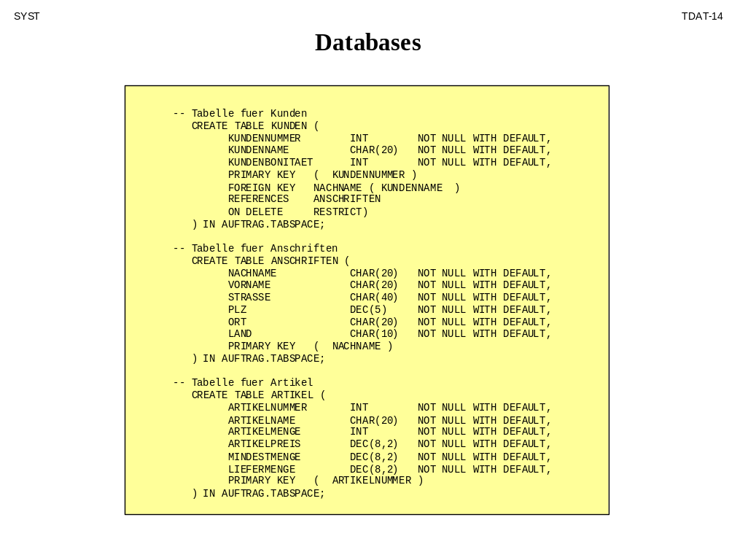

Slide 16
SYST
System Interfaces
TDAT-15
<schema name = "RECHPOST" xmlns= "XSDCOB">
<XSDCOB:complexType type = "#file" name = "RECHPOST” content = "eltOnly" model = "closed">
<XSDCOB:element type = "#char" name = "STATUS-CODE” content = "TextOnly" model = "closed"
level = "02” occurs = "1” minOccurs = "0001" maxOccurs = "0001”
pos = "0000" lng = "0002” pic = "XX" usage = "DISPLAY"/>
<XSDCOB:complexType type = "#record" name = "RECHNUNGSKOPF” content = "eltOnly” model = "closed”
level = "02” occurs = "ONEORMORE" minOccurs = "0001" maxOccurs = "unbounded">
<XSDCOB:element type = "#char" name = "SATZKZ” content = "TextOnly" model = "closed"
level = "05” occurs = "ONEORMORE" minOccurs = "0001" maxOccurs = "0001"
pos = "0001" lng = "0002” pic = "XX" usage = "DISPLAY"/>
<XSDCOB:element type = "#dec" name = "AUFTRAGNR” content = "TextOnly" model = "closed”
level = "05” occurs = "ONEORMORE" minOccurs = "0001" maxOccurs = "0001"
pos = "0003" lng = "0006” pic = "9(6)" usage = "DISPLAY"/>
<XSDCOB:element type = "#dec" name = "KUNDENNR” content = "TextOnly" model = "closed”
level = "05” occurs = "ONEORMORE" minOccurs = "0001" maxOccurs = "0001"
pos = "0009" lng = "0006” pic = "9(6)" usage = "DISPLAY"/>
<XSDCOB:element type = "#dec" name = "KUNDENBONITAET” content = "TextOnly" model = "closed"
level = "05” occurs = "ONEORMORE" minOccurs = "0001" maxOccurs = "0001"
pos = "0015" lng = "0002” pic = "99" usage = "DISPLAY"/>
<XSDCOB:complexType type = "#group" name = "KUNDENDATEN” content = "eltOnly" model = "closed"
level = "05” occurs = "ONEORMORE" minOccurs = "0001" maxOccurs = "0001">
<XSDCOB:element type = "#char" name = "KUNDENNAME” content = "TextOnly" model = "closed"
level = "10” occurs = "ONEORMORE" minOccurs = "0001" maxOccurs = "0001"
pos = "0017" lng = "0030” pic = "X(30)" usage = "DISPLAY"/>
<XSDCOB:complexType type = "#group" name = "KUNDENANSCHRIFT” content = "eltOnly" model = "closed"
level = "10” occurs = "ONEORMORE" minOccurs = "0001" maxOccurs = "0001">
<XSDCOB:element type = "#char" name = "KUNDEN-LAND” content = "TextOnly" model = "closed"
level = "15” occurs = "ONEORMORE" minOccurs = "0001" maxOccurs = "0001"
pos = "0047" lng = "0004” pic = "XXXX" usage = "DISPLAY"/>
<XSDCOB:element type = "#dec" name = "KUNDEN-PLZ” content = "TextOnly" model = "closed"
level = "15” occurs = "ONEORMORE" minOccurs = "0001" maxOccurs = "0001"
pos = "0051" lng = "0005” pic = "9(5)" usage = "DISPLAY"/>
<XSDCOB:element type = "#char" name = "KUNDEN-ORT" content = "TextOnly" model = "closed"
level = "15” occurs = "ONEORMORE" minOccurs = "0001" maxOccurs = "0001"
pos = "0056" lng = "0020” pic = "X(20)" usage = "DISPLAY"/>
<XSDCOB:element type = "#char" name = "KUNDEN-STRASSE” content = "TextOnly" model = "closed"
level = "15" occurs = "ONEORMORE" minOccurs = "0001" maxOccurs = "0001"
pos = "0076" lng = "0020” pic = "X(20)" usage = "DISPLAY"/>
</XSDCOB:complexType>
</XSDCOB:complexType>
</XSDCOB:complexType>

Slide 17
SYST
<?xml version="1.0" encoding="ISO-8859-1"?> User Interfaces
<xsl:stylesheet xmlns:xsl="http://www.w3.org/TR/WD-xsl”>
<!-- Author: Your Name -->
<xsl:template> <xsl:apply-templates/></xsl:template>
<xsl:template match="text()"><xsl:value-of/></xsl:template>
<xsl:template match="Cliente">
<html> <head><title>Cliente:</title></head>
<body bgcolor="yellow">
<table border="1"> <xsl:apply-templates/> </table>
</body>
</html>
</xsl:template>
<xsl:template match="Cognome">
<tr>
<th>Cognome:</th>
<td><xsl:apply-templates/></td>
</tr>
</xsl:template>
<xsl:template match="Nome">
<tr>
<th>Nome:Nome</th>
<td><xsl:apply-templates/></td>
</tr>
</xsl:template>
<xsl:template match="Strade">
<tr>
<th>Strade:</th>
<td><xsl:apply-templates/></td>
</tr>
</xsl:template>
<xsl:template match="Citta">
<tr>
<th>Citta:</th>
<td><xsl:apply-templates/></td>
</tr>
</xsl:template>
TDAT-16

Slide 18

SYST
TDAT-17
Generating Test Data
Test Data Specification
Test Data Generation
Test Data
assert X1 = 100;
assert X2 > X1;
assert X3 < X1;
assert X4 = #X4 + 1;
assert X5 = X2 - X3;
assert X6 = X4 * 4;
assert X7 = range (0:100);
assert X8 = set ('a', 'b', 'c');
assert X9 = 'string';
if (X1 > X7)
assert X10 = #X10 + 1;
else
assert X10 = 50;
Generate
Data Objects
with
specified
values
100 100 100
101 101 101
99 99 99
1 2 3
2 2 2
4 8 32
0 100 50
a b c
string string string
1 50 51

Slide 19
SYST
TDAT-18
Test Data Generation Functions
DataTest
(DataGen)
Test Data
Specification
Test Data
Generation
Test Data
Conversion
Set Values
Compute Values
Replace Values
Create Index Table
Insert Records
Select Records
Delete Records
Modify Records
Text → CSV/ XML
CSV → TXT / XML
XML → TXT / CSV

Slide 20
SYST
TDAT-19
Inputs to Test Data Generation
Text
CSV
XML
whens
ifs
asserts
Names
Types
Separators
Options
Controls
Data Files
Assertion Scripts
User Parameters
DataTest
(DataGen)

Slide 21
SYST
TDAT-20
Outputs from Test Data Generation
DataTest
(DataGen)
Execution Log
Error Reports
Statistics
Test Data File
Text
CSV
XML
Test Data Report
Records created
Records changed
Records deleted
FileName.log
FileName.rpt
FileName.txt
csv
xml

Slide 22
SYST
TDAT-21
Generierung der Datenbanken
Regel
_ _ _ _ _ _ _
_ _ _ _ _ _ _
_ _ _ _ _ _ _
_ _ _ _ _ _ _
_ _ _ _ _ _ _
_ _ _ _ _ _ _
_ _ _ _ _ _ _
_ _ _ _ _ _ _
Beispiel
Daten
Structure
Generator
Struktur
+
Inhalt
DB
Schema
Content
Generator
Test Datenbank

Slide 23
SYST
TDAT-22
Generierung der Systemschnittstellen
Test
Skript
Test
Daten
Test
Treiber
API
IT
ANWENDUNGS
SYSTEM
empfängt
Nachrichten
von anderen
Systeme
Parameter
Schnittstellen
Definition
Test
Daten
Datei
Generator
XML
Dateien
Nachrichten
Test
Skript

Slide 24
SYST
TDAT-23
Generierung der Benutzeroberflächen
Test
Skript
Endbenutzer
nicht erforderlich
Benutzer-
oberfläche simuliert durch generierte Masken
Form
Generator
Style
Sheet
Screen
buffer
XML
Test Daten
HTML
Map
XML
Client
Programm
XML
Schema
XSL
Layout
XSD/DTD
XSL/HTML
Glaubt es erhält seine Daten von dem Endbenutzer

Slide 25
SYST
TDAT-24
Recycling Testdaten
Produkt
Version_1
Test
Daten
mutierte
Test
Daten
1. Test
Daten
Erweiterung
Test
Req.
Produkt
Version_2
Test
Daten++
mutierte
Test
Daten
Change
Req.
2. Test

