Slide 1
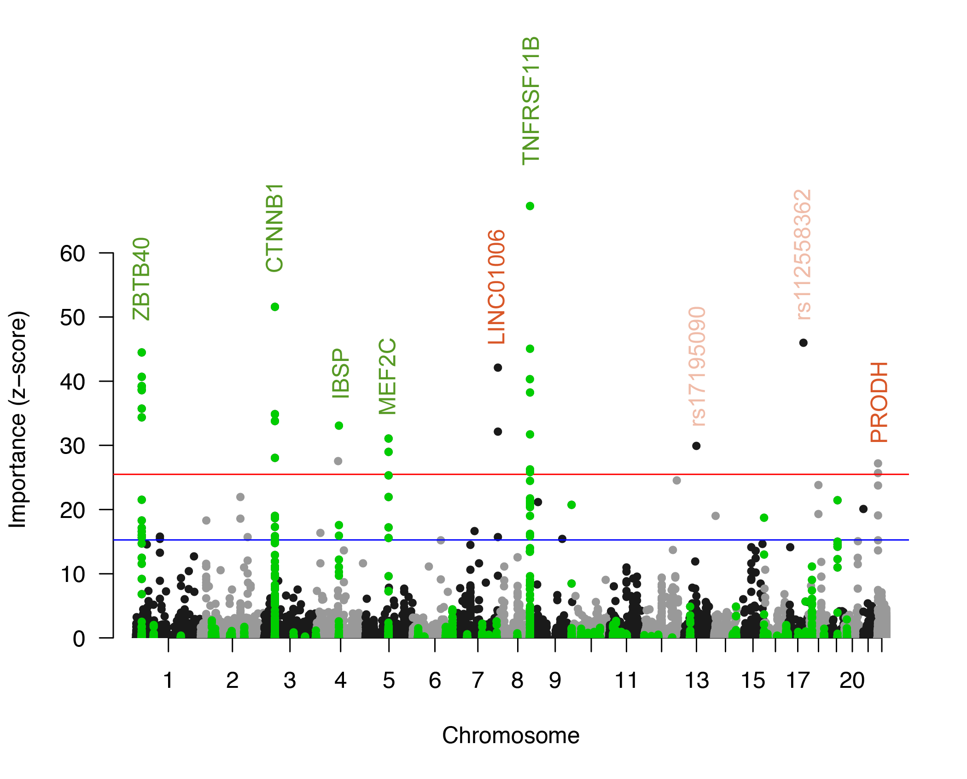
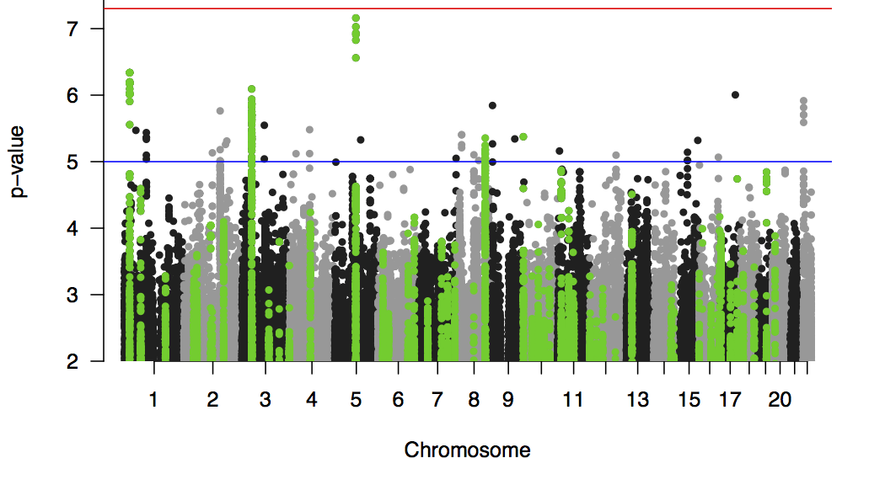
CursedForest
Traditional GWAS
Genome-wide significance
suggestive

