Slide 1
Group 2
Presentation 2: 14.12.2016

Slide 2
Improvements
Improvements since last time:
User:
random start at the grid
3 types of users available
Longer simulation duration
Migrate to most energy efficient edge (not nearest)

Slide 3
Users
3 different type of users
bronze user
slow movements; needs less energy/storage
silver user
average movement speed; average use of energy/storage
gold user
many and fast movements; need many energy/storage

Slide 4
Simulation properties
Number of users:
5 bronze
3 silver
1 gold
Number of edges: 18
PM’s: 180

Slide 5
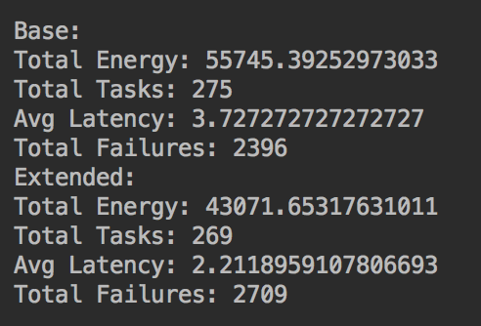
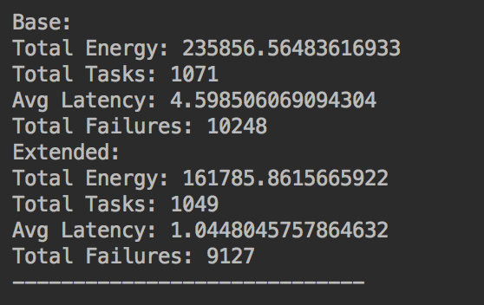
Results of short and long simulation
Not optimized
short simulation
Optimized energy consumption
longer simulation (couple of hours)

Slide 6
Improvements
prefer higher user-types (gold, silver, bronze) for task distribution and migration

