Slide 1
Group 2
Presentation 2: 16.11.2016

Slide 2
General
Programming language: Java
Baseline algorithm: Retry
Extended algorithm: Task/Job resubmission & migration
Round based approach

Slide 3
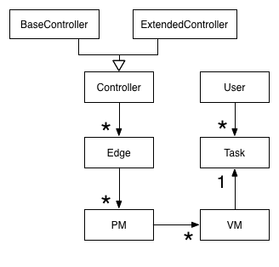
Model - Setup
Controller (BaseController, ExtendedController)
18 Edges
à 10 physical machines (PM)
Multiple virtual machines (VM) per PM
Exactly one task per VM
Arbitrary number of users creating tasks

Slide 4
Baseline algorithm
Situation | Reaction
PM fails | Wait until the PM is up again and restart the task
User movement | If a user reaches a certain distance threshold => migrate to new PM
During Migration:
- Source PM fails | Keep migrating, but task stops. (Assumption: anomaly detection system)
- Destination PM fails | Drop migration, wait until PM is up again and restart migration. Task is still executing on source PM.

Slide 5
Extended algorithm
Situation | Reaction
PM fails | Search for closest available edge/PM and start migration
User movement | If a user reaches a certain distance threshold => migrate to new PM
During Migration:
- Source PM fails | Keep migrating, but task stops. (Assumption: anomaly detection system)
- Destination PM fails | Drop migration, search for closest available edge/PM and start new migration

Slide 6
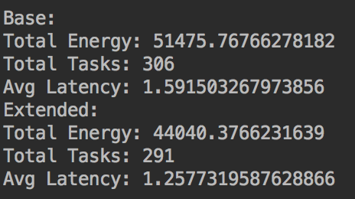
Result for short simulation
Improvement:
Energy: ca. 14% more efficient
Avg. Latency: ca. 21% less latency
Failure rate: 25 failures/round

Slide 7
Interpretation
Assumption:
Long downtime of PMs
Fast migration inside an edge or very close edge
Extended algorithm profits highly from a fast migration
Baseline algorithm suffers from a long downtime

Slide 8
How to test our algorithm
During the execution relevant data are collected
KPIs are calculated and presented at the end of a run
Adjusting the internal parameters will affect the result
↑ downtime ⇒ ↑ ↑ ↑ Latency in baseline
↑ downtime ⇒ ↑ Latency in extended
↑ transmission rate ⇒ ↓ Latency in baseline
↑ transmission rate ⇒ ↓↓↓Latency in extended

Slide 9
SLA (with 10 Users)
Baseline:
amount of edges = 18
every edge have 10 PMs
PMs:
CPU = 5GHz
Memory = 5GB
Bandwidth = 50 MBit/s
latency = 1.5
energy consumption → 51475
Availability →
MTTR → no downtime with 10 users
Extended:
amount of edges = 18
every edge have 10 PMs
PMs:
CPU = 5GHz
Memory = 5GB
Bandwidth = 50 MBit/s
latency = 1.29
energy consumption → 44040
Availability →
MTTR → no downtime with 10 users

