Slide 1
Group 2
Presentation 2: 18.01.2017

Slide 2
Improvements
Improvements since last time:
User:
starts at random places
3 types: gold, silver, bronze
different priority and SLAs for user types
long simulation duration
normal distribution of failures to the edges
random energy consumption of PMs
migrate to more energy efficient edge and PM

Slide 3
Users
3 different types of users
bronze user
slow movements; needs less energy/storage
silver user
average movement speed; average use of energy/storage
gold user
many and fast movements; need many energy/storage

Slide 4
Simulation properties
Number of users:
25 bronze
15 silver
5 gold
Number of edges: 100
PM’s: 1000
VM’s: 3000

Slide 5
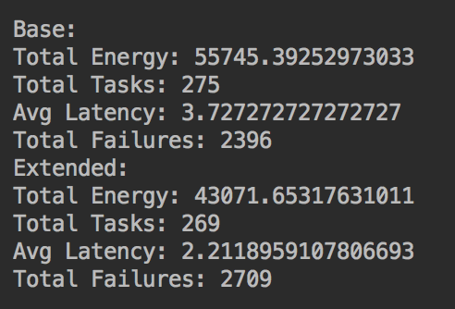
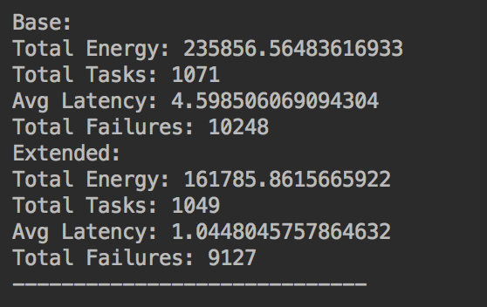
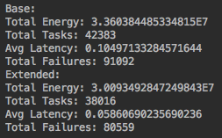
Results of short and long simulation
Not optimized
short simulation
Optimized energy consumption
longer simulation (couple of hours)
Optimized energy consumption
long simulation

Slide 6
Final Algorithm
Baseline algorithm: Retry
if a task fails → try to run the task again on the same PM (after restart)
Extended algorithm: Task resubmission
if a task fails → migration to the most energy efficient Edge/PM
handle user types (gold, silver, bronze) → priority
maximum amount of failures which the algorithm can handle: ~120.000

