Slide 1
Progress in Boarding Simulation
Ground Operations
Marc Engelmann, Tobias Brügge-Zobel, Martin Glas, Michael Schmidt, Stefan Weber, Pedro Martinez, Philipp Osterrieder

Slide 2



Frameworks & Tools
Implementation in OpenCDT
Eclipse Modeling Framework (EMF)
A* path-finding algorithm
Parallel thread processing
Graphics generation via Java SWT Framework
CheckStyle plugin for code hints and correct formatting
JIRA for bug tracking and collaborative work
Overview of open and accomplished tasks
Report bugs and assign tasks to other developers
GIT repository for code versioning
Jump back to earlier versions
Work on the same source code with serveral developers simultaneously

Slide 3
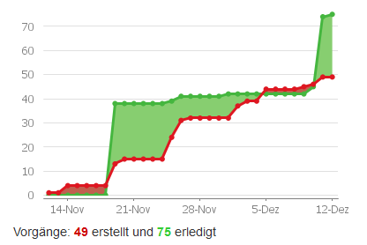
Features – Version Alpha 0.1
Implementation in OpenCDT
Cabin model definition
Automatic generation and manual editing of each monument
Passenger characteristics description
Graphical cabin representation
Console & Info view
A* path-finding algorithm
cost and distance based
Visualization of simulation results

Slide 4
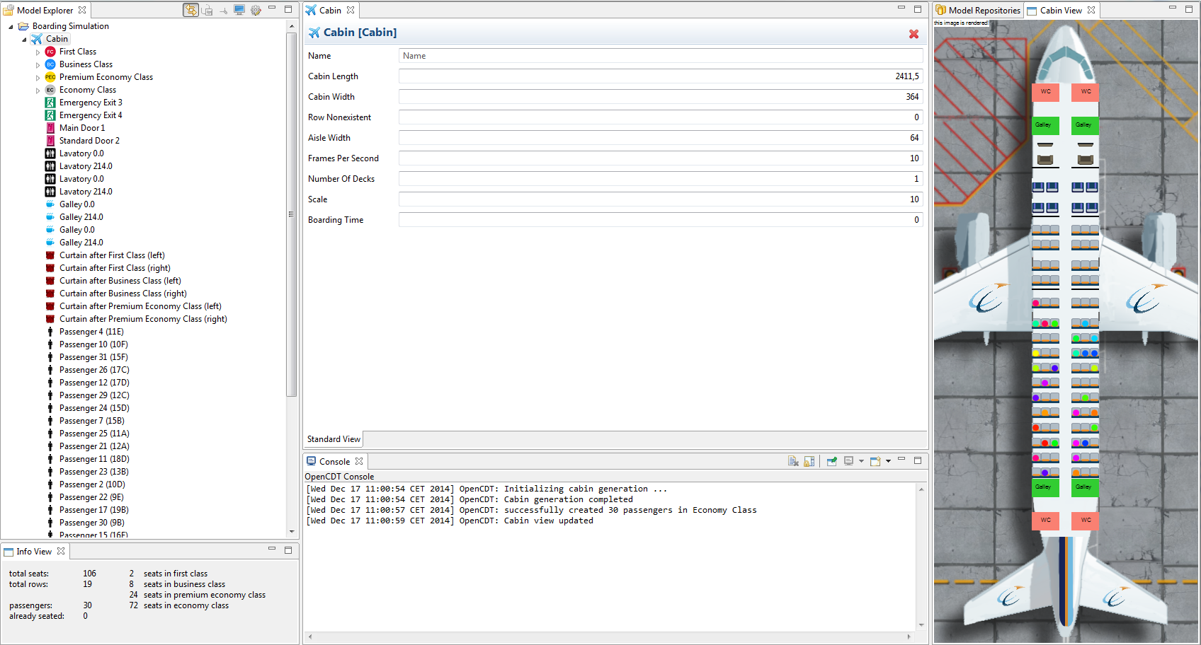
Overview
Cabin visualisation
Cabin Model
Parameter assignment
Console view
Info View

Slide 5
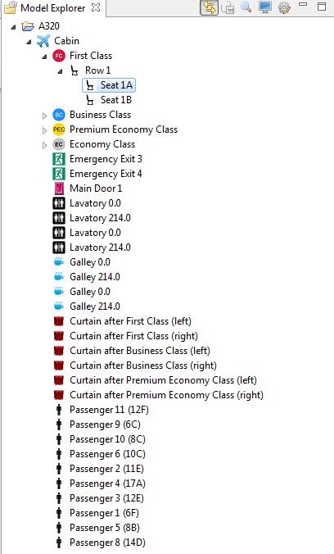
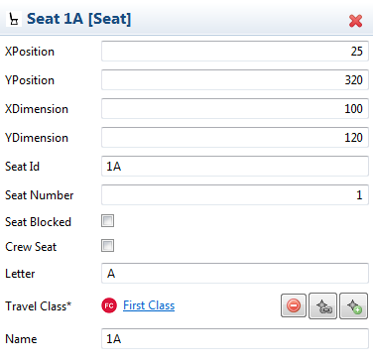
Seat Parameters

Slide 6
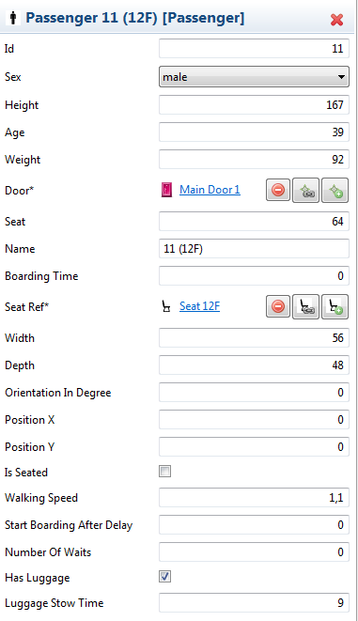
Passenger Chracteristics

Slide 7
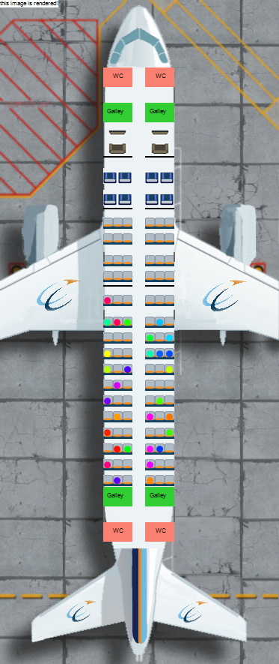
Cabin Visualisation
Doors
Monuments
Seats
Occupied passenger seats

Slide 8
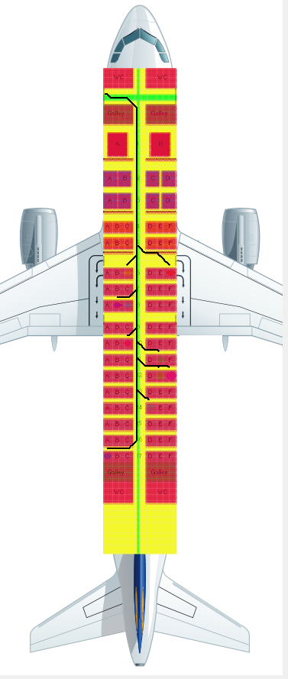
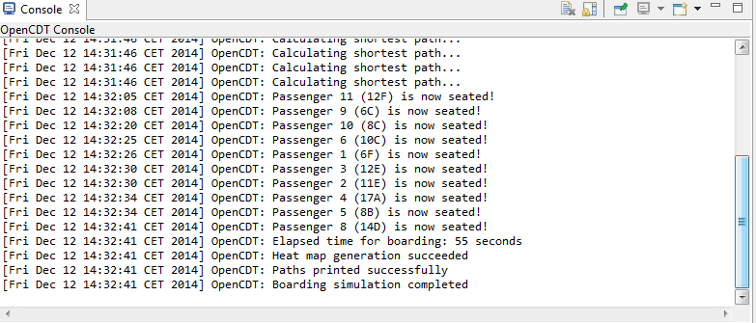
Simulation
Live feed of all relevant information
Agent path
Overview of seats and passenger
Potential map

Slide 9
Future Work
Version Alpha 0.2 (Febuary 2015)
Character modelling for passengers
Dynamic reactions based on mood and environment
Different character patterns like business / family / …
Path finding improvements
Adapted from Matlab predecessor
Potential around passengers
Widebody & double deck cabin designs
Results handling and saving
Improved graphics
Live-editing of monuments
Version X
Definition of common cabin layouts
Simulation result validations
Comparison to real experiments
Batch simulation execution and parameter variation
Boarding strategies
Release as open source version
New graphics framework (openGL)
Better performance
Third dimension

