Slide 1


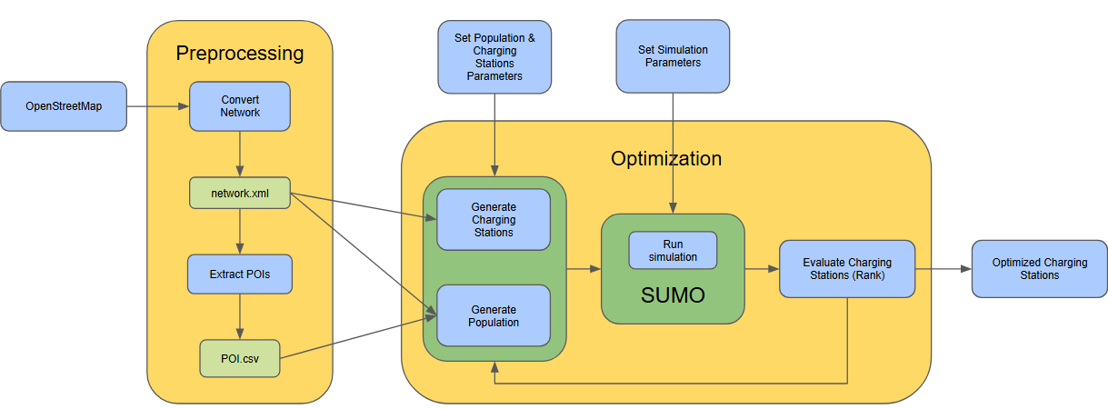

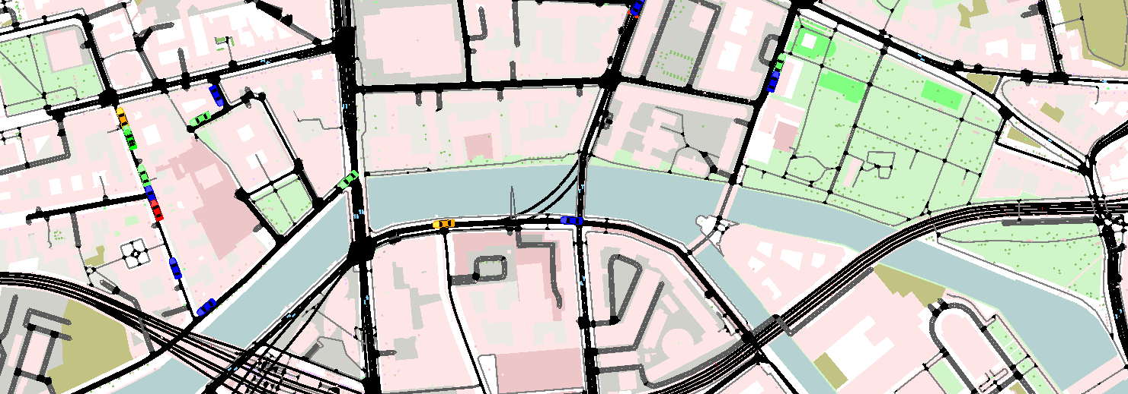
Simulation-Driven Optimization of EV Charging infrastructure with SUMO Achim Baumgärtner, Erik Weigand
Challenge
Rapid EV growth requires scalable, bidirectional charging—but no data‑driven way exists to pick sites, size capacity or assess impact
Objectives
1. Site Identification
Build a map‑based tool (OSM + grid data) to simulate location‑specific charge/discharge demand
Pinpoint optimal bidirectional charger sites, accounting for existing infrastructure
2. Operational Simulation & Scaling
Validate site placements in SUMO; simulate mobility, charging/discharging events
Determine ideal charger count, capacity and rollout sequence
Quantify grid‑level (load, flexibility) and user‑level (wait‑times, utilization) effects
Next Steps
Generalize placement tool for any region
Interactive Dashboard
Estimate V2G potential and model outage/failure scenarios

