Slide 1


K.RAMAKRISHNAN COLLEGE OF ENGINEERING
(AUTONOMOUS), TRICHY
EGB1201-JAVA PROGRAMMING
II year /III Sem
TITLE: TIC TAC TOE GAME
PRESENTED BY,
BAVADHARANI D
8115U23EC007
SUPERVISOR
Mr.V.KUMARARAJA, M.E., (PhD),
AP/CSE.
DATE : 06/12/2024

Slide 2
PRESENTATION OVERVIEW
Project Introduction
Objective
Problem Statement
Java Concept
List of programming concepts used
Modules Used
List of Modules
6. Architecture of the proposed system
7. Merits and Demerits
Comparison with other Programming concepts
8. Program Execution and Output
9.Conclusion

Slide 3
PROJECT INTRODUCTION
Title:
Tic-Tac-Toe Game Using Java AWT
Description:
This project implements a GUI-based Tic-Tac-Toe game using Java Abstract Window Toolkit (AWT). It provides an engaging way for two players to compete in a 3x3 grid. The interface allows players to alternate turns with their respective symbols ('X' and 'O').
The game detects winning conditions and declares the result. It is designed to demonstrate core Java programming concepts and enhance GUI development skills in Java.

Slide 4
OBJECTIVE
To create an interactive and user-friendly Tic-Tac-Toe game.
To demonstrate the use of Java Abstract Window Toolkit (AWT) for building graphical user interfaces.
To apply event-driven programming to handle player actions during the game.
To build a logic that determines the game result (win, draw, or ongoing).
To familiarize with grid layouts and Java's object-oriented approach.
To implement game rules effectively using logical checks.

Slide 5
PROBLEM STATEMENT
The game must feature a 3x3 grid for two players to play alternately.
Players should only be able to mark empty spaces during their turn.
The game should check for all winning conditions: horizontal, vertical, and diagonal.
It must detect a draw when all cells are filled without a winner.
A result notification should be displayed at the end of the game.
Ensure the program exits cleanly after the game concludes.

Slide 6
Java Concepts
Key Concepts Used in the Project:
Abstract Window Toolkit (AWT): Used for creating GUI components like Frame, Button, Dialog.
Event Handling: To handle player clicks on the grid buttons and game interactions.
Control Flow Statements: Used to check for win or draw conditions after each move.
Object-Oriented Programming: Encapsulating game functionality within methods and classes.
String Handling: Used for comparing button labels to detect win conditions.
Dynamic Interaction: Switching between players after every valid move.

Slide 7
MODULES USED
List of Modules and Their Functions:
Game Board Initialization: Creates a 3x3 grid of buttons with dynamic event handling.
Player Move Handler: Manages alternate moves between Player X and Player O.
Win Check Module: Validates win conditions based on rows, columns, and diagonals.
Draw Check Module: Ensures all cells are filled without a win condition.
Result Display Module: Uses a dialog box to display the game outcome.
Exit Mechanism: Ensures proper program termination after displaying results.

Slide 8
ARCHITECTURE OF THE PROPOSED SYSTEM
INITIALIZE BOARD
PLAYER INPUT
UPDATE BORD
EXIT
DISPLAY RESULT
CHECK FOR WIN

Slide 9
MERITS Intuitive graphical interface for easy gameplay. Compact and efficient logic to detect game results. Hands-on experience with Java GUI and event handling. Encourages programming creativity and problem-solving skills. | DEMERITS Single-match limitation; players must rerun the program to play again. No AI functionality for single-player mode. Limited styling options with basic AWT compared to modern GUI libraries.

Slide 10
Comparison with other Programming concepts for the same problem statement
Python Tkinter:
Offers a simpler syntax and quicker GUI building but lacks the robustness of Java.
C++ with Qt Framework:
Provides more advanced features but has a steeper learning curve.
Web-Based JavaScript:
Suitable for online games but not as efficient for standalone desktop applications.
JavaFX:
A more modern alternative to AWT with enhanced styling options and animations.
This project highlights the simplicity and efficiency of Java AWT for standalone desktop applications.

Slide 11
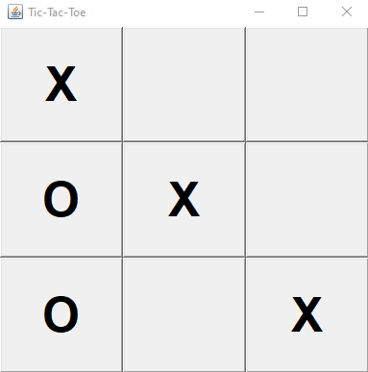
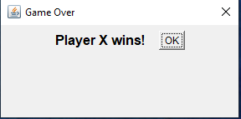
OUTPUT

Slide 12
CONCLUSION
The Tic-Tac-Toe game created with Java AWT offers a simple, interactive experience with clear game logic. The game alternates between two players, checks for wins or draws, and displays results via a dialog box. It is built using a modular design, separating the UI, game logic, and data model for easy maintenance and future enhancements. While the game is user-friendly and portable, challenges include handling invalid moves and edge cases. This project serves as a good foundation for adding features like an AI player or score tracking.

Slide 13


