Slide 1
CAPSTONE PROJECT – BATTLE OF NEIGHBORHOODS
CAFE VENUE DATA ANALYSIS OF SALEM

Slide 2
INTRODUCTION
Salem is a city in the South Indian state of Tamil Nadu, having a population of around 8.29 lakhs and a population density of 9,079/km²
As seen from the figures, Salem is a city with high population density.
Being a crowded city, it leads the owners of shops and social sharing places in the city to where the population is dense.
An investor may want to choose the venue according to the social places density.

Slide 3
TARGET AUDIENCE
Business personnel who wants to invest or open a café in Salem. This analysis will be a comprehensive guide to start or expand coffee shops.
Drip Coffee Drinkers: The latest research has found that 77 percent of adults in the United States drink coffee on a daily basis. Depending on the price you charge for a cup of coffee, your target market may be students and business workers on their way to work or class.
Coffee Shop Lovers: People who spend time at shops and cafes where specialty drinks and regular cups of coffee are available along with an inviting atmosphere – rather than coming in to grab a cup of coffee.
Specialty Coffee Drinkers: Espressos, cappuccinos, lattes, and mochas are just the start, if you want to sell specialty coffee drinks. The target market for this coffee product consists of those who love specific ingredients in their coffee-based beverage.
Whole Bean Buyers: Another target market consists of people who buy whole bean coffee to make at home or in the office. This audience buys whole beans by the pound in different flavors from various regions.

Slide 4
DATA DESCRIPTION
Foursquare API is used to get the most common values of city. The Foursquare API is also used to collect the information about the competitors in the neighborhood.
Data regarding the coffee shops, cafes etc in the city is obtained by using FourSquare API
Query the FourSquare website for the coffee shops in Salem.
Use the FourSquare API to get supplemental geographical data about the top sites.
Finally select and appropriate location for a new coffee shop to be started.

Slide 5
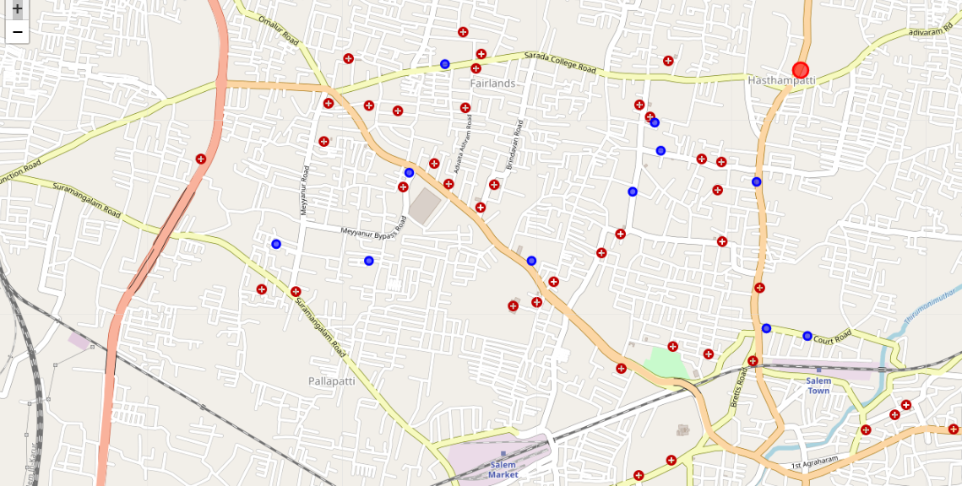
RESULT

Slide 6
CONCLUSION
Data analysis is performed through the information by adding the co-ordinates of cafes and coffee shops in the district.
This may be helpful to someone planning on opening a cafe in Salem, by comparing the current offers and neighborhood profile.
May not cover all the variables so it shall not be used as a single decision making tool.
This not only applies or helps the investors but also city managers can manage the city more regularly by using similar data analysis types or platforms

