Slide 1
PROJECT 3: HEURISTICS
CAPITA SELECTA AI
Bavo Goosens & Michiel Vandendriessche

Slide 2
Overview
Problem generation
LAHC
Assignment generation
Solution generation
IRACE

Slide 3
Problem generation
6 program parameters:
Time span
Minimum days off
Maximum days off
Minimum days on
Maximum days on
Demand for each day
If one of these parameters is not set, it is chosen randomly:
Time span: 5, 7 or 14
Minimum days off: random integer between 0 and the time span
Maximum days off: random integer between minimum days off and the time span
Minimum days on: random integer between 0 and the time span
Maximum days on: random integer between minimum days on and the time span
Demand: array of length time span with integers between 0 and 2 times the time span
This may still lead to insolvable problems
When a problem appears to be insolvable, a new problem is generated

Slide 4
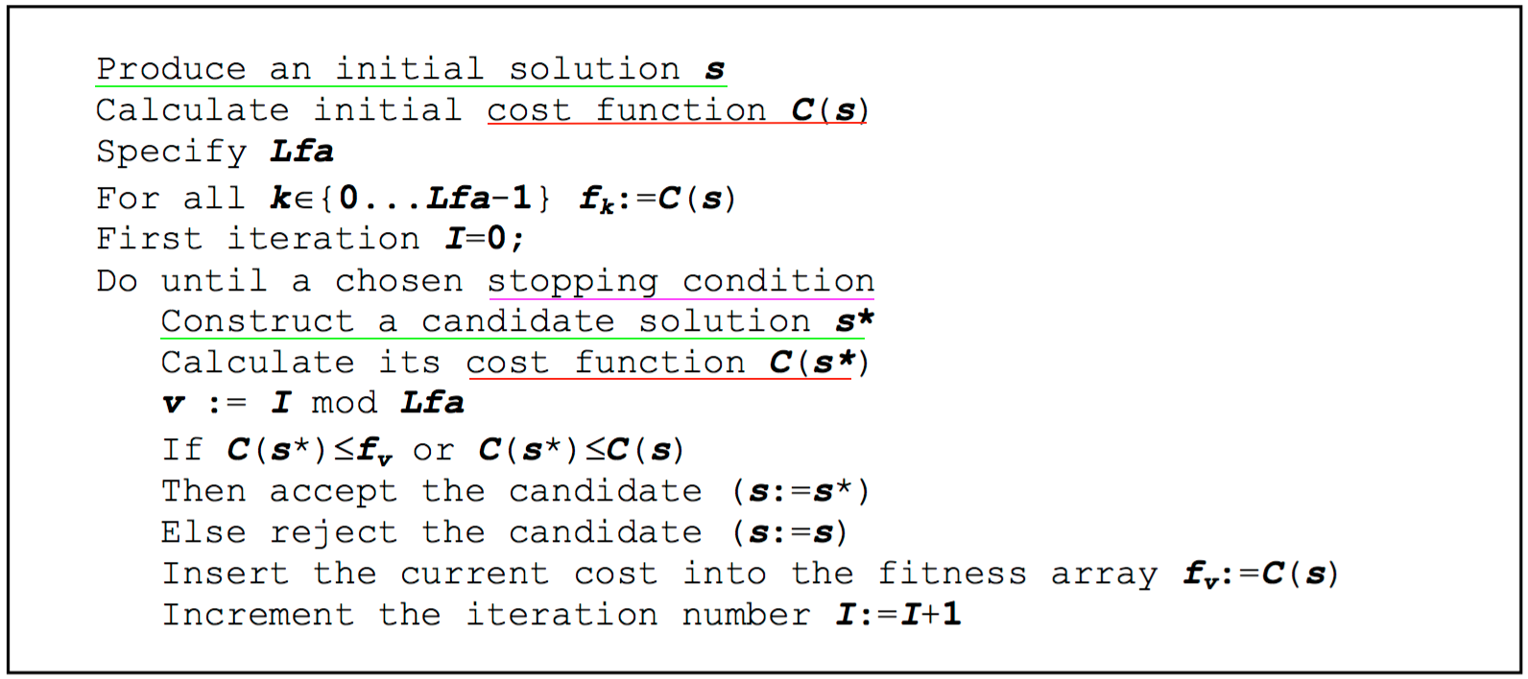
LAHC
Used for both GDODOSP and CDODOSP
Simple algorithm
Less greedy hill climbing
We won’t go into too much detail
Main difficulties:
Candidate solution generation
Stopping condition
A cost function
One Parameter:
Length of Fitness Array

Slide 5
LAHC
Stopping condition
Try to guess when the algorithm has converged to a close to optimal solution
For CDODOSP and GDODOSP difficult to pinpoint
=> Opted for limiting the number of repeating solutions
Cost function
Simple cost function: just count the number of ones.
Neighbourhoods
When generating solution the decision to fulfil a certain demand.
For CDODOSP adding extra basic assignment represents a neighbourhood

Slide 6
Assignment generation
Build tree like structure by linearly ”walking” through possible assignments
Decompose the tree using linked list structure
After these steps we have a list of BASIC assignments
If GDODOSP: Permute cyclically these results and filter again
If CDODOSP: Choose one “BASIC” assignment and permute this one cyclically
These are all stored in a dictionary where the key indicates in which position a one can be found

Slide 7
[]
[0]
[1]
[1,0]
[0,1]
[0,0]
[1,1]
[0,1,1]
[0,1,0]
[0,0,1]
[0,0,0]
[1,0,1]
[1,0,0]
[1,1,1]
[1,1,0]
Example

Slide 8
Solution generation
GDODOSP:
Choose an assignment to satisfy a certain day in the demand
Keep adding assignments until all demands are satisfied
CDODOSP:
Design neighbourhoods: choose a basic assignment and permute cyclically
Try to build solutions from a random neighbourhood
When the neighbourhood space increases, there are more neighbourhoods to choose from

Slide 9
IRACE
Parameter for GDODOSP: length of fitness array
Experiments: length best between 55 and 65
Parameter for CDODOSP: size of the neighbourhood space and the length of the fitness array
Experiments: length best between 40 and 79, size best between 110 and 180
When best length increases, best size decreases
Not efficient: +6u runtime

Slide 10
Conclusion
New interesting algorithm but our candidate generation is not as optimal as we wished for
Irace ran into some difficulties. Partly because of the way we deal with unsolvable problems
Difficulty discovering neighbourhoods so we chose a suboptimal random method
This mostly applies to GDODOSP. CDODOSP had more well defined neighbours

Slide 11
Questions
?

