Slide 1
PROJECT 3: HEURISTICS
CAPITA SELECTA AI
Bavo Goosens & Michiel Vandendriessche

Slide 2
Overview
Problem generation
LAHC
Assignment generation
Solution generation
IRACE

Slide 3
Problem generation
6 program parameters:
Time span
Minimum days off
Maximum days off
Minimum days on
Maximum days on
Demand for each day
If one of these parameters is not set, it is chosen randomly:
Time span: 5, 7 or 14
Minimum days off: random integer between 0 and the time span
Maximum days off: random integer between minimum days off and the time span
Minimum days on: random integer between 0 and the time span
Maximum days on: random integer between minimum days on and the time span
Demand: array of length time span with integers between 0 and 2 times the time span
This may still lead to insolvable problems
When a problem appears to be insolvable, a new problem is generated

Slide 4
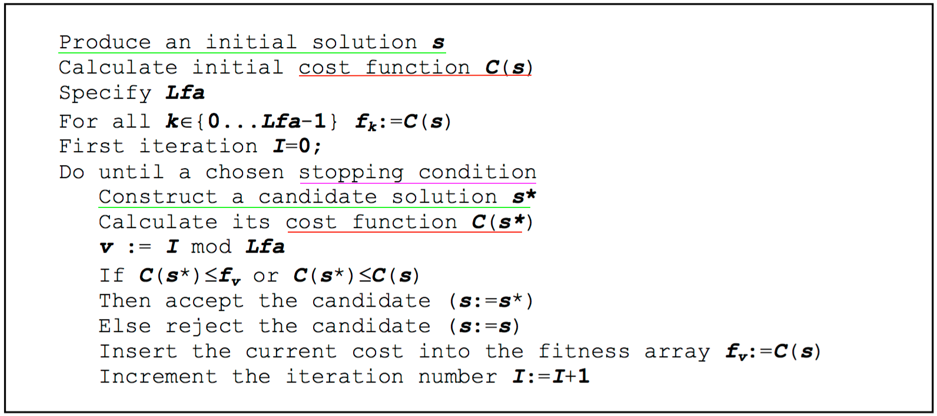
LAHC
Used for both GDODOSP and CDODOSP
Simple algorithm
Less greedy hill climbing
We won’t go into too much detail
Main difficulties:
Candidate solution generation
Stopping condition
A cost function
One Parameter:
Length of Fitness Array

Slide 5
LAHC
Stopping condition
Try to guess when the algorithm has converged to a close to optimal solution
For CDODOSP and GDODOSP difficult to pinpoint
=> Opted for limiting the number of repeating solutions
Cost function
Simple cost function: just count the number of ones.

Slide 6
Assignment generation
Build tree like structure by linearly ”walking” through possible assignments
Decompose the tree using linked list structure
After these steps we have a list of BASIC assignments
If GDODOSP: Permute cyclically these results and filter again
If CDODOSP: Choose one “BASIC” assignment and permute this one cyclically
These are all stored in a dictionary where the key indicates in which position a one can be found

Slide 7
[]
[0]
[1]
[1,0]
[0,1]
[0,0]
[1,1]
[0,1,1]
[0,1,0]
[0,0,1]
[0,0,0]
[1,0,1]
[1,0,0]
[1,1,1]
[1,1,0]
Example

Slide 8
Solution generation
GDODOSP:
Choose an assignment to satisfy a certain day in the demand
Keep adding assignments until all demands are satisfied
CDODOSP:
Design neighbourhoods: choose a basic assignment and permute cyclically
Try to build solutions from a random neighbourhood
When the neighbourhood space increases, there are more neighbourhoods to choose from

Slide 9
IRACE
Parameter for GDODOSP: length of fitness array
Experiments: length best between 55 and 65
Parameter for CDODOSP: size of the neighbourhood space and the length of the fitness array
Experiments: length best between 40 and 79, size best between 110 and 180
When best length increases, best size decreases
Not efficient: +6u runtime

