Slide 1
PROJECT 3: HEURISTICS
CAPITA SELECTA AI
Bavo Goosens & Michiel Vandendriessche

Slide 2
Overview
Problem generation
LAHC
Applied
Tuning
Experiments
Results

Slide 3
Problem generation

Slide 4
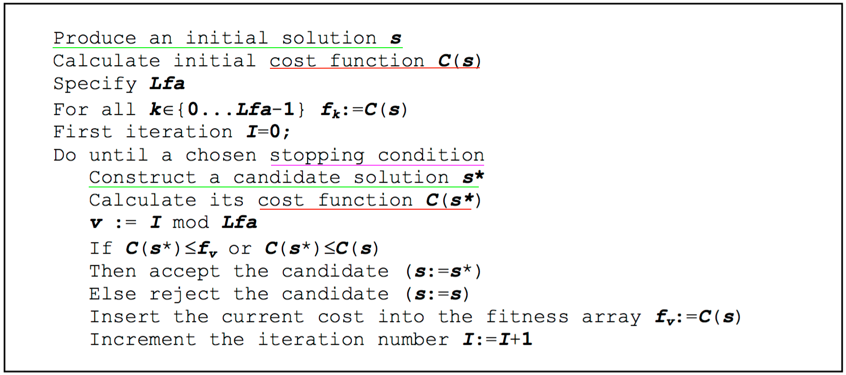
LAHC
Used for both GDODOSP and CDODOSP
Simple algorithm
Less greedy hill climbing
We won’t go into too much detail
Main difficulties:
Candidate solution generation
Stopping condition
A cost function
One Parameter:
Length of Fitness Array

Slide 5
LAHC
Stopping condition
Try to guess when the algorithm has converged to a close to optimal solution
For CDODOSP and GDODOSP difficult to pinpoint
=> Opted for limiting the number of repeating solutions
Cost Function
Simple cost function just count the number of ones.

Slide 6
LAHC
Candidate solution Generation
Build tree like structure by linearly ”walking” through possible assignments
Decompose the tree using linked list structure
After these steps we have a list of BASIC assignments
If GDODOSP: Permute cyclically these results and filter again
If CDODOSP: Choose one “BASIC” assignment and permute this one cyclically
These are all stored in a dictionary where the key indicates in which position a one can be found

Slide 7
[]
[0]
[1]
[1,0]
[0,1]
[0,0]
[1,1]
[0,1,1]
[0,1,0]
[0,0,1]
[0,0,0]
[1,0,1]
[1,0,0]
[1,1,1]
[1,1,0]
Example

