Slide 1
Lecture 3
Data Tables, Indexes, pandas

Slide 2
Announcements
HW1 out

Slide 3
Where we are

Slide 4
Data Science Lifecycle
Ask question(s)
Obtain data
Understand the data
Understand the world

Slide 5
Data Science Lifecycle
Ask question(s)
Obtain data
Understand the data
Understand the world
Your brain
The Internet
pandas and EDA
Inference and prediction

Slide 6

Today: pandas
http://pandas.pydata.org/

Slide 7
The DataFrame
The dataframe object represents a table with column names, rows, and indices
All data in a column must be the same kind…
Index
Column
Column Names
 | Age | Sex | State | …
0
1
2

Slide 8
How this lecture will work
Using the dataset of baby names, we will...
Ask questions
Break down each question into steps
Learn the pandas knowledge needed for each step

Slide 9
What you will learn
Data manipulation in pandas
Sorting, filtering, grouping, pivot tables
Data visualization in pandas and seaborn
Bar charts, histograms, scatter plots
Prior knowledge of all concepts assumed!
~3 weeks of Data 8 in 1.5 hours
Practical, not conceptual

Slide 10
You won’t remember everything, but...

Slide 11
Getting the data
(Demo)

Slide 12
Question 1:
What was the most popular name in CA last year?
(2-min discussion)

Slide 13
Always have high-level steps
Read in the data for CA
Keep only year 2016
Sort rows by count
Table.read_table
Table.where
Table.sort

Slide 14
In pandas
Read in the data for CA
Keep only year 2016
Sort rows by count
pd.read_csv
Slicing
df.sort_values
(Demo)

Slide 15
Recap
pd.read_csv(...) => DataFrame
DataFrame is like the Data 8 Table
Series is like a NumPy array
Slice DFs by label or by position
df.loc and df.iloc
DF index is a label for each row, used for slicing
df.sort_values(...) like Table.sort

Slide 16
Question 2:
What were the most popular names in each state for each year?
(2-min discussion)

Slide 17
Break it down
Put all DFs together
Group by state and year
pd.concat
df.groupby
(Demo)

Slide 18
Recap
zipfile
Work with compressed archives efficiently in-memory
df.groupby(...).agg(...)
Groups one or more columns, applying aggregate function on each group
df.groupby(...).sum() # or .max(), etc.
Shorthand for df.groupby(...).agg(np.sum)

Slide 19
When do I need to group?
Do I need to count the times each value appears?
Do I need to aggregate values together?
Am I looping through a column’s unique values?

Slide 20
Question 3:
Can I deduce gender from the last letter of a person’s name?

Slide 21
Survey Question
Which last letter is most indicative of a person’s birth sex?
bit.ly/ds100-sp18-c7a
g
m
t
z
e
This is a trick question!

Slide 22
Break it down
Compute last letter of each name
Group by last letter
Visualize distribution
series.str
df.groupby
df.plot
(Demo)

Slide 23
Recap
series.str
To use string methods
Use series.apply when you need flexibility
df.pivot_table(...)
Computes a pivot table
df.plot
To use plotting methods

Slide 24
When do I need to pivot?
Am I grouping by two columns...
And do I want the resulting table to be easier to read?
Or, am I using pandas plotting on the groups?

Slide 25
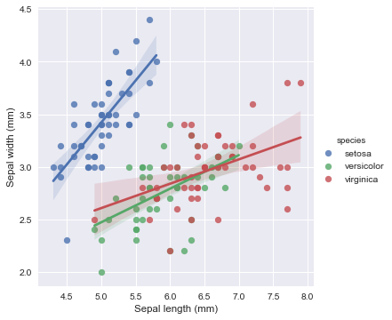
Seaborn
http://seaborn.pydata.org/index.html

Slide 26
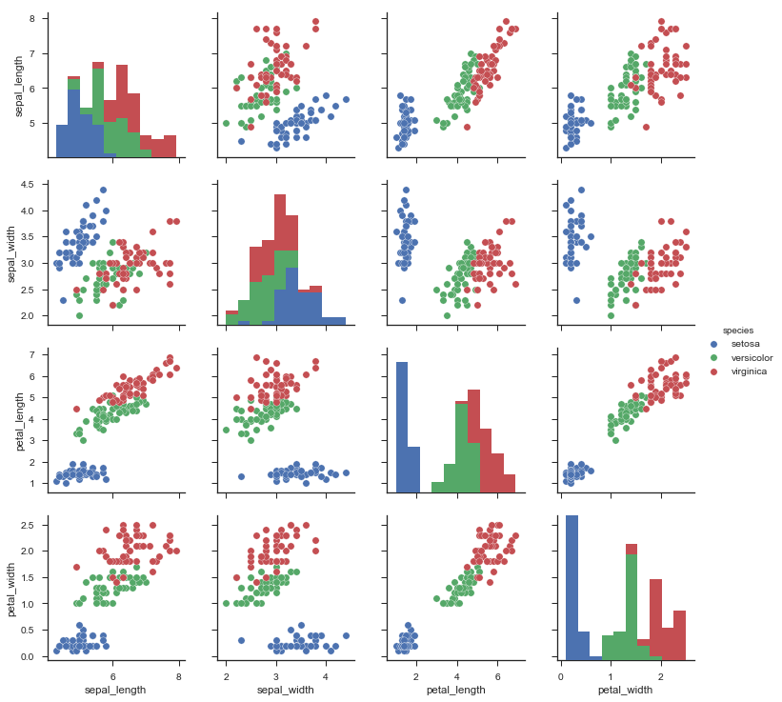
Seaborn
Statistical data visualization
Has common plots with some bonus features
And some fancier plots too
Works well with pandas DataFrames
sns.pairplot(df, hue="species")

Slide 27
How to Seaborn
DataFrame should ideally be in long-form (not grouped)
Most Seaborn methods work like this: sns.barplot(x=..., y=..., hue=..., data=df)
(Demo)

Slide 28
Recap
Pandas for tabular data manipulation
Slicing for row/column selection
Group with df.groupby
Pivot with df.pivot_table
Join with pd.merge (covered in lab next week)
df.plot for basic plots
Seaborn for statistical plots
Reference the docs for available methods

Slide 29
Use the docs!
And Google.

