Slide 1
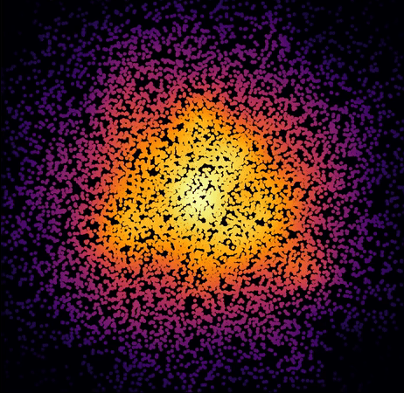
Neural Ordinary Differential Equations

Slide 2
Motivation
[1] original got best paper award at NeurIPS 2018
Offers some interesting perspectives
It’s cool
[1] Chen, Ricky TQ, et al. "Neural ordinary differential equations." Advances in neural information processing systems. 2018.

Slide 3

ODEs
DE contains functions and their derivatives with only 1 independent variable (usually time t)
Often used to describe dynamically changing phenomena (dynamical systems)
Solve an ODE: find the function that satisfies the equation usually initial value is known (initial value problems)
Often solved numerically (e.g. using euler integration)

Slide 4
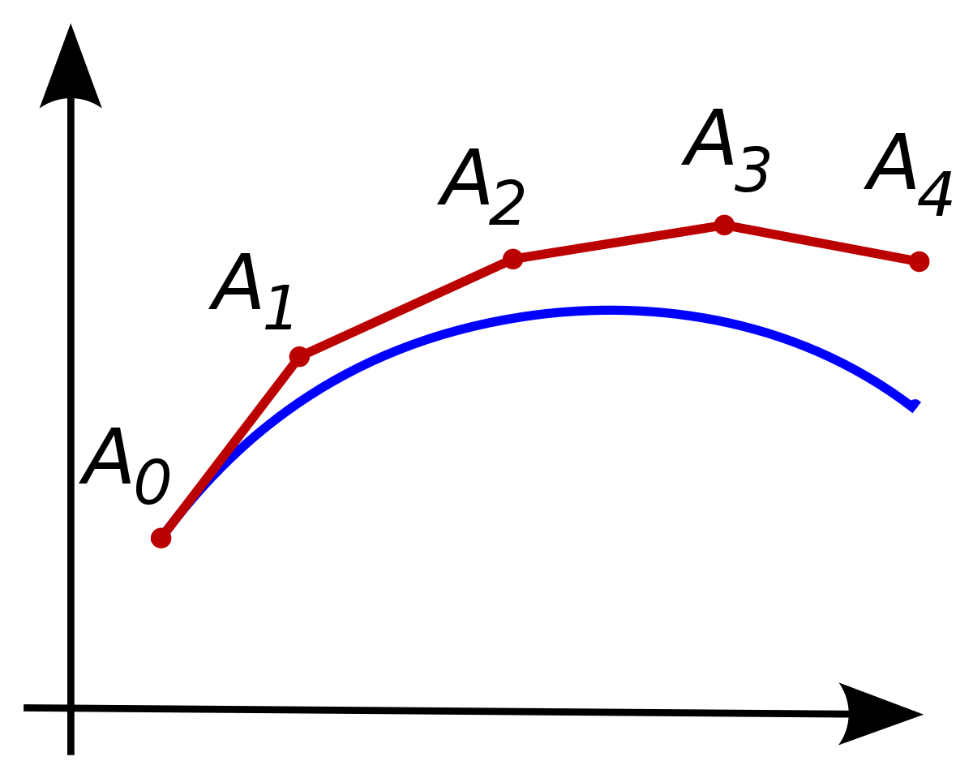
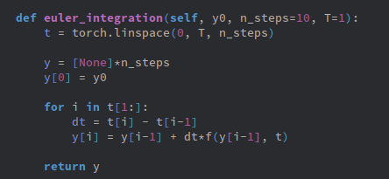
Euler Integration

Slide 5
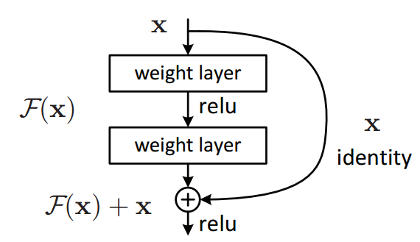
Residual Blocks
use skip connections to skip some layers
Useful to prevent vanishing gradient

Slide 6
ResNets as ODE solvers
A single residual blocks in a NN corresponds to a single Euler step!
More layers/steps ⇒
  Increase model complexity and ability to learn (Data scientist)
  Better approximation of continuous system (Numerical analysis)

Slide 7
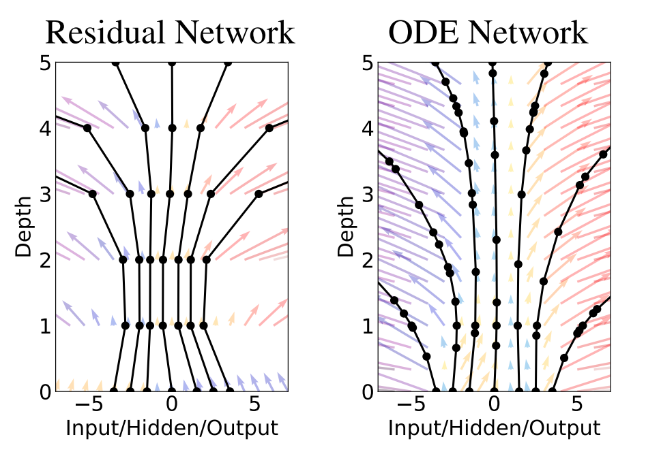

Neural ODEs
Take this idea one step further
Makes use of continuous depth networks
  Can be thought of as solving an ODE with a neural network representing the dynamics
Main contribution:
  Reverse-mode automatic differentiation

Slide 8
DEMO

Slide 9
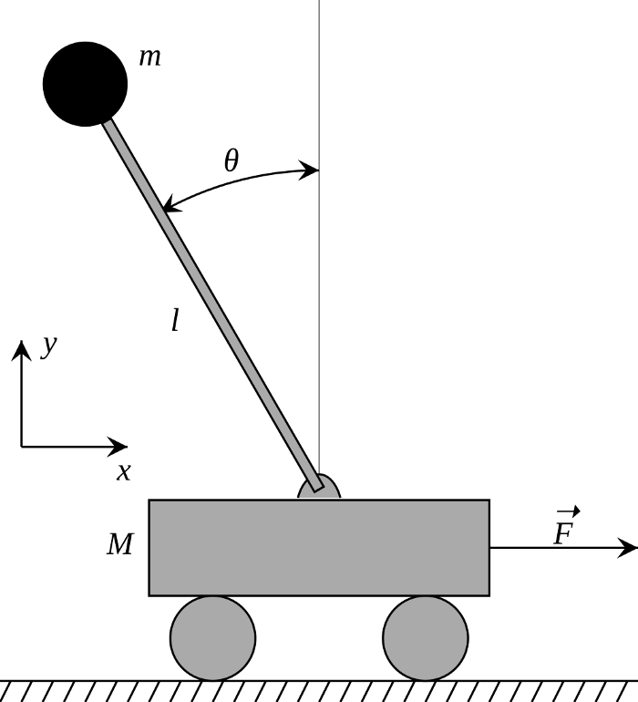
Inverted pendulum (cartpole) problem
Actions : (push_left, push_right)
State : (position, velocity, angle, tip_velocity)

Slide 10
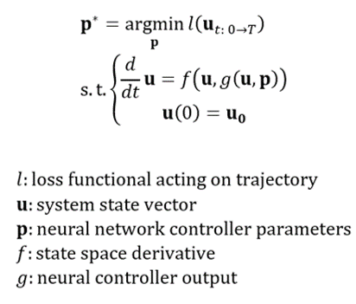

Slide 11
Applications
Just for dynamical systems? -> No!
  Very similar to RNNs
  Can be used in supervised setting classification, regression, …
Should I use them?
  Advantages: train with constant memory usage (due to backprop), no need to define depth, useful for time series modelling, …
  Disadvantages: still very experimental, useful for different kind of functions, …
  => probably not?

Slide 12
References
Tutorial based on: https://medium.com/swlh/neural-ode-for-reinforcement-learning-and-nonlinear-optimal-control-cartpole-problem-revisited-5408018b8d71
Chen, Ricky TQ, et al. "Neural ordinary differential equations." Advances in neural information processing systems. 2018.
Brunton, Steven L., and J. Nathan Kutz. Data-driven science and engineering: Machine learning, dynamical systems, and control. Cambridge University Press, 2019.

