Slide 1
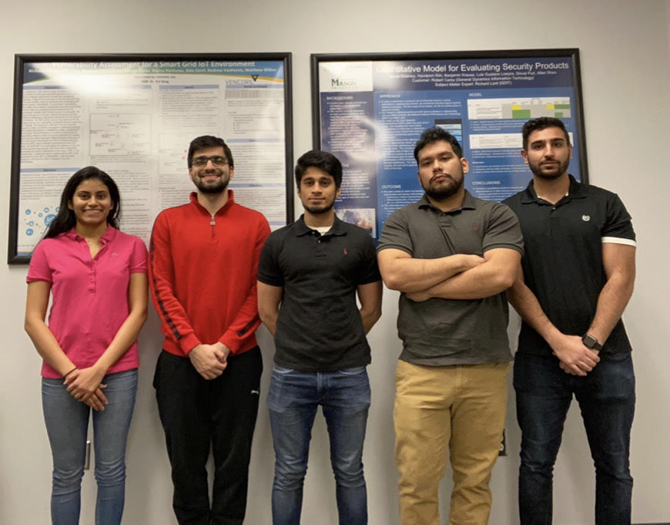
Lockheed Martin Space Cyber Research Project
Tim Parker
Jonathan Brant
The purpose of this project is to improve the process of tagging data to use for the training of machine learning object detection and classification models.
Amir Itayem, Gainesville, VA
Cyber Security Engineering
I aspire to get certified in the Splunk tool and work on projects with that.
Twinkle, Bawer, Mohammad, Adalid, Amir
(Left to Right)
This class and project has taught me to gain a deeper knowledge of how neural networks work.
Bawer Alissa, South RIding, VA
Cyber Security Engineering
Adalid Helguero, Falls Church, VA
I plan to become a System Integrity Management Platform Engineer
Cyber Security Engineering
I am studying to become an expert in cyber security practices, ethical hacker, or penetration tester.
This project helped me become a TensorBoard expert which helped push our project forward to deeper milestones.
I learned how to use Keras to deepen our models for the senior design project.
Mohammad Saad, Lorton VA
Cyber Security Engineering
Twinkle Gera, Falls Church, VA
I aspire to learn new things everyday to become an experienced and efficient cyber security engineer.
Cyber Security Engineering
I’m working to learn new things and become successful in cyber security,
I learned how to generate fake images with machine learning.
This capstone project has taught me a lot about machine learning and artificial intelligence.

