Slide 1
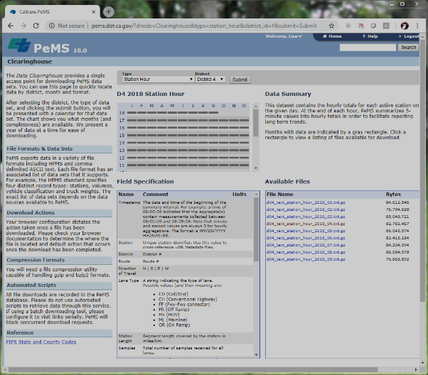
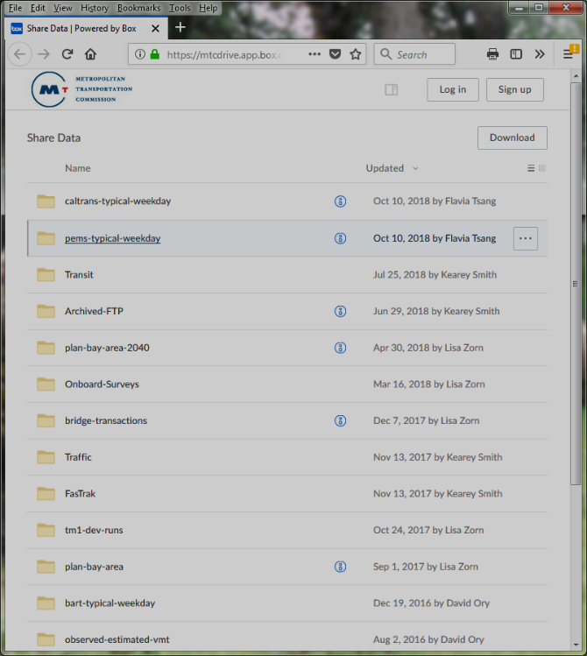
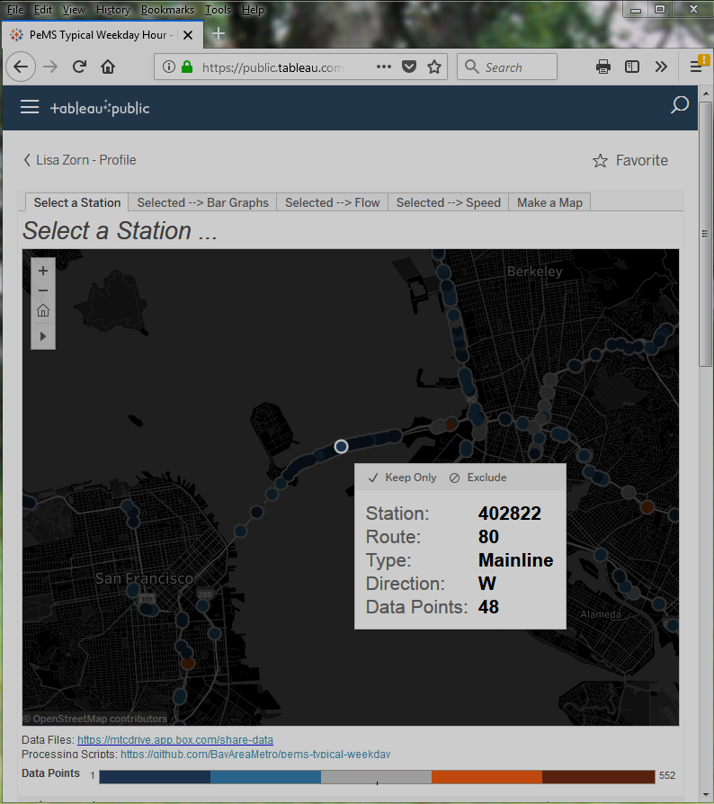
pems_hour, pems_period (RDS, Rdata, csv)
PeMS Data
Clearinghouse
summarize-to-hour-and-timeperiod.R
For a given year:
Filter to Tues, Wed, Thurs and non-holidays
Filter out suspect data
Summarize by time period and hour
https://mtcdrive.box.com/v/pems-typical-weekday
Raw hourly PeMS
station data
combine-all-years-districts.R
Combines annual district files
Tableau

