Slide 1
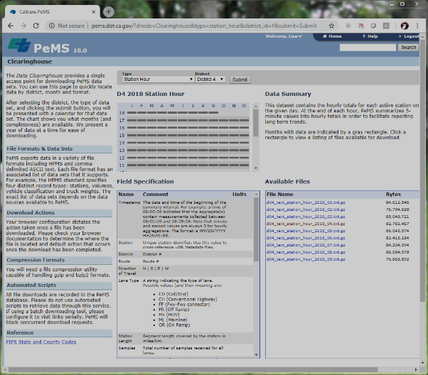
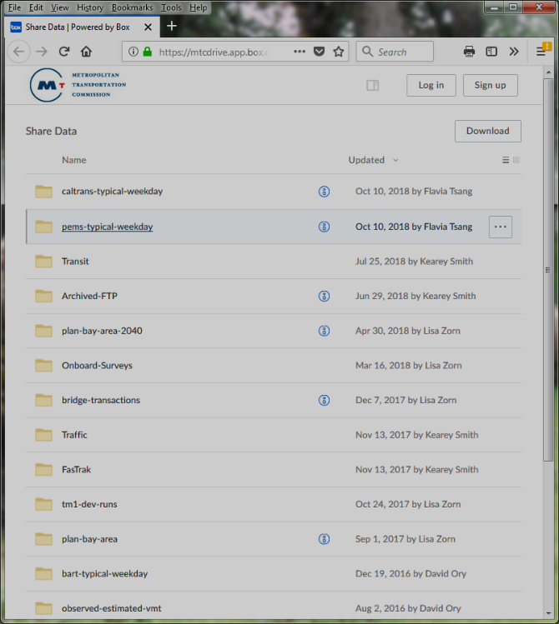
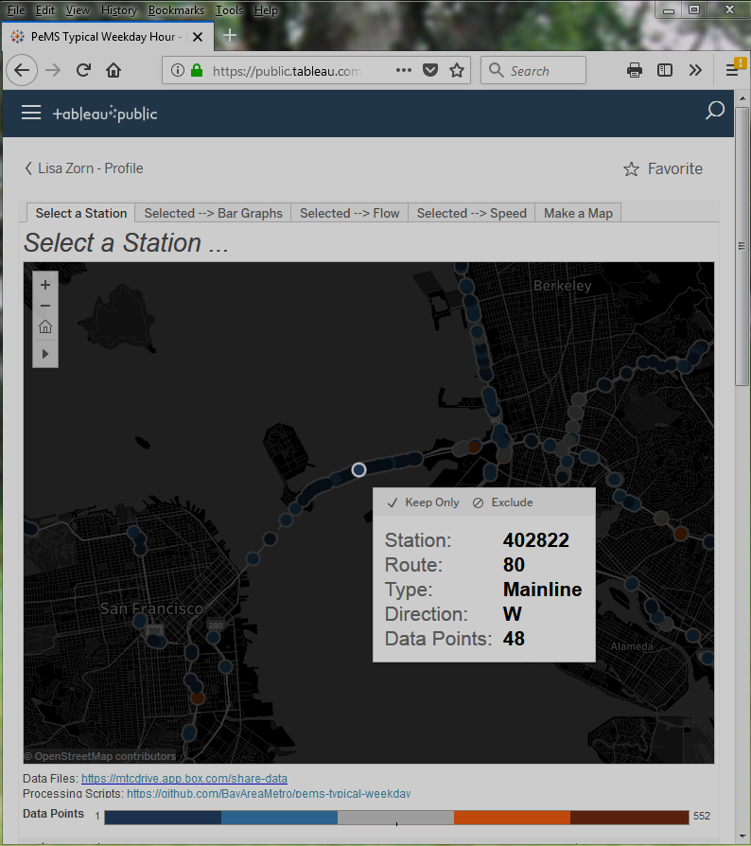
PeMS Data
Clearinghouse
pems_hour.csv
pems_period.csv
Build_Annual_ Database.R
For a given year:
Filter to Tues, Wed, Thurs and non-holidays
Filter out suspect data
Summarize by time period and hour
https://mtcdrive.app.box.com/v/share-data
Raw hourly PeMS
D4 station data
Build_Database.R
Combines annual databases
Tableau

