Slide 1
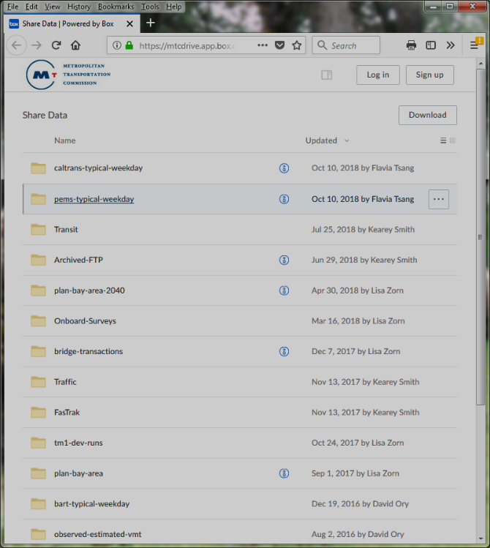
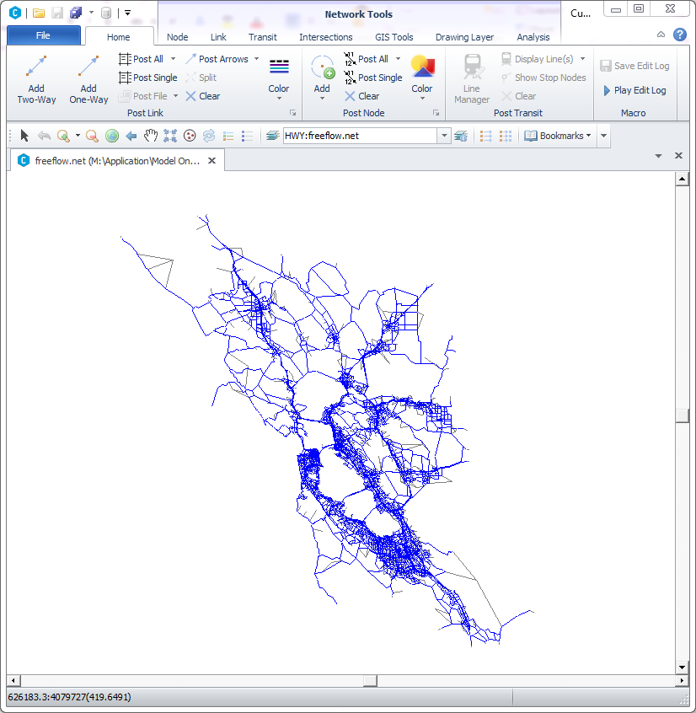
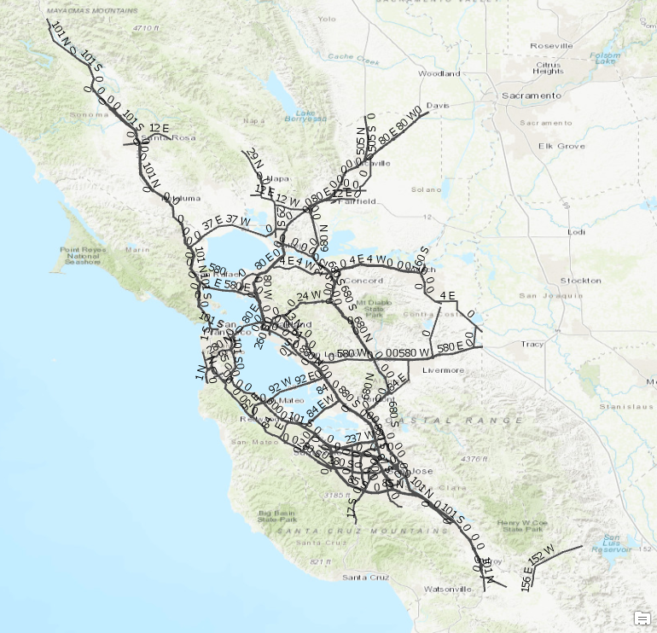
pems_hour.csv
pems_period.csv
crosswalk_pems_to_TM.R
Finds closest link of matching
type + route + direction
croswalk.csv with columns:
PeMS key (station, district, route, direction, type)
TM link (A, B, A_B)
https://mtcdrive.app.box.com/v/share-data
Filtered to freeways, expressways, HOV and ramps and projected to WGS1984 in ArcGIS Pro
Model
Network

