Slide 1
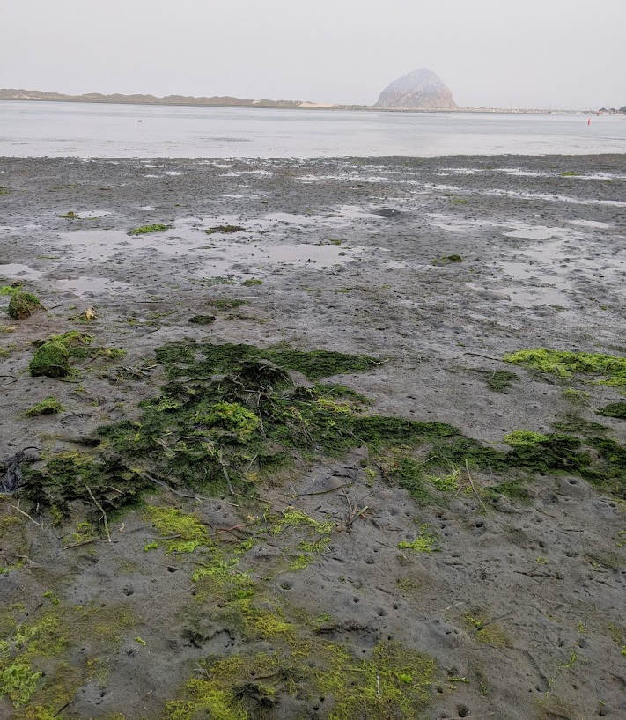
Genome-Environment Associations (GEAs)
Marine Genomics S22
Week 10 – June 2nd 2022

Slide 2
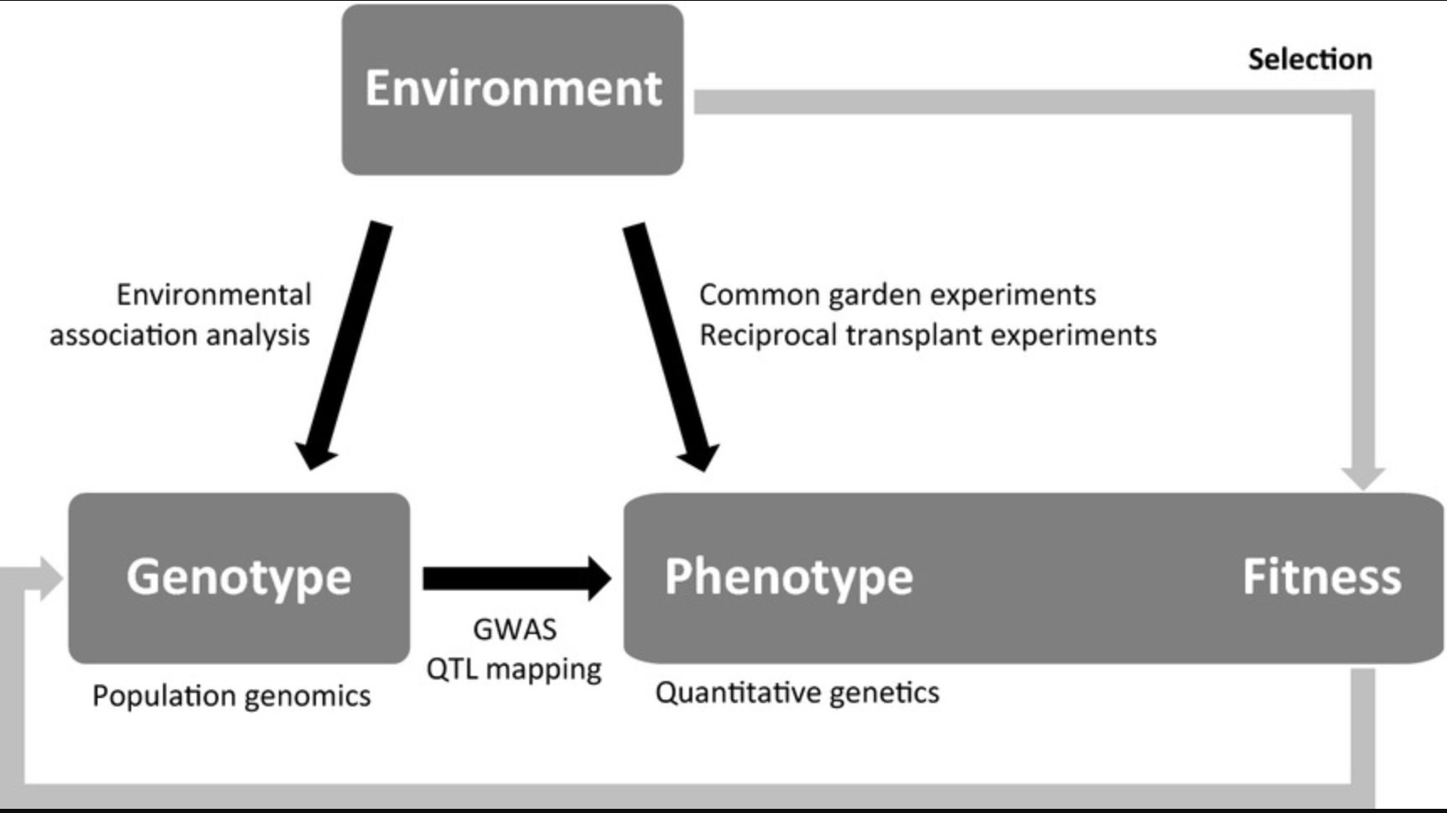
Rellstab et al. (2015)

Slide 3
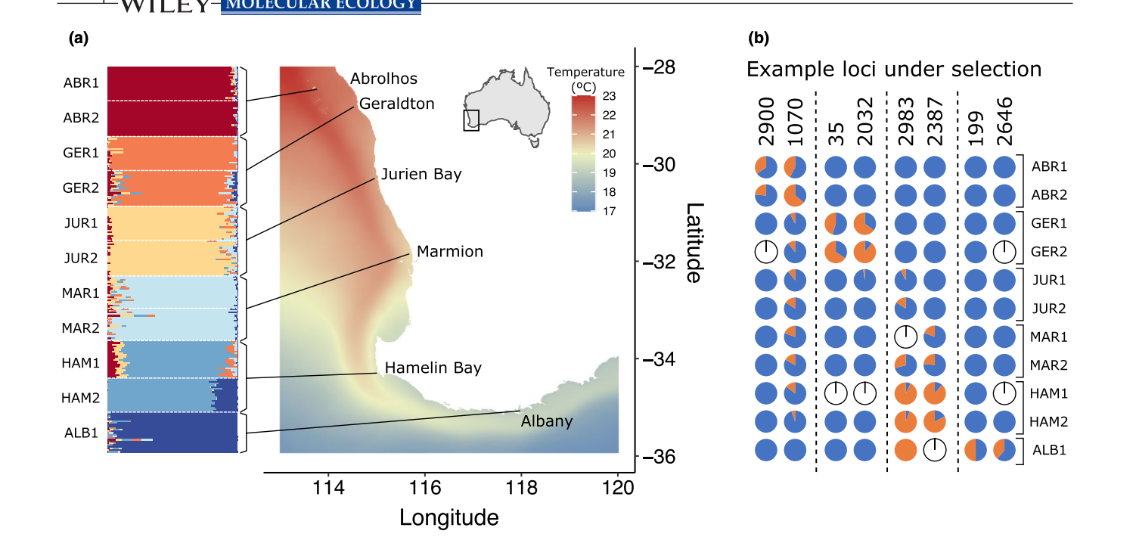
What SNPs are associated with the environment?
Vranken et al. (2022)

Slide 4
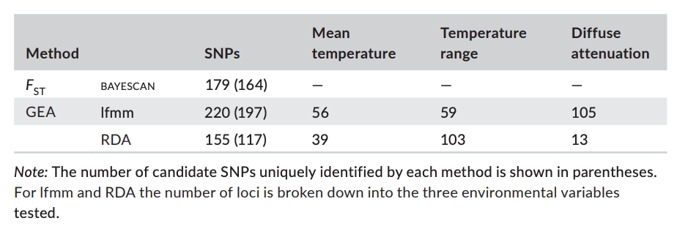
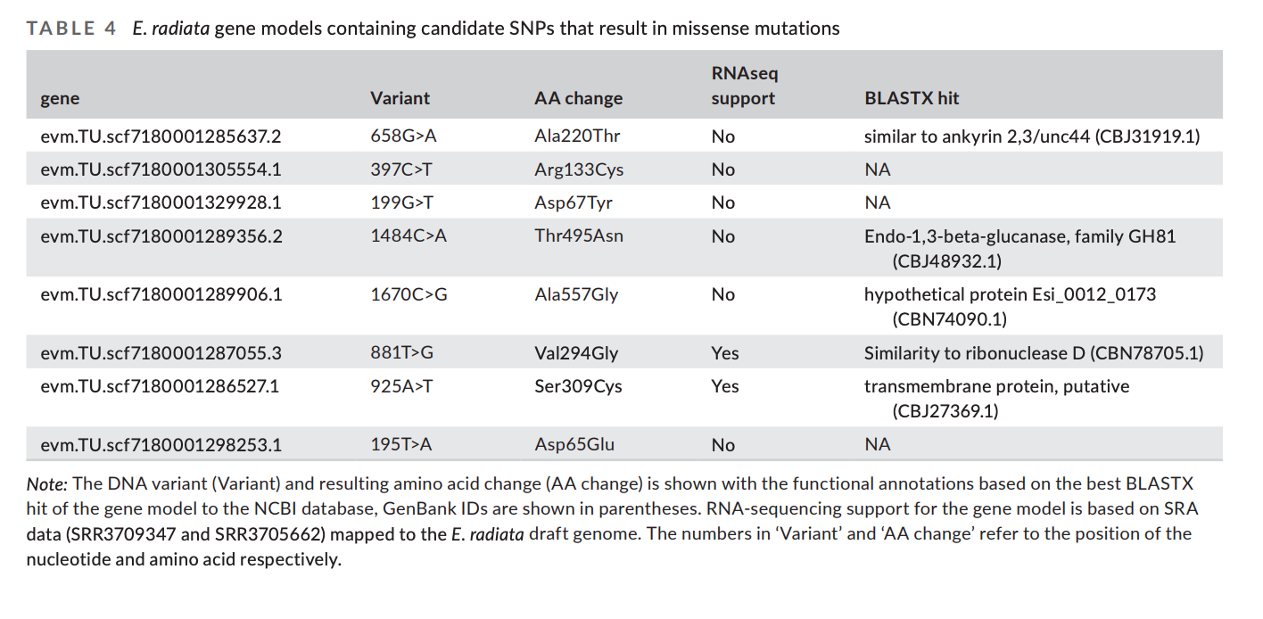
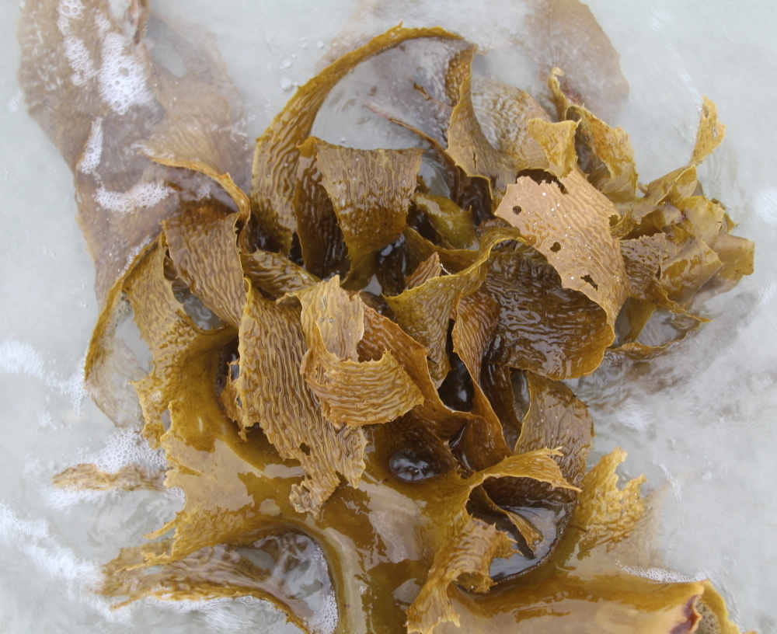

Slide 5

Environmental data
https://www.bio-oracle.org/explore-data.php

Slide 6

GEA analysis
Correlation between environmental data and genomic data
We’ll be using the R package lfmm (latent factor mixed model)
Basically, a regression model with fixed and latent effects
Y=XB^T+W+E
Fixed effects in matrix B
Latent effects in matrix W
Residual errors in E
Response variable
(genomic variation)
Environmental variable
https://academic.oup.com/mbe/article/36/4/852/5290100#138397544
Notes:
In LFMMs (Frichot et al. 2013), neutral genetic structure is introduced as a random factor with the so-called latent factors, which are similar to principal components and calculated from all available markers. The advantage of this linear approach is that the effects of environmental factors and neutral genetic structure on allele frequencies are simultaneously estimated.

Slide 7
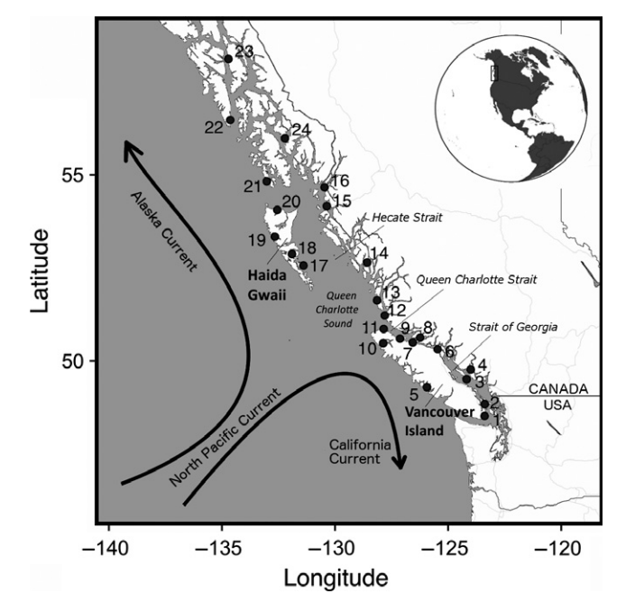
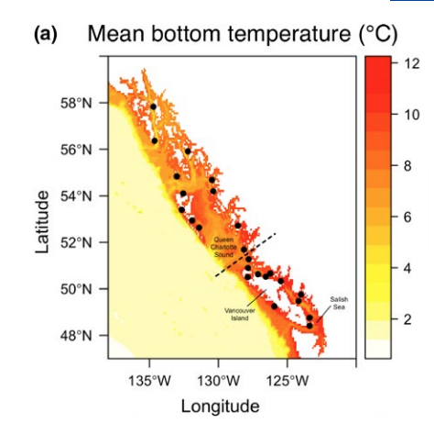
Population structure
If population structure follows environmental gradient, it can confound GEA
Many GEA programs will correct for structure (via different statistical analyses)
Can also run GEAs within each pop if enough sample sites
Notes:
In structured populations, genetic signatures of selection may
be confounded with signatures of neutral (i.e., historical or demographic)
processes that may be falsely interpreted as selection
(Excoffier, Hofer, & Foll, 2009). Corrections for population structure
are thus recommended to control for signals generated by neutral
processes, although these corrections can also be overly conservative
in some cases by inadvertently removing true signals of selection
(Forester et al., 2018).

Slide 8

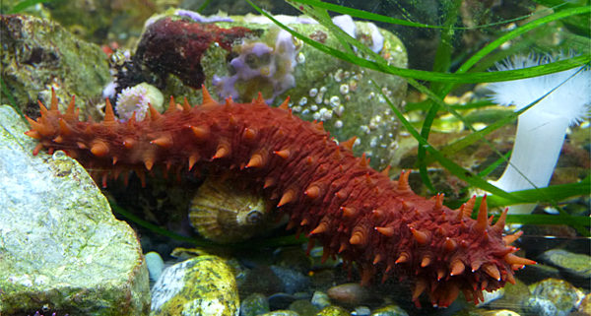
Data for class today
3966 SNPs from 685 Pacific sea cucumbers

