Slide 1
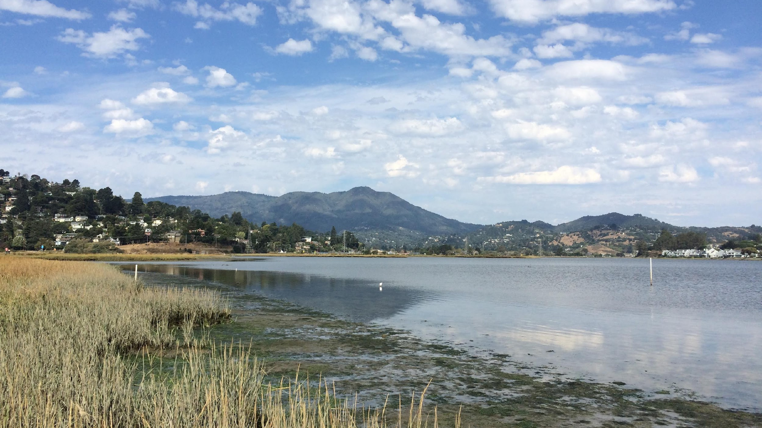
Marine Genomics
April 14th 2022
Mapping and calling variants

Slide 2
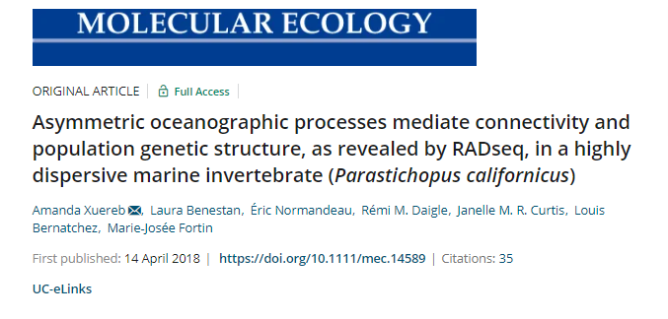
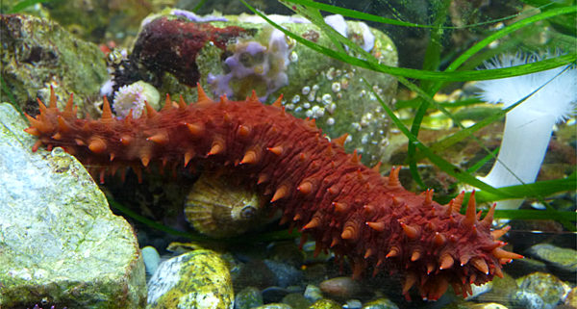
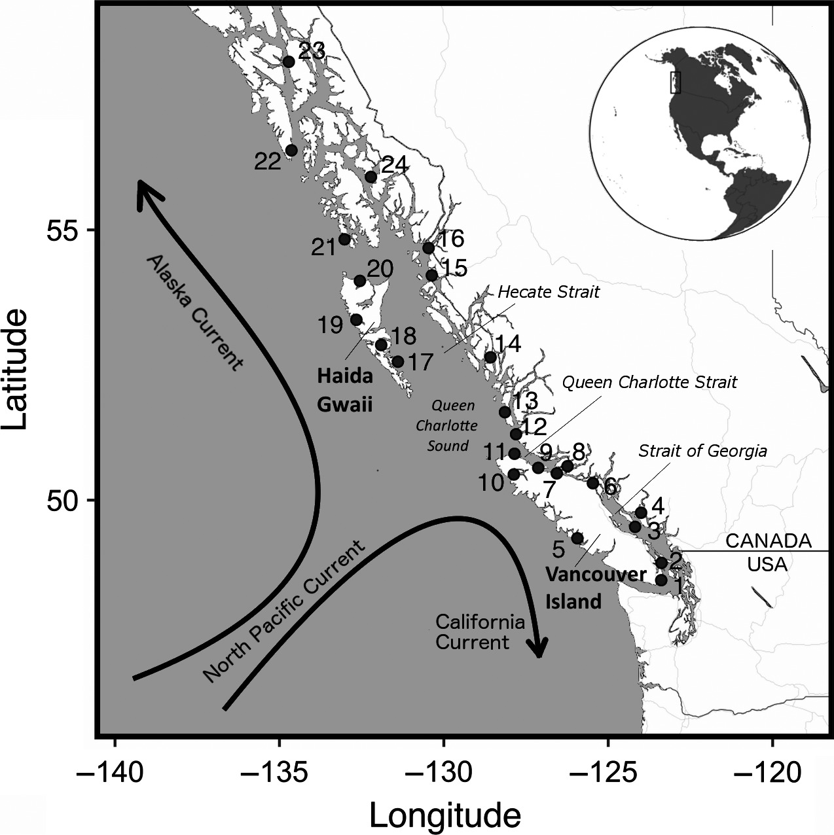
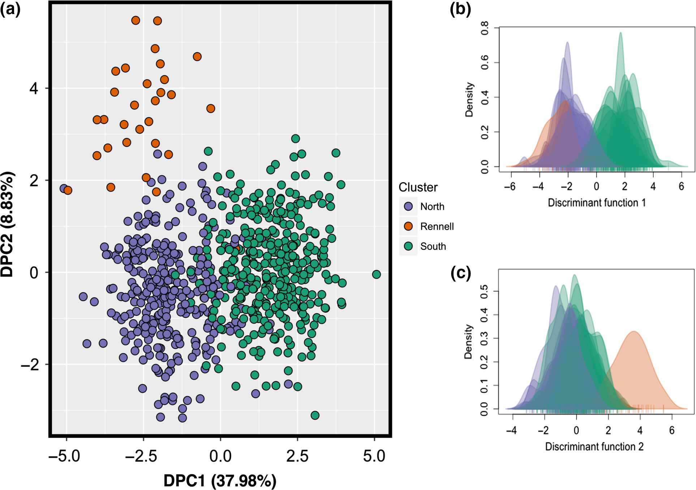
Notes:
Now we will be starting with actual NGS data from this paper- which we have pruned down so that we get fast run times
Are there different populations?
If so, is one population better suited to be grown in warmer conditions?
Which genes will lead to suitable growth traits?

Slide 3
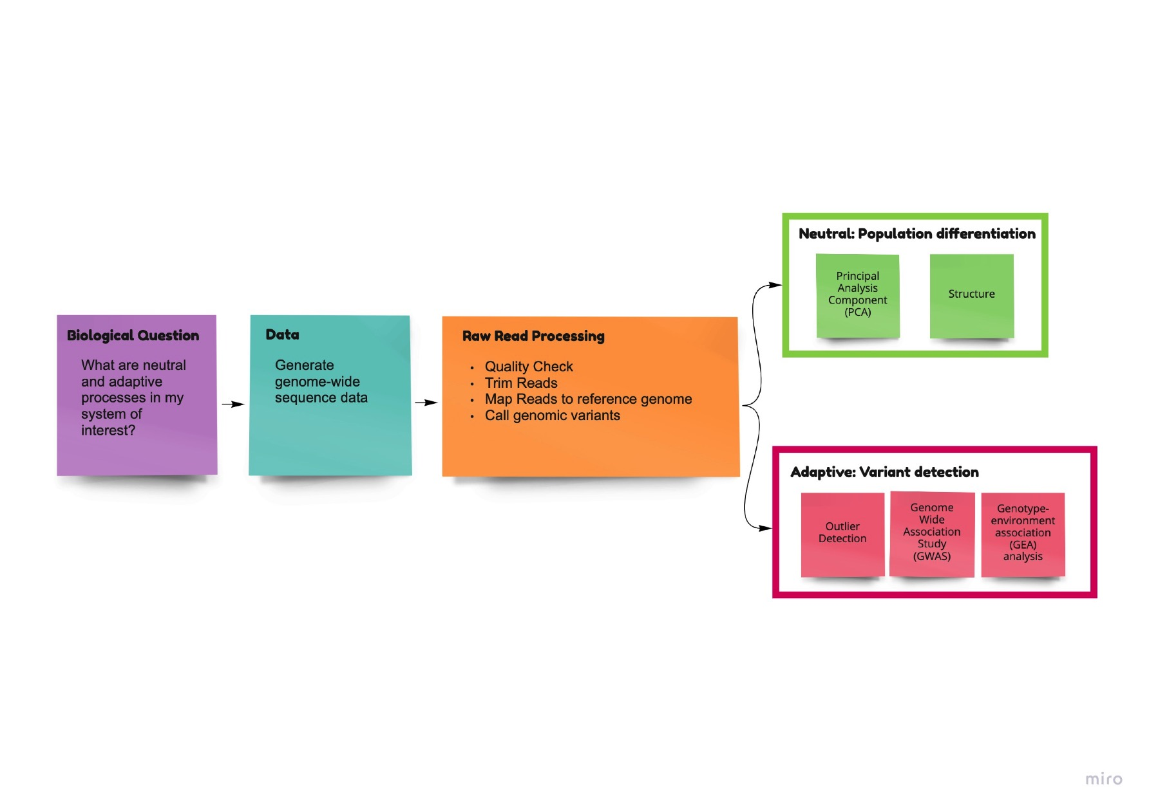
What we’re going over today

Slide 4
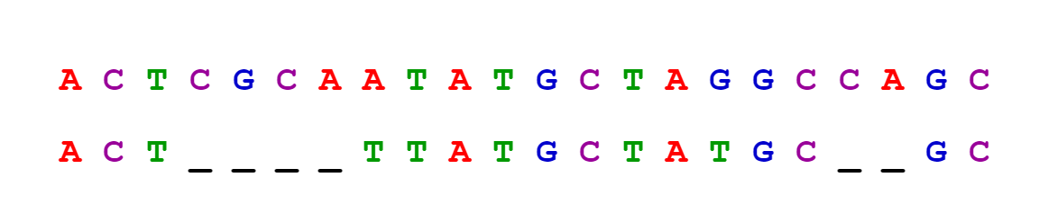
What is a genetic variant?
A region of the genome that differs from the reference (or another genome)
Signifies a mutation and can be a single base-pair, or larger insertion and/or deletion of several base-pairs.
Sequence 1
Sequence 2
Indel
SNP
SNP
Indel

Slide 5
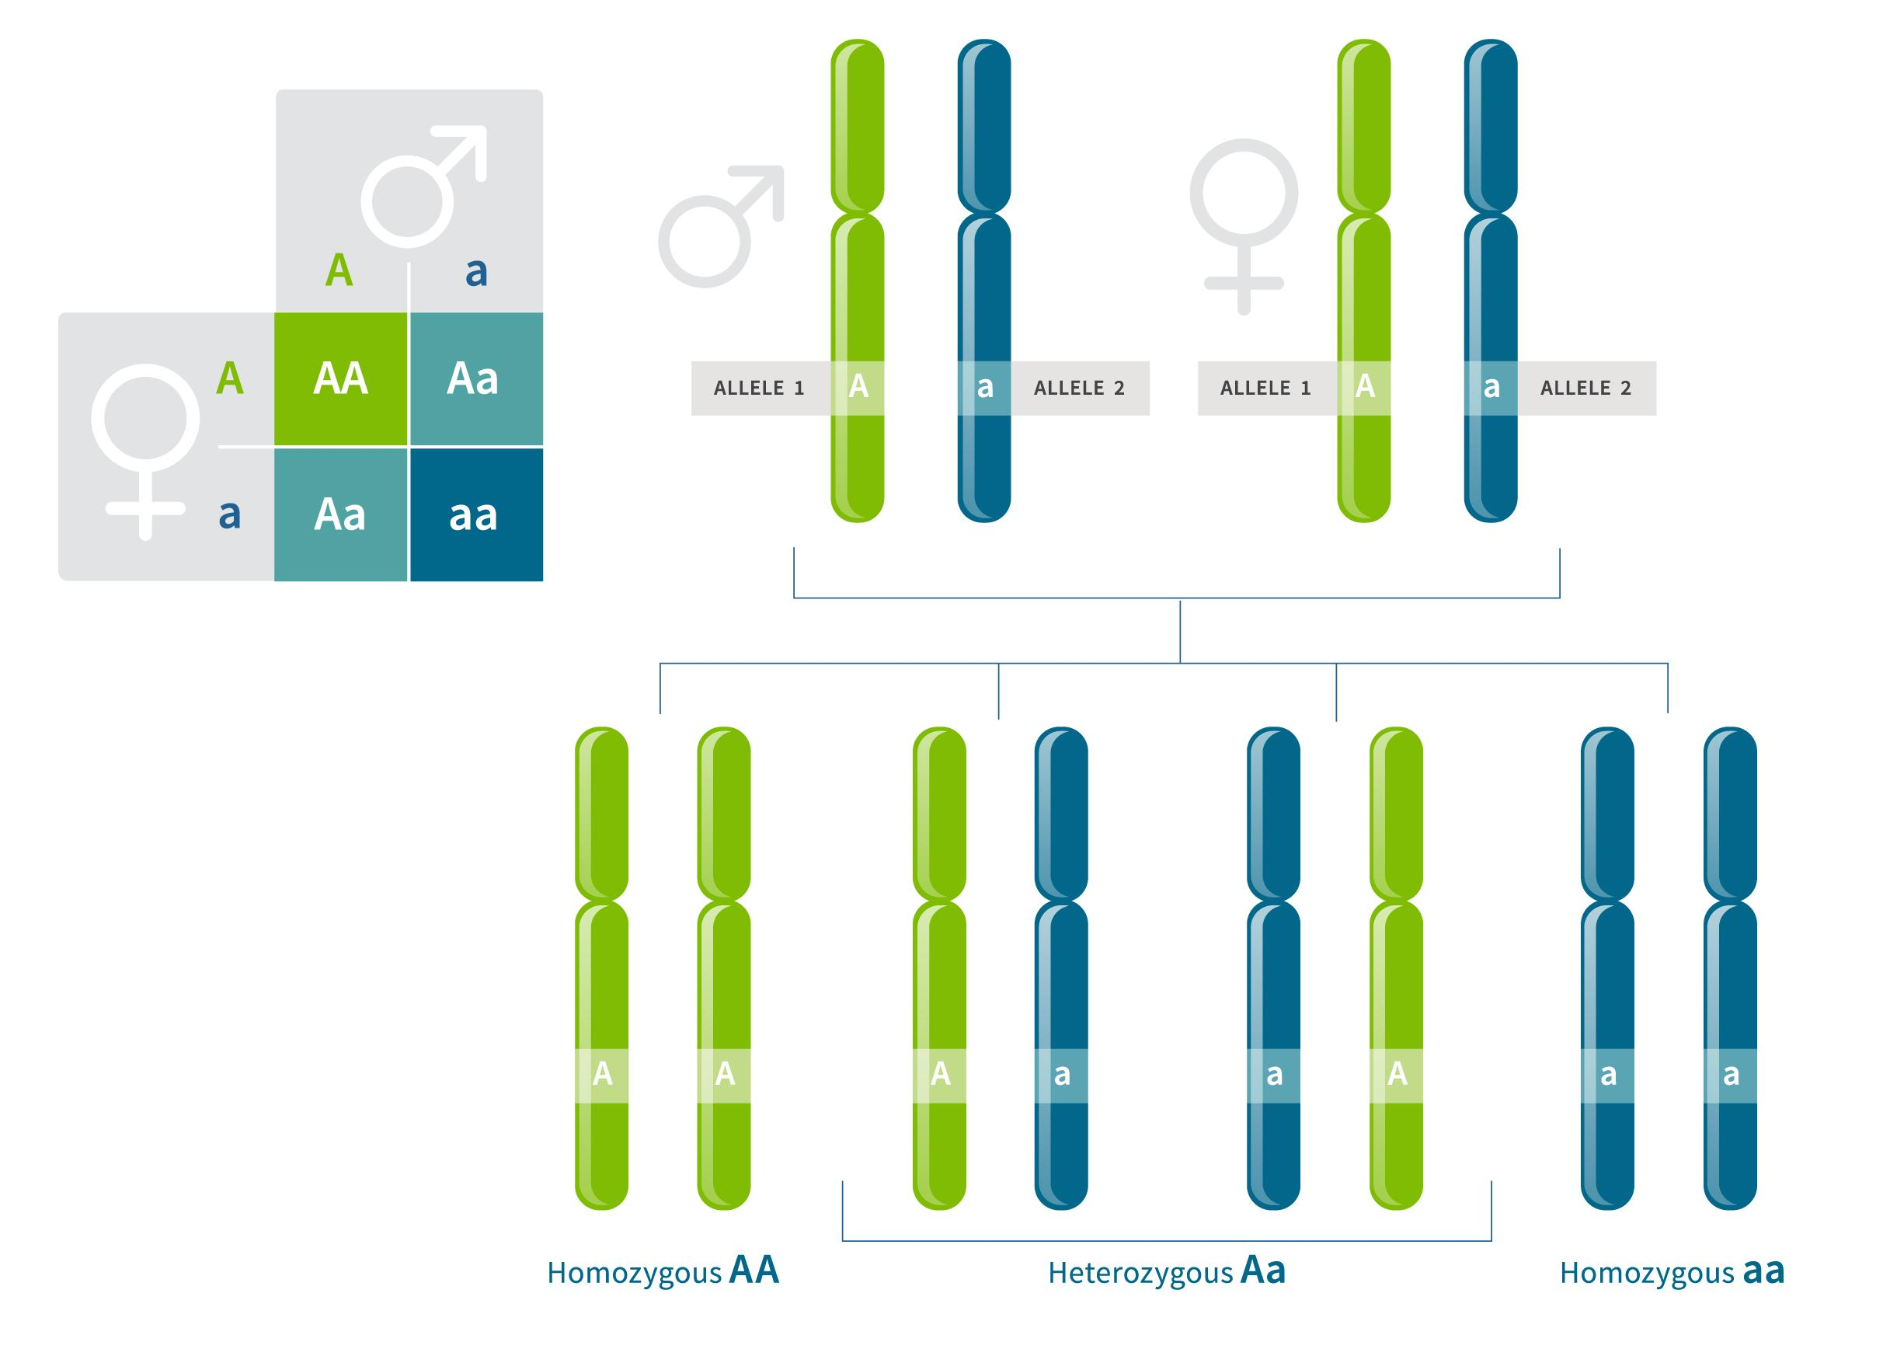
What is a genotype?
Image credit: https://www.ancestry.com/lp/genotype
Notes:
The genotype of an organism is its complete set of genetic material.^{[1]} Genotype can also be used to refer to the alleles or variants an individual carries in a particular gene or genetic location.^{[2]}
Can “add up” individ variants of org to get its genotype, but we may refer to a single gene in org and its genotype there

Slide 6
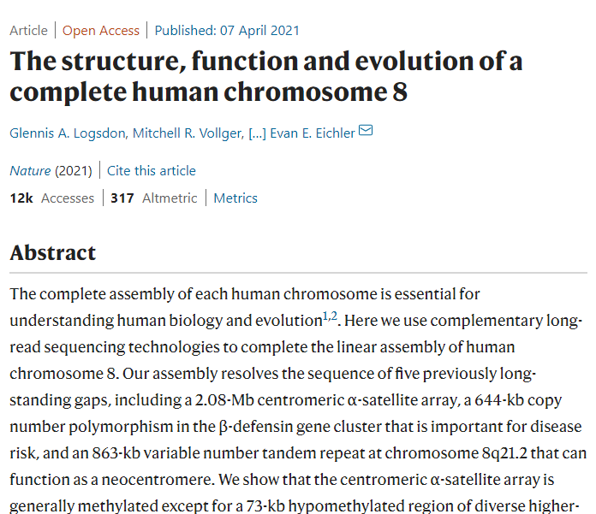


Genomes are continually being improved
More genomes are being sequenced all the time
Many marine organisms don’t yet have a genome sequence available
Notes:
Ref genome / reference assembly = a digital nucleic acid sequence database, assembled by scientists as a representative example of the set of genes in one idealized individual organism of a species
Reference genomes can be accessed online at several locations, using dedicated browsers such as Ensembl or UCSC Genome Browser.^{[8]}

Slide 7
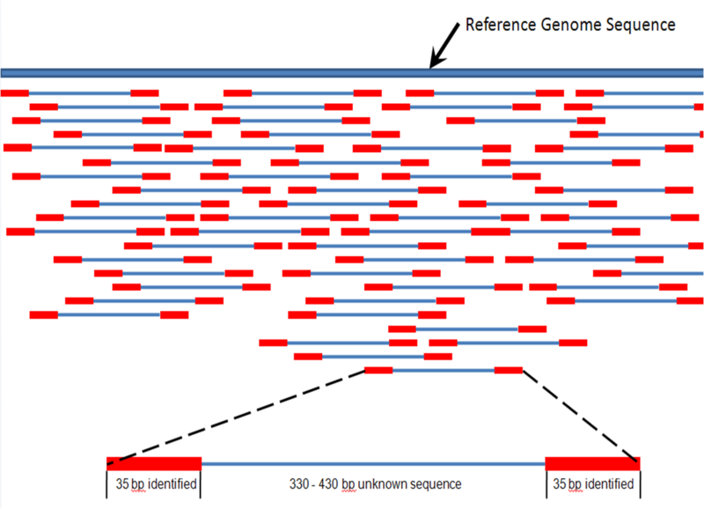
How do we find a variant?
Map and align sequences from other individuals to a reference genome
Does It matter what your reference genome is?
Is it the same or different species?
Is it from the same population?
Short answer: Yes, it matters!
Notes:
Can also assemble genotype by looking for areas of overlap
Here overlap will be greater with more coverage – these sequences can be copies of one individ, or diff individs

Slide 8
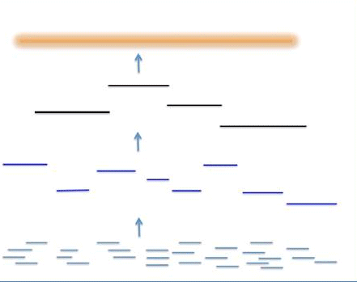
Finding variants – some terminology
Chromosome
Scaffolds
A reference genome is a collection of contigs
Contigs
Reads
Figure modified from here https://www.ddbj.nig.ac.jp/ddbj/assembly-e.html

Slide 9
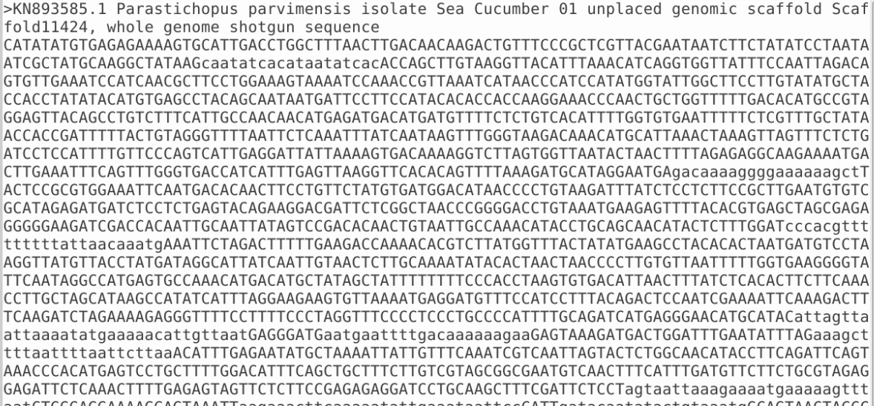
Finding variants – some terminology
A reference genome is a collection of contigs
Typically, in fasta format

Slide 10
Finding variants - pipeline
Download reference genome and sample reads
Trim adaptors (cutadapt)
Index the reference genome (bowtie2)
Map the reads to the genome (bowtie2)
Convert sam file to bam file (samtools)
Calculate genotype likelihoods (angsd)

Slide 11
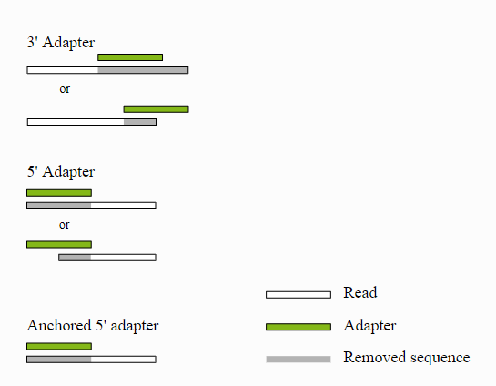

Trimming adaptors from reads
Notes:
The adapters contain the sequencing primer binding sites, the index sequences, and the sites that allow library fragments to attach to the flow cell lawn

Slide 12
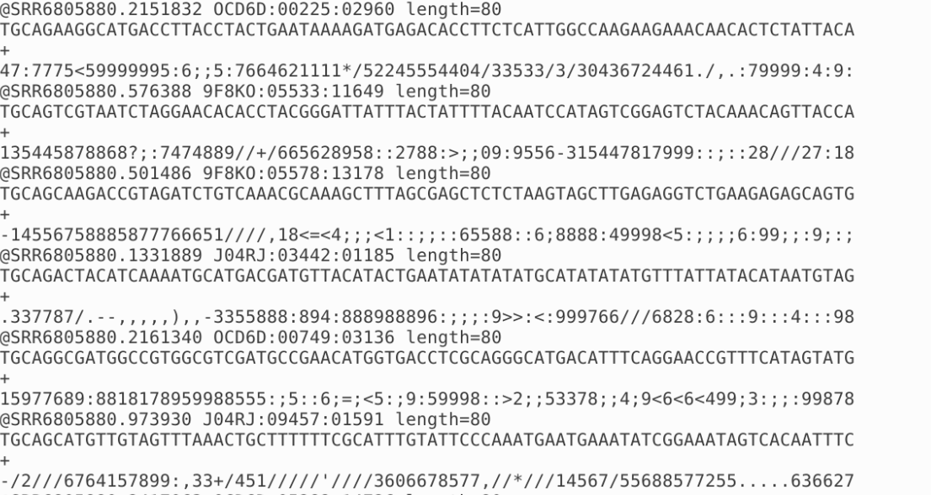
Trimming adaptors from reads
Notes:
Not biologically informative

Slide 13
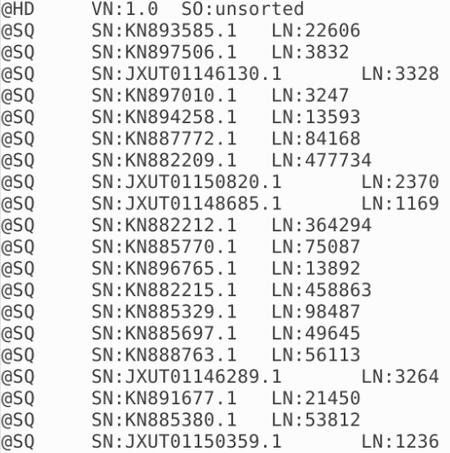
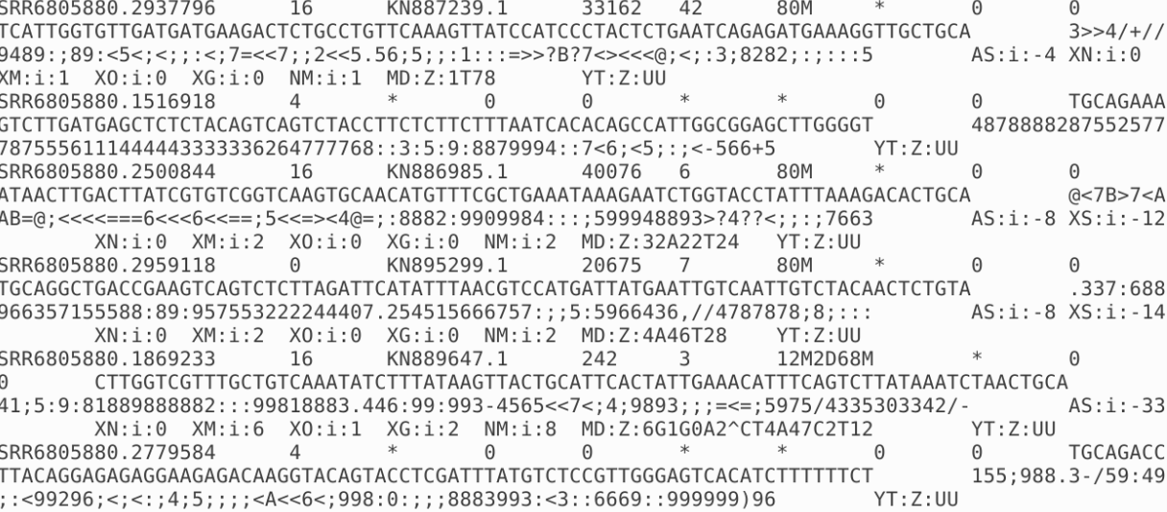
SAM and BAM file formats
Sequence Alignment Map, Binary Alignment Map
Head of .sam file
Tail of .sam file
Notes:
Sequence Alignment/Map
SN (SN=reference sequence name) and LN (LN=reference sequence length).
It is a TAB-delimited text format consisting of a header section, which is optional, and an alignment section. header lines indicated with the “@”
Each alignment line has 11 mandatory fields for essential alignment information such as mapping position, and variable number of optional fields for flexible or aligner specific information.
http://samtools.github.io/hts-specs/SAMv1.pdf

Slide 14
SAM and BAM file formats
Sequence Alignment Map, Binary Alignment Map
Name of read
Name of contig where read aligns
Position on contig where 5’ end starts
Alignment information “cigar string”
80M = contiguous match of 80bp
Tail of .sam file
Notes:
Alignment section of .sam
Flags= mapping quality, mapping in proper pair, number of times mapped, etc.

Slide 15
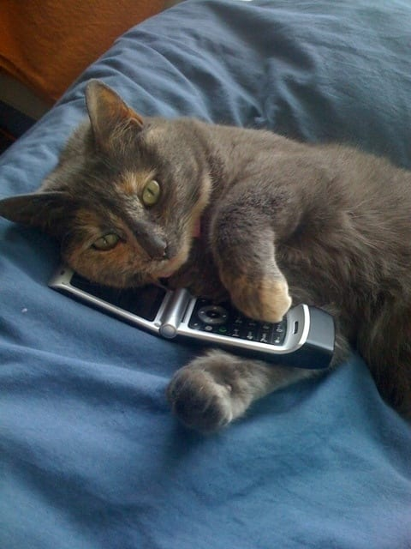
“Calling” a genotype
Two main ways to estimate a genotype:
Hard genotype calling vs. genotype likelihoods
If you have reads with a high degree of coverage (many copies of the same read) you can do hard genotype calling.
If you have variable coverage or low coverage you can do genotype likelihoods, to account for some uncertainty in the genotype.
Notes:
Depends on the type of data that you have.
NGS data can suffer from high error rates that are due to multiple factors, including base-calling and alignment errors.
many NGS studies rely on low- coverage sequencing (<5× per site per individual, on average), for which there is high probability that only one of the two chromosomes of a diploid individual has been sampled at a specified site

Slide 16
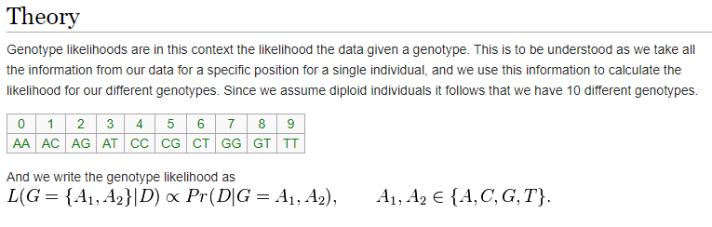
Genotype likelihoods
In ANGSD
Accounts for some uncertainty in the genotype estimation
http://www.popgen.dk/angsd/index.php/Genotype_Likelihoods

