Slide 1
ARMv8 Big Little

Slide 2
History / Approaches
1. Cpu Migration (IKS / bL_switcher)
2. Big Little MP (GTS / HMP)
3. Energy Aware Scheduler (EAS)

Slide 3
1. IKS / Cpu Migration / BL switcher
Merged in 3.14
  Originally either “All big or All Little”.
  One Big with one Little Core,
    Better than “All big or All Little”, less migration cost.
    Allows mix of Big and Little.
  Uses cpufreq (load) as deciding mechanism.
  Can be turned on with CONFIG_BL_SWITCHER
  Does not touch files outside arm
Issues:
  Half of cpu's available
  4 Little 2 Big Architectures
  No “smart” task placement. Load based.

Slide 4
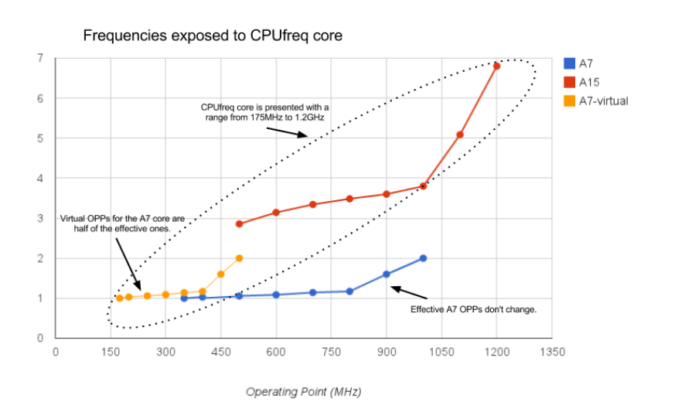
IKS / Cpu Migration / BL switcher

Slide 5
2. Big Little MP / GTS / HMP
The idea is that scheduler is able to properly spread a workload across multiple types of processors, based on previous load of the Task.
Development tree:
  https://git.linaro.org/arm/big.LITTLE/mp.git
Also on linaro Stable:
  git://git.linaro.org/kernel/linux-linaro-stable.git
    switch between IKS and MP by passing 'bL_switcher_active=no' to the kernel on the boot command

Slide 6
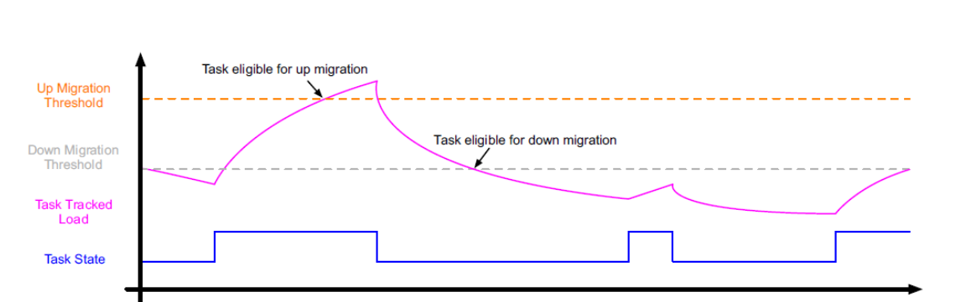
Big Little MP / GTS / HMP
When tasks are created (fork migration).
At wakeup time (wakeup migration).
With every scheduler tick (forced migration).
When a CPU is about to become idle (idle pull).

Slide 7
Big Little MP / GTS / HMP
Issues
  Touches too much generic code.
  Architectures were clusters overlap (2 clusters 8 A53's)
  Thermal management big cluster could offer less performance
  “Having power management decisions taken by three independent components (cpufreq, cpuidle, and the scheduler) with no integrated policy is no longer acceptable.”
Rejected by community, BUT need to add power awareness to the scheduler was acknowledged.

Slide 8
3. Energy aware Scheduler - EAS
New effort, Work in progress
Idea is to integrate better Cpuidle and cpuFreq with scheduler.
  Tune the scheduler to optimize for energy savings and performance
  Schedule correctly on big.LITTLE systems
  Improve PM behavior on SMP systems
  Provide mechanisms for thermal management
ARM partners want an upstream solution so they maintain GTS for Android stuff on older kernels but all upstream focus has shifted to EAS.
Repo: https://git.linaro.org/kernel/eas-backports.git
Mailing list: https://lists.linaro.org/mailman/listinfo/eas-dev

Slide 9
EAS – Work in progress
Cpuidle:
  Tighter integration of the idle task in the scheduler.
  IO latency tracking framework - replace menu governor (no prediction factor, use device IO)
CpuFreq
  bring scale invariance to load tracking
Scheduler
  breaking the scheduler’s (and the Linux kernel’s) assumption that all CPUs are equal
  power-aware scheduler http://lwn.net/Articles/600135/
  sched_domain topology https://lkml.org/lkml/2014/3/19/377
  CPU capacity tracking consolidation https://lkml.org/lkml/2014/5/23/458
Issue ?
  Vendors generally don't publish power numbers
  Picking the right cpu/cluster in a b.L system is hard. Maybe over engineering?

Slide 10
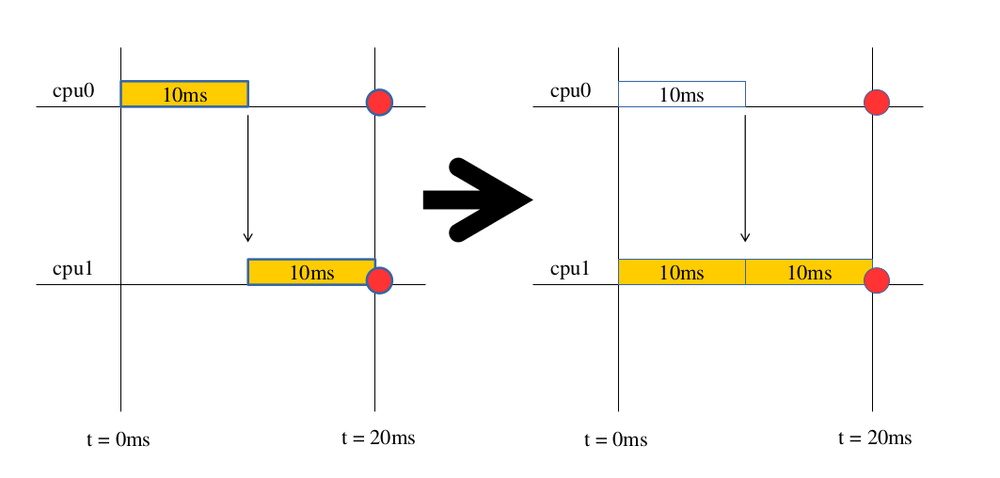
Load Aggregation

Slide 11
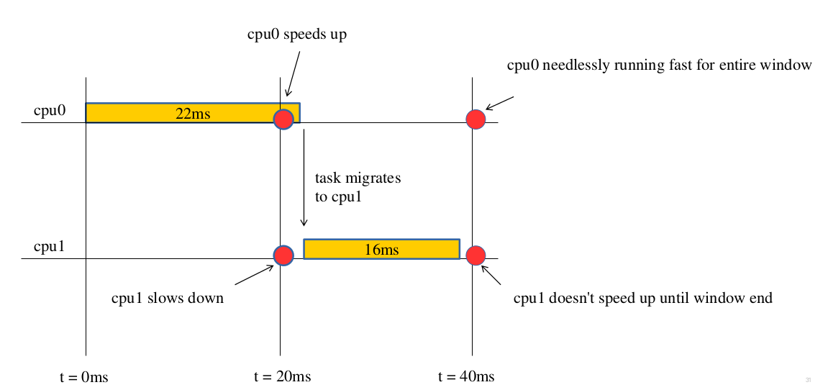
Scheduler aware cpu feq

Slide 12
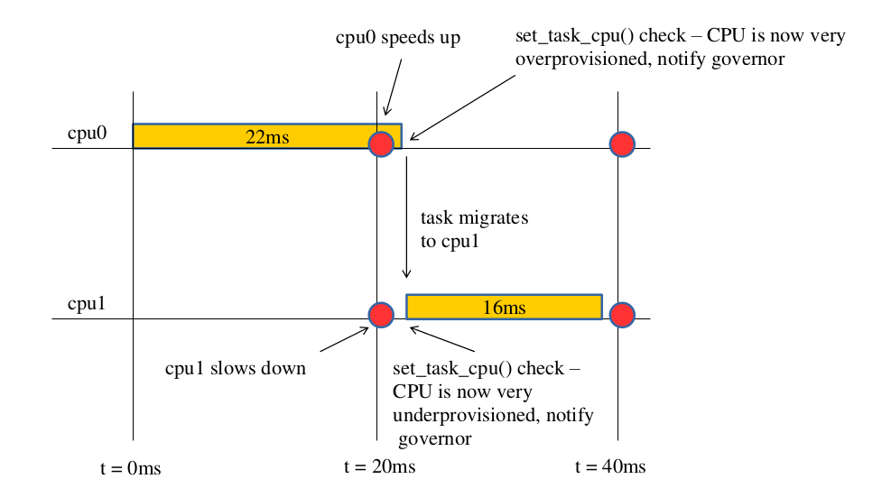
Scheduler aware cpu feq

Slide 13
References
https://events.linuxfoundation.org/images/stories/slides/elc2013_poirier.pdf
http://www.arm.com/files/pdf/big_LITTLE_Technology_the_Futue_of_Mobile.pdf
http://lwn.net/Articles/481055/
http://www.arm.com/files/pdf/big_LITTLE_technology_moves_towards_fully_heterogeneous_Global_Task_Scheduling.pdf
http://lwn.net/Articles/552885/
https://www.linaro.org/blog/core-dump/summary-energy-aware-scheduling-workshop-linux-kernel-summit-2014/
http://lwn.net/Articles/609969/
http://lwn.net/Articles/602479/
http://lwn.net/Articles/602479/

