Slide 1
2015-05-28
Renesas
PSCI
Power State Coordination Interface

Slide 2
ARM32
Problem:
  Lots of out of tree code.
  Legacy platforms. hard to standardize procedures.
  Quirks and hacks for power controllers and/or Trusted OS'es
  Generic “hacks” like coupled cpuidle states means something is wrong.
  CPU PM became more complicated than necessary, without clear justifiable reasons.

Slide 3
ARM64
Start clean:
  Standardize pm controllers Hardware and Software.
  Keep platform pm quirks out of the kernel.
  Design improvements for Security and Hypervisors
  Provide a reference design.

Slide 4
PSCI
“The aim is to ease the integration between supervisory software from different vendors working at different privilege levels”
PSCI Standard
http://infocenter.arm.com/help/topic/com.arm.doc.den0022c/DEN0022C_Power_State_Coordination_Interface.pdf
BayLibre wiki:
http://wiki.baylibre.com/doku.php?id=psci

Slide 5
ARM Privilege Levels
Transition to higher levels via exceptions
  SVC for transition to EL1 (system calls)
  HVC for transition to EL2 (hypervisor calls)
  SMC for transition to EL3 (secure monitor call)
  ELR register for the return address.
 | Non-secure | Secure
EL0 | Apps | Secure apps
EL1 | Rich OS | Trusted OS
EL2 | Hypervisor
EL3 |  | Secure Firmware Secure Monitor

Slide 6
PSCI Scope
Standardize CPU PM interactions across Normal/Secure worlds.
  Suspend/idle
  CPU hotplug
  Migration of trusted OS
  Shutdown and reset
NOT meant for:
  CPU DVFS
  Device pm
    Why? Device pm generally does not require secure interactions
    Security implications. Keep the firmware as simple as possible.
  Trusted OS interactions.
SoC
ARMv8
EL0
EL0
EL1
EL1
PSCI
EL2
X
EL3
MailBox
Power Controller
i2c
PMIC
http://infocenter.arm.com/help/topic/com.arm.doc.den0022c/DEN0022C_Power_State_Coordination_Interface.pdf

Slide 7
CPU PM Recommendations
ARM strongly recommends that the Secure world is responsible for the control of low power states.
  Most current Trusted OS implementations are not SMP-capable.
  The lack of SMP support in the Trusted OS helps to keep code simple and small.
ARM strongly recommends that all policy in power and performance management is performed in the Normal world.
  Normal world knows about the history and work load of the system

Slide 8
PSCI – CPU states
An ARM core can be in any of the following power states:
  Run: The core is powered up and operational.
  Standby: Measures are employed to reduce energy consumption. State is preserved.
  Retention: Like Standby state but debug requests remain pending.
  Power-down: The core is powered off. Software needs to save/restore all core state.

Slide 9
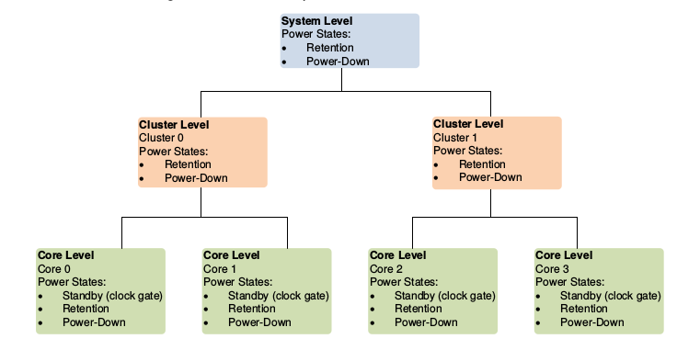
PSCI - Affinity
Platform coordinated mode
  Each core select deepest state. Firmware decides when to execute low power state.
OS initiated mode
  Last man selects deep state mode, firmware returns error if it can't comply.

Slide 10
PSCI – CPU_ON / OFF
Hotplug:
  No more irq's on cpu, no more wakeup events
  CPU becomes unavailable until an explicit command is issued to bring up the CPU
  OSPM should provide a normal world return address to jump on exit from secure.
big.LITTLE
  Cluster migration
    Switch all tasks to new clusters depending on load
  CPU migration
    Allows mix of little and big cpu's active concurrently.
  Global Task Scheduling
    All cores are active and available, the OS assignes tasks to a core based on core and task characteristics.

Slide 11
PSCI – Functions 1/2
PSCI_VERSION: Return the version of PSCI implemented (16-bit major and 16-bit minor number)
CPU_SUSPEND: Suspend execution on a core or higher level topology node. Intended for use in idle subsystems where the core is expected to return to execution through a wakeup event
CPU_OFF: Power down the calling core. Intended for use in hotplug. A core that is powered down by CPU_OFF can only be powered up again in response to a CPU_ON
CPU_ON: Power up a core. Used to power up cores that either:
  Have not yet been booted into the calling supervisory software
  Have been previously powered down with a CPU_OFF call
AFFINITY_INFO: Enable the caller to request status of an affinity instance (a particular core/cluster/the whole system)
MIGRATE: Used to ask a uniprocessor Trusted OS to migrate its context to a specific core
MIGRATE_INFO_TYPE: Allows a caller to identify the level of multicore support present in the Trusted OS
MIGRATE_INFO_UP_CPU: For a uniprocessor Trusted OS, returns the current resident core
SYSTEM_OFF: Shutdown the system
SYSTEM_RESET: Reset the system
PSCI_FEATURES: Query API that allows discovering whether a specific PSCI function is implemented and its features

Slide 12
PSCI – Functions 2/2
CPU_FREEZE: Places the core into an IMPLEMENTATION DEFINED low-power state. Unlike CPU_OFF it is still valid for interrupts to be targeted to the core. However, the core must remain in the low-power state until it a CPU_ON command is issued for it
CPU_DEFAULT_SUSPEND: Will place a core into an IMPLEMENTATION DEFINED low-power state. Unlike CPU_SUSPEND the caller need not specify a power_state parameter
NODE_HW_STATE: Intended to return the true HW state of a node in the power domain topology of the system
SYSTEM_SUSPEND: Used to implement suspend to RAM. The semantics are equivalent to a CPU_SUSPEND to the deepest low-power state
PSCI_SET_SUSPEND_MODE: Allows setting the mode used by CPU_SUSPEND to coordinate power states
PSCI_STAT_RESIDENCY: Returns the amount of time the platform has spent in the given power state since cold boot
PSCI_STAT_COUNT: Returns the number of times the platform has used the given power state since cold boot

Slide 13
“Juno” reference
Juno board is ARM's development platform for armv8
It has a 2 cluster bL topology: 2 A57 + 4 A53
The System Control Processor (SCP) a Cortex-M3, interfaces to the PMIC.
Message Handling Unit (MHU) to talk to the SCP.
Open source Arm Trusted Firmware (ATF).
PSCI reference implementation.
Kernel SCPI for device and DVFS operations

Slide 14
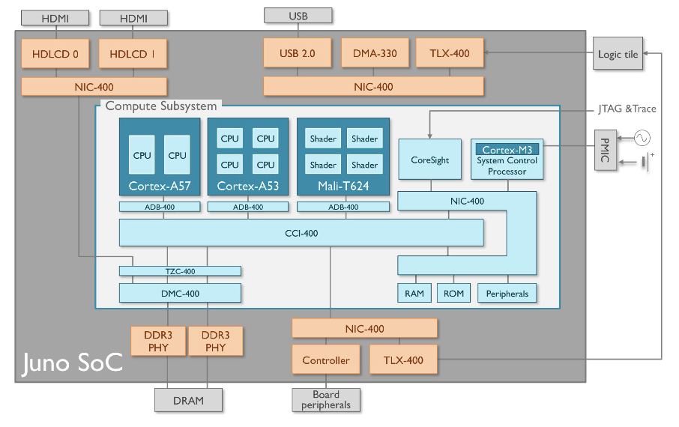
“Juno” reference

Slide 15
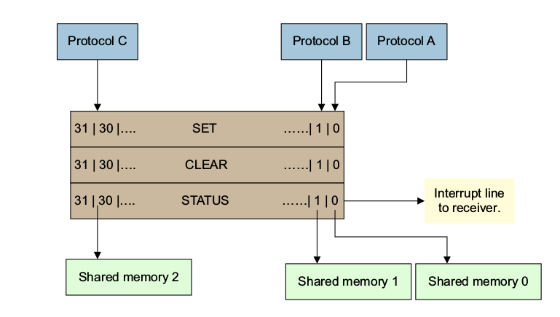
Message Handling Unit (MHU)
Sending a message
1. The sender polls STAT [0] to determine if the virtual channel associated with slot 0 is ready to accept a message. The sender must wait until STAT[0] becomes clear to ensure that any previous commands have been received and processed.
2. The sender writes a message to the shared memory area of the receiver. The content and size of the message are protocol-specific. The sender must then ensure that the written data is visible to the receiver. This visibility is achieved, where appropriate, though the use of barriers, or their equivalent, before proceeding to the next step.
3. The sender writes 1 to SET [0]. This write signals to the receiver that a new message ispending on the virtual channel for slot 0.

Slide 16
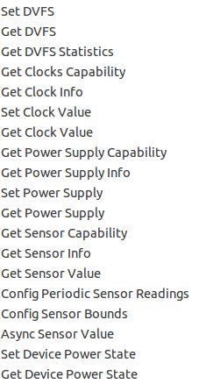
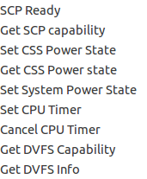
System Control and Power Interface (SCPI)
Protocol over MHU
Primary interface to the SCP
Message consists of a compulsory header and an optional payload
http://infocenter.arm.com/help/index.jsp?topic=/com.arm.doc.dto0038a/CJHJIJBJ.html

Slide 17
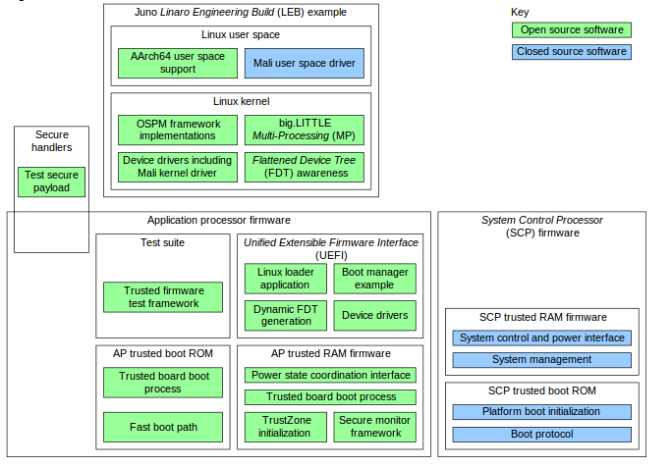
Software View
PSCI
SCPI
PMIC
I2C
SCPI
SCPI
MHU
http://infocenter.arm.com/help/index.jsp?topic=/com.arm.doc.ddi0515b/CJHCIJHF.html

Slide 18
Boot Secondary CPU
KERNEL
./kernel/smp.c
__cpu_up()
boot_secondary()
pu_ops[cpu]->cpu_boot(cpu);
./kernel/psci.c
.cpu_boot = cpu_psci_cpu_boot,
cpu_psci_cpu_boot()
psci_ops.cpu_on()
err = invoke_psci_fn(fn,...);
./kernel/psci-call.S
ENTRY(__invoke_psci_fn_smc)
smc #0
ret
ENDPROC(__invoke_psci_fn_smc)
ARM TRUSTED FIRMWARE
./services/std_svc/psci/psci_main.c
psci_smc_handler
psci_cpu_on();
psci_afflvl_on()
services/std_svc/psci/psci_afflvl_on.c
psci_call_on_handlers();
psci_afflvl0_on /* cpu */
psci_plat_pm_ops->affinst_on
psci_afflvl1_on, /* cluster */
psci_afflvl2_on /* system */
PLATFROM SPECIFIC:
./plat/juno/plat_pm.c
.affinst_on = juno_affinst_on,
juno_affinst_on()
juno_program_mailbox(mpidr, sec_entrypoint)
scpi_set_css_power_state(mpidr, ...);
plat/juno/scpi.c
scpi_secure_send32(SCPI_CMD_SET_CSS_POWER_STATE, state);
mhu_secure_message_send()
mmio_write_32();
Does WFI.
0xC4000003
CCI + NIC*
Cortex M3
*Cache coherent interconnect
Network interconnect
i2c
PMIC

Slide 19
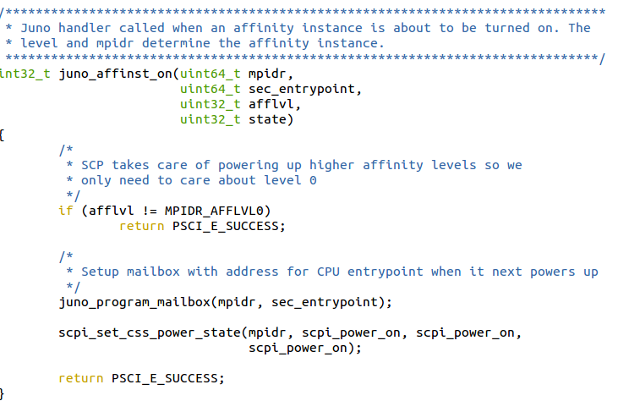
ATF CPU_ON routine

Slide 20
Code walk of CPU idle
./drivers/cpuidle/cpuidle-arm.c
arm_enter_idle_state()
arm_cpuidle_suspend()
arch/arm64/include/asm/cpuidle.h
arm_cpuidle_suspend()
cpu_suspend();
arch/arm64/kernel/cpuidle.c
cpu_suspend();
cpu_ops[cpu]->cpu_suspend(arg);
arch/arm64/kernel/psci.c
.cpu_suspend = cpu_psci_cpu_suspend,
cpu_psci_cpu_suspend()
__cpu_suspend(psci_suspend_finisher)
or psci_cpu_suspend()
arch/arm64/kernel/suspend.c
__cpu_suspend()
__cpu_suspend_enter()
arch/arm64/kernel/sleep.S
__cpu_suspend_enter /* save cpu context and call finisher */
psci_suspend_finisher()
arch/arm64/kernel/psci.c
psci_ops.cpu_suspend = psci_cpu_suspend;
psci_cpu_suspend()
invoke_psci_fn()
./services/std_svc/psci/psci_main.c
psci_smc_handler
psci_cpu_suspend
psci_afflvl_suspend()
services/std_svc/psci/psci_afflvl_suspend.c
psci_afflvl_suspend()
psci_call_suspend_handlers()
psci_afflvl0_suspend
psci_plat_pm_ops->affinst_suspend
psci_afflvl1_suspend
psci_afflvl2_suspend
psci_power_down_wfi
./plat/arm/css/common/css_pm.c
.affinst_suspend = css_affinst_suspend
css_affinst_suspend()
css_power_down_common(afflvl);
scpi_set_css_power_state
0xc4000001

Slide 21
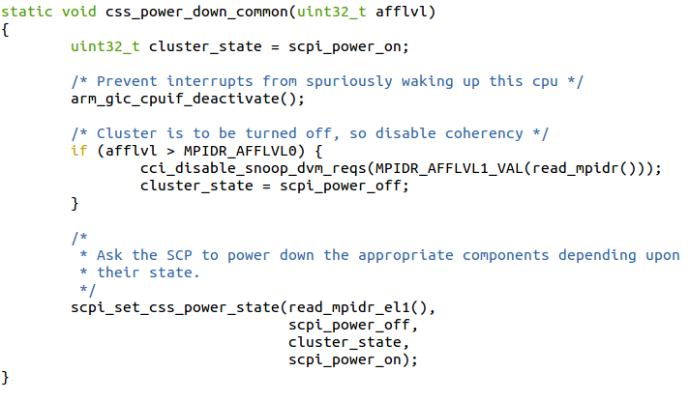
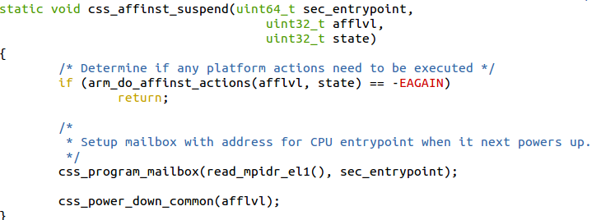
CPU suspend routine

Slide 22
References
Juno TRMhttp://infocenter.arm.com/help/topic/com.arm.doc.dto0038a/DTO0038A_juno_arm_development_platform_soc_technical_overview.pdf
PSCI Specification:http://infocenter.arm.com/help/index.jsp?topic=/com.arm.doc.den0022c/index.html
ARM Compute Subsystem SCP
https://wiki.linaro.org/ARM/Juno?action=AttachFile&do=get&target=DUI0922B_scp_message_interface.pdf
ARM Trusted Firmware
  https://github.com/ARM-software/arm-trusted-firmware.git

