Slide 1
Session 13
Chapter 6 – Full relation operations
Database Systems

Slide 2
Objectives
1
Understand what are grouping and aggregate functions in SQL
2
Understand HAVING clauses
3
Know about the NULL when grouping

Slide 3
Contents
1
Aggregation operators
2
Grouping
3
Grouping, Aggregation and NULLs
4
HAVING clauses

Slide 4
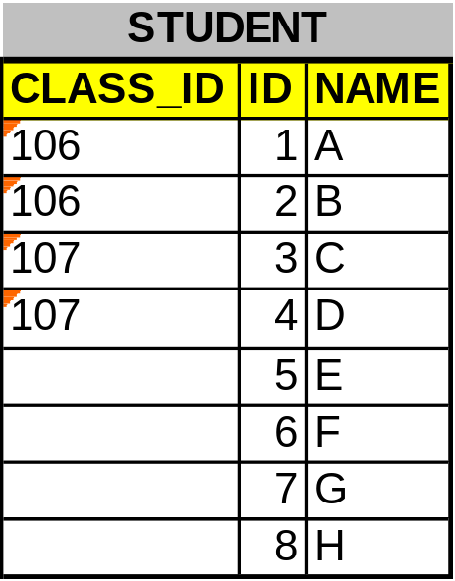
1 - Aggregate Functions OR Aggregate Operators
Group functions (or Aggregate Functions) operate on sets of rows to give one result per group. These sets may be the whole table or the table split into groups.
Exp: If we want all rows with the same CLASS_ID value will be groupped: GROUP BY class_id

Slide 5
1 - Aggregate Functions OR Aggregate Operators
AVG
COUNT
MAX
MIN
SUM
STDDEV
VARIANCE
AVG([distinct | ALL] column | expression)
COUNT({ * | [distinct | ALL] column | expression})
MAX([distinct | ALL] column | expression)
MIN([distinct | ALL] column | expression)
STDDEV([distinct | ALL] column | expression)
SUM([distinct | ALL] column | expression)
VARIANCE([distinct | ALL] column | expression)
DISTINCT makes the function consider only nonduplicate values;
ALL makes it consider every value including duplicates.
The default is ALL and therefore does not need to be specified.
All group functions ignore NULL values.

Slide 6


Example: AVG, SUM, MIN, MAX, COUNT

Slide 7

Example: Aggregate Functions and DISTINCT

Slide 8
2 - Grouping
Until now, all group functions (demonstrated in above examples) have treated the table as one large group of information.
Sometime you need to divide the table of information into smaller groups and calculate the aggregate functions for each group -> use GROUP BY clause
The keyword GROUP BY is followed by a list of grouping attributes.

Slide 9
2 - Grouping
Syntax: Divide rows in a table into smaller groups and calculate aggregate functions by using the GROUP BY clause.
SELECT column, aggregate_function (column)
FROM table
[WHERE conditions]
[GROUP BY grouping_attributes]
[ORDER BY {column [ASC | DESC] ,…} ]
grouping_attributes: specifies columns whose values determine the basis for grouping rows

Slide 10
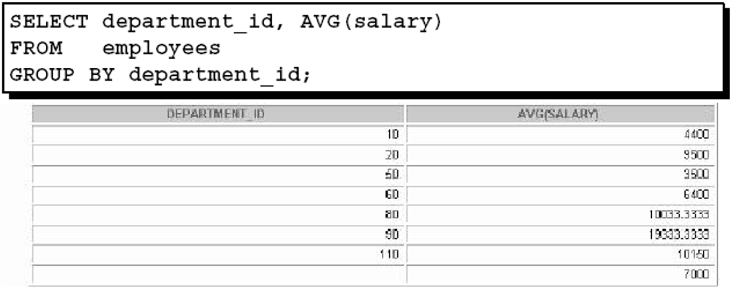
Example: Aggregate Functions and GROUP BY
Group function AVG(salary) is calculated for each group of rows having the same value for department_id (grouping attribute in this case)
All columns in the SELECT list that are not in group functions must be in the GROUP BY clause.

Slide 11
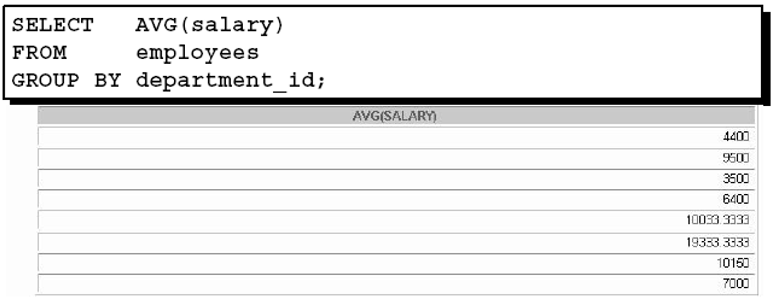
Example: Aggregate Functions and GROUP BY
Grouping column (e.g. department_id) does not always have to be in the SELECT list

Slide 12
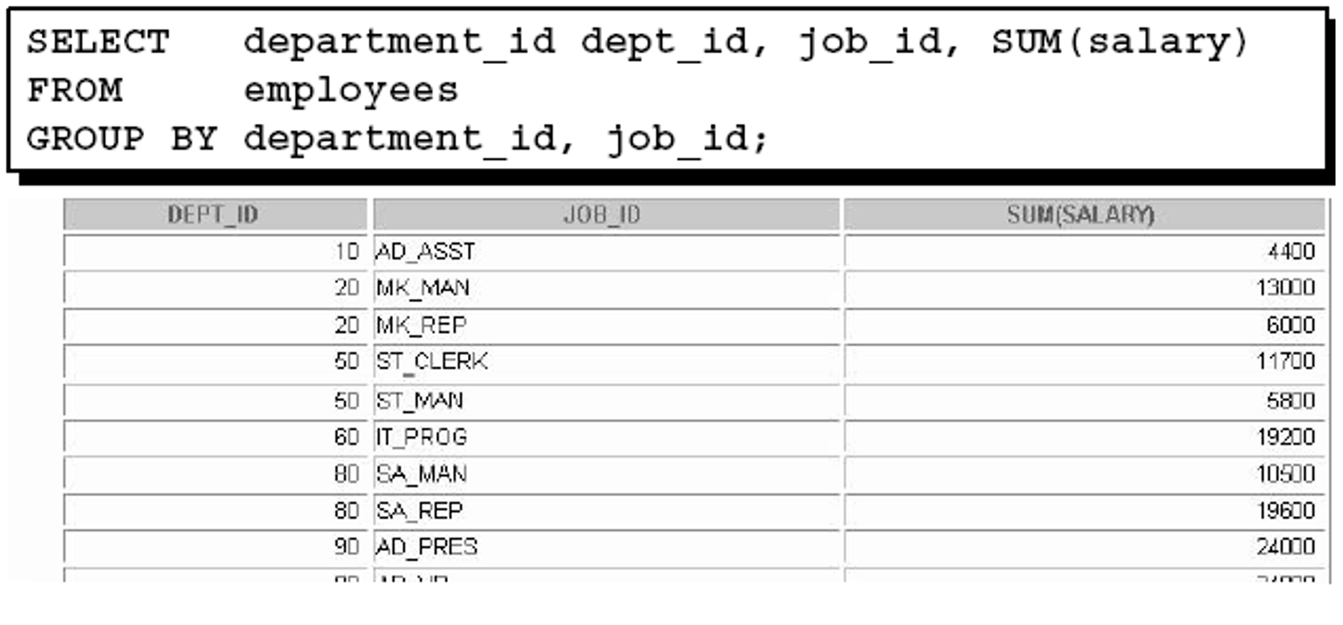
Example: Aggregate Functions and GROUP BY
GROUP BY clause can be use on multiple columns
The group function SUM(salary) is calculated for each group of the same department_id and job_id

Slide 13
2 – Grouping: rules to remember
SELECT column, aggregate_function (column)
FROM table
[WHERE conditions]
[GROUP BY grouping_attributes]
[ORDER BY {column [ASC | DESC] ,…} ]
When aggregate functions are used in a select list, the select list can contain only:
Aggregate functions.
Grouping columns from a GROUP BY clause.
An expression that returns the same value for every row in the result set, such as a constant

Slide 14
6.4.6 – Grouping, Aggregation, and NULLs
When tuples have nulls, there are a few rules we must remember:
  The value NULL is ignored in any aggregation: it does not contribute to a SUM, AVG or COUNT of an attribute, nor can it be the minimum or maximum in its column.
  Exp: COUNT(*) is always a count of the number of tuples in a relation; but COUNT(A) is the number of tuples with non-NULL values for attribute A
  On the other hand, NULL is treated as an ordinary value when forming groups: that is, we can have a group in which one or more of the grouping attributes are assigned the value NULL
  When we perform any aggregation except COUNT over an empty bag of values, the result is NULL (the COUNT of an empty bag is 0)

Slide 15
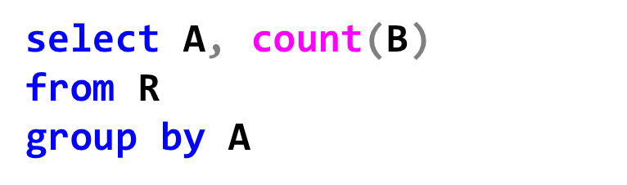
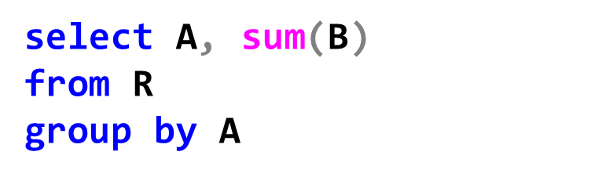
Example – Grouping, Aggregation, and NULLs
R
A | B
NULL | NULL
The result is one tuple (NULL,0)
The result is one tuple (NULL,NULL)

Slide 16
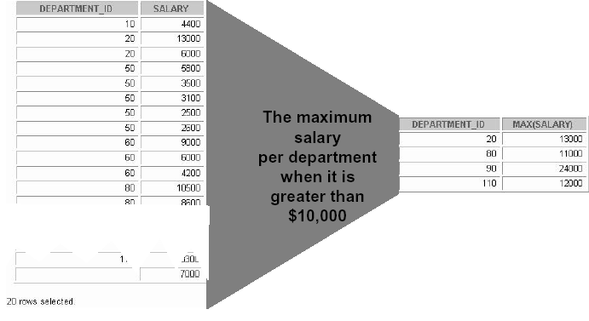
3 - HAVING clauses
Department with the maxmimum salary less than or equal to $10,000 like departments 10, 50, 60… are not shown
Sometimes, we want to exclude some groups from displaying result. The solution is using HAVING clause

Slide 17
3 - HAVING clauses
Syntax:
SELECT column, aggregate_function (column)
FROM table
[WHERE conditions]
[GROUP BY grouping_attributes]
[HAVING conditions]
[ORDER BY {column [ASC | DESC] ,…} ]
The WHERE clause is used to restrict the rows that you select
But the HAVING clause is used to restrict groups.

Slide 18
6.4.7 - HAVING clauses (page 288)
SELECT column, group_function (column)
FROM table
[WHERE conditions]
[GROUP BY group_by_expression]
[HAVING conditions]
[ORDER BY {column [ASC | DESC] ,…} ]
Groups are formed and group functions are calculated before the HAVING clause is applied to the groups.
In Oracle (not SQL Server), the HAVING clause can precede the GROUP BY clause, but it is recommended that you place the GROUP BY clause first because it is more logical.

Slide 19
3 - HAVING clauses
1
Select ROWS (with WHERE clause) first
2
ROWS are grouped (GROUP BY clause)
3
Groups matching the HAVING clause are
displayed

Slide 20
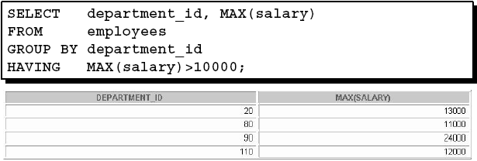
Example: HAVING
The example displays department numbers and maximum salaries for those departments whose maximum salary is greater than $10,000.

Slide 21
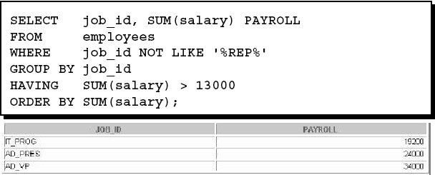
Example: HAVING
The example displays the job ID and total monthly salary for each job with a total payroll exceeding $13,000.

Slide 22
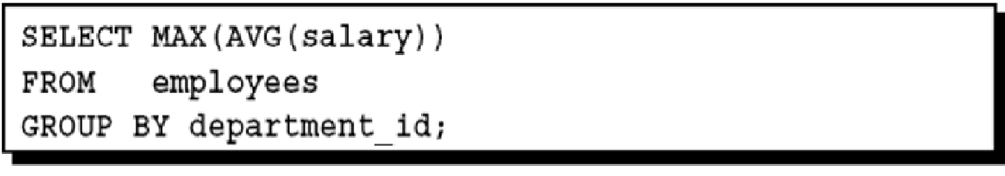
Example: HAVING
In SQL Server, we cannot perform an aggregate function on an expression containing an aggregate function or a subquery as in this example

Slide 23
Thank You !

