Slide 1
Neighborhoods in Los Angeles
Coursera/Capstone

Slide 2
Introduction
Exploring the neighborhood in Los Angeles to find the best location for establishing a business
Los Angeles has a huge population, poverty and in living condition vary significantly
Choosing a location for independent restaurants and café shops are the most crucial decision that have to be made
‘Is it better to have the café shop close to public transportation or within a grocery store that have lots of foot traffic ?
Should the café shop have to be near another café shop in order to attract more new customers?

Slide 3
Data acquisition and cleaning
A data from Census office on 2018 population/demographic data approximated from block groups to LA Neighborhood Councils will be used
Foursquare location data will be used in this project to identify local business and venues

Slide 4



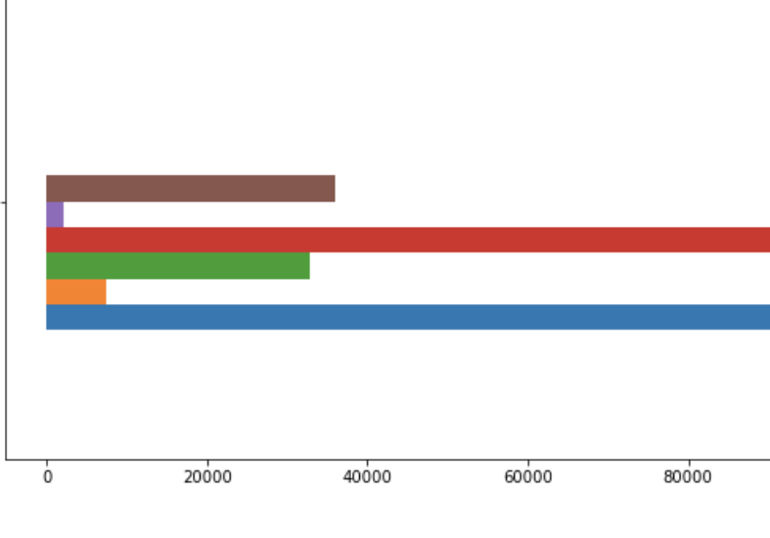
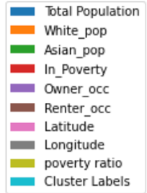
Relationship between neighborhood and population:
proportion of owner and renters have a very large gap
number one most common venue was Korean restaurant followed by coffee shop

Slide 5
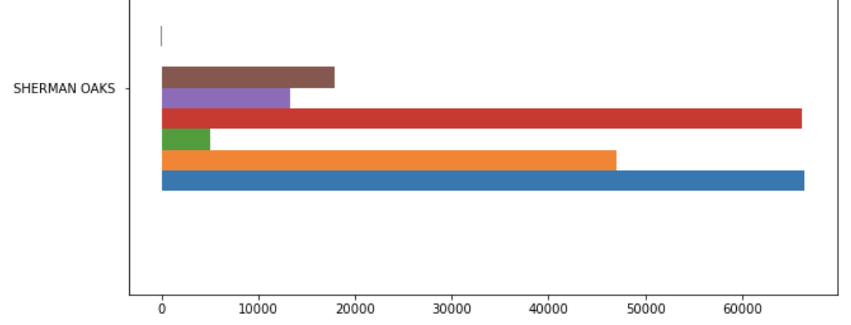
Proportion between renter and owners doesn’t have large difference like the previous one
The most common venue was Sushi Restaurants followed by fitness center.

Slide 6
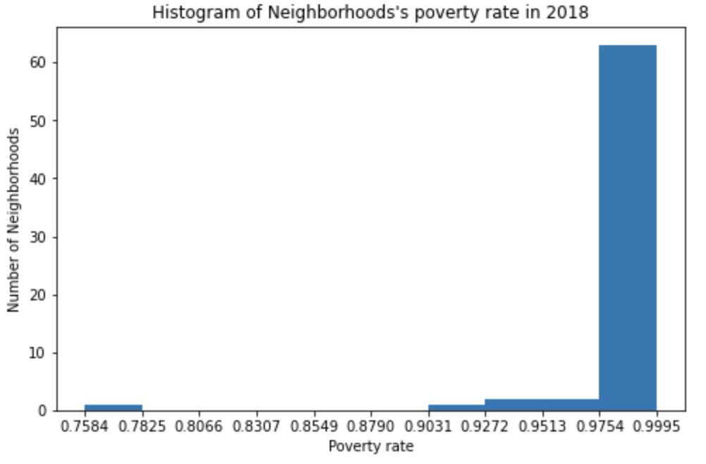
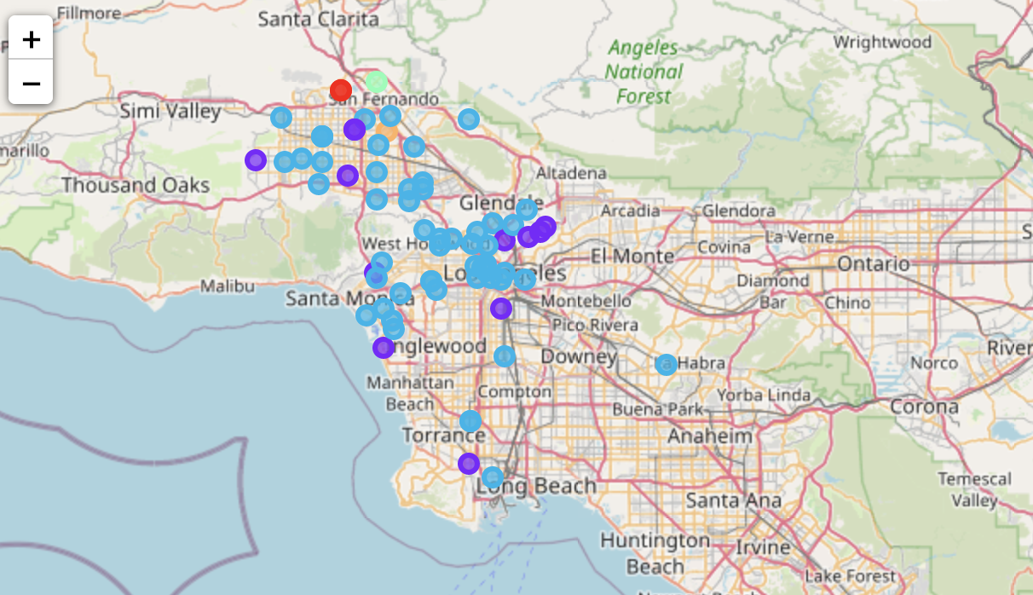
Result
z

Slide 7
Discussion
Establishing business in a crowded area can be not ideal for freshly starting business
Considering the amount of venues, the neighborhood, and the population rate choosing a medium range of neighborhood would be the best to start a new business in service.

Slide 8
Conclusion
In this study, I analyzed the relationship between neighborhood’s poverty rate and venue categories using data from Census 2018.
Few things were observed, such as the property ownership were higher in white ethnicity populated area, and the most renters were in Asian populated area.
High number in renters mean that the businesses are moving in or out from this neighborhood much more often than the area where businesses have their ownership

