Slide 1



PID and DMP Automated End to End Testing
Data as an Asset (DaaA)
14.10.19 / Kanwalmeet Singh / Draft 22.10.19 / Kanwalmeet Singh / version 1.1

Slide 2
Agenda
End to End Testing
Strategy
Testing Tool (Codeceptjs)
Testing Tool Architecture
Components Overview
Project Implementation
Testing Scenarios
Technical Overview
Automated E2E
Challenges Faced and Future Enhancements

Slide 3




End to End Testing
End-to-end testing is a technique used to test whether the flow of an application right from start to finish is behaving as expected.
The purpose of performing end-to-end testing is to identify system dependencies and to ensure that the data integrity is maintained between various system components and systems.

Slide 4
Strategy
PID – It is an Independent system with APIs that can be used to capture new PID entries
DMP – It depends search Requests using Elastic Search
Nightly Integration Test Job – A Linux service is setup which will automatically invoke the test scripts once every 24 hours and send alerts to the team in case of failures.
Prerequisites
To Test PID scenarios – DMP must be available
To Test DMP scenarios – PID must be available
Notes:
Pre-requisites
To test PID, DMP should be available: No. Because PID publishes data to MessageQueue (RabbitMQ). To test DMP, PID should be available: No. Same DMP subscribes to MessageQueue.

Slide 5
Strategy
Integration Testing (PID+DMP)
Pros:
Faster Build Duration
Independent development of PID/DMP possible
Cons:
Mocking is Time consuming
Failed Integration might not be highlighted immediately
Notes:
Pre-requisites
To test PID, DMP should be available: No. Because PID publishes data to MessageQueue (RabbitMQ). To test DMP, PID should be available: No. Same DMP subscribes to MessageQueue.

Slide 6
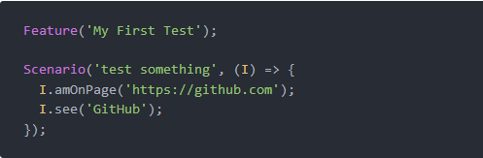
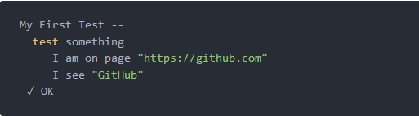
Testing Tool - Overview
CodeceptJS – JavaScript based modern end to end testing framework
Test is written as a linear scenario of user's action on a site
Test described as Scenario function with I object (actor).
Notes:
special BDD-style syntax. The test is written as a linear scenario of user's action on a site.

Slide 7
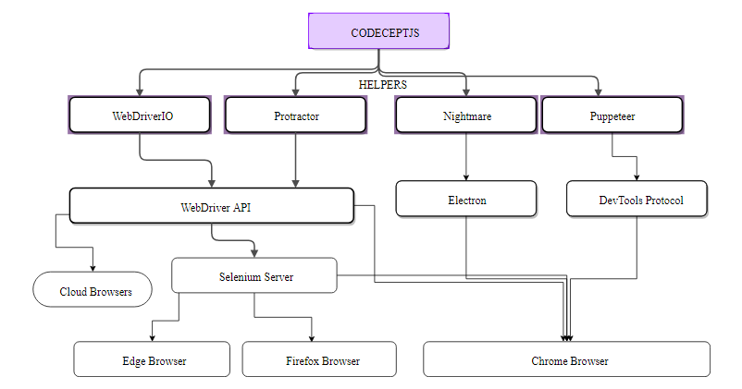
Testing Tool – Architecture
CodeceptJS uses various helpers to execute test scripts.
Puppeteer is a Node library which provides a high-level API to control Chrome or Chromium over the DevTools Protocol. Puppeteer runs headless by default.
Salient Features:
Readability
Test Engine Agnostic
Headless Chrome (CI execution)
Notes:
Test Engine Agnostic: Although we would be using CodeceptJS but still it would run on Puppeteer. In future if Puppeteer does not fulfils our needs then it easy to migrate to some other test engine like Protractor.
-Headless Chrome (CI execution): Puppeteer is developed by Google to provide headless Chromium testing. In contrast Protractor, which does not support headless.

Slide 8
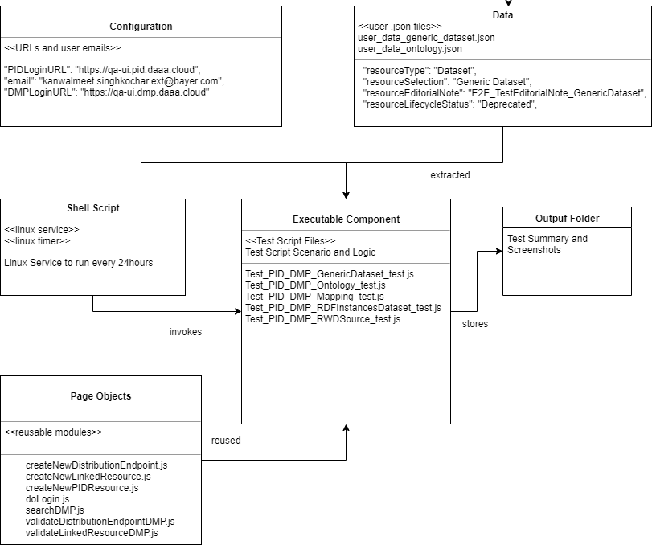
Components Overview
Executable – Main executable component which tests particular functionality.
Configuration: Consists of URLs of environments to be tested.
Data: Testing data is stored as .json files in this component.
Page Objects: Reusable objects that perform PID/DMP functions such as Login, Creating/Searching/Validating Resource etc.
Output: Screenshots repository for failed test cases.
Shell Script/Service: Linux service which will invoke shell scripts to kick-off the test cases.

Slide 9
Project Implementation
Testing Scenarios
Process overview for PID and DMP
Automated E2E

Slide 10
Project Repository Introduction
Gitlab Repo - DaaA / PID / End to End tests
Structure
Folder | Content
config | Basic configuration for test cases
data | Data definition to be used within the test cases (user data .json files)
docs | Documentation of this project
pages | Sub test scripts / Single page use cases (modules)
scripts | Main test scripts / Starting points
utils | Utility classes/methods to be used
Notes:
The main test scripts are based on the test case definition file which is located inside the docs folder. This document defines test cases on the 'Overview' tab and goes into details on one tab for each test case. There also the single scenarios are listed which are used in the main scripts. The main scripts will be available in the scripts folder - one for each test case.

Slide 11
Testing Scenarios
 | Scenario | Resource Elaboration
PID | Create Resource. | - Mathematical Model - RWD Source - Generic Dataset - RDF Dataset with Instances - Ontology - Mapping
 | Create Resource with Linked Resources.
 | Create Resource with Distribution Endpoints.
DMP | Search Resource and Validate | - Mathematical Model - RWD Source - Generic Dataset - RDF Dataset with Instances - Ontology - Mapping
 | Validate Distribution Endpoints
 | Validate Linked Resources
 | Validate Country Data/Therapeutic Area/Dimension/Mathematical Model Category/Base URI

Slide 12
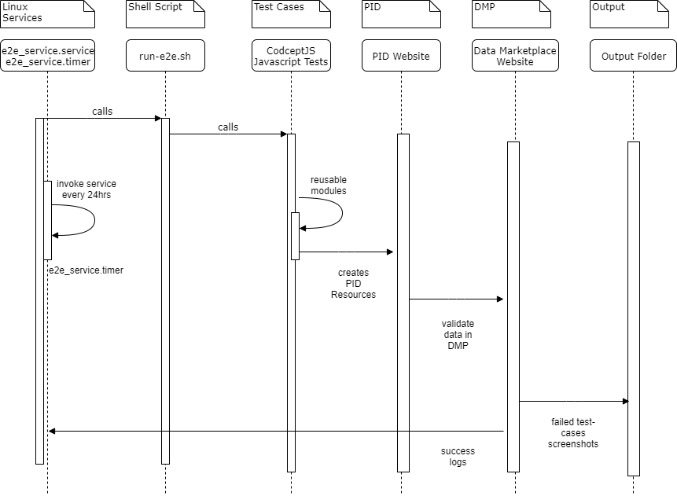
Process overview for PID and DMP
Create Linux service and timer (every 24 hours)
Service invokes the shell script which has the execution commands for Test Cases.
Test cases execute to create and publish resources in PID and validate the created resources in DMP in QA environment.
In case of failure, the screenshots are stored in output folder
Success logs can be extracted from the service journals
Notes:
[Unit]
Description=A job to run automated e2e scripts
[Service]
Type=simple
WorkingDirectory=/app/e2e
ExecStart=/app/e2e/run-e2e.sh
StandardOutput=syslog
StandardError=syslog
[Install]
WantedBy=default.target

Slide 13
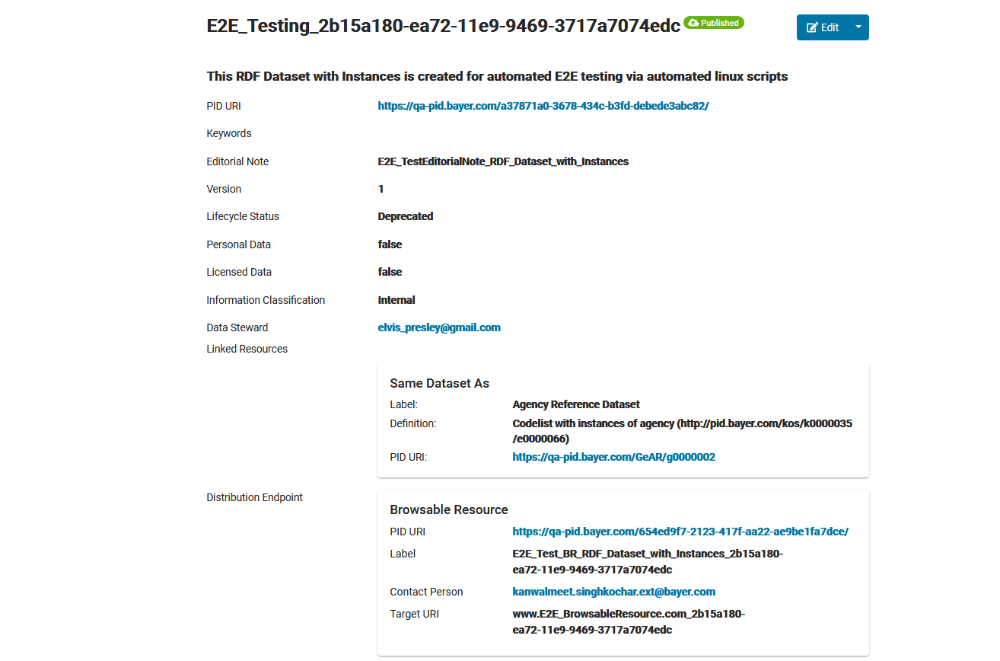
Automated E2E - PID
Resources are created and published with Unique GUID in QA environment.
Resources created with Linked Resources and Distribution endpoints.

Slide 14
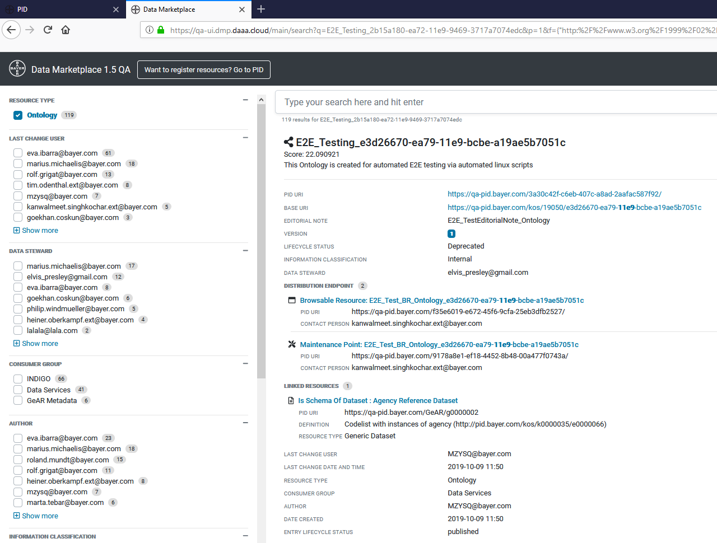
Automated E2E - DMP
Created and published resources validated in DMP QA environment.
Easy to understand log files:-
validateDistributionEndpointDMPPage: validateDistributionEndpointDMP I see "Browsable Resource: E2E_Test_BR_Ontology“ I see "Maintenance Point: E2E_Test_BR_Ontology“ I see "LINKED RESOURCES“ I click "//*[text()='Linked Resources']“ validateLinkedResourceDMPPage: validateLinkedResourceDMP I see "Is Schema Of Dataset : Agency Reference Dataset“ ✔ OK in 46354ms

Slide 15
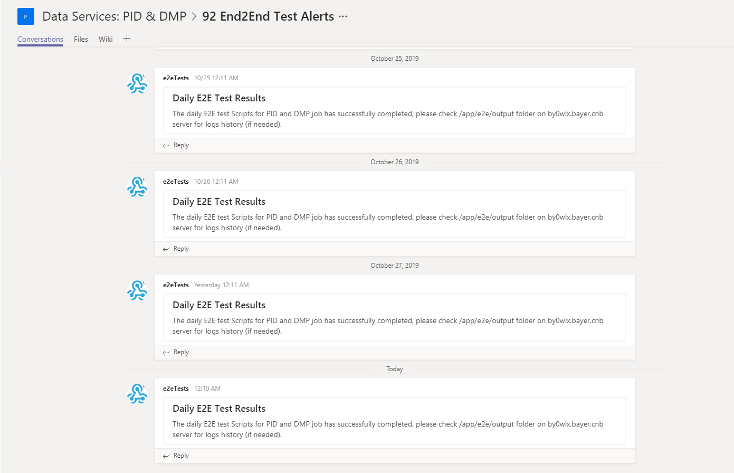
Automated E2E - Usage
The daily job sends alerts to the Microsoft Teams ‘End 2 End Test Alert’ Groups regarding test status.
The results can be consumed as .txt log files and .png screenshots from Linux server repository (/app/e2e/output)
The testing scripts can also be run adhoc as a npm command.

Slide 16
Challenges Faced & Future Enhancements

Slide 17
Challenges Faced
Frontend coding is required for encapsulating IDs and Names for some of the HTML classes.
Multi-factor authentication needed for Bayer Gitlab Runners thus test cases couldn’t be automated through the CI-CD*
Setting up of headless CodceptJS/Chromium on Bayer 7.6 Red Hat Linux Server.

Slide 18
Future Enhancements
Keeping test scripts logic up-to date as per the changes in PID/DMP after every Sprint
Setting up Automated Test Jobs to delete/purge test resources.
Running the scripts through Gitlab CI/CD once the security issue is resolved by Bayer Infrastructure Team.
Creating Notifications/Alerts on failures and allowing users to extract Test scripts logs through Microsoft Teams.

Slide 19

Thank you!

