Slide 1

Scalable Paraellel Downsampler Modeling Algorithm
DSAA Global Embedded TA
Dr. Calvin Chan
June 2021

Slide 2




Conceptual Problem Definition
Overview
Regression problem with output at a lower non-uniform resolution at the input space (e.g. y₁ contributed by x₁ to x₅, and y₂ contributed x₅ to x₇)
Input dataset
Samples are grouped into cluster, where each cluster produce an aggregated output for the cluster
Samples are divided into subgroup, each subgroup has a different model
Output dataset
Cluster output is given as: Aggregated sum of model output with input from within the same cluster
Output must be positive value
X
One-to-Many
Y
Sample ID
Cluster ID
Sample Features
Subgroup OHE ID
Cluster ID
Aggregated
Output
Problem:
Output at lower non-uniform resolution (different number of samples at each cluster)
X_{feature}
S
Notes:
s

Slide 3

Mathematical Problem Definition: Bottom-Up Approach
Neural Network Forward Downsampling Architecture
Cluster Sample 1
Output must be positive, therefore ReLU activation
Important Remarks
This algorithm made no assumptions on data relationship!
The number of network input samples is different for each cluster.
The network parameters of each subblock is the same.
Output of final output must use a ReLU as activation function to ensure a positive value.
Although the network visually looks very large, but the non-linear model block is redundant. Very few parameters are required.
Non-Linear Model Block
Non-Linear Model Block
Similar to mini-batch but the batch size varies with respect to the number of samples in each cluster
∑
Cluster 2
=
Block Sample 2
…
…
…
Non-Linear Model Block
Cluster Sample 2
Non-Linear Model Block
Non-Linear Model Block
∑
…
…
…
Non-Linear Model Block
Each cluster sample has a different number of samples
Each subblock with same parameters
…

Slide 4
Mathematical Problem Definition: Bottom-Up Approach
Neural Network Forward Downsampling Architecture Varying Batch Training
Stochastic Gradient Descent
Uses 1 sample at a time iteratively optimize the model parameters at each iteration.
Forward Downsampling Varying Batch Training
Model parameters are adjusted with batch gradient descent within the brick (average gradient) and stochastic gradient descent across the brick.
Non-Linear Model Block
Closter
Sample 1
Non-Linear Model Block
Non-Linear Model Block
∑
Batch Gradient Descent
Uses all samples at once iteratively optimize the model parameters
…
…
…
Similar to mini-batch but the batch size varies with respect to the number of sample in each cluster
Non-Linear Model Block
All model blocks share the same parameters (weights)
Non-Linear Model Block
Non-Linear Model Block
Cluster
Sample 2
Non-Linear Model lock
Non-Linear Model Block
∑
Optimization Gradient (parameter adjustment) are average over all samples
…
…
…
…
…
…
Non-Linear Model Block
Non-Linear Model Block

Slide 5
Parallel Branch Expansion
Neural Network Forward Downsampling Architecture
Cluster Sample 1
Non-Linear Model Block
Non-Linear Model Block
∑
All Parallel Branches shares the same parameters
…
…
…
Non-Linear Model Block
Parallel Branch
∑
∑
…
∑
ReLU
ReLU
ReLU
∑
∑
…
∑
∑
ReLU
ReLU
ReLU
ReLU
…
…
…
…
…
…
…
∑
∑
…
∑
ReLU
ReLU
ReLU
Layer 1
Layer 2
Layer J
Output Layer

Slide 6
Adding Multi-submodels with respect to Subgroup
Neural Network Forward Downsampling Architecture with Multiple Subgroup Submodels
Subgroup Parallel Branch
∑
∑
…
∑
ReLU
ReLU
ReLU
∑
∑
…
∑
∑
ReLU
ReLU
ReLU
ReLU
Switch
…
…
…
…
…
…
…
∑
∑
…
∑
ReLU
ReLU
ReLU
∑
∑
∑
…
∑
Separate segments into submodels to accommodate differences between subgroups
ReLU
ReLU
ReLU
∑
∑
…
∑
∑
ReLU
ReLU
ReLU
ReLU
Switch
Each sample can only activate training of its corresponding subgroup branch
…
…
…
…
…
…
∑
∑
…
∑
ReLU
ReLU
ReLU

Slide 7
Architectural Definition: Bottom-Up Approach
Data Dimension Visualization
(Sample ID, Subgroup)
Feature
Processing only done within feature space, Sample and Subgroup dimension remains parallel
Sample ID
Subgroup
Subgroup
Sample ID
Subgroup
Sample ID
Feature

Slide 8
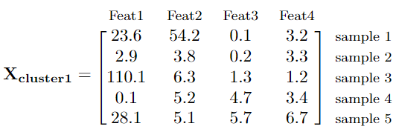
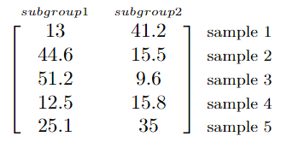
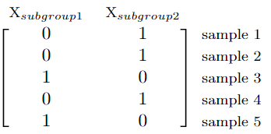




Architectural Definition: Bottom-Up Approach
Data Dimension Visualization
Sample ID
Subgroup 1 Model
x
Sample ID
Subgroup 2 Model
Note that the input sample dimension for each cluster is different, to perform Batch Gradient Decent at brick resolution, it requires to patch ZERO on X_{cluster} and X_{subgroup}
Sample ID
Subgroup 1 Model
x
Sample ID
Subgroup 2 Model

Slide 9
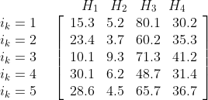
Data Splitting Strategy
Training, Validation and Testing
80%
20%
Modeling = Train + Validation
Test
Model can be further improved later by determining the % of subgroup of X for each Y and sample each fold by balancing number of samples in each subgroup.
K-Fold Training for all Hyperparameter Sets
Hyperparameter Set
Train
Train
Train
Train
Validation
Train
Train
Train
Validation
Train
K-Fold Data Set
Train
Train
Validation
Train
Train
Train
Validation
Train
Train
Train
RMSE will be evaluated for each model, the hyperparameter set will be selected based on mean and variance of the RMSE across k-folds
Validation
Train
Train
Train
Train
Model using Selected Hyperparameter Set
Train
Test
Accuracy Metric

Slide 10


Hyperparameter Tuning Strategy
Neural Network Forward Downsampling Architecture
Parameters in model
Number of layers and number of neurons
Learning rate
Type of output activation function (not yet implemented)
Use progressive sampling by optimizing at 3 different levels:
total neuron (underfitting/overfitting) → neuron per segment (submodel complexity) → neuron per layer (optimal model)
This could be sub-optimal, but provide a fair model comparison with the same number of neurons
The architecture varies by the number of layers in every branch and the number of neurons in each layer.
For fair comparison, the number of neuron is fixed and the statistics can be computed distribution for each recursive selection layer.
Neuron Layer Parameter Sampling
Number of neuron per segment branch
Overall Complexity
# Segments = # Submodels
Number of neuron per layer for each segment branch

Slide 11
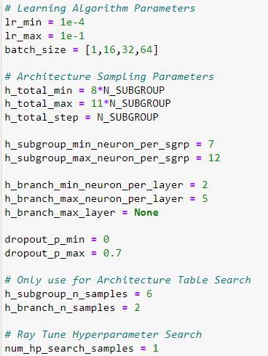
Getting Started
X
Sample ID
Cluster ID
Sample Features
Subgroup OHD ID
How to run it?
3 Types of Inputs are required:
Data Requirement
X: {Cluster ID, Features, Subgroups}
Y: {Cluster ID, Aggregated Output}
Hyperparameter Parameters Search Space
Learning rate range to be sampled
Batch size for zero-filled BGD
Neural Network Architecture sampling parameters
Hyperparameter Tunning Samples
X_{feature}
S
Y
Cluster ID
Aggregated
Output

Slide 12
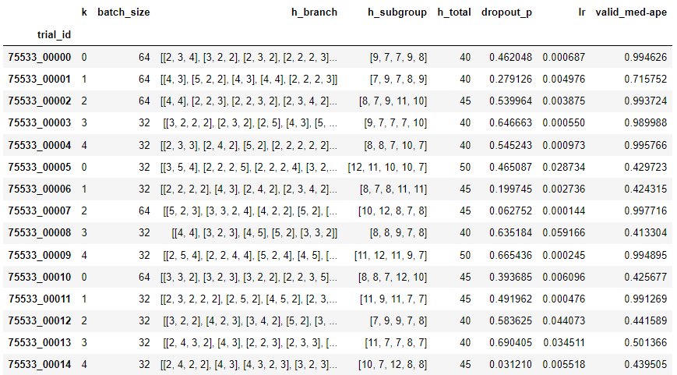
Architecture Hyperparameters and Results Table
Table Sample
Result Ready for Statistical Comparison with respect to parameters and K-Fold

Slide 13
Error Measurement
Sampling Definition
A total of 240 model was built using 250 sets of Hyperparameter to generate the following results
Training Samples Error
1 Epoch
Training Iteration
Models:
Error measurement was done using last 1/10 of the moment on the last 1/10 of training data within the epoch
Data:
Validation Samples Error
1 Epoch
Training Iteration
Models:
Latest model on the entire set of validation data
Data:

Slide 14
Preliminary Results
CSPD Deep Learning Workflow

Slide 15
Conversion Text
HCP - SAMPLE
BRICK - CLUSTER
SEGMENT - SUBGROUP
brick_id - cluster_id
Segmentation - Subgrouping
segmentation - subgrouping
segment - subgroup
seg - sgrp
brick - cluster
potential – y_out

