Slide 1

Constraining the symmetry energy with heavy-ion collisions and Bayesian analysis
Chun Yuen Tsang

Slide 2
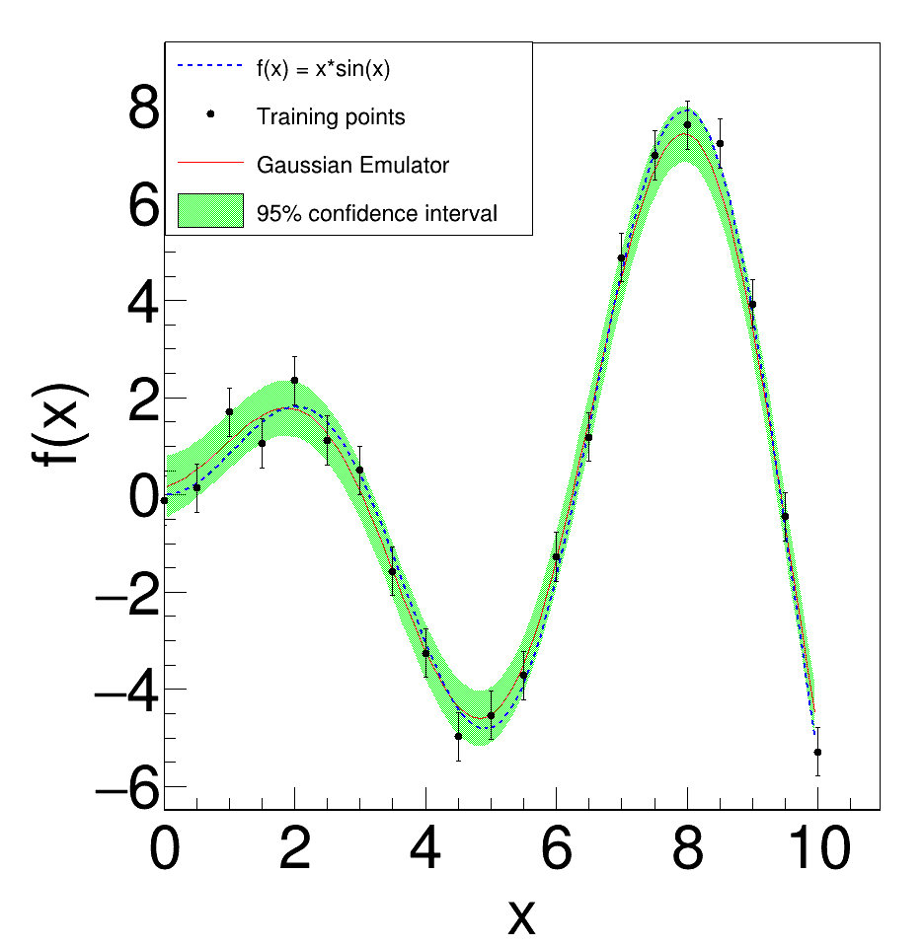
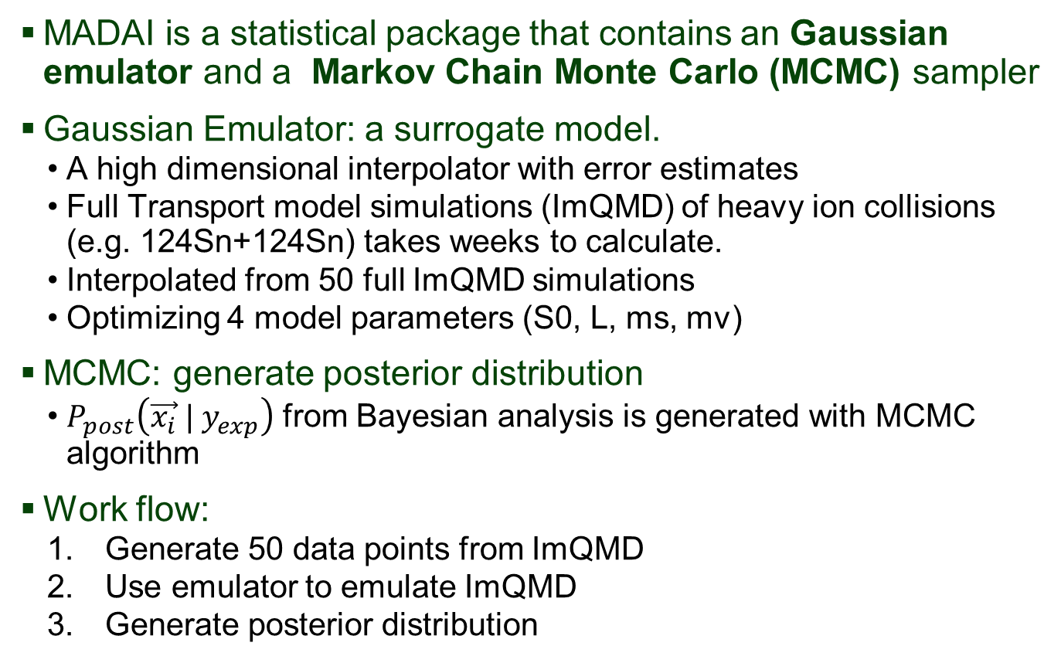
Models and Data Analysis Initiative (MADAI)
MADAI is a statistical package that contains an Gaussian emulator and a Markov Chain Monte Carlo (MCMC) sampler
Gaussian Emulator: a surrogate model.
A high dimensional interpolator with error estimates
Full Transport model simulations (ImQMD) of heavy ion collisions (e.g. 124Sn+124Sn) takes weeks to calculate.
Interpolated from 50 full ImQMD simulations
Optimizing 4 model parameters (S0, L, ms, mv)
MCMC: generate posterior distribution
$P_{post}\left(\vec{x_{i}} | y_{exp}\right)$ from Bayesian analysis is generated with MCMC algorithm
Work flow:
Generate 50 data points from ImQMD
Use emulator to emulate ImQMD
Generate posterior distribution
Demonstration of using a Gaussian emulator with 1D data points

Slide 3

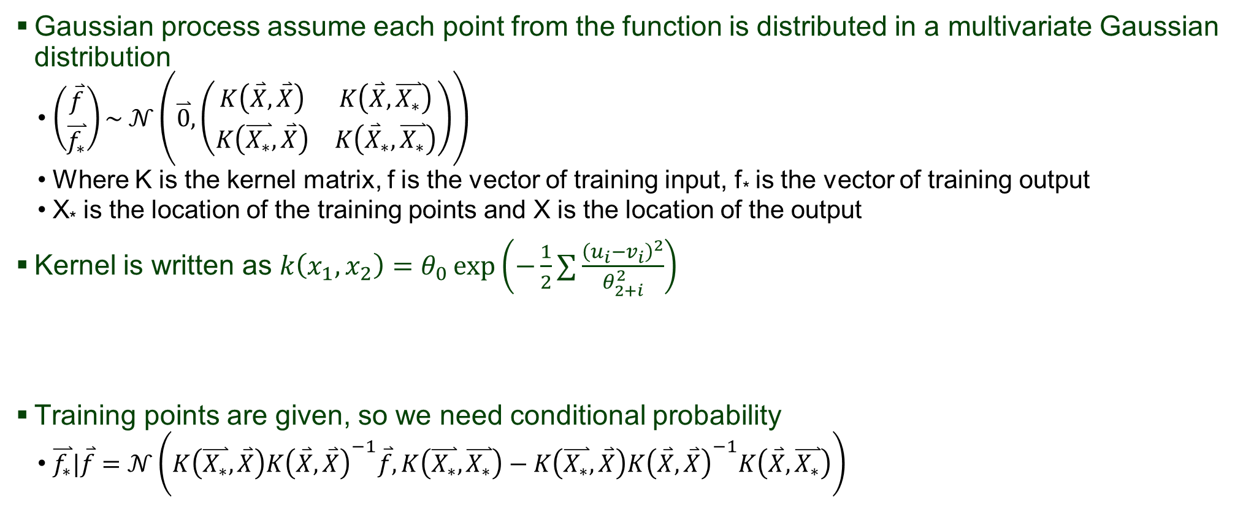
Gaussian process
Gaussian process assume each point from the function is distributed in a multivariate Gaussian distribution
$\left(\begin{matrix}\overset{⃑}{f} \\ \overset{⃑}{f_{∗}}\end{matrix}\right)\sim 𝒩\left(\overset{⃑}{0}, \left(\begin{matrix}K\left(\overset{⃑}{X}, \overset{⃑}{X}\right) & K\left(\overset{⃑}{X}, \overset{⃑}{X_{∗}}\right) \\ K\left(\overset{⃑}{X_{∗}}, \overset{⃑}{X}\right) & K\left({\overset{⃑}{X}}_{∗}, \overset{⃑}{X_{∗}}\right)\end{matrix}\right)\right)$
Where K is the kernel matrix, f is the vector of training input, f* is the vector of training output
X* is the location of the training points and X is the location of the output
Kernel is written as $k\left(x_{1},x_{2}\right)=θ_{0}\exp\left(−\frac{1}{2}∑\frac{{\left(u_{i}−v_{i}\right)}^{2}}{θ_{2+i}^{2}}\right)$
Training points are given, so we need conditional probability
$\overset{⃑}{f_{∗}}|\overset{⃑}{f}=𝒩\left(K\left(\overset{⃑}{X_{∗}}, \overset{⃑}{X}\right)K{\left(\overset{⃑}{X}, \overset{⃑}{X}\right)}^{−1}\overset{⃑}{f},K\left(\overset{⃑}{X_{∗}}, \overset{⃑}{X_{∗}}\right)−K\left(\overset{⃑}{X_{∗}}, \overset{⃑}{X}\right)K{\left(\overset{⃑}{X}, \overset{⃑}{X}\right)}^{−1}K\left(\overset{⃑}{X}, \overset{⃑}{X_{∗}}\right)\right)$
Notation:
$\overset{⃑}{f}$ = training points
$\overset{⃑}{f_{∗}}$= emulator output
$\overset{⃑}{X}$= training points parameters
$\overset{⃑}{X_{∗}}$= parameters where predications are made
Amplitude
Scale

Slide 4
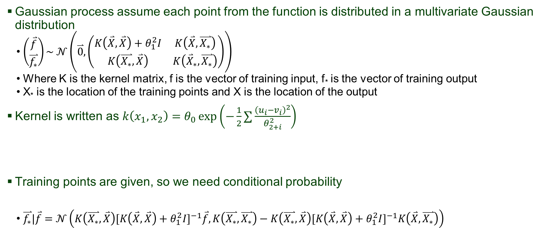
Gaussian process (noisy input)
Gaussian process assume each point from the function is distributed in a multivariate Gaussian distribution
$\left(\begin{matrix}\overset{⃑}{f} \\ \overset{⃑}{f_{∗}}\end{matrix}\right)\sim 𝒩\left(\overset{⃑}{0}, \left(\begin{matrix}K\left(\overset{⃑}{X}, \overset{⃑}{X}\right)+θ_{1}^{2}I & K\left(\overset{⃑}{X}, \overset{⃑}{X_{∗}}\right) \\ K\left(\overset{⃑}{X_{∗}}, \overset{⃑}{X}\right) & K\left({\overset{⃑}{X}}_{∗}, \overset{⃑}{X_{∗}}\right)\end{matrix}\right)\right)$
Where K is the kernel matrix, f is the vector of training input, f* is the vector of training output
X* is the location of the training points and X is the location of the output
Kernel is written as $k\left(x_{1},x_{2}\right)=θ_{0}\exp\left(−\frac{1}{2}∑\frac{{\left(u_{i}−v_{i}\right)}^{2}}{θ_{2+i}^{2}}\right)$
Training points are given, so we need conditional probability
$\overset{⃑}{f_{∗}}|\overset{⃑}{f}=𝒩\left(K\left(\overset{⃑}{X_{∗}}, \overset{⃑}{X}\right)[K{\left(\overset{⃑}{X}, \overset{⃑}{X}\right)+θ_{1}^{2}I]}^{−1}\overset{⃑}{f},K\left(\overset{⃑}{X_{∗}}, \overset{⃑}{X_{∗}}\right)−K\left(\overset{⃑}{X_{∗}}, \overset{⃑}{X}\right)[K{\left(\overset{⃑}{X}, \overset{⃑}{X}\right)+θ_{1}^{2}I]}^{−1}K\left(\overset{⃑}{X}, \overset{⃑}{X_{∗}}\right)\right)$
Nugget
Notation:
$\overset{⃑}{f}$ = training points
$\overset{⃑}{f_{∗}}$= emulator output
$\overset{⃑}{X}$= training points parameters
$\overset{⃑}{X_{∗}}$= parameters where predications are made
Amplitude
Scale

Slide 5
Short summary (so far)
Gaussian process assume each point from the function is distributed in a multivariate Gaussian distribution
$\left(\begin{matrix}\overset{⃑}{f} \\ \overset{⃑}{f_{∗}}\end{matrix}\right)\sim 𝒩\left(\overset{⃑}{0}, \left(\begin{matrix}K\left(\overset{⃑}{X}, \overset{⃑}{X}\right)+θ_{1}^{2}I & K\left(\overset{⃑}{X}, \overset{⃑}{X_{∗}}\right) \\ K\left(\overset{⃑}{X_{∗}}, \overset{⃑}{X}\right) & K\left({\overset{⃑}{X}}_{∗}, \overset{⃑}{X_{∗}}\right)\end{matrix}\right)\right)$
Where K is the kernel matrix, f is the vector of training input, f* is the vector of training output
X* is the location of the training points and X is the location of the output
Kernel is written as $k\left(x_{1},x_{2}\right)=θ_{0}\exp\left(−\frac{1}{2}∑\frac{{\left(u_{i}−v_{i}\right)}^{2}}{θ_{2+i}^{2}}\right)$
Training points are given, so we need conditional probability
$\overset{⃑}{f_{∗}}|\overset{⃑}{f}=𝒩\left(K\left(\overset{⃑}{X_{∗}}, \overset{⃑}{X}\right)[K{\left(\overset{⃑}{X}, \overset{⃑}{X}\right)+θ_{1}^{2}I]}^{−1}\overset{⃑}{f},K\left(\overset{⃑}{X_{∗}}, \overset{⃑}{X_{∗}}\right)−K\left(\overset{⃑}{X_{∗}}, \overset{⃑}{X}\right)[K{\left(\overset{⃑}{X}, \overset{⃑}{X}\right)+θ_{1}^{2}I]}^{−1}K\left(\overset{⃑}{X}, \overset{⃑}{X_{∗}}\right)\right)$
Nugget
2 hyperparameters scale and nugget will affect how the model is interpolated
Main Question: How to decide which values to use?
Notation:
$\overset{⃑}{f}$ = training points
$\overset{⃑}{f_{∗}}$= emulator output
$\overset{⃑}{X}$= training points parameters
$\overset{⃑}{X_{∗}}$= parameters where predications are made
Amplitude
Scale

Slide 6
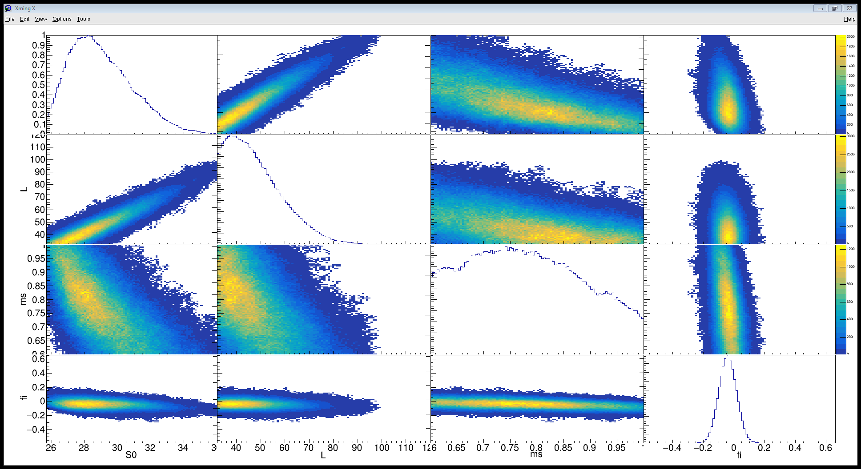
Correlation with all default values Scale = 0.001, nugget = 0.01
Sn+Sn
E=120 MeV
n/p and DR data set
Model Parameters: S0, L, ms, mv
_{S0}
_{L}
_{mv}
_{fi}
_{S0}
_{L}
_{mv}
_{fi}

Slide 7
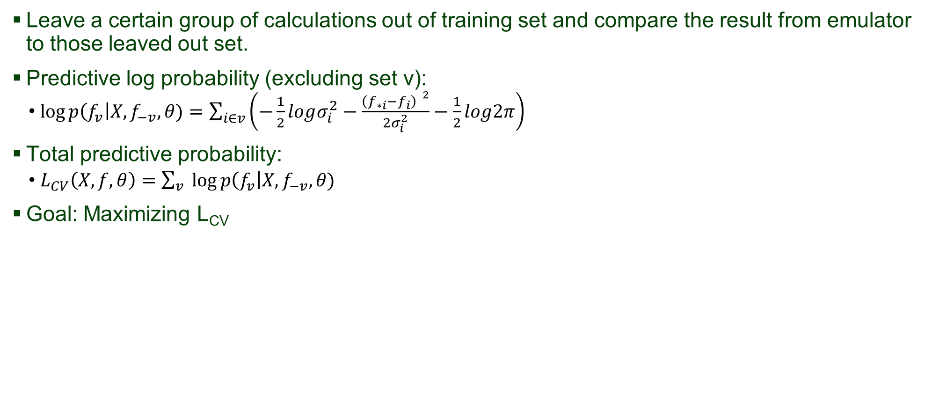
Cross validation
Leave a certain group of calculations out of training set and compare the result from emulator to those leaved out set.
Predictive log probability (excluding set v):
$\log{p\left(f_{v}\right|X, f_{−v},θ)}=\sum_{i∈v}{\left(−\frac{1}{2}logσ_{i}^{2}−\frac{{\left(f_{∗i}−f_{i}\right) }^{2}}{2σ_{i}^{2}}−\frac{1}{2}log2π\right)}$
Total predictive probability:
$L_{CV}\left(X,f,θ\right)=\sum_{v}{\log{p\left(f_{v}\right|X, f_{−v},θ)}}$
Goal: Maximizing L_{CV}

Slide 8
Segregate training data for cross validation
Testing sets: Sets that are NEVER involved in training
i.e. Emulator is oblivious to the testing sets
Goal: Test the accuracy of the emulator’s prediction
Goal: Test if the emulator overfit the training data
Validation sets: will be left out sequentially and compare emulator’s result and validation sets
Groups of 5 sets will be left out each time
Repeat until every single run in the validation set will be left out at lease once
Ask emulator to extrapolate to where the 5 sets are supposed to be
Sum up the log likelihood of those 5 sets given emulator output
5 sets of simulations will be taken out
Train emulator with the remaining sets
Put the taken out sets back in and choose another 5 sets
All runs have been left out at least once?
No?
Output total log likelihood
Yes?

Slide 9
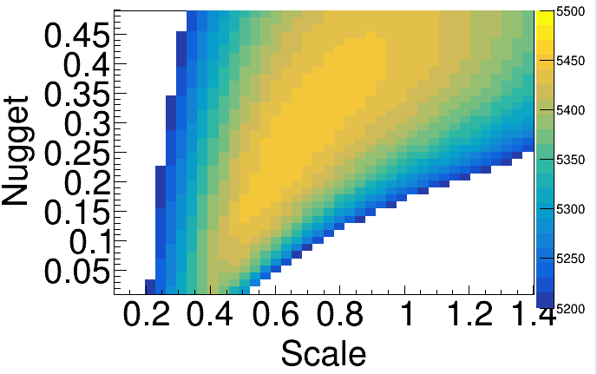
Segregate training data for cross validation
What we have : 49 ImQMD full simulation sets.
Segregation of data:
Testing sets: set 1 – 5
Validation sets: any 5 sets from set 6 – 49
Log likelihood from all validation sets (set 6 – 49) is shown
Predicted highest likelihood is located at:
scale = 0.633,
nugget = 0.248

Slide 10
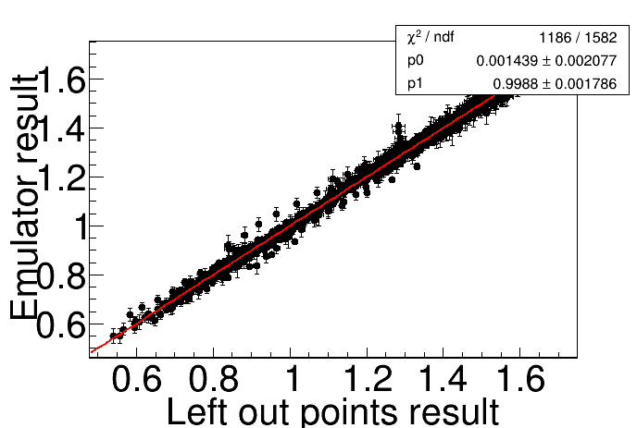
Emulator vs left out training points
After optimization
Scale = 0.633
Nugget = 0.248
Reduced chi-square
(Arguably) intercept is closer to 0 and slope is closer to 1
Default value (before optimization)
Scale = 0.01
Nugget = 0.001

Slide 11
Log likelihood of testing set
Gradient descent into the max. log likelihood with validation sets
Plot testing sets log likelihood
Caution:
testing sets was not involved in the validation sets log likelihood!
If overfit, testing sets log likelihood may decrease even when validation sets log likelihood decreases.

Slide 12
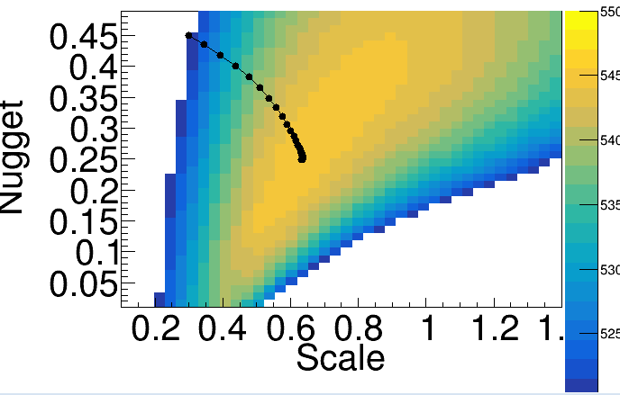
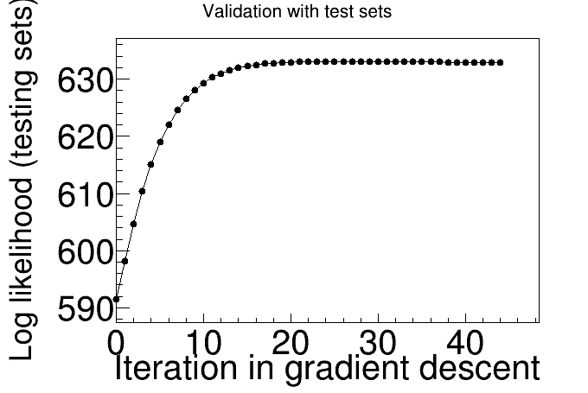
Log likelihood of testing set
Gradient descent into the max. log likelihood with validation sets
Plot testing sets log likelihood
Caution:
testing sets was not involved in the validation sets log likelihood!
If overfit, testing sets log likelihood may decrease even when validation sets log likelihood decreases.

Slide 13
Log likelihood of testing set
Gradient descent into the max. log likelihood with validation sets
Plot testing sets log likelihood
Caution:
testing sets was not involved in the validation sets log likelihood!
If overfit, testing sets log likelihood may decrease even when validation sets log likelihood decreases.
HOWEVER

Slide 14
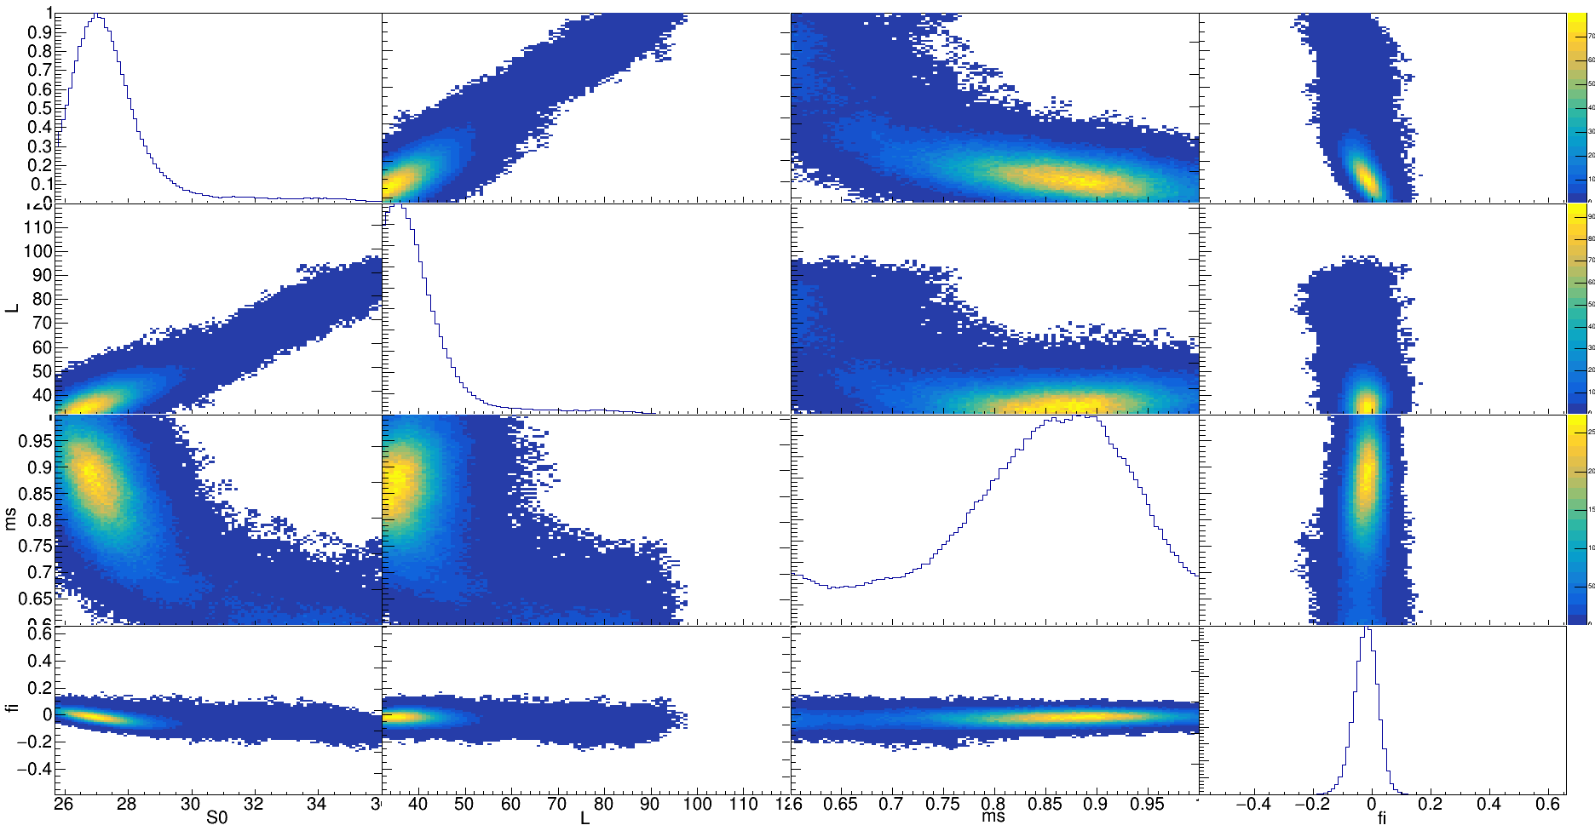
New Correlations Scale = 0.91, nugget = 0.14
_{S0}
_{L}
_{mv}
_{fi}
_{S0}
_{L}
_{mv}
_{fi}

Slide 15
Correlation with all default values Scale = 0.001, nugget = 0.01
Sn+Sn
E=120 MeV
n/p and DR data set
Model Parameters: S0, L, ms, mv
_{S0}
_{L}
_{mv}
_{fi}
_{S0}
_{L}
_{mv}
_{fi}

Slide 16
Comparison
Scale = 0.91, nuggets = 0.47
Scale = 0.001, nuggets = 0.01

Slide 17
Summary and Outlook
Correlation is sensitive to the emulator parameters: scale and nugget
Outcome is inconsistent with expectation
Further tests on the choice of hyperparameters?
Ways to test if the emulator does a good job?
Validation with other software?

Slide 18

Acknowledgment
HiRA group: Corinne Anderson, Jon Barney ,John Bromell, Kyle Brown, Giordano Cerizza, Jacob Crosby, Justin Estee, Genie Jhang, Bill Lynch, Juan Manfredi, Pierre Morfouace, Sean Sweany, Betty Tsang, Tommy C. Y. Tsang, Kuan Zhu

