Slide 1
Estimating the Best Commute: Adaptive Trial Design and Execution
Byron Gajewski
FACTS Working Group
9/1/2023
9/15/2023 (slide 18)
9/22/2023 (slide 18)

Slide 2
Note
Most of these images come from me
However, Richard Kinai or Jiawai Duan contributed some

Slide 3
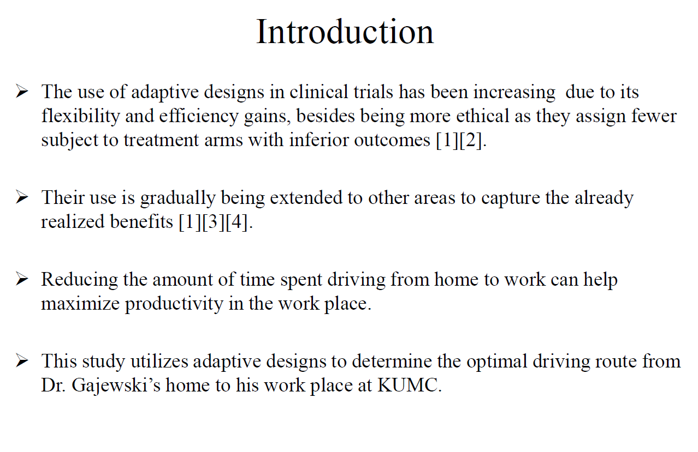

Slide 4
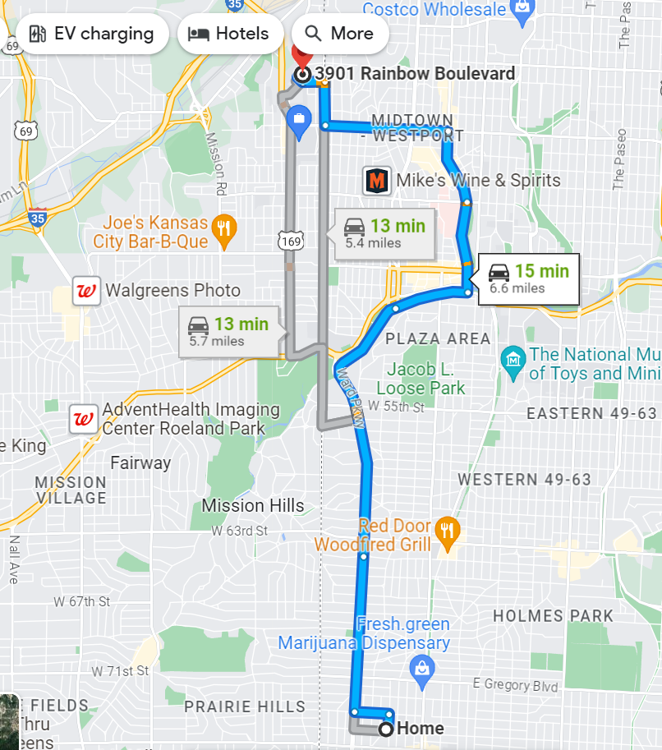
Plaza Route (Control)
Three lanes (faster speed)
Aesthetic (goes through Plaza)
First route when moving to KC
Indirect (slow?)

Slide 5
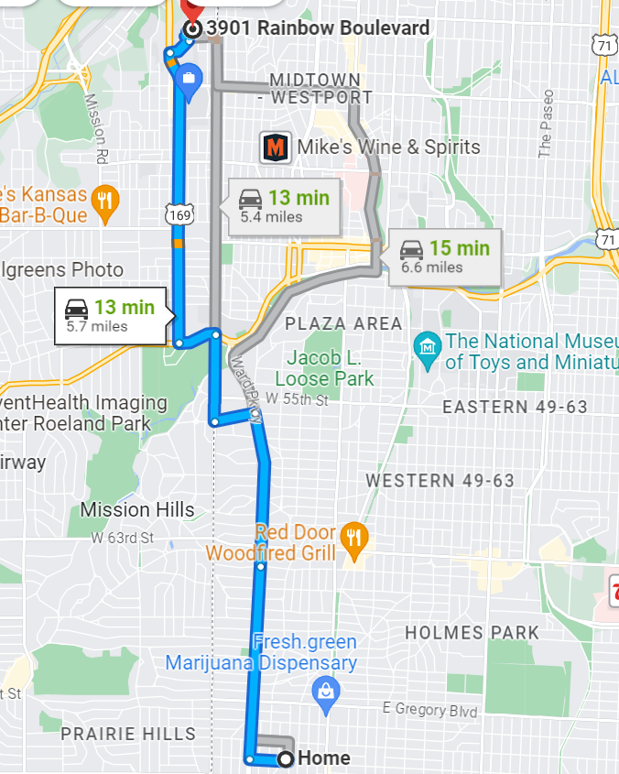
New route 1: Rainbow
Two lanes
Faster speed
Direct

Slide 6
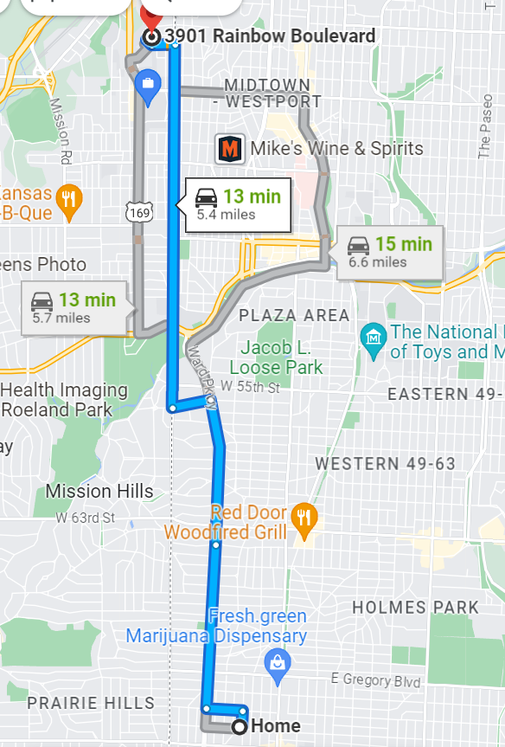
New route 2: Stateline
Straight
Direct
One lane (slower?)

Slide 7
I want to see if there is a better route than Plaza
Arm | Route
1 | Plaza (Control)
2 | Rainbow
3 | Stateline

Slide 8
Assumptions
Arm | Route | Data Source | Average Driving Time (µ_{j})
1 | Plaza (Control) | Google maps | 15 minutes
2 | Rainbow | Google maps | 13 minutes
3 | Stateline | Google maps | 13 minutes
σ~1.2 minutes (preliminary data)

Slide 9
Fixed Design (Strawman)
1:1:1 Allocation
One analysis
Compare two new arms to control
Type I error 2.5%, 1-sided, Bonferroni (2.5%/2=1.25%)
90% power -> 11/group (n=33)
Will take about 6.5 weeks to implement (1 driver, 5 times/week)

Slide 10
Can we do better? Adaptive Design Choices?
Prior?
Randomization? Response Adaptive Randomization
What’s the optimal allocation control?
Interim analyses? How many?
Success and futility rule?
Can we do better in the average number of drives, time, better route?

Slide 11
Goal
Design, conduct, and analyze this study.
Write-up for a journal (Journal of Statistics and Data Science Education), all of us co-authors
Need a Principal Investigator (PI) (Naima Alam)
Leads the project, manages timelines, and works with Co-Investigators
Works with notes taker to have good notes
Responsible for leading the final write-up
Need milestone co-I (co-Investigators)
Who’s in?

Slide 12
Milestones/Products
Design (FACTS) (co-I: Elena)
Protocol (co-I: Geeth/Kate)
Statistical Analysis Plan (Geeth/Kate)
Data Capturing (RedCAP and a Shiny App for Randomization) (Sreejata/Fred)
Analysis (Kaustubh/JZ)
Paper (PI)

Slide 13
Milestone 1: Design
Each of you, with a partner, come up with a new design
Pair a rookie user with a veteran user of FACTS
FACTS, Core Design, Continuous
Calculate operating characteristics under various virtual subject responses (VSR)
Accrual (drive all workdays)
Endpoint (Driving time immediate)
When you have your design in FACTS:
S:\Biostats\BIO-STAT\BISR\FACTS Working Group\FACTS code\Case Study 22 Optimal Driving Route
Have done by September 15
Each will present brief overview, then we vote which one to build off of

Slide 14
Virtual Subject Responses (VSR): Average Driving Time
Arm | Route | Null | Expected | One Best
1 | Plaza (Control) | 15 minutes | 15 minutes | 15 minutes
2 | Rainbow | 15 minutes | 13 minutes | 13 minutes
3 | Stateline | 15 minutes | 13 minutes | 14 minutes
σ~1.2 minutes

Slide 15
Procedure
This will be our primary agenda for the FACTS Working Group until done
If it is a slow meeting day, will have presentations on other topics from Working Group members

Slide 16
Questions

Slide 17
Appendix: Alternate
2 x 2 factorial design
Route: Stateline vs. Rainbow
Elevator: Wescoe vs. Orr Major
Interesting: no interaction expected!!!!!
Endpoint: home-to-office travel time
Which one does the group prefer???
Three arms best driving (questionable control)
Four arms 2 x 2 factorial design

Slide 18
Initial Designs
Team | Type of Design | Comments
DIAS | Adaptive (RAR, three interims, success/futility), EMAX and Independent, deterministic accrual!!! Fixed allocation for control | No dose structure no EMAX (over parameterized) Independent model good, modify variance prior
Lauren&Elena | Comparative (no control), adaptive (arm dropping), fixed sample size, drops an arm immediately. Always dropped control | Prior needs fixing N(0,10) to N(13,10), variance prior needs fixing (prior sample size say .1) The arm dropping is good, but let other have a chance to be dropped I think they are comparing two active arms against each other, which is not a goal Optimistic prior
TheStarFish | “weeks” means “days” Adaptive (RAR, power .7, aggressive), control is not fixed allocation it allocates with the best | Type I error needs to be lowered to .025; match the block size with the interim, Not a lot of early sample size savings. Allows one to choose among the active routes in addition to better than control. Optimistic prior
JZ | Fixed | Fixed design with success criteria 1:1:1 allocation. “delta=1 min” decision making criteria (non-zero)
Byron | Two RAR’s
Elena: for our next meeting we need you and your team to evaluate the designs above and give a recommendation of a final design
to Naima with a 2-page rationale (by Oct 13). Naima will present and discuss the next steps (Elena can present too).

