Slide 1
Adapters for Transfer Learning
Jorge Valles

Slide 2
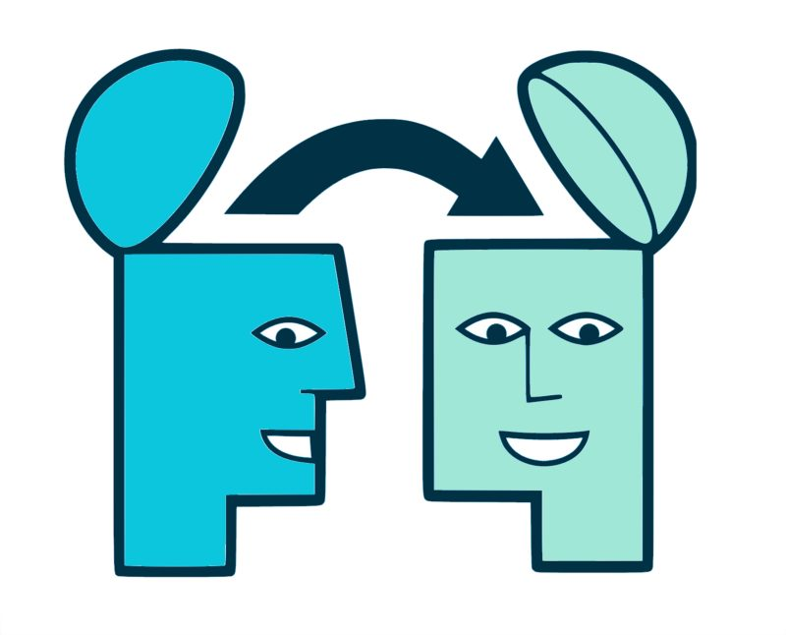
Transfer-Learning
Deep Learning models increasingly require more resources and training time.
Using pre-trained models as a starting point makes it possible to quickly develop effective models and solve complex problems.
This is called Transfer Learning.

Slide 3
Transfer-Learning
There are several methods to make transfer-learning.
The most common are:
Embeddings
Feature extractors
Full-Fine Tuning
We will talk briefly about each of them and then about a more recent method: adapters.

Slide 4
Contents
Examples of Transfer Learning
Motivation and first proposals from adapters
Adapters for transformers
Combination of adapters

Slide 5
Examples of Transfer Learning

Slide 6


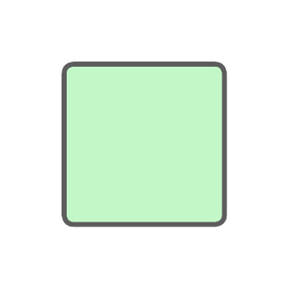
Convention for submission
Hidden inputs, outputs and tensors:
Pre-trained frozen parameters:
Training parameters:

Slide 7
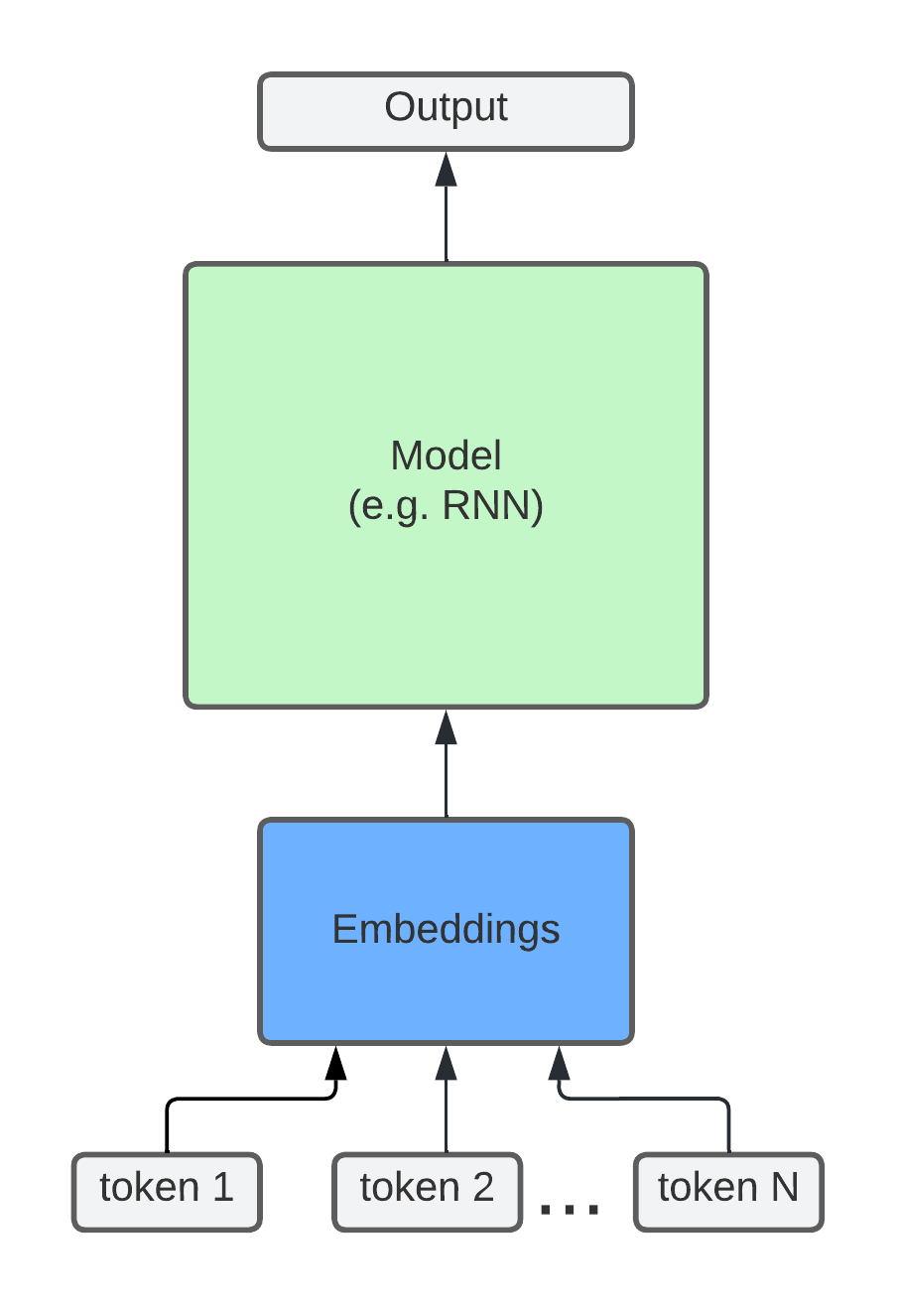
Embeddings
Embeddings are useful for representing discrete or categorical data in a continuous space.
Transfer-Learning with word-embeddings has been used in NLP.
Disadvantage: vector representation of tokens may not be very useful for the new vocabulary.

Slide 8
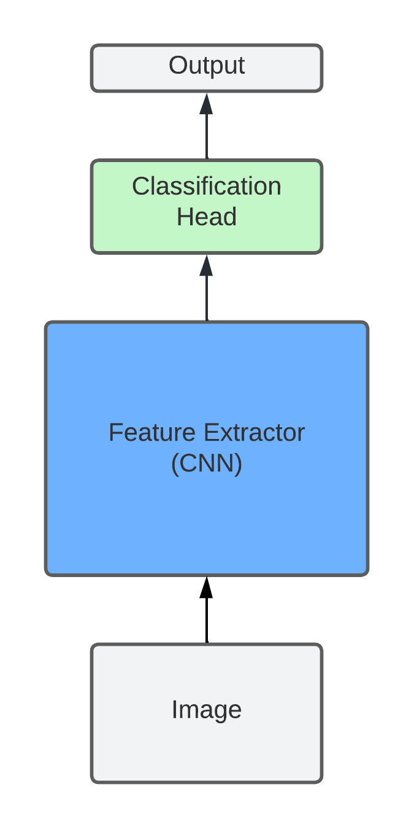
B. Feature extractors (CV)
Models in computational vision usually use convolutional layer blocks.
With an image as input, these layers blocks detect patterns and features, called features. These can be used for classification.
Disadvantage: pre-trained weights do not always work well for new tasks. Bad results.

Slide 9
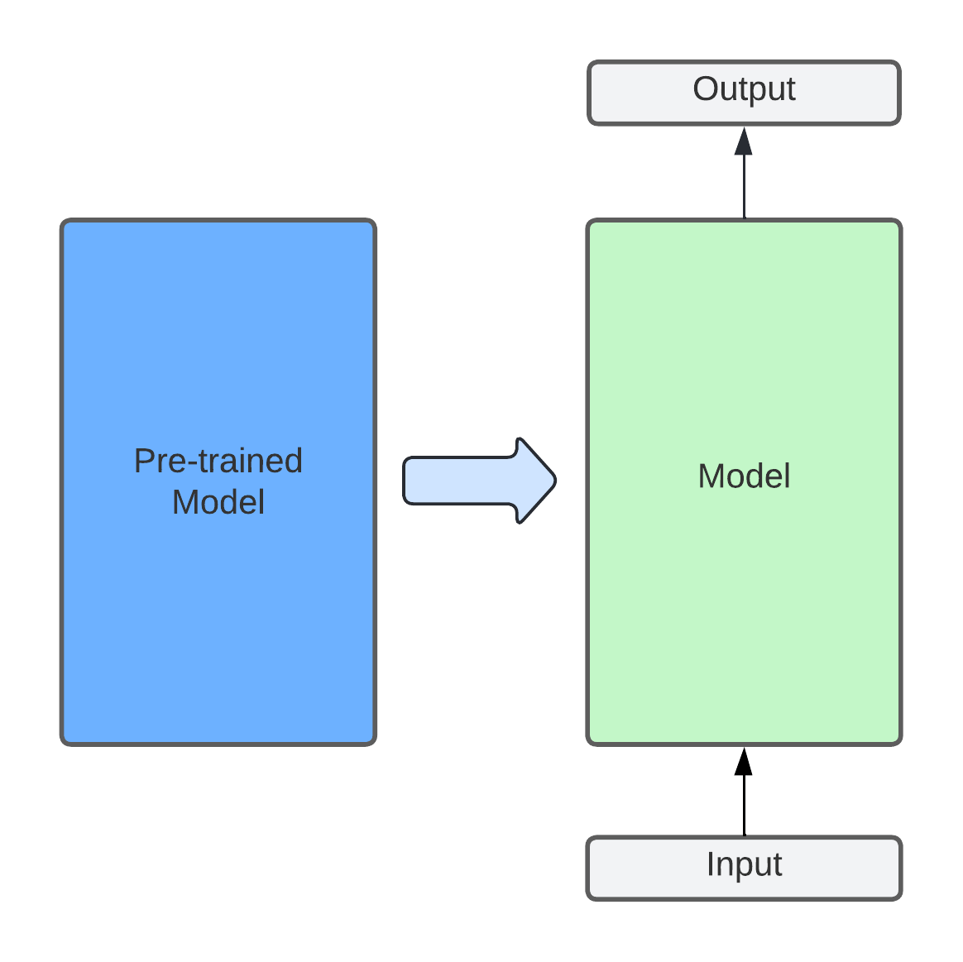
C. Full Fine-Tuning
It refers to initializing the weights of a model with those of a pre-trained model with the same architecture (or part of it) and training the entire model.
Of the methods so far mentioned, it is the most effective in terms of inference.
Disadvantage: the time and computational cost of training.

Slide 10
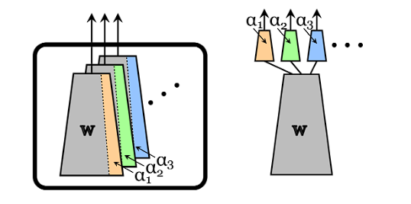
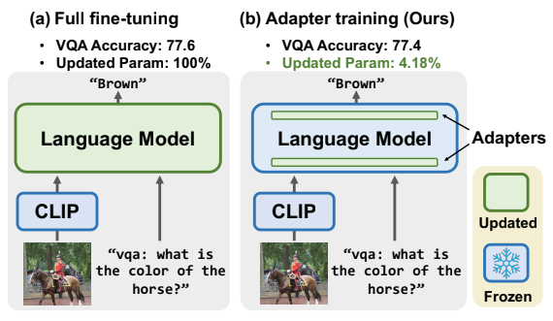
Adapters
[2]
Adapters are an alternative to full fine-tuning in which pre-trained weights are kept frozen and only new intermediate layers are trained that are added to the model.
Generally the number of parameters of the new layers represents less than 10% of the parameters of the final model. It can even be less than 1%.
[3]

Slide 11
Motivation and first proposals from adapters

Slide 12
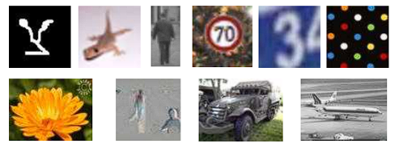
Origin
They were first proposed in two articles of computational vision that were published in 2017 and 2018 ([1] and [2]).
They tried to solve several image sorting tasks simultaneously with the same architecture (ResNet).

Slide 13
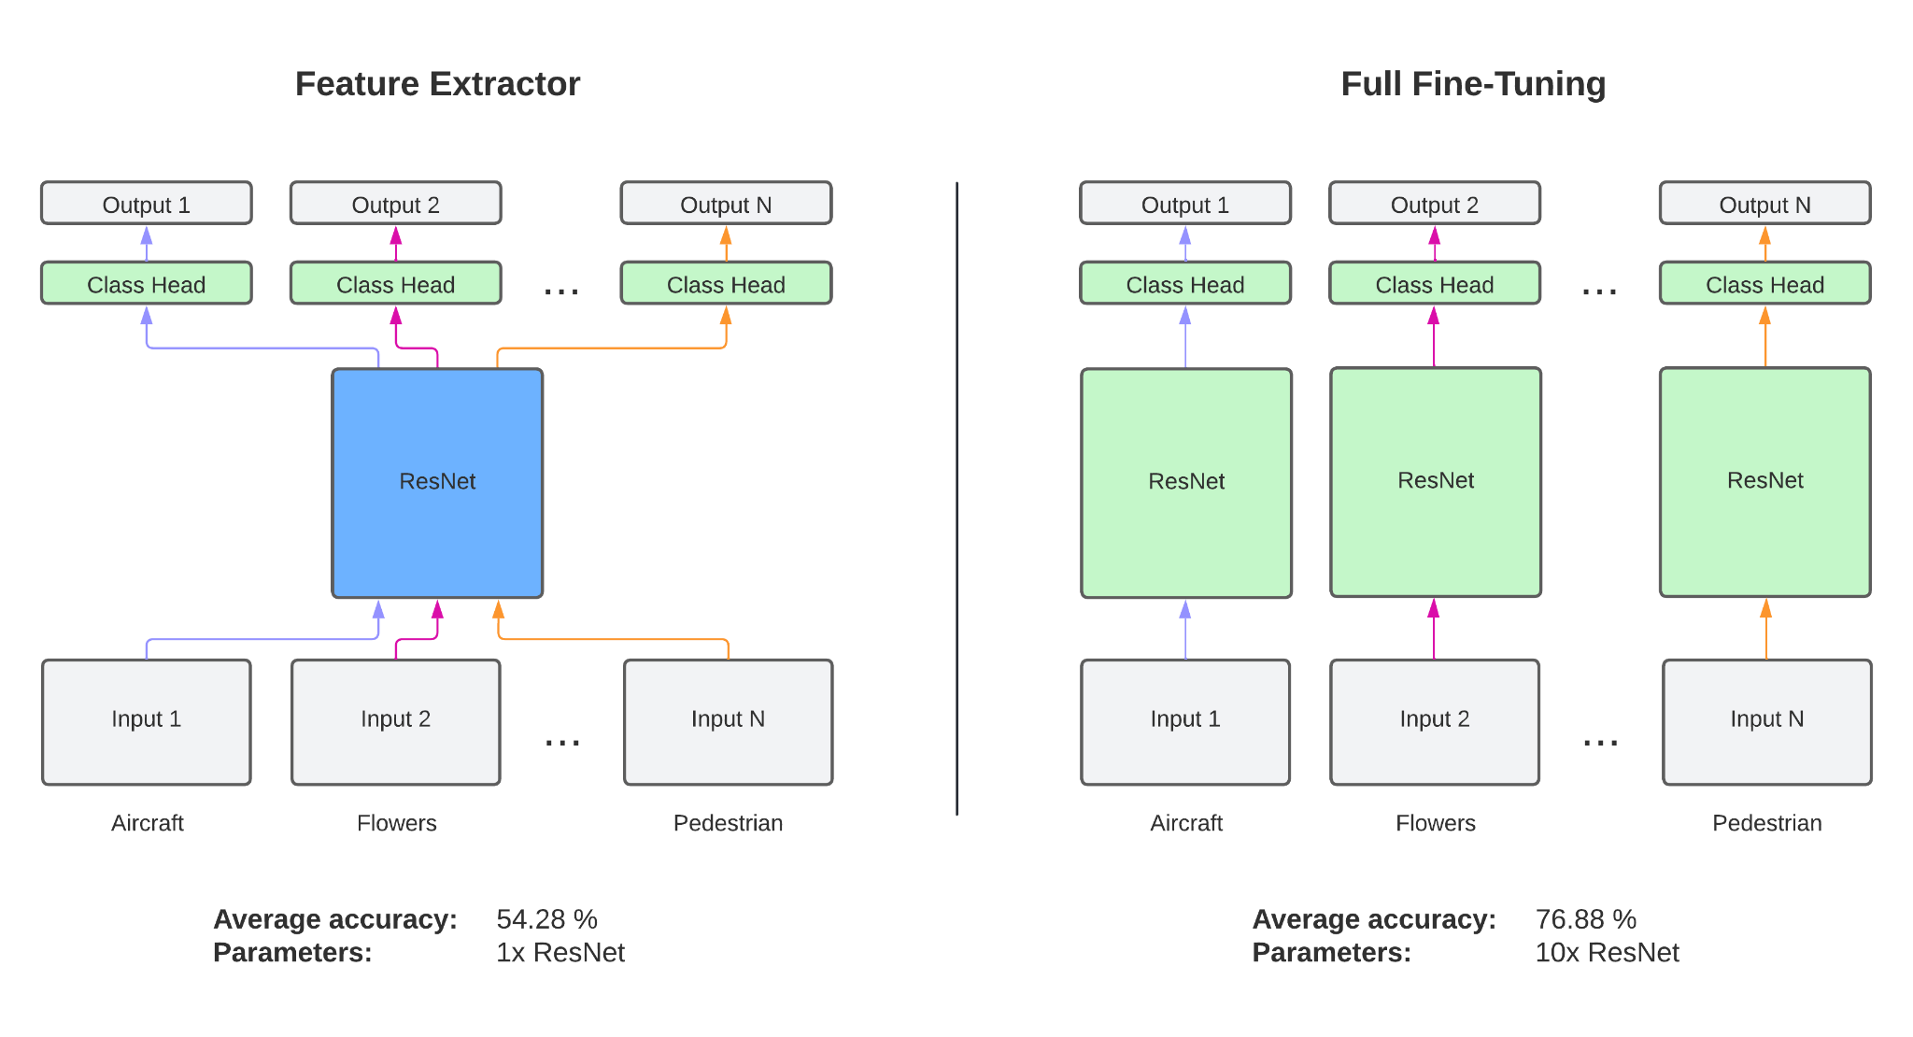
Origin

Slide 14
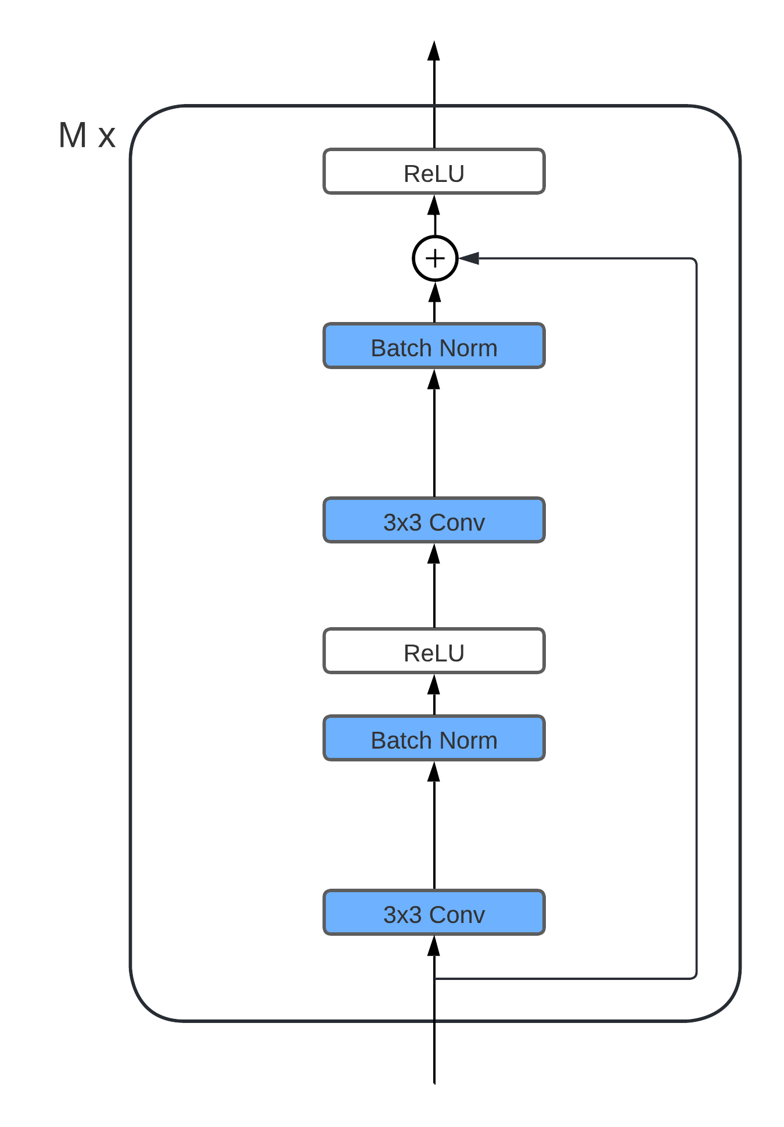
ResNet
In its simplest configuration, a ResNet consists of a string of several blocks with the architecture shown on the right.
The vast majority of parameters are concentrated in the Convolutional layers.

Slide 15
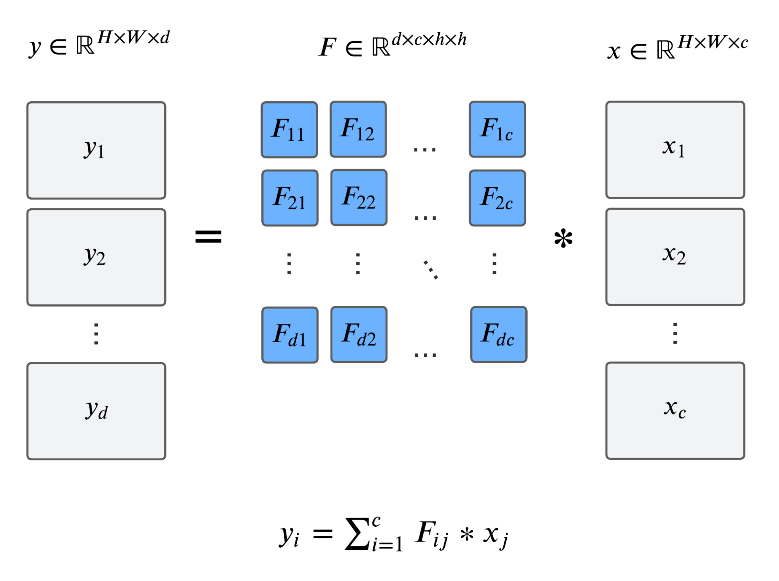
Convolutional layer

Slide 16
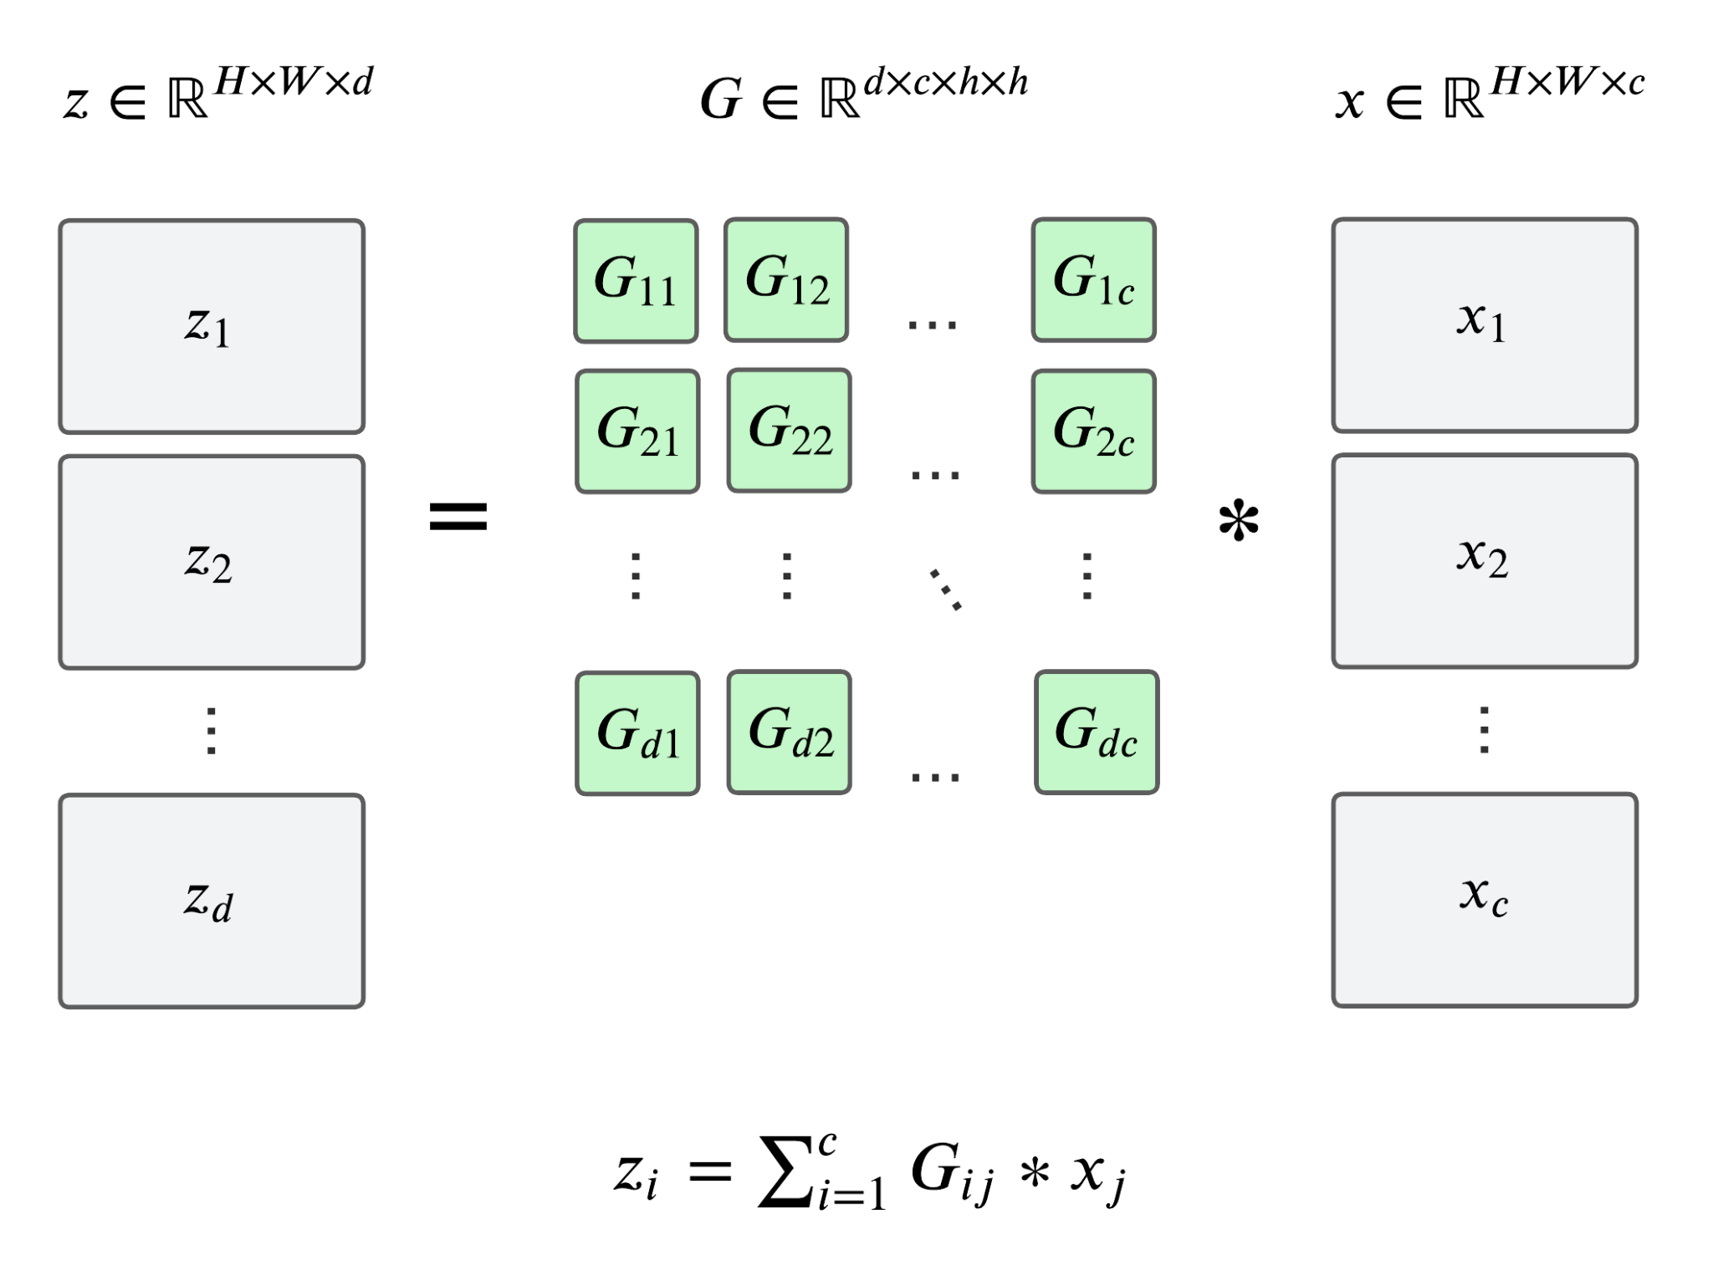
Convolutional layer (fine-tuned)

Slide 17
Adapters hypothesis
The question is: how to approximate layer G with layer F without making full Fine-Tuning?
The proposal was: fine-tuned filters can be approached by means of a linear transformation of the pre-trained.

Slide 18
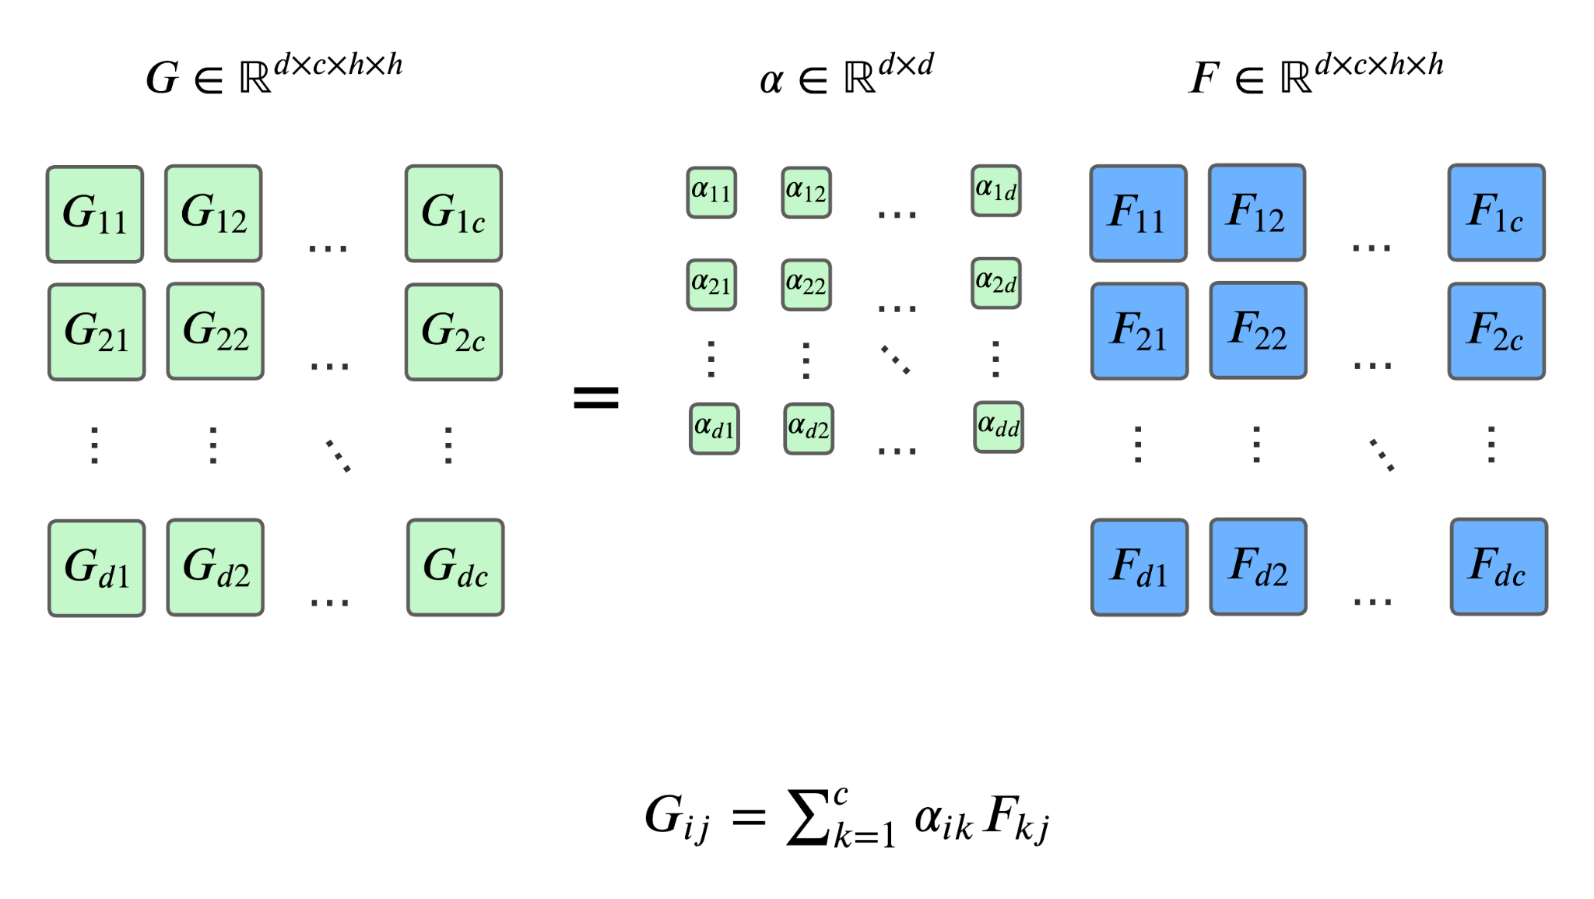
Adapters hypothesis

Slide 19
Observation
Training is used to find scalars, freezing pre-trained filters.
The implementation of the method seems complex.
The above transformation is simply equivalent to adding a Convolutional layer of 1x1 filters.

Slide 20
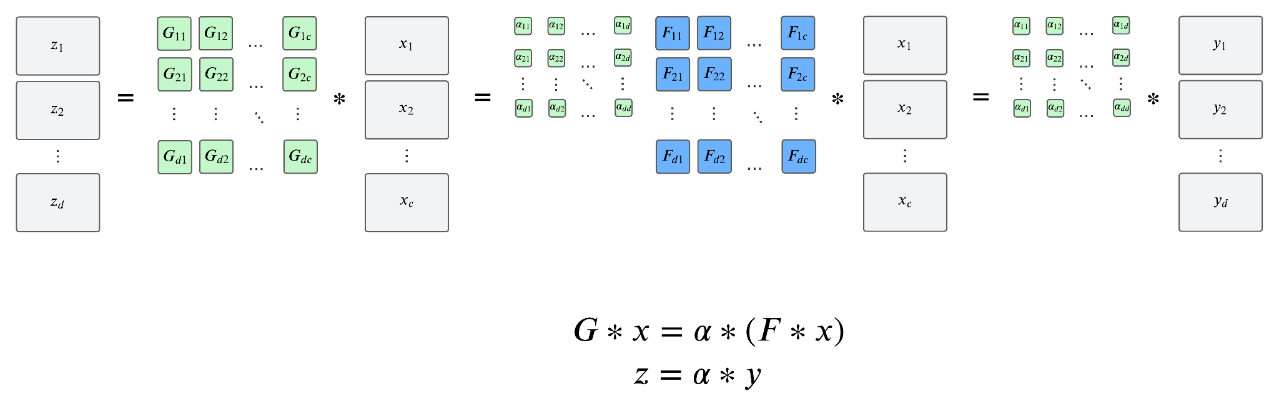
Observation

Slide 21
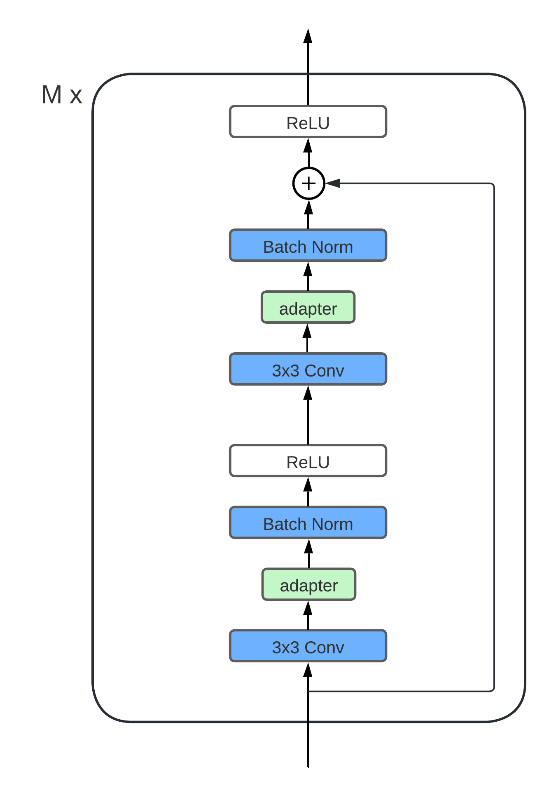
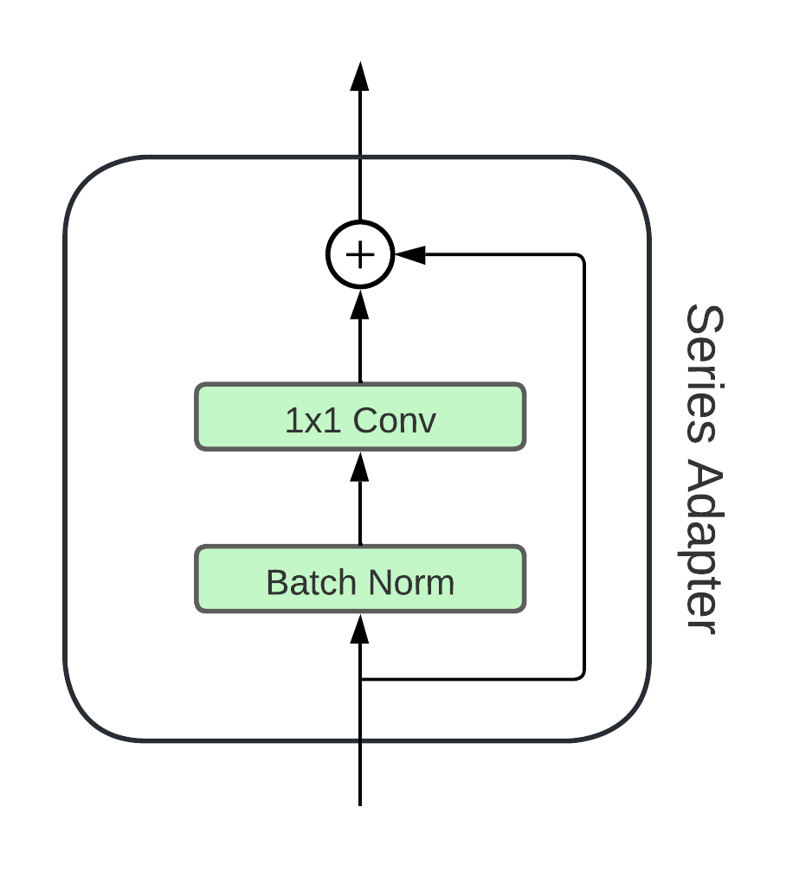
Adapter Series
This type of adaptation was called Series adapter.
'Series' refers to the calculation being sequential.

Slide 22
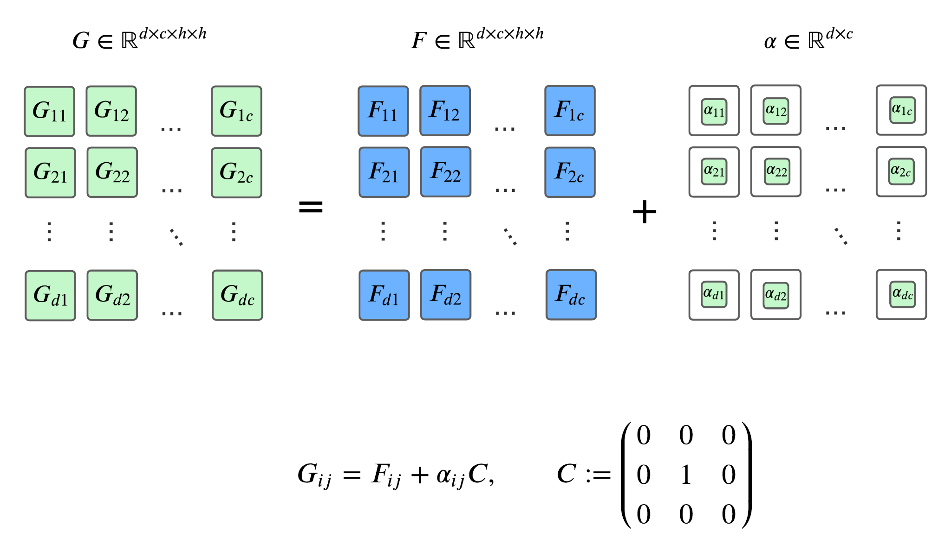
Parallel adapter
Related transformation was also proposed:

Slide 23
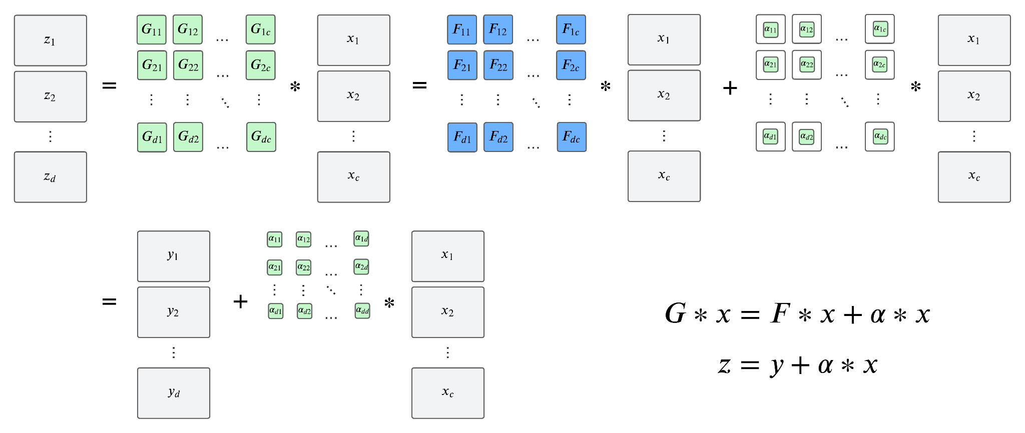
Parallel adapter

Slide 24
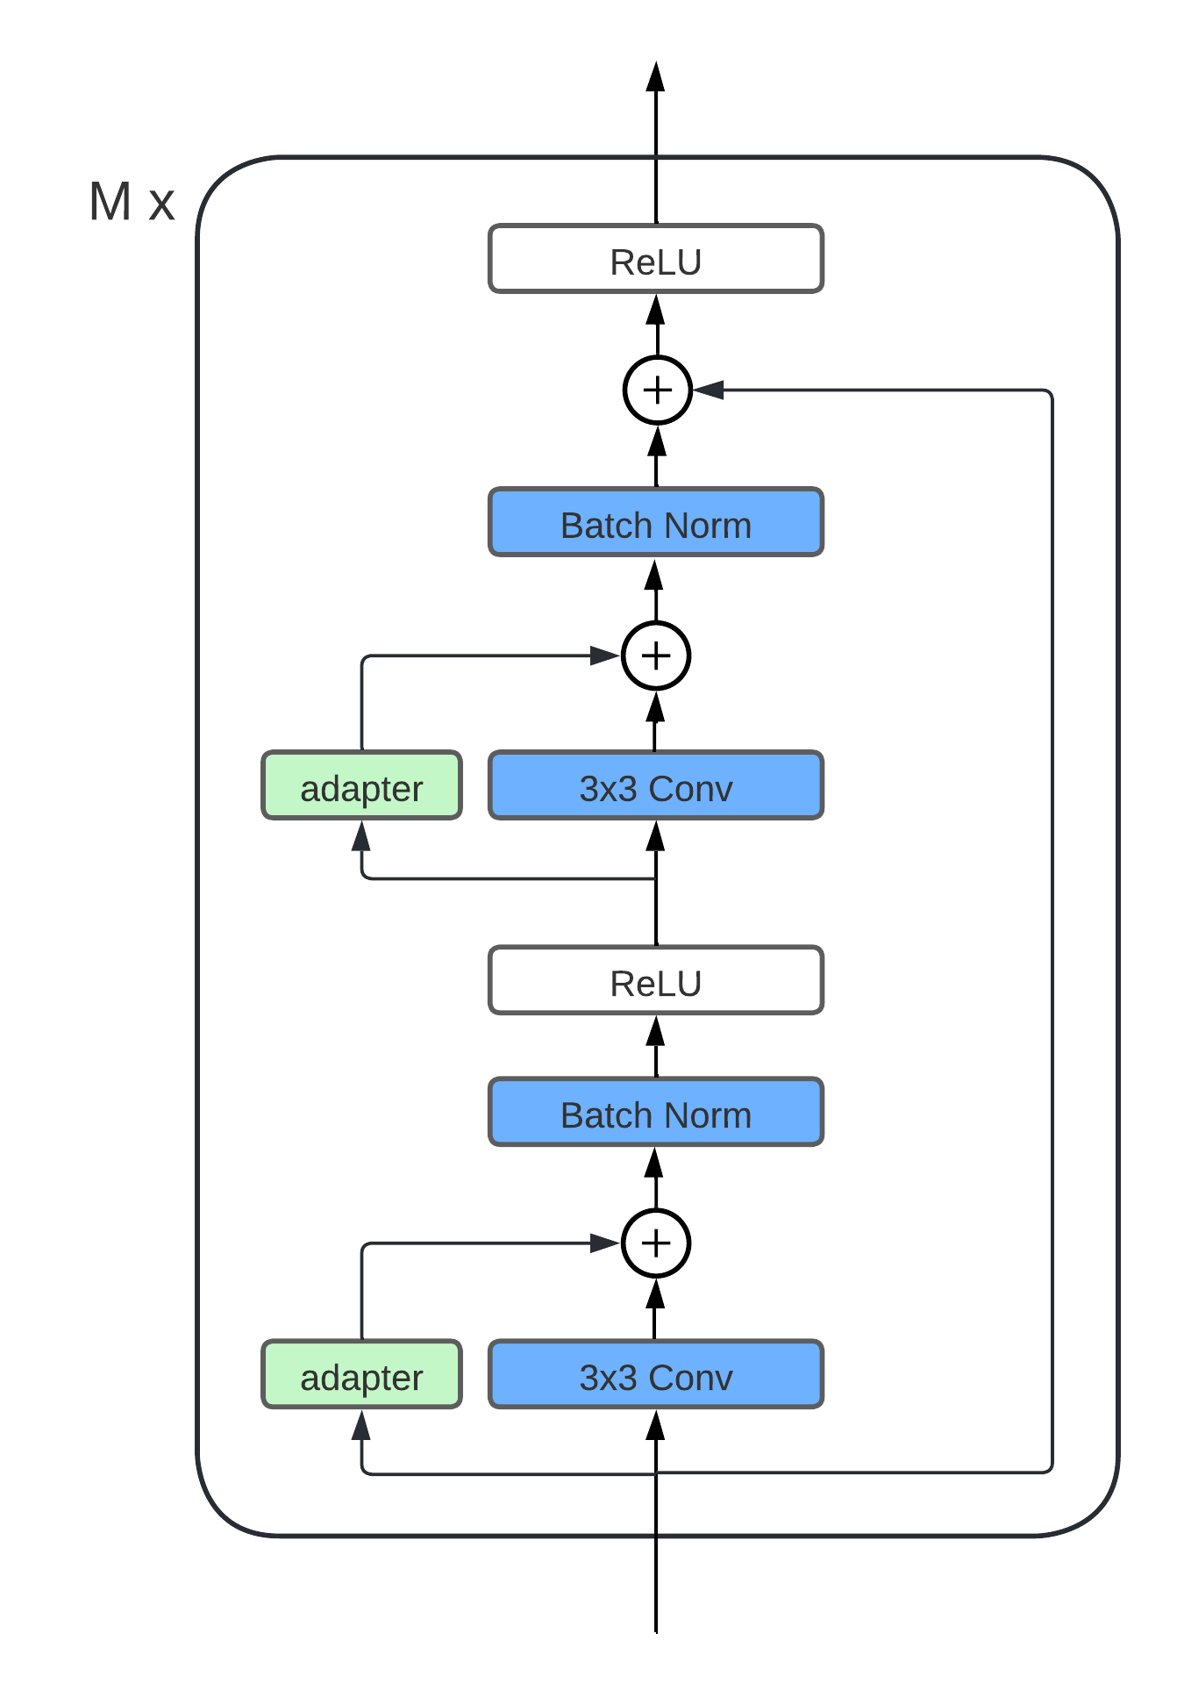
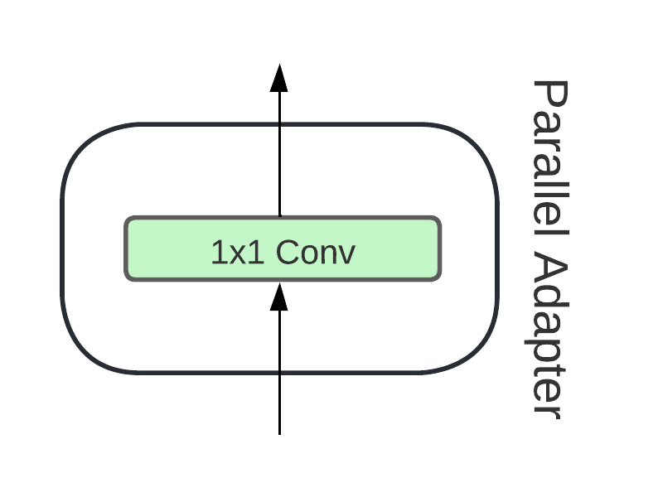
Parallel adapter
The previous transformation is equivalent to the architecture on the right.
This type of adaptation was called parallel adapter.

Slide 25
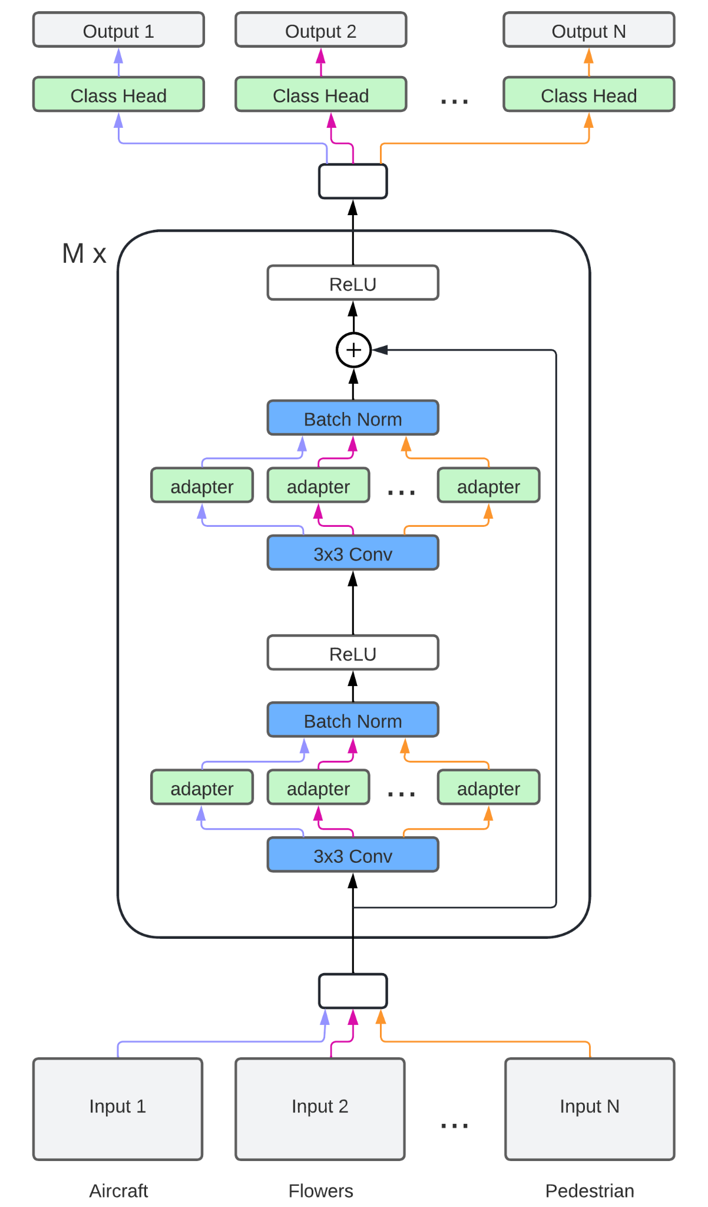
Adapters for Multi-Task Learning
For each task a new copy of adapters is created, while the pre-trained model is frozen and used for all tasks.
A classification head for each task.

Slide 26
Results
Model | #par | ImNet | Airc. | C100 | DPed | DTD | GTSR | Flwr | OGlt | SVHN | UCF | mean
# Images |  | 1.3m | 7k | 50k | 30k | 4k | 40k | 2k | 26k | 70k | 9k
Scratch | 10x | 60.32 | 57.10 | 75.73 | 91.20 | 37.77 | 96.55 | 56.30 | 88.74 | 96.63 | 43.27 | 70.32
Scratch+ | 11x | 59.67 | 59.59 | 76.08 | 92.45 | 39.63 | 96.90 | 56.66 | 88.74 | 96.78 | 44.17 | 71.07
Feature Extractor | 1x | 60.32 | 23.31 | 63.11 | 80.33 | 45.37 | 68.16 | 73.69 | 58.79 | 43.54 | 26.80 | 54.28
Full Fine-Tuning | 10x | 60.32 | 60.34 | 82.12 | 92.82 | 55.53 | 99.42 | 81.41 | 89.12 | 96.55 | 51.20 | 76.88
Series Adapters | 2x | 60.32 | 61.87 | 81.22 | 93.88 | 57.13 | 99.27 | 81.67 | 89.62 | 96.57 | 50.12 | 77.17
Parallel Adapters | 2x | 60.32 | 64.21 | 81.91 | 94.73 | 58.83 | 99.38 | 84.68 | 89.21 | 96.54 | 50.94 | 78.07

Slide 27
Adapters for transformers

Slide 28
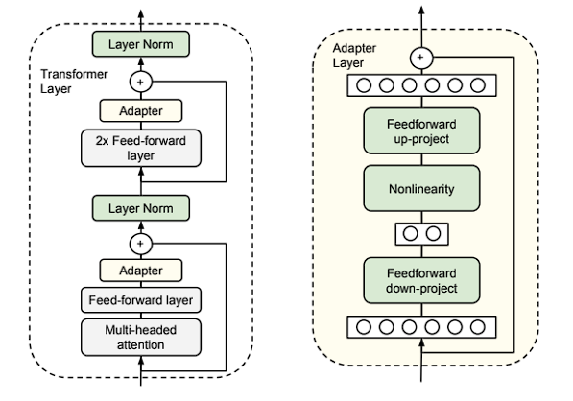
Houlsby 2019 [4]
First adapters for transformers.
Two adapter series per layer.
Just sorting tasks.

Slide 29
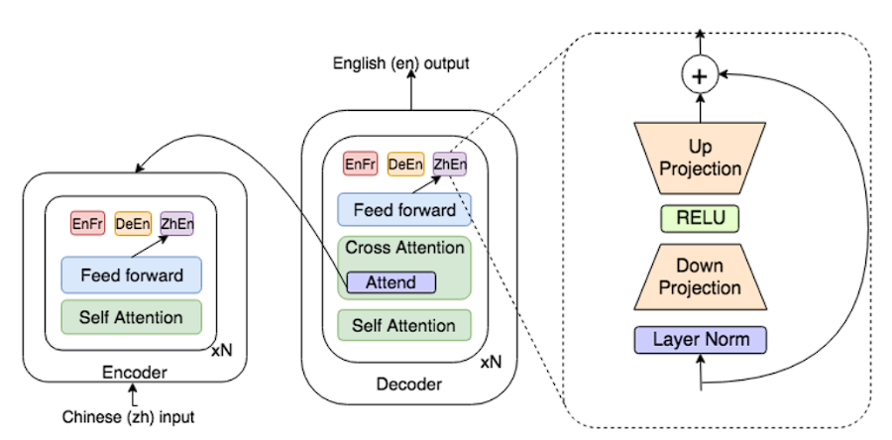
Bapna 2019 [5] (Pfeiffer [6])
A serial adapter per layer.
Used for cross-linguistic translation.
Transformer complete.

Slide 30
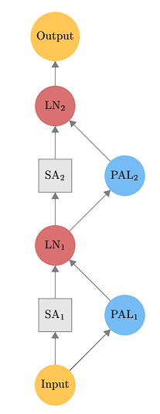
Stickland 2019 [7]
First parallel adapters for transformers.
One parallel adapter per layer.
Just sorting tasks.

Slide 31
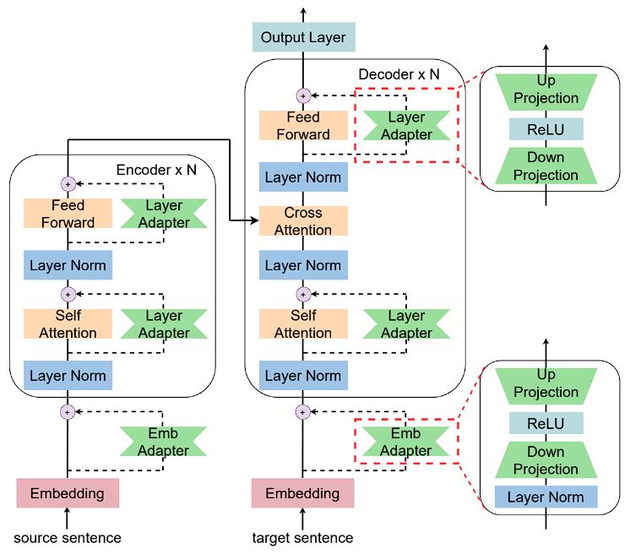
Zhu 2021 [8]
First adapter for embeddings.
Two parallel adapters per layer
Machine translation.

Slide 32
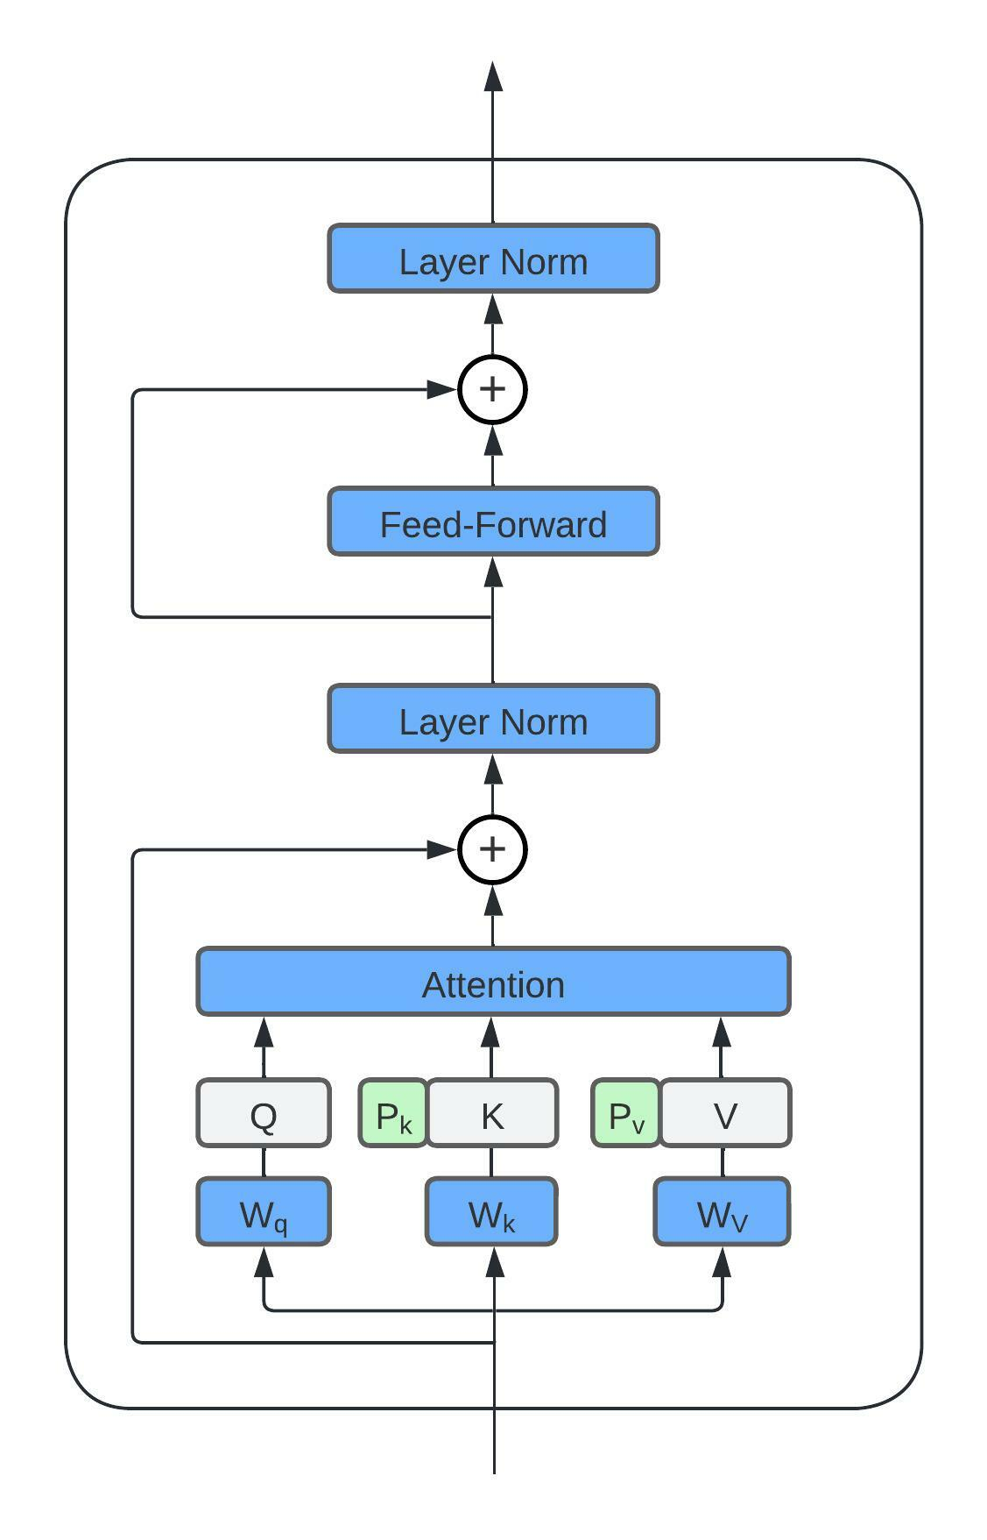
Prefix Tuning 2021 [9]
First to propose the use of prefixes.
Vectors are added as prefixes to K and V matrices.
It is possible to model it as an adapter parallel.
Text generation tasks.

Slide 33
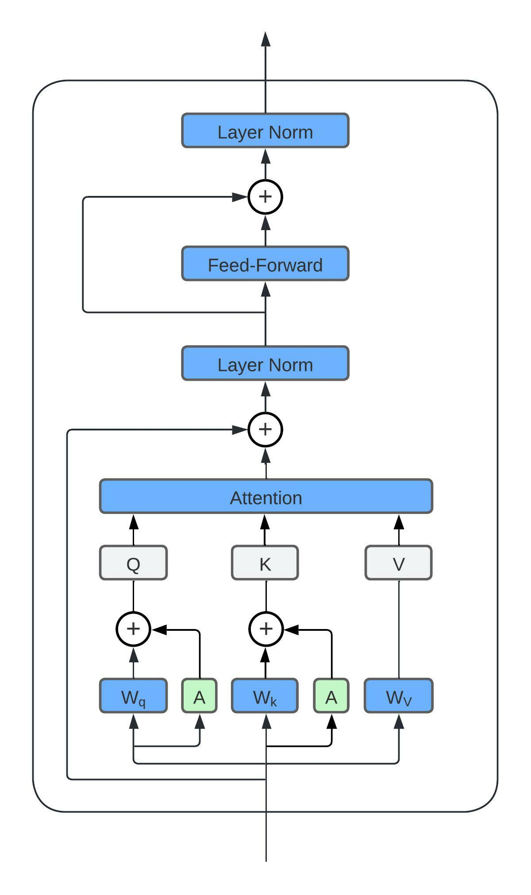
Lora 2021 [10]
First to add adapters to the care mechanism.
Parallel adapters to the Wq and Wk layers.
Motivated by decomposition W + BA.
Classification tasks.

Slide 34
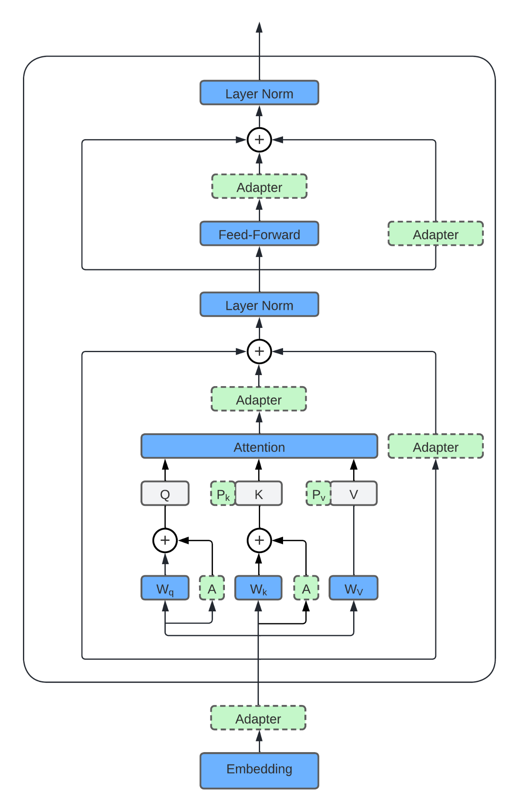
Summary []

Slide 35
Which one's the best?

Slide 36
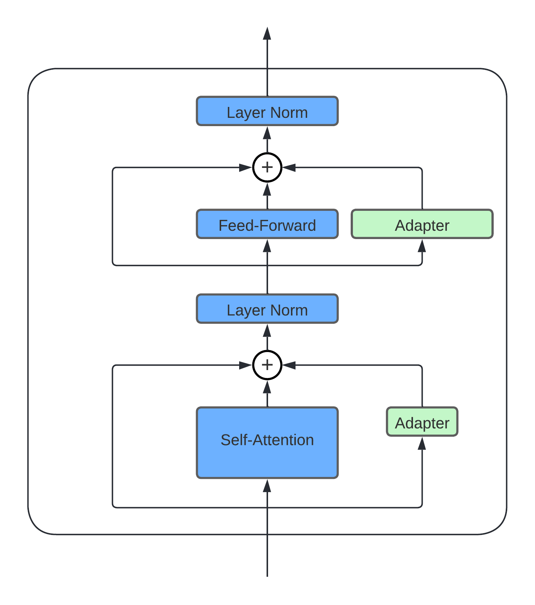
MAM 2022 [11]
They rewrote prefix Tuning as a parallel adapter.
First to empirically test the current variants.
Two parallel adapters per layer, with different bottlenecks.

Slide 37
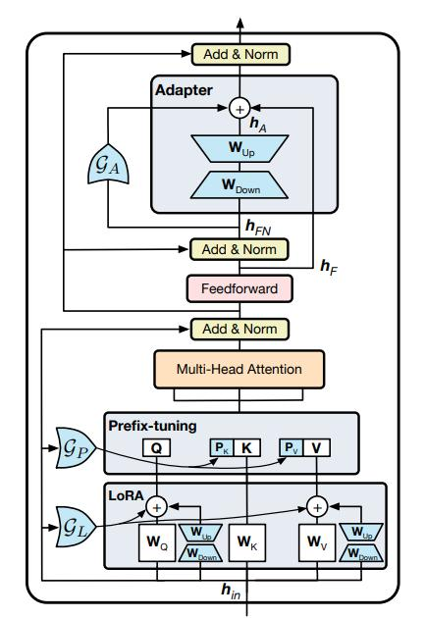
UniPELT 2022 [12]
First to use floodgates for adapters.
Adapter series, Lora and prefix-tuning.
Classification tasks.

Slide 38
Combination of adapters

Slide 39
Parallel adapters
Solve several independent tasks with the same base model.
Used from the first adapter proposals.

Slide 40
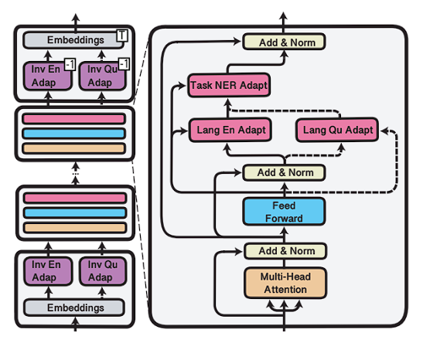
Stacked adapters (MAD-X) [6]
Originally proposed for Cross-Lingual.
An adapter for Masked Languange Modeling for a specific language.
An adapter for a sorting task.

Slide 41
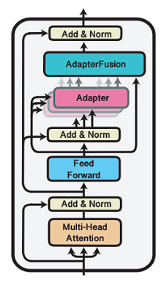
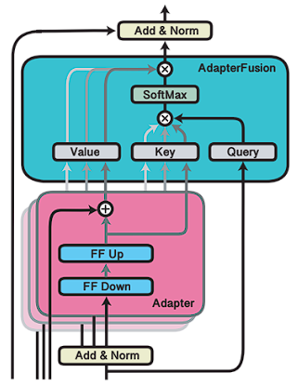
Fusion of adapters [13]
To solve multi-task learning problems.
The adapters of a task have knowledge in that task.
The knowledge of different tasks is combined with attention.

Slide 42
Thank you for your attention.

Slide 43
References
43Rebuffi (2017). Learning multiple visual domains with residual adapters. CVPR.
Rebuffi (2018). Efficient parametrization of multi-domain deep neural networks. CVPR.
Sung (2022). VL-adapter: parameter-efficient Transfer Learning for vision-and-Language tasks. CVPR.
Houlsby (2019). Parameter-efficient Transfer Learning for NLP. PMLR.
Bapna (2019). Simple, scalable Adaptation for Neural machine Translation. EMNLP.
Pfeiffer (2020). MAD-X: an adapter-based Framework for Multi-Task Cross-Lingual Transfer. EMNLP.
Stickland (2019). Bert and PALs: project attention Layers for efficient Adaptation in Multi-Task Learning. PMLR.
Zhu (2021). Counter-interference adapt for multilingual machine Translation. EMNLP.
Li (2021). Prefix-Tuning: optimizing continuous Prompts for Generation. ACL.
Hu (2022). Lora: Low-rank Adaptation of large Language models. ICLR.
He (2022). Towards a Unified view of parameter-efficient Transfer Learning. ICLR.
Mao (2022). UniPELT: A Unified Framework for Parameter-Efficient Language Model Tuning. Preprint.
Pfeiffer (2021). AdapterFusion: Non-Destructive Task Composition for Transfer Learning. ACL.

