Slide 1


SPACEX IBM DATA SCIENCE PROJECT
Baylee Devers
23rd April 2022

Slide 2
Outline
- Executive Summary
- Introduction
- Methodology
- Results
- Conclusion

Slide 3
Executive summary
Summary of methodologies
- Data Collection via SpaceX REST API
- Data Collection with Web Scraping
- Data Wrangling
- Exploratory Data Analysis with SQL
- Exploratory Data Analysis through Data Visualization
- Interactive map with Folium
- Machine Learning Prediction
Summary of all results
- Exploratory Data Analysis result
- Interactive analytics in screenshots
- Predictive Analytics result

Slide 4
Introduction
The goal of this project is to predict if the first stage of a Falcon 9 rocket launch will land successfully. SpaceX publishes the costs of its Falcon 9 rocket launches, which are significantly cheaper than other providers, much of these savings are due to SpaceX being able to reuse the first stage. Thus, by modelling first stage of the rocket launch, we can determine the total cost of a launch.
Problems that need solving –
- What variables determine if the rocket will land successfully?
- The correlation between these variables.
-What conditions much be met to maximise the probability of a successful launch.

Slide 5
Methodology

Slide 6
Executive summary
Data collection via SPACEX REST API, and webscraping from Wikipedia page: https://en.wikipedia.org/w/index.php?title=List_of_Falcon_9_and_Falcon_Heavy_launches&oldid=1027686922
Data Wrangling using one hot encoding and dropping unnecessary columns to transform data for machine learning
Exploratory data analysis using SQL and data visualization through various plots with seaborn
Interactive visual analytics with folium and plotly dash
Predictive analytics via classification models

Slide 7
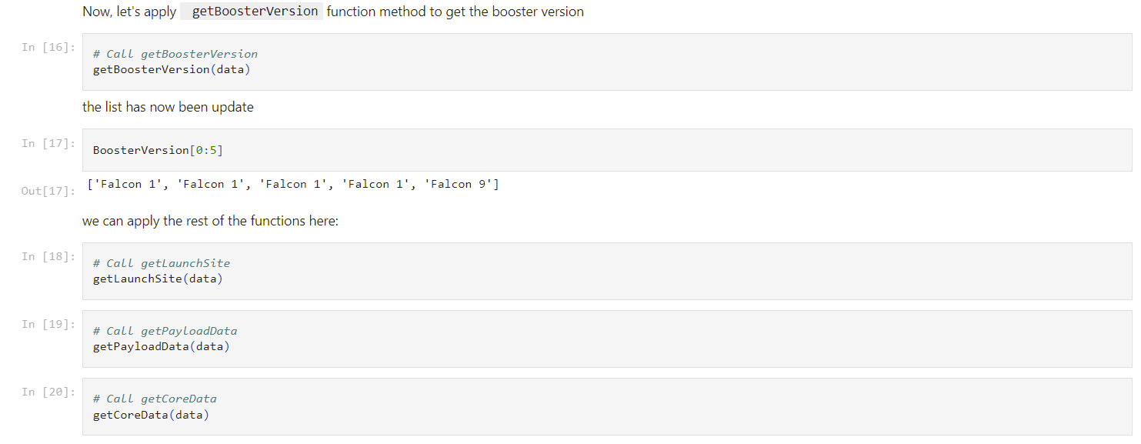
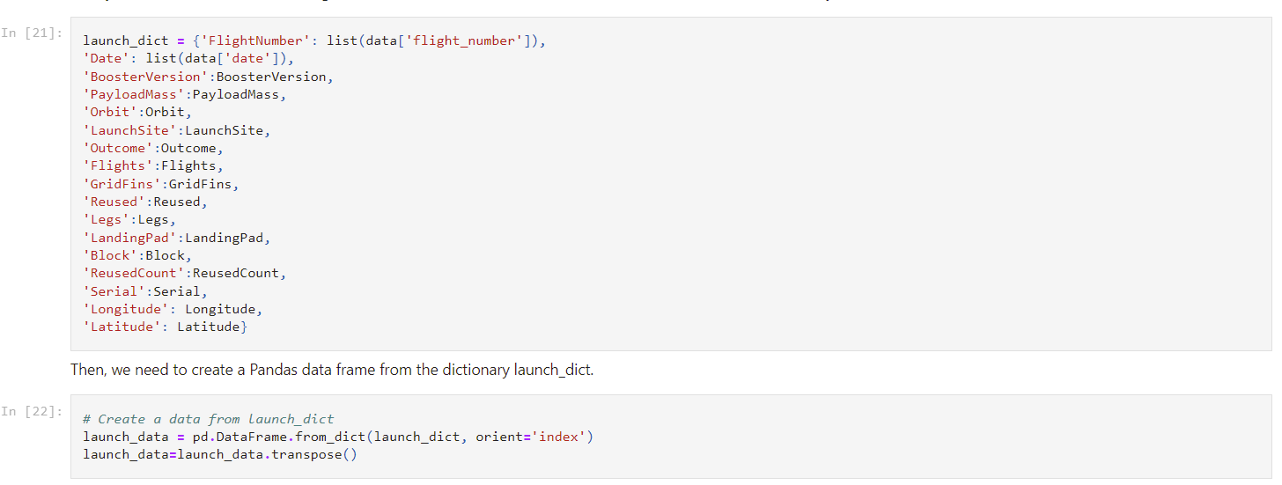
Data collection – api
1. Request data from API url
2. Convert json to pandas dataframe
3. Clean data with prebuilt functions
4. Create dictionary for data, then convert to pandas dataframe
5. Filter data to remove Falcon 1 launches
6. Replace missing values with the mean
7. Export data as csv

Slide 8
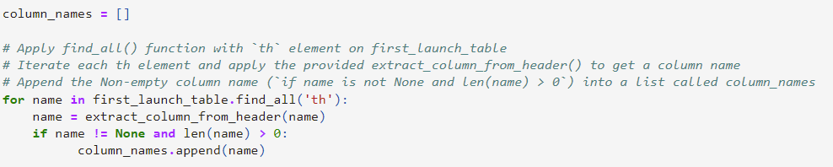
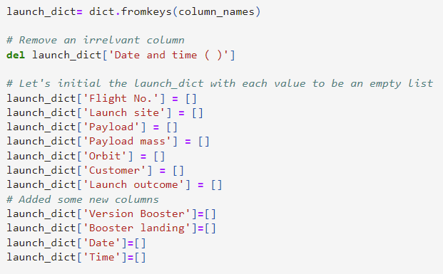
Data collection - webscraping
1. Get response from website url
2. Create beautiful soup object for data
3. Find all tables in object
5. Create dictionary, and fill it with table rows
4. Find all column names
6. Convert to pandas dataframe
7. Export data as csv

Slide 9
Data wrangling
In the data set, a launch can be unsuccessful in many different ways. True/False Ocean represents whether or not a launch successfully landed in a specific part of the ocean, True/False RTLS denotes whether a launch was successfully landed to a ground pad, and True/False ASDS denotes whether a launch was successfully landed onto a drone ship. To manipulate our data such that it is ready to act as input in our model, we need to create a new column, that simply denotes whether or not a launch was successful. To do this we group all successful launch times, and assign values of 1 to our column if the launch is successful, and denote 0 to any launches that were unsuccessful. In total, 2/3 of the launches in the dataset were successful.
Each launch aims for a specific orbit type, here are some examples:

Slide 10
Eda with data visualisation
We will create scatter plots for the following:
We will also create a bar chart for Mean vs Orbit. This will allow us to see the success rate by orbit type.
Flight Number vs Payload Mass
Flight Number vs Launch Site
Payload vs Launch Site
Orbit vs Flight Number
Payload vs Orbit Type
Orbit vs Payload Mass
Finally, we will create a line chart for Success Rate vs Year.
This will show us how the success rate has changed over time
These will show us the correlation between different variables.

Slide 11
Eda with sql
We will be using SQL to solve the following problems:
1. Display the names of the unique launch sites in the space mission
2. Display 5 records where launch sites begin with the string 'CCA’
3. Display the total payload mass carried by boosters launched by NASA (CRS)
4. Display average payload mass carried by booster version F9 v1.1
5. List the date when the first successful landing outcome in ground pad was achieved.
6. List the names of the boosters which have success in drone ship and have payload mass greater than 4000 but less than 6000
7. List the total number of successful and failure mission outcomes
8. List the names of the booster_versions which have carried the maximum payload mass. Use a subquery
9. List the failed landing_outcomes in drone ship, their booster versions, and launch site names for in year 2015
10. Rank the count of landing outcomes (such as Failure (drone ship) or Success (ground pad)) between the date 2010-06-04 and 2017-03-20, in descending order
To gain some insight on our data

Slide 12
Interactive map and dashboard with folium and dash
To create an interactive map of our launch sites, we use latitude and longitude coordinates, and draw a Circle Marker around each site, and label site names.
We then use Green and Red markers to denote successful and unsuccessful launches using the folium plugin MarkerCluster.
We will then calculate the distance between launch sites and their proximities, to discover what kind of things successful launches are in close proximity to.
We then create a dashboard containing a pie chart to show the total successful launches by site, and scatter plots to show the relationship between outcome and payload mass.

Slide 13
Predictive analysis
In this final stage, we will load our data into Numpy and Pandas, and transform it. We will then split our data into train and test subsets. We will use the training data on various classification models. These will be: K Nearest-neighbours, Decision Tree, Support Vector Machine, and Logistic Regression. Then we will use GridSearchCV to tune our hyperparamaters. Then we will compare the accuracy and confusion matricies of each model, to determine which one perfomes best on our test data.

Slide 14
results

Slide 15
EDA with data visualisation

Slide 16
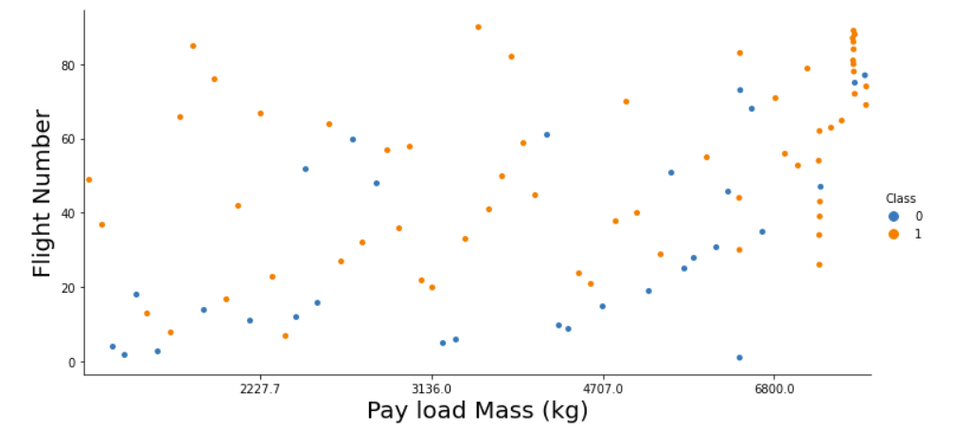
Flight number vs payload mass
We see that as Flight Number increases, the first stage is more likely to land (class 1)

Slide 17
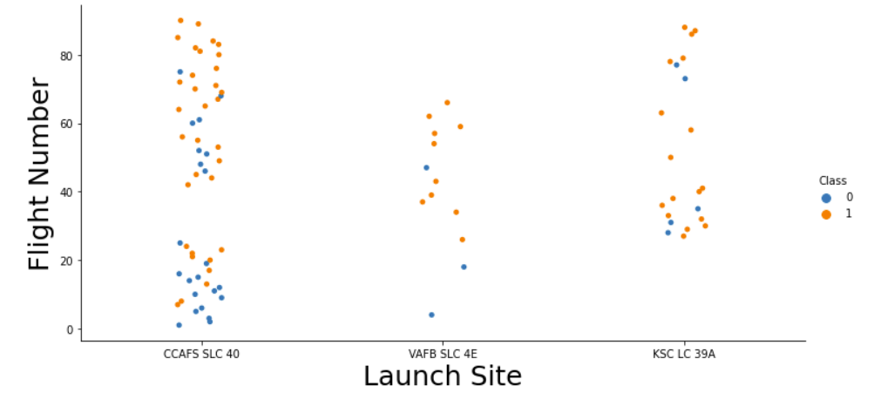
Flight number vs launch site
Launch sites with more flights, have greater success rates

Slide 18
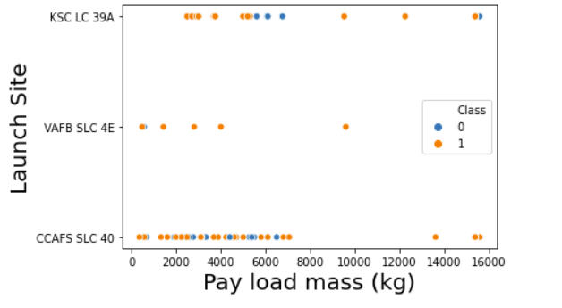
Launch site vs payload mass
At launch site CCAFS SLC 40, higher payload mass improves the success rate of a launch

Slide 19
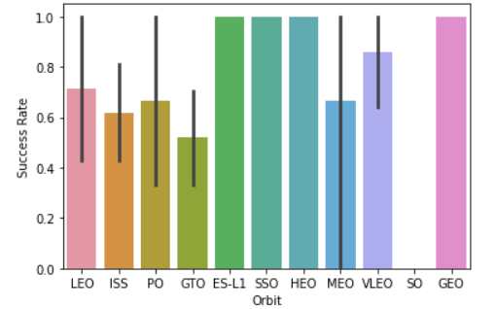
Success rate by orbit type
ES-L1, SSO, HEO, and GEO are the most successful orbit types

Slide 20
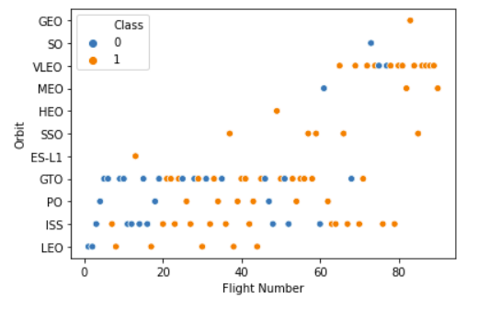
Orbit type vs flight number
In the Leo orbit, success seems to depend on a high Flight Number

Slide 21
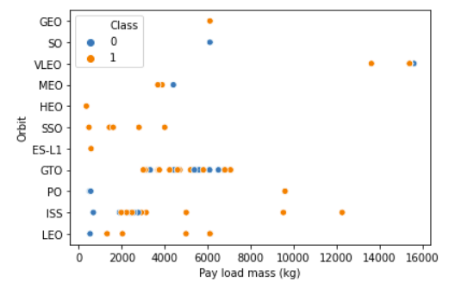
Orbit vs payload mass
High payload mass has a positive influence on ISS and LEO orbits

Slide 22
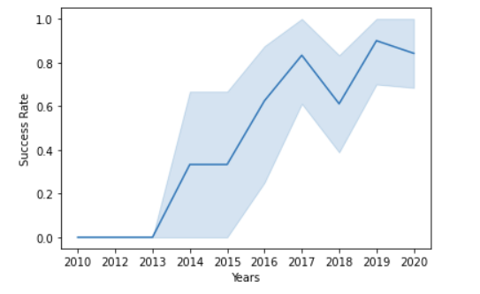
Success rate by year
Successful launches have become more likely over time

Slide 23
Eda with sql

Slide 24
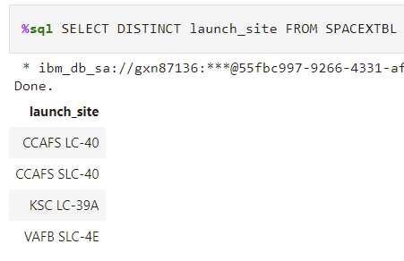
Display the names of the unique launch sites in the space mission
DISTINCT allows us to select unique values from a table

Slide 25
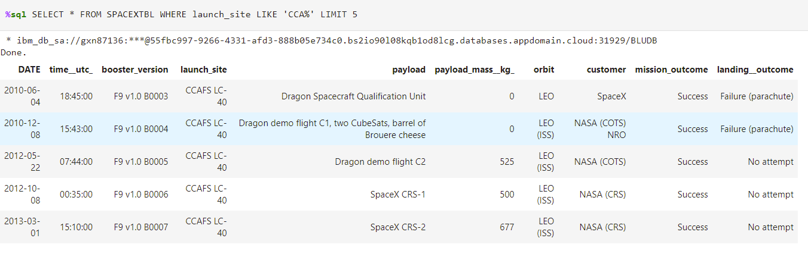
Display 5 records where launch sites begin with the string 'CCA’
LIKE allows us to select all launch types that start with CCA, and LIMIT allows us to limit our result to 5 rows

Slide 26
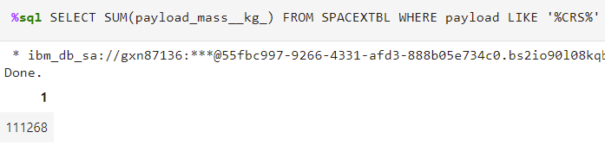
Display the total payload mass carried by boosters launched by NASA (CRS)
SUM allows us to calculate the total payload mass

Slide 27
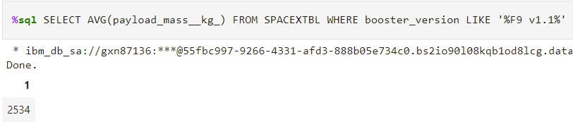
Display average payload mass carried by booster version F9 v1.1
AVG allows us to calculate the average payload mass

Slide 28
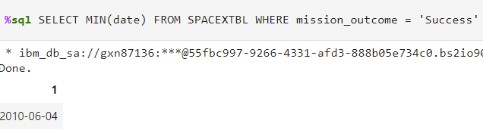
List the date when the first successful landing outcome in ground pad was achieved.
MIN allows us to select the earliest date

Slide 29
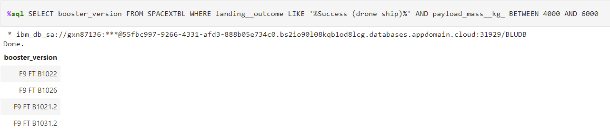
List the names of the boosters which have success in drone ship and have payload mass greater than 4000 but less than 6000
AND allows us to set multiple conditions for our query, and BETWEEN allows us to select values within our range

Slide 30
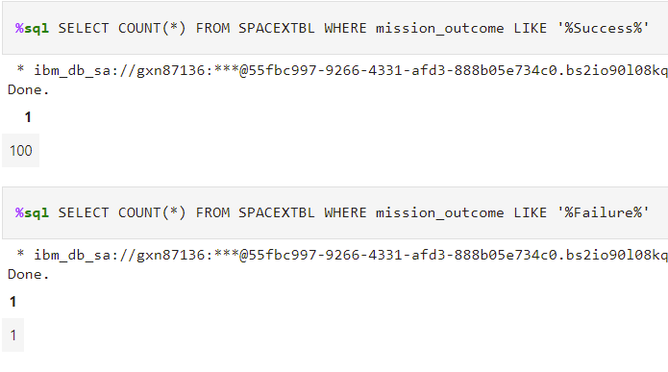
List the total number of successful and failure mission outcomes
COUNT allows us to count successful and failed outcomes

Slide 31
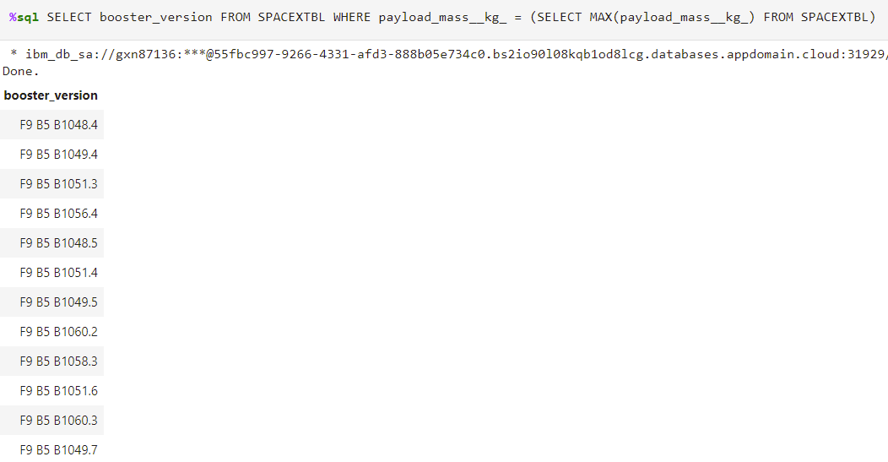
List the names of the booster_versions which have carried the maximum payload mass. Use a subquery
MAX allows us to select the largest payload mass

Slide 32
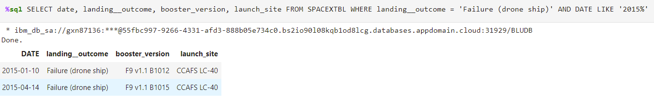
List the failed landing_outcomes in drone ship, their booster versions, and launch site names for in year 2015

Slide 33
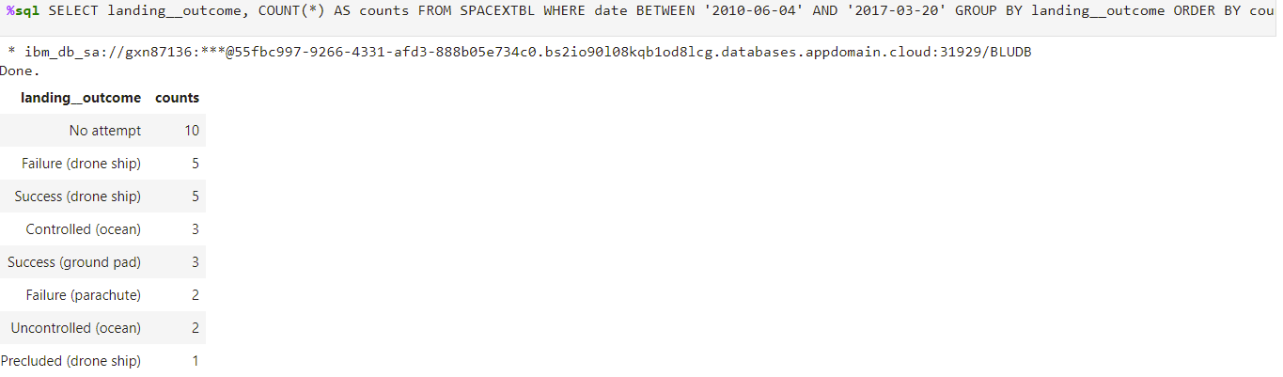
Rank the count of landing outcomes (such as Failure (drone ship) or Success (ground pad)) between the date 2010-06-04 and 2017-03-20, in descending order
GROUP BY allows us to group our results by landing_outcome, and ORDERBY allows us to rank them by the number of failed outcomes

Slide 34
Interactive map and dashboard with folium and dash

Slide 35
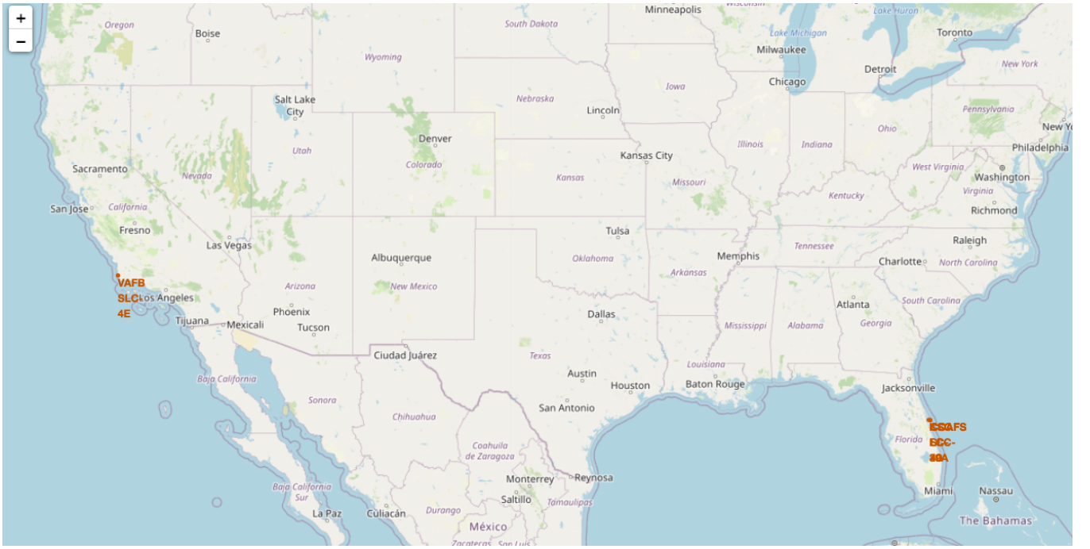
Launch sites by geographic location
The launch sites are located in California ad Florida

Slide 36
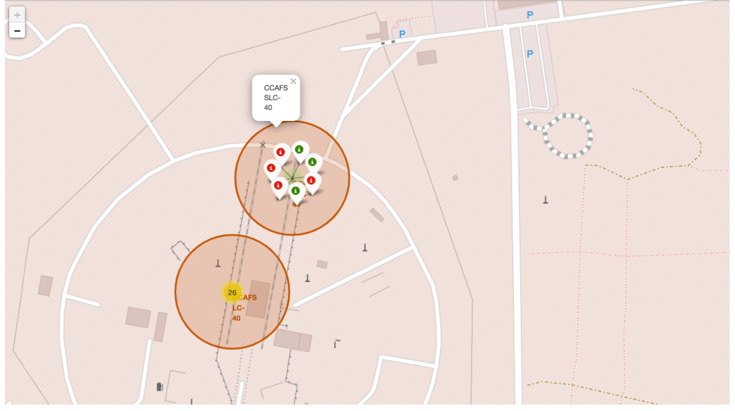
Launch labels
Green markers show a successful launch, Red labels show failures

Slide 37
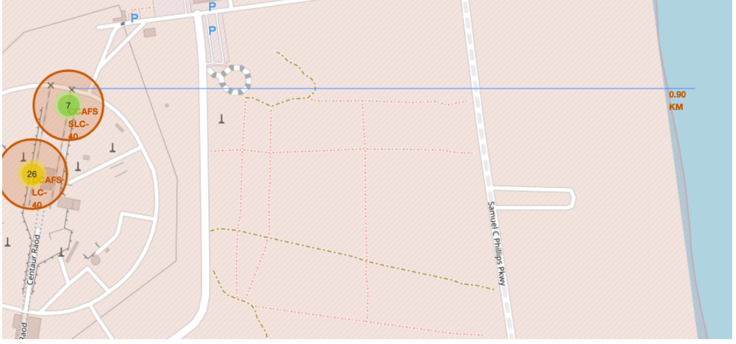
Distance to coast
Summary of findings:
•Are launch sites in close proximity to railways? No
•Are launch sites in close proximity to highways? No
•Are launch sites in close proximity to coastline? Yes
•Do launch sites keep certain distance away from cities? Yes
Here is an example of one of the distance measurements (to coastline)

Slide 38
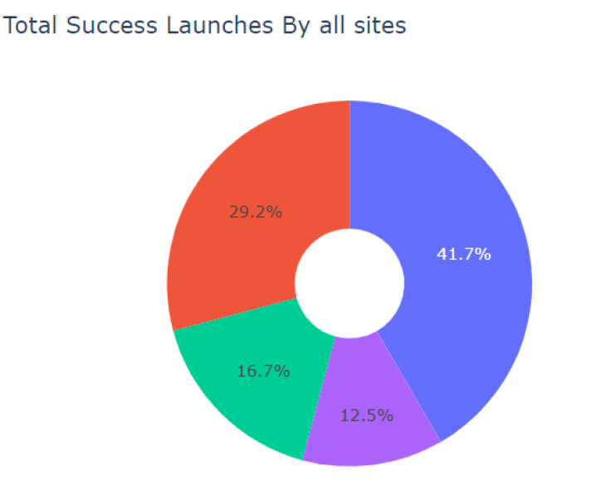
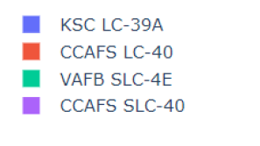
Total successes by launch site
We see that KSC LC-39A had the most successful launches

Slide 39
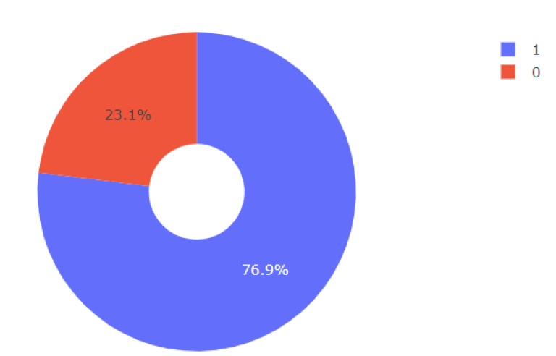
Success rate of KSC LC-39A
76.9% of launches were successful

Slide 40
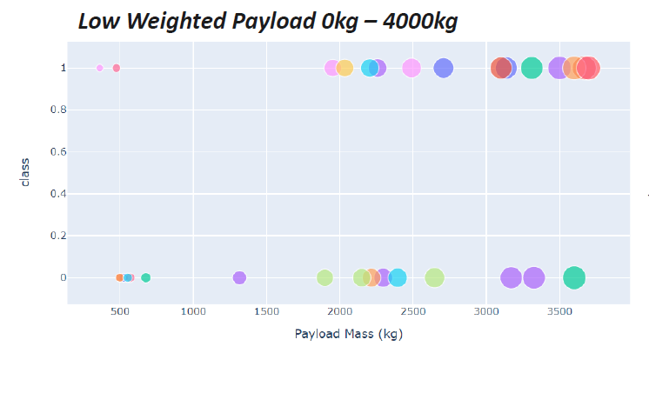
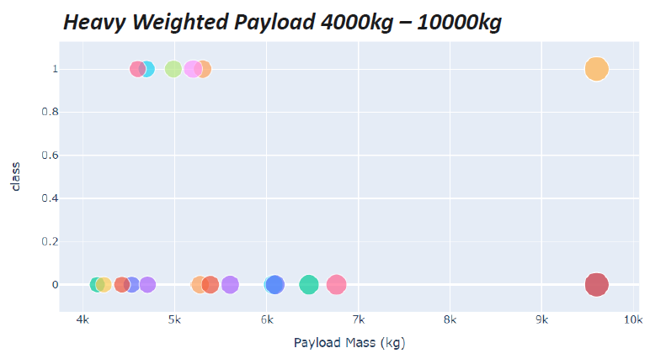
Success by payload mass
We can see that the success rate is higher for low weighted payloads

Slide 41
Predictive analysis

Slide 42
Ml evaluation
After training the models, the most accurate model on the test data was the decision tree model. However the results are quite close.
Above are the optimized hyperparameters for the Decision Tree

Slide 43
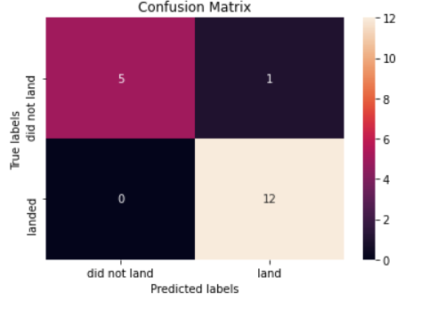
Decision tree confusion matrix
We can see that this confusion matrix is very good, and only has one incorrectly labelled launch.

Slide 44
Conclusion
Throughout this project, we unlocked many key insights for this data.
Here is a quick summary of some of the main ones:
Low weighted payloads outperform heavier ones
KSC LC-39A was the most successful of all launch sites
GEO, HEO, SSO, and ES-L1 were the most successful launch types
A Decision Tree was the best algorithm for predicting whether a launch would be successful from our data
The success rate has improved drastically over time, showing that SpaceX is learning from their data, and is adjusting the conditions of its launches to increase the probability of sucess

