Slide 1

Python
From basic to pro

Slide 2
Python
- High Level Language*
- Versatile in Application
- Web Application
- Data Science
- Automation
- Mobile Application
- Desktop Application
- Easy to Learn

Slide 3
Integrated Development Environment
Jupyter Notebook
Visual Studio Code
Pycharm
Atom
Spider
And many more
Online IDEs - colab

Slide 4
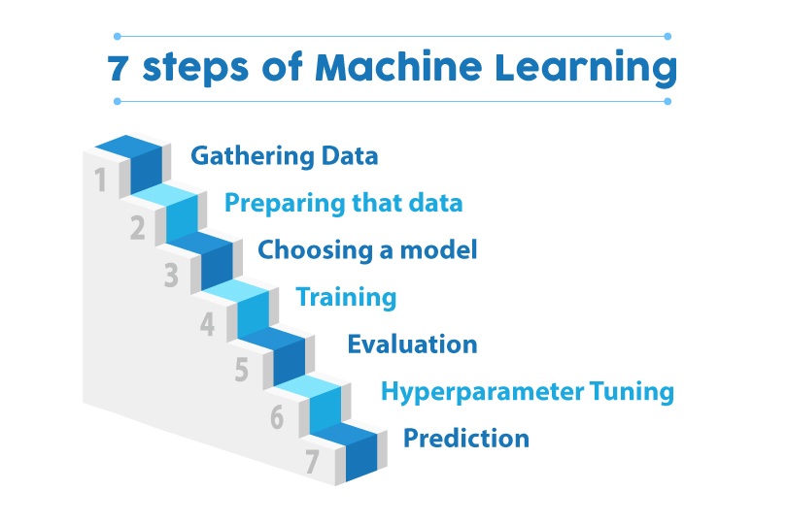

Slide 5
Let’s Code

