Slide 1

ORA PLAYER
M.Obay Daba
Rama Allafy
Alaa Gamoos
Supervision: Eng. Safwan Ghanem

Slide 2

Why Android ?

Slide 3
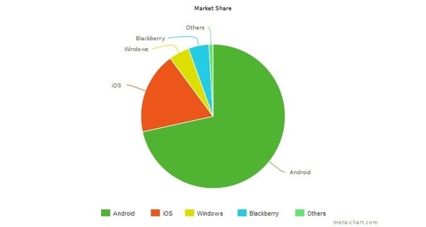
Why Android ?

Slide 4
ORA Features:
Cool & Easy Audio Player
Efficient Video Player
Simple Design

Slide 5
About ORA

Slide 6
Android Techniques
SharedPrefrences
Searchable configartion
Media MetaData Retriever
Navigation Drawer

Slide 7
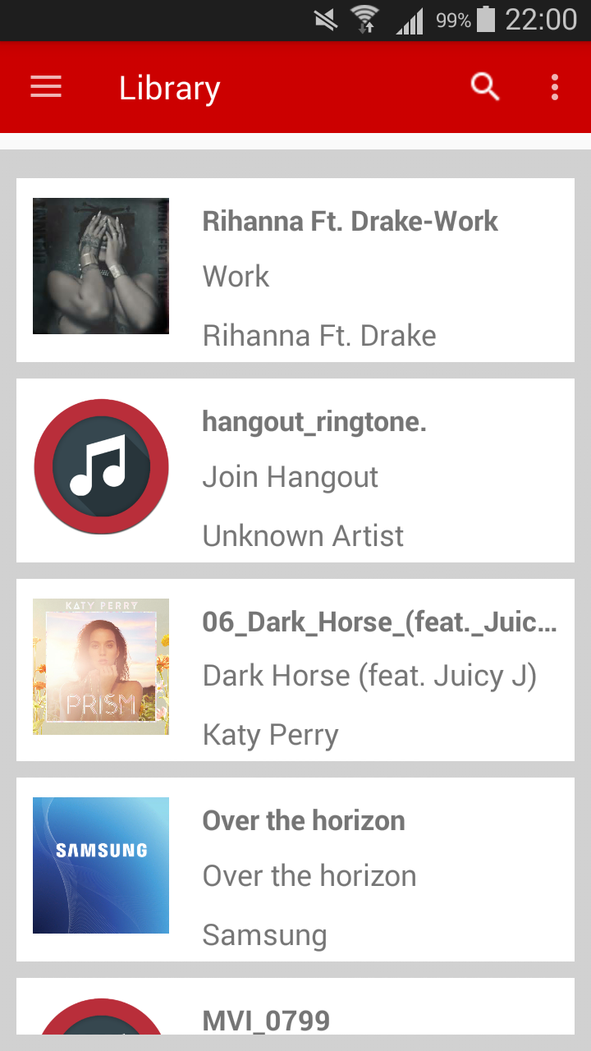
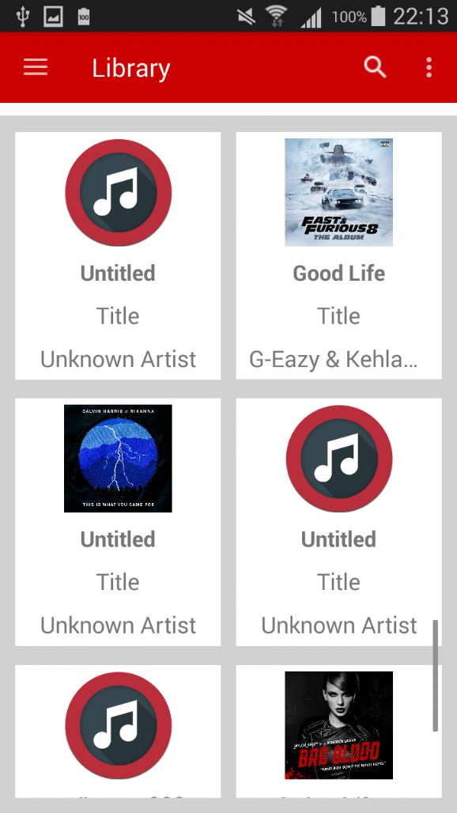
Simple Design

Slide 8
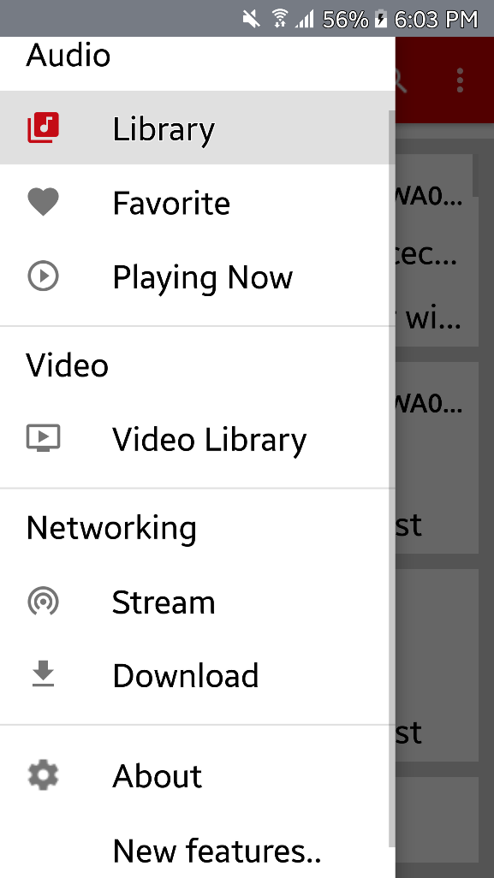
Easy to Navigate

Slide 9
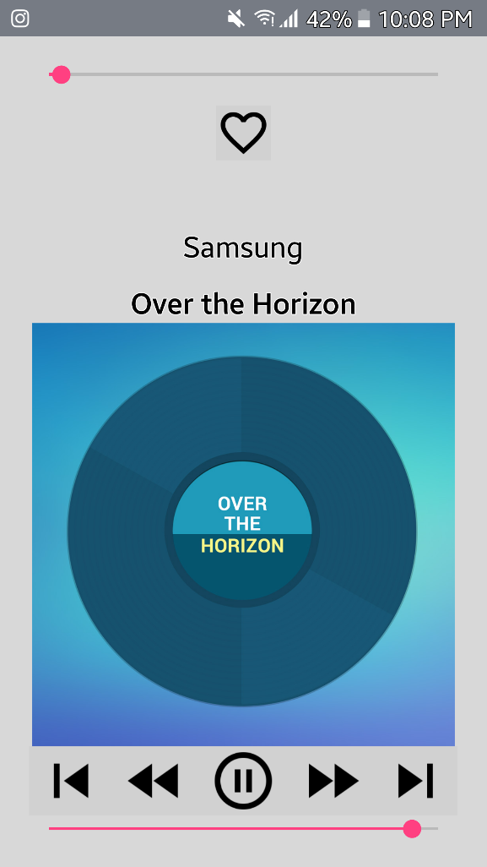
Audio Player

Slide 10
More Features
Audio Streaming
Media Downloader
Powerful Search

Slide 11

Similar App

Slide 12
ORA V VLC
 | ORA | VLC
Search | Automatically search for all media files in Device | Manual Search for media
Audio Player | Integrated Audio Player | Integrated Audio Player
Video Player | Classic Video Player | More Powerful Player
Favorite Playlist | supports | dose not support
Streaming | Stream only audio files | Stream all media files
Download | Audio & video | Audio & Video

Slide 13
Future Prospects:
More Video Related Features
More Media Format Supported
Add Online Radio
Sort Songs by Artist,Album,Genre ..

Slide 14
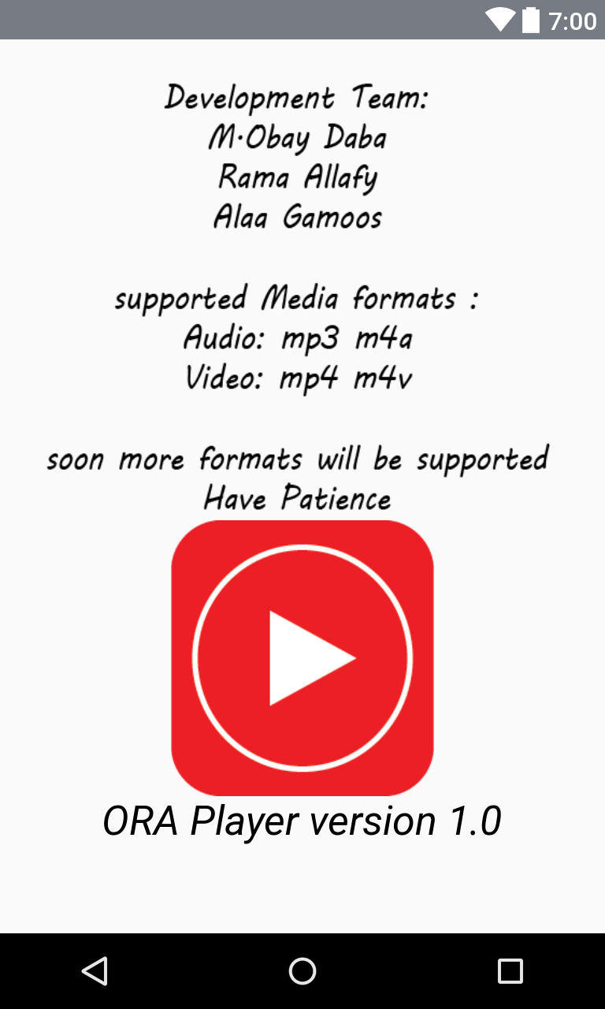

Slide 15
ORA PLAYER
M.Obay Daba
Rama Allafy
Alaa Gamoos
Supervision: Eng. Safwan Ghanem

