Slide 1

Dirty COW (CVE-2016-5195)

Slide 2
What is Dirty COW?
Present in majority of linux kernels since 2005 https://github.com/dirtycow/dirtycow.github.io/wiki/VulnerabilityDetails
An race condition exploit in the Linux kernel
Allows writing to protected file/memory
Easy root access to any vulnerable system

Slide 3
OS Memory Paging Review
Virtual Memory
Every process is allocated its own virtual memory address space which is divided into pages.
The virtual memory point to a physical address stored in the page tables.
Physical Memory
The memory management unit translates the virtual memory into a physical memory address when accessed
When memory is full the OS will swap pages in and out of memory as needed

Slide 4
Copy-on-Write (AKA The “COW”)
When a fork() occurs the OS does not allocate new memory to the new process but instead has the old memory in a read only state.
A reference counter is kept on the memory to ensure it is not thrown away.
When a process requests to modify this memory, the OS will then generate a private writable copy for the process to use in memory.

Slide 5
Manipulating Memory
madvise()
“/proc/self/mem”
As the name implies this file points to the memory of a process making the call
By opening this with a file descriptor we are able to write directly to memory
We use this instead of directly writing to mmap as this function will run through the kernel’s flawed code.
A system call used to give directions/advise to the kernel on managing specific memory address space
“MADV_DONTNEED: Do not expect access in the near future. (For the time being, the application is finished with the given range, so the kernel can free resources associated with it.)”

Slide 6
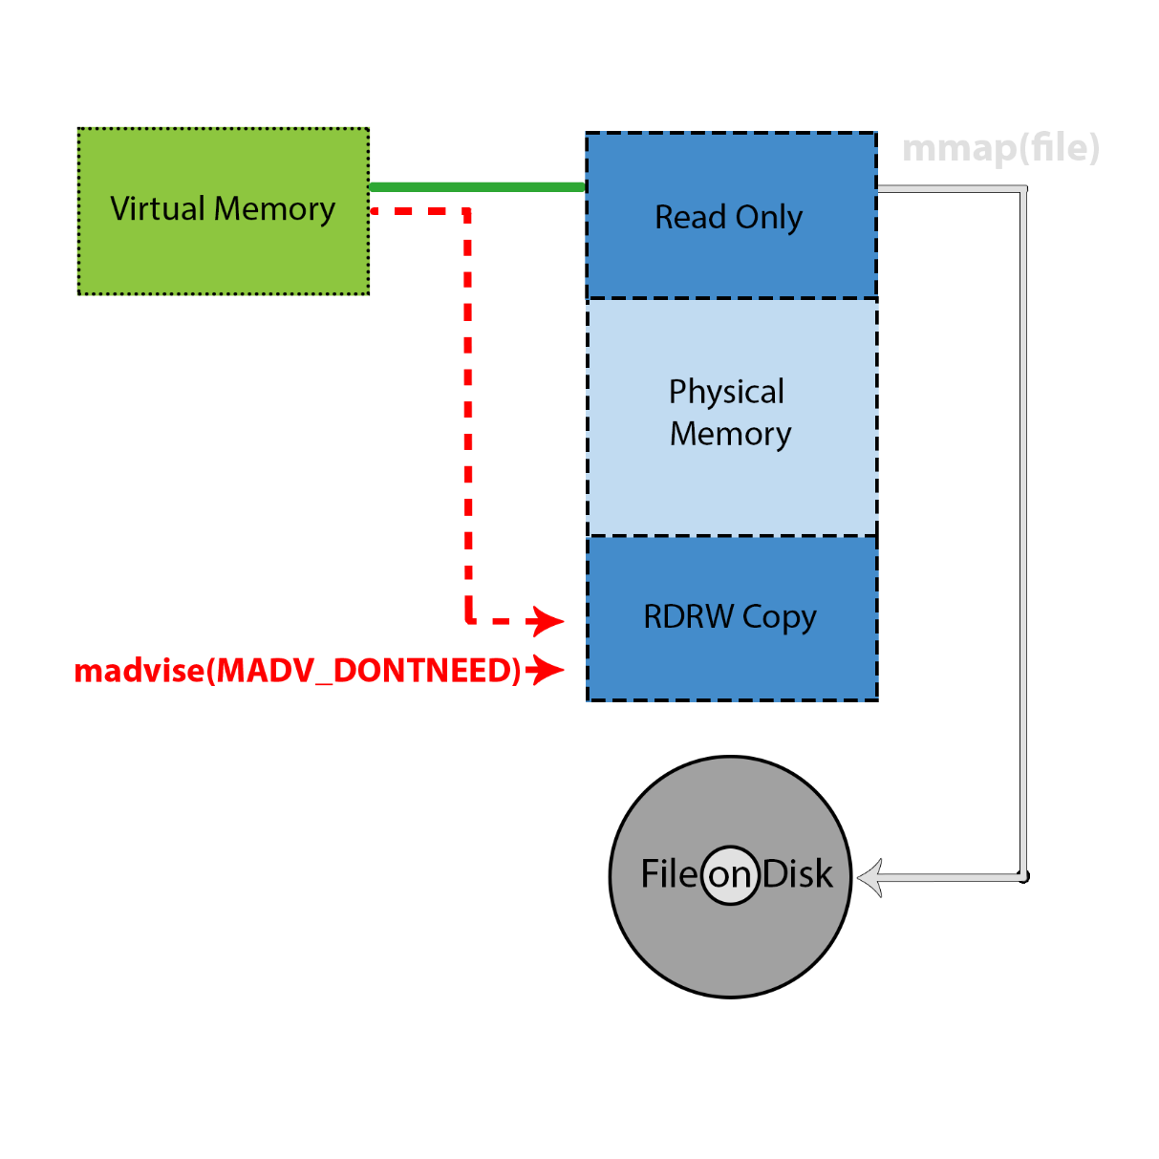
Dirty COW At-a-Glance
Copy-on-write has two non-atomic actions
Create a copy in memory
Write to the new copy
madvise(MADV_DONTNEED) tells the kernel to remove the page from memory
Dirty COW is when madvise happens between the two actions of CoW

Slide 7
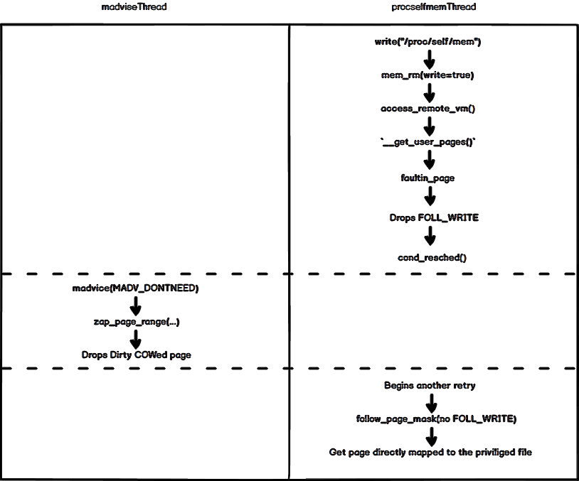
The Guts of the Dirty COW
https://github.com/dirtycow/dirtycow.github.io/wiki/VulnerabilityDetails

Slide 8
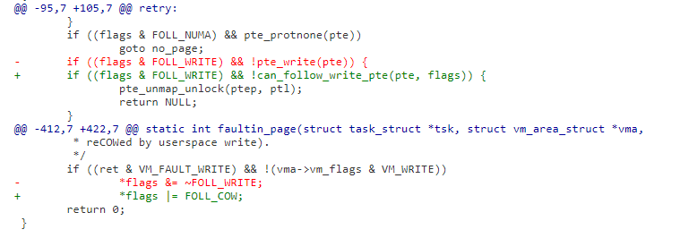
Cleaning The Dirty COW (The Fix)
“To fix it, we introduce a new internal FOLL_COW flag to mark the "yes, we already did a COW" rather than play racy games with FOLL_WRITE that is very fundamental, and then use the pte dirty flag to validate that the FOLL_COW flag is still valid.”
https://git.kernel.org/pub/scm/linux/kernel/git/torvalds/linux.git/commit/?id=19be0eaffa3ac7d8eb6784ad9bdbc7d67ed8e619

Slide 9
References
https://github.com/dirtycow/dirtycow.github.io/wiki/VulnerabilityDetails
https://chao-tic.github.io/blog/2017/05/24/dirty-cow
https://www.youtube.com/watch?v=PCKhmPTDurg

