Slide 1
Intro to Deep learning
Session – 03: Training Neural Networks
Instructor: Diego Corona
The University of Manchester

Slide 2
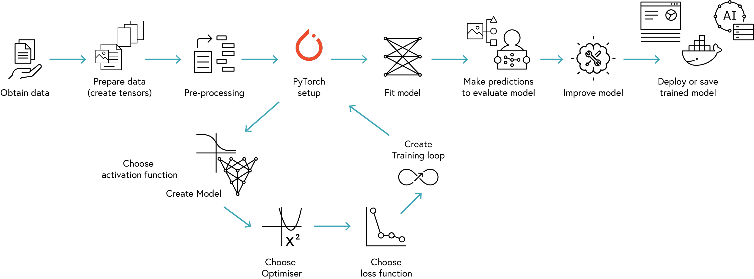
WORKFLOW

Slide 3
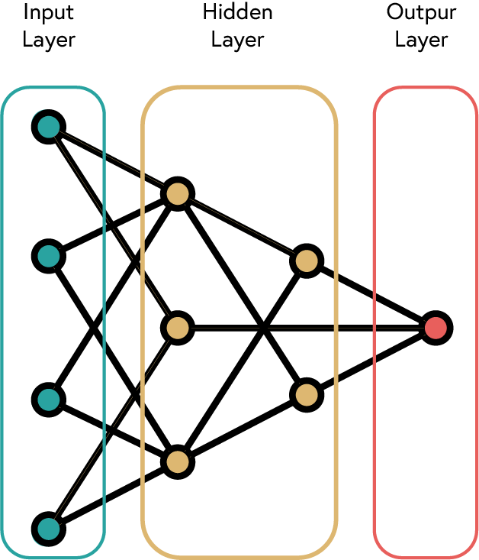
Layers

Slide 4
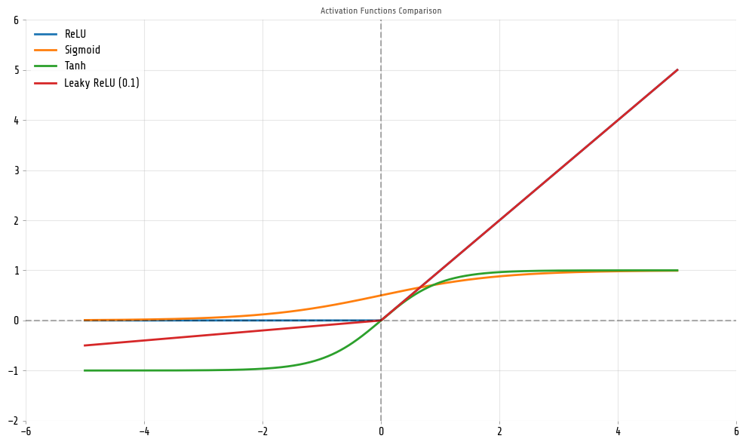
Activation functions

Slide 5
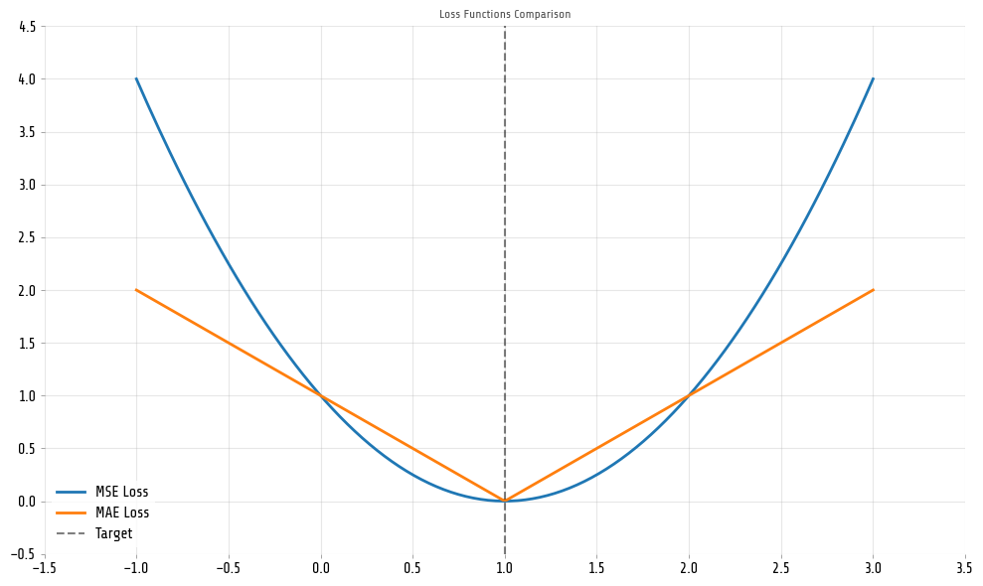
Loss functions

Slide 6
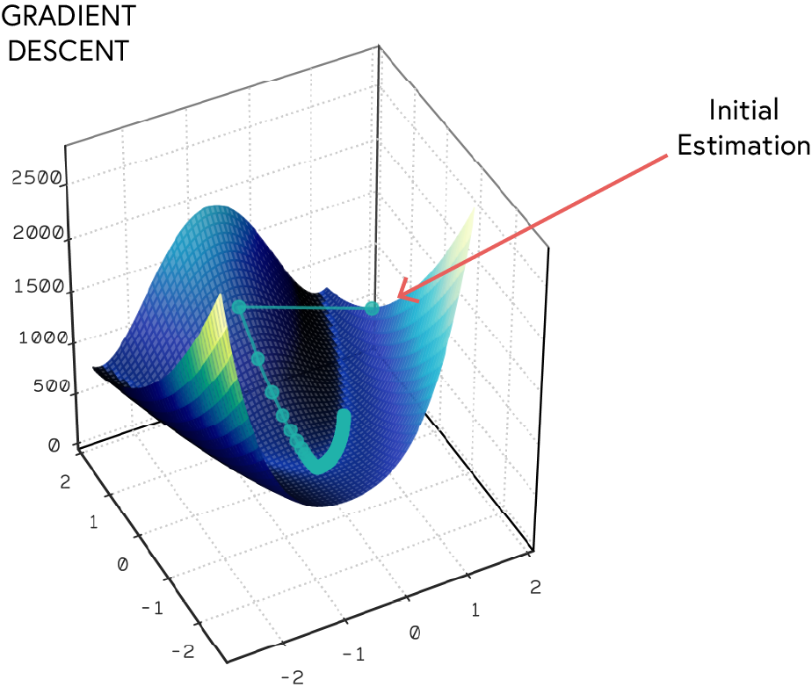
Optimiser

Slide 7
Training Loop

Slide 8
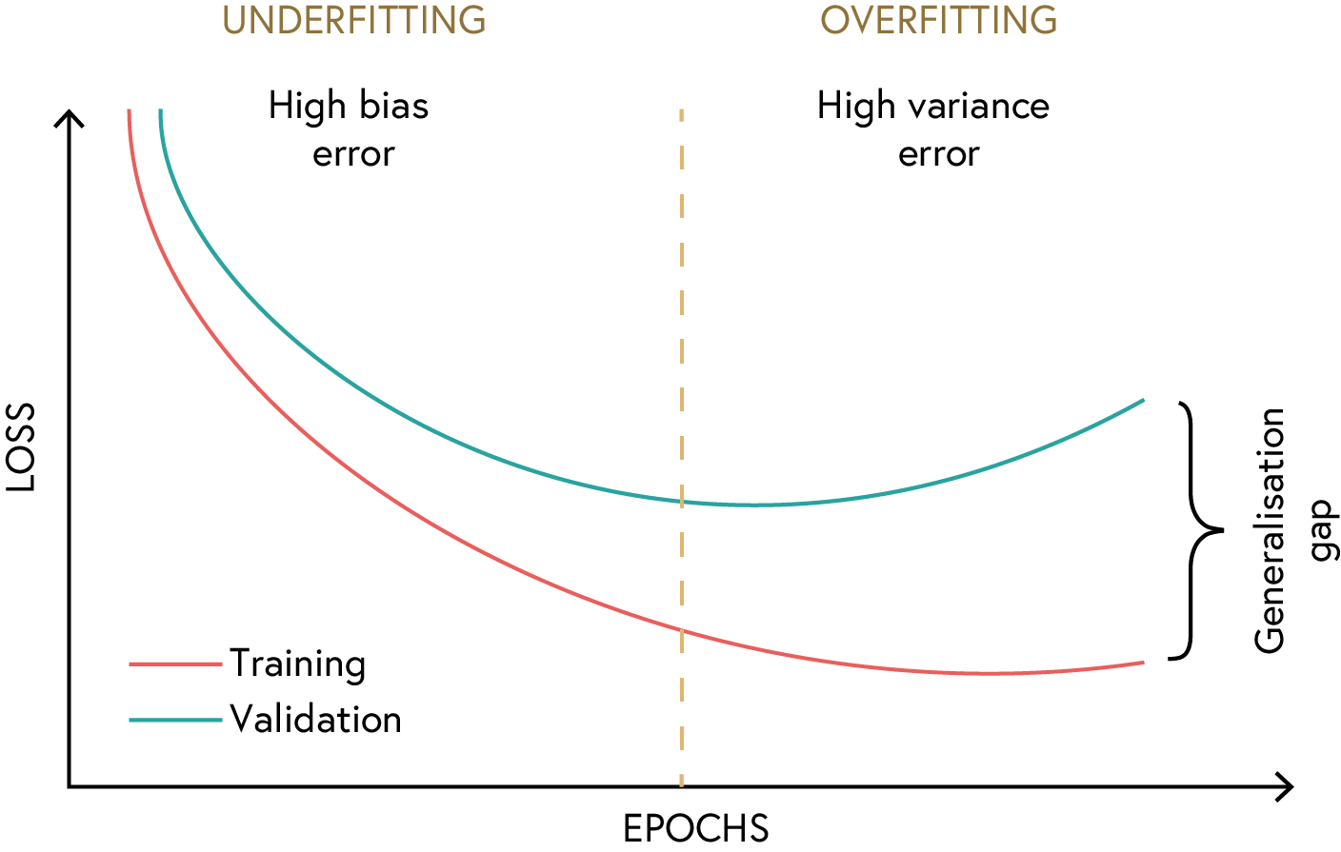
Evaluation

Slide 9
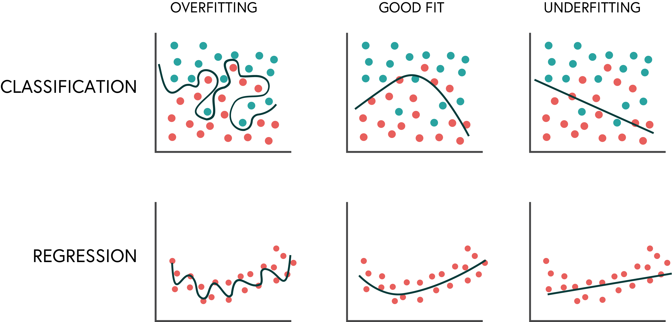
Evaluation

