Slide 1
Pre-Training Based Personalized Dialogue Generation Model with Persona-sparse Data
Yinhe Zheng^{1,3*}, Rongsheng Zhang^{2*}, Xiaoxi Mao², Minlie Huang¹
1. Tsinghua University
2. Fuxi AI Lab NetEase Inc.
3. Samsung Research
* Yinhe Zheng and Rongsheng Zhang contributed equally

Slide 2
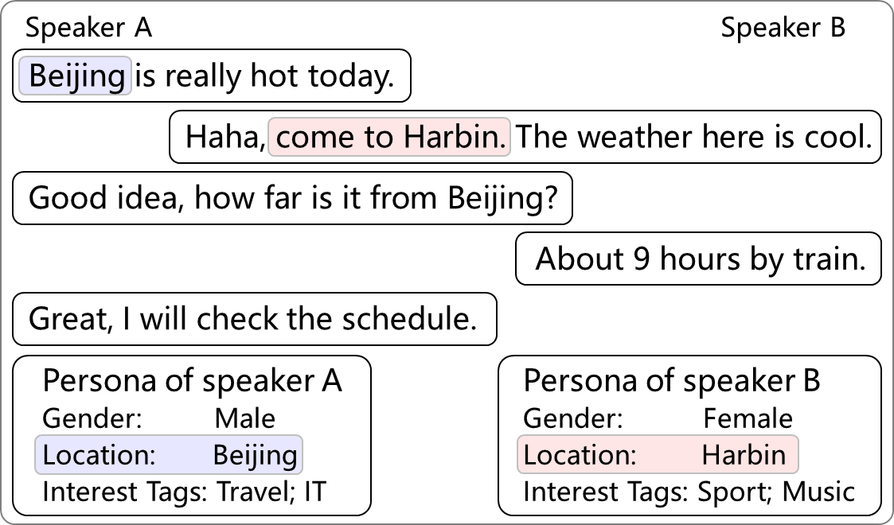
Open-domain Dialogues are Persona-sparse
Persona related
Persona related
Non-persona related
Non-persona related
Non-persona related
An example dialogue sampled from the PersonalDialog dataset

Slide 3
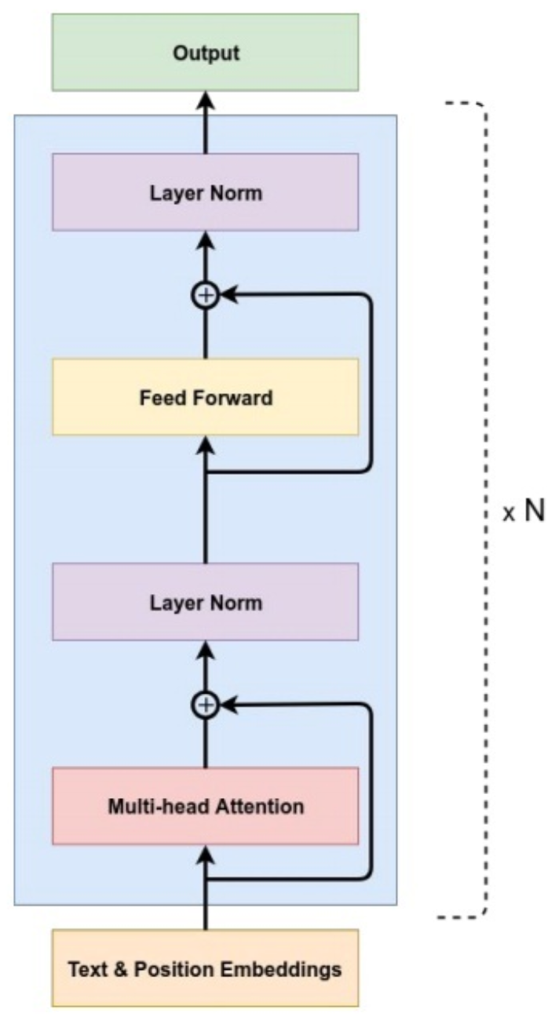



Problems When Using Persona-dense Data
I need to exhibit my persona ASAP
I need to exhibit my persona ASAP
Nice to meet you
Fine-tune with PERSONA-CHAT
Pre-trained GPT
How PERSONA-CHAT is collected
Direct fine-tuning lead to in-coherent responses

Slide 4
Our Contribution
A pre-training-based dialogue model that can utilize persona-sparse dialogue data
An attention routing mechanism to control the amount of persona-related features to exhibit in the response

Slide 5
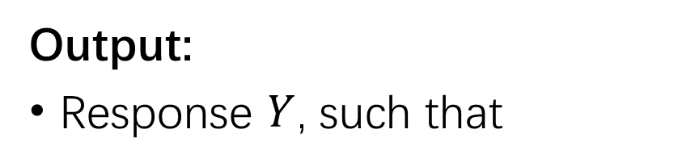
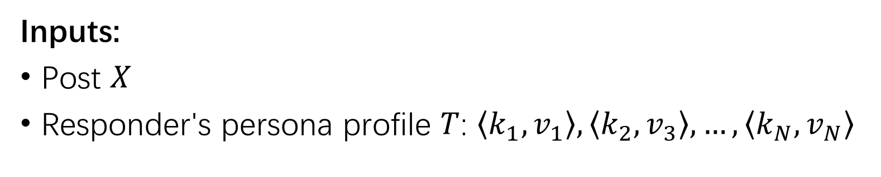
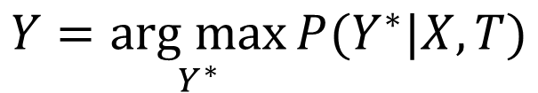
Task Formulization
Inputs:
Post $X$
Responder's persona profile $T$: $\left\langle k_{1},v_{1}\right\rangle , \left\langle k_{2},v_{3}\right\rangle , …,\left\langle k_{N},v_{N}\right\rangle$
Output:
Response $Y$, such that
$$Y=\underset{Y^{∗}}{arg max}{P(Y^{∗}|X, T)}$$

Slide 6
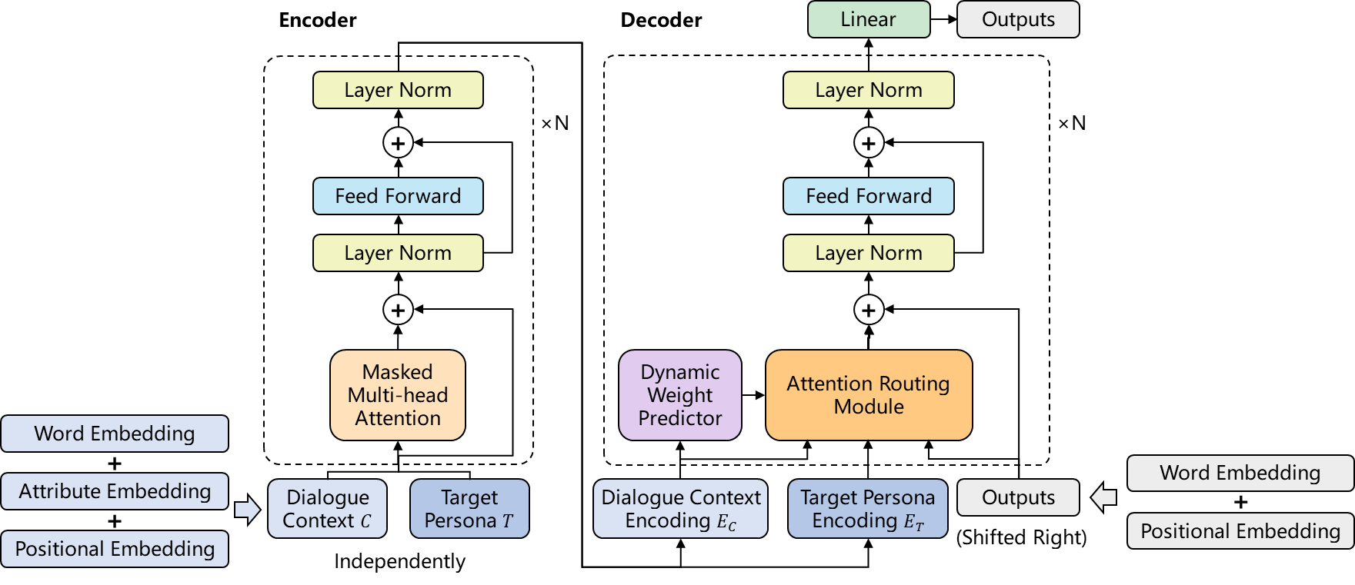
Model: Overview
2
1

Slide 7
Model: Overview
2
1

Slide 8
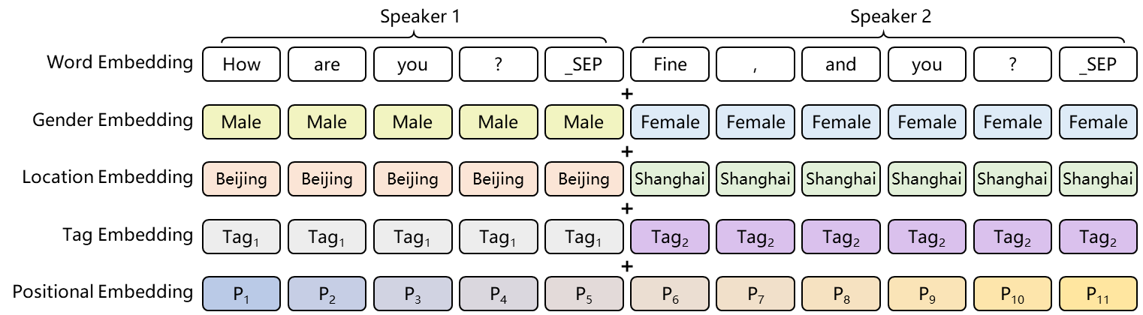
Model: Attribute Embedding
The input representation of the dialogue context
The input embedding for each token is the sum of
A word embedding
A positional embedding
Attribute embeddings (Gender embeddings, Location embeddings, Tag embeddings)

Slide 9
Model:
2

Slide 10
Model: Attention Routing

Slide 11
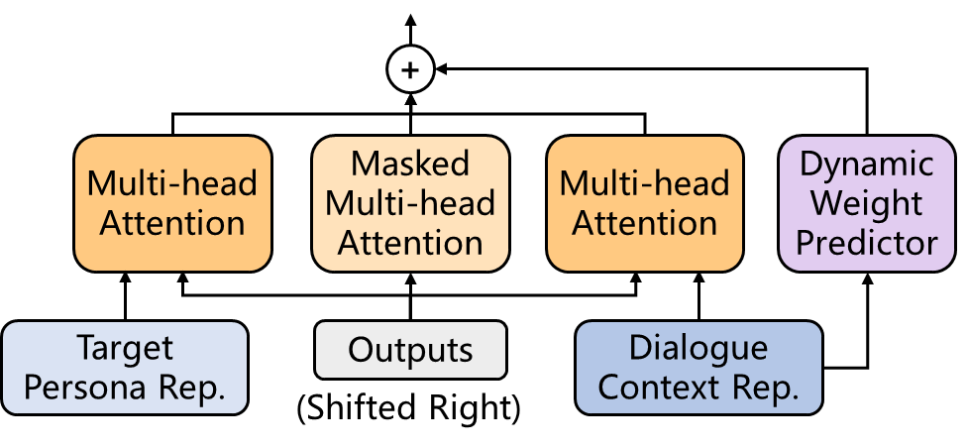







Model: Attention Routing
Dynamic Weight predictor
$$α=P_{θ}(is persona related|E_{C})$$
Attention Routes
Query
Key
Value
$$E_{T}$$
$$E_{prev}$$
$$E_{C}$$
$$O_{T}=MultiHead(E_{prev},E_{T},E_{T})$$
The weight predictor and three attention routes
$$O_{c}=MultiHead(E_{prev},E_{c},E_{c})$$
$$O_{prev}=MultiHead(E_{prev},E_{prev},E_{prev})$$
$$O_{merge}=αO_{T}+\left(1−α\right)O_{C}+O_{C}+O_{prev}$$

Slide 12
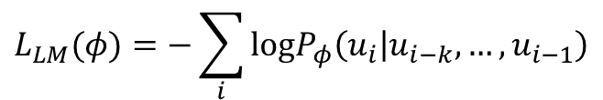
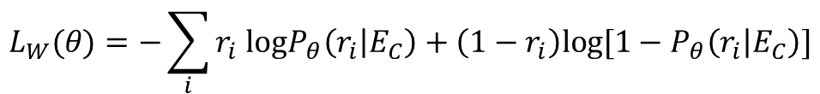
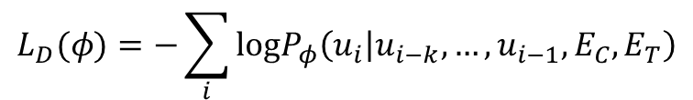
Model: Loss and Training
Loss:
Predictor loss:
$$L_{W}(θ)=−\sum_{i}{r_{i} logP_{θ}\left(r_{i} | E_{C}\right)+\left(1−r_{i}\right)log⁡[1−P_{θ}\left(r_{i} | E_{C}\right)]}$$
Language model loss:
$$L_{LM}(φ)=−\sum_{i}{logP_{φ}\left(u_{i} | u_{i−k},…,u_{i−1}\right)}$$
Dialogue model loss:
$$L_{D}(φ)=−\sum_{i}{logP_{φ}\left(u_{i} | u_{i−k},…,u_{i−1},E_{C},E_{T}\right)}$$
Total loss:
$$L\left(φ,θ\right)=L_{D}\left(φ\right)+λ_{1}L_{LM}\left(φ\right)+λ_{2}L_{W}(θ)$$
Training:
The encoder and decoder share a same set of parameters
Parameters are initialized using a pretrained GPT model

Slide 13
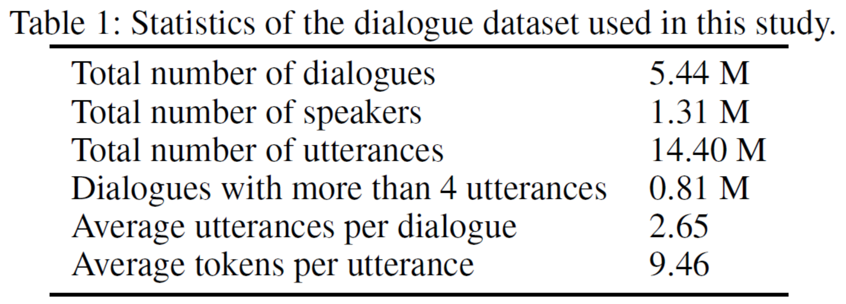
Dataset: PersonalDialog
Three persona attributes were approached (“Gender”, “Location”, and “Interest Tags”)
Two test sets are used: random test set and biased test set

Slide 14
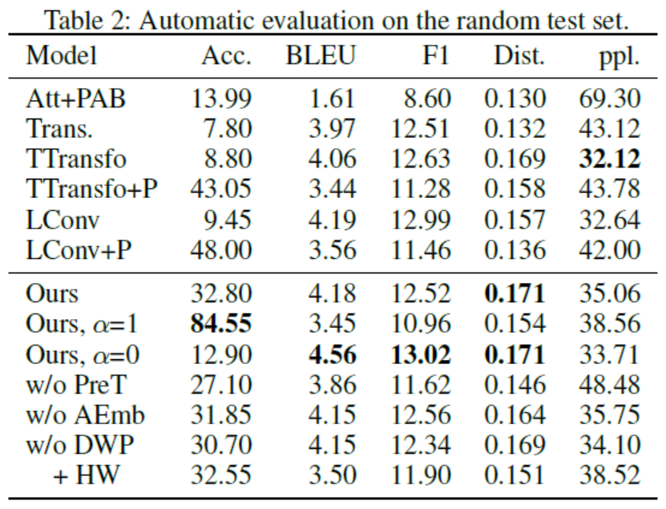
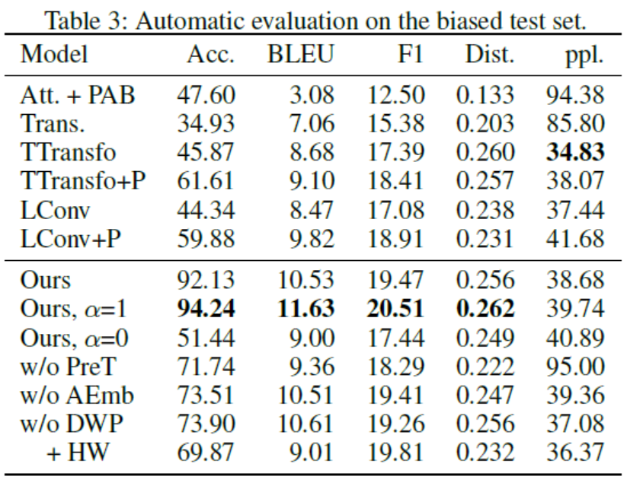
Automatic Evaluation
Metric:
(1) Persona Accuracy, (2) BLEU, (3) F1, (4) Distinct

Slide 15
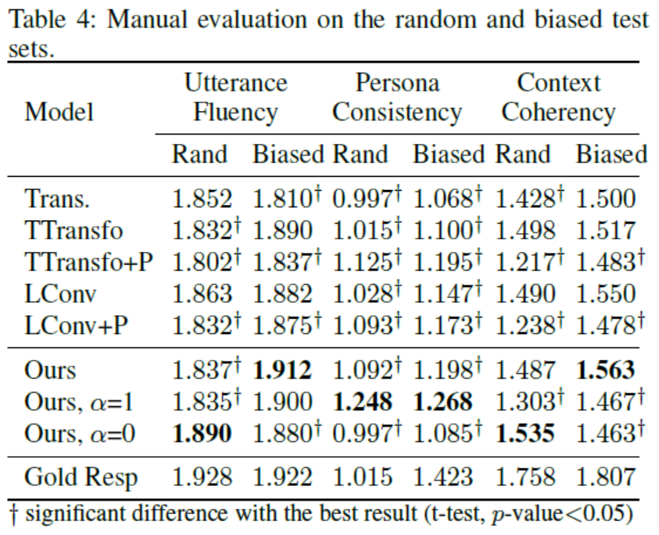
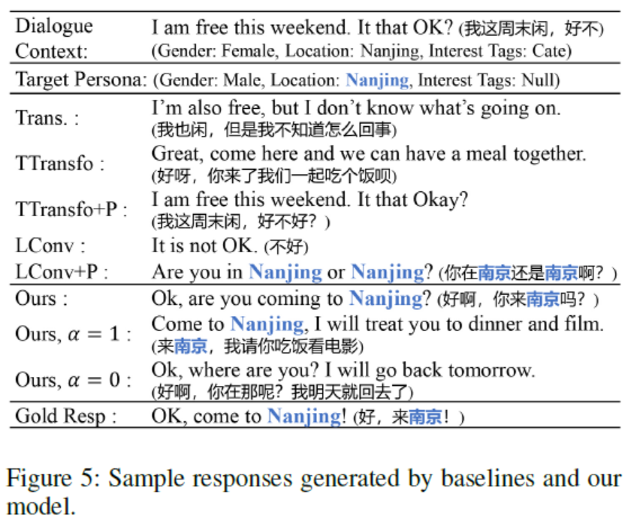
Manual Evaluation
Metric:
(1) Utterance Fluency, (2) Persona Consistency, (3) Context Coherency

Slide 16
Conclusion
Our model can produce coherent and persona-consistent responses
The dynamic routing mechanism helps to utilize persona-sparse dialogues
There are trade-offs between persona consistency and context coherency

