Slide 1
Multi-Scale Self-Attention for Text Classification
Qipeng Guo* Xipeng Qiu Pengfei Liu Xiangyang Xue Zheng Zhang
Fudan University
AWS Shanghai AI Lab
*presenter

Slide 2
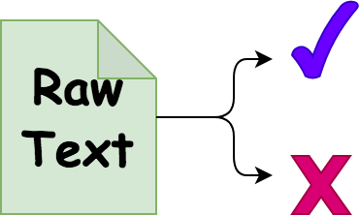
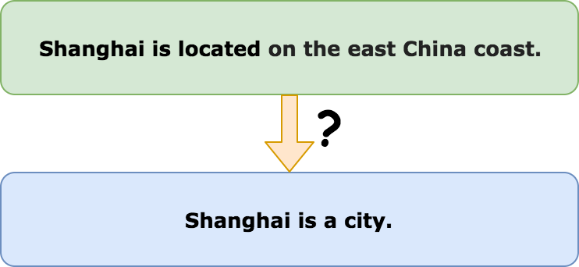
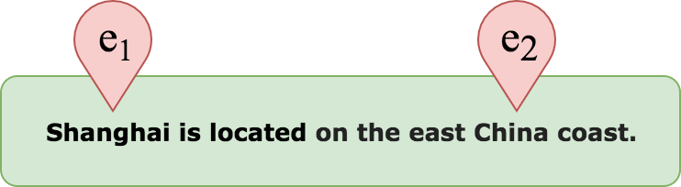
Classification Tasks
Text Classification, Sequence Labeling, Natural Language Inference

Slide 3
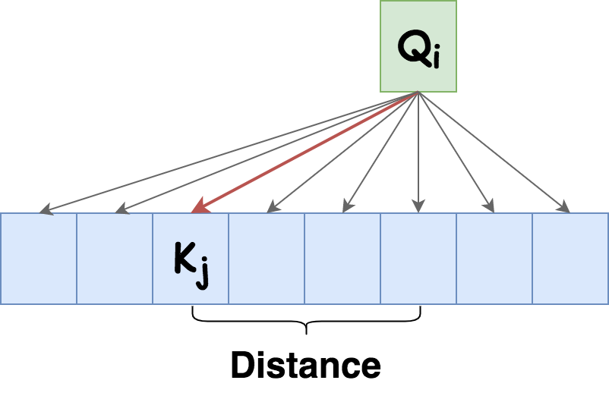
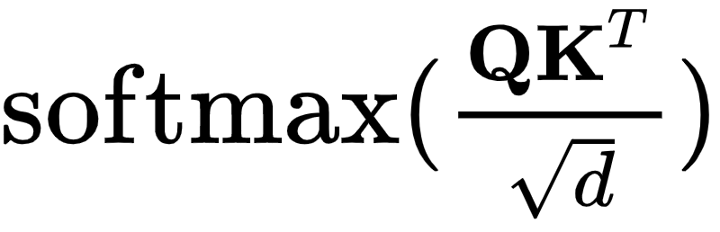
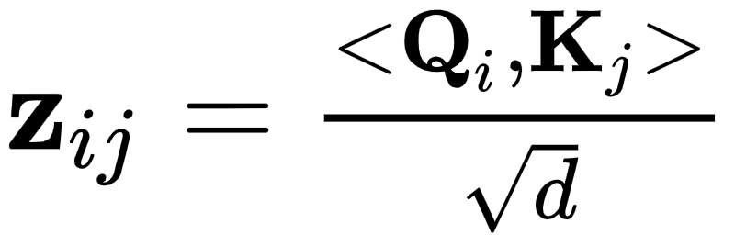
Attention? Scale?
The scale measures the distance between two endpoints of attention edges on average.

Slide 4
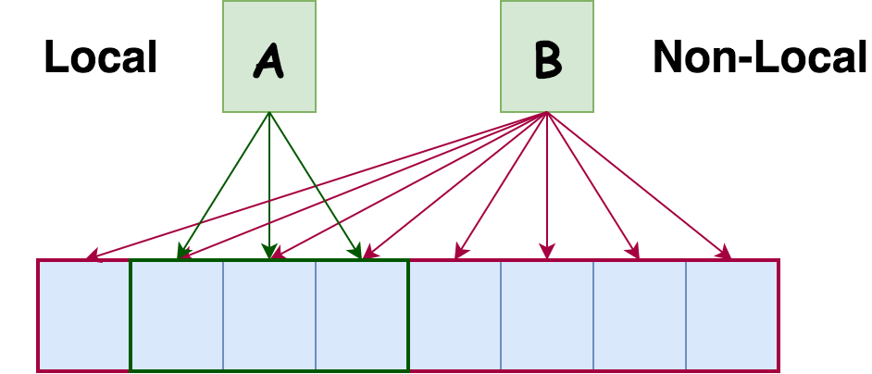
Which scale should be used?
Small-Scale: Local patterns, N-gram
Large-Scale: Non-Local patterns, long-term dependencies

Slide 5
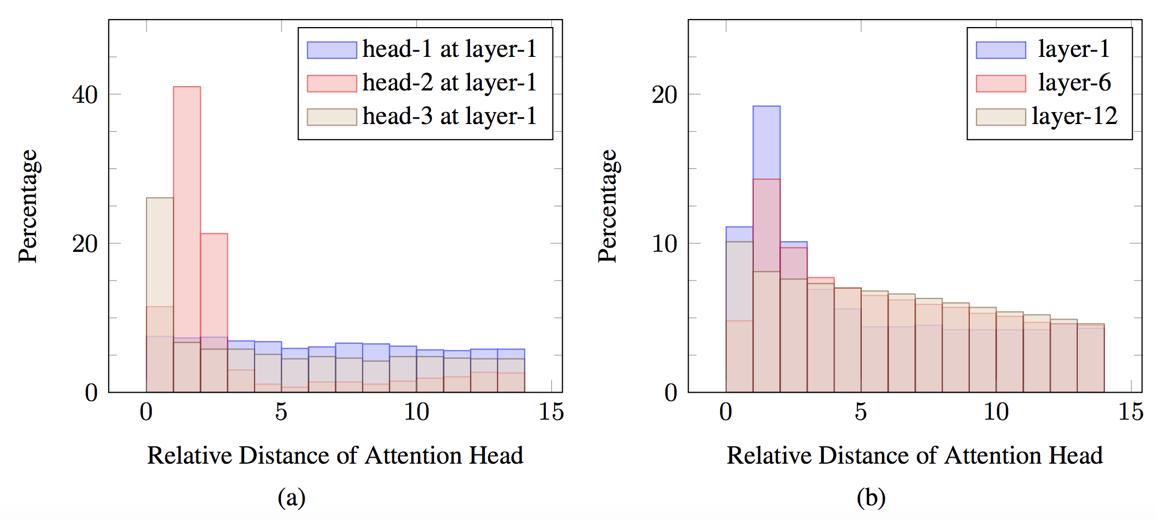
Observations of Pre-trained models
It is hard to make the trade-off. Take a look at what the model learned from data.
Results from BERT

Slide 6
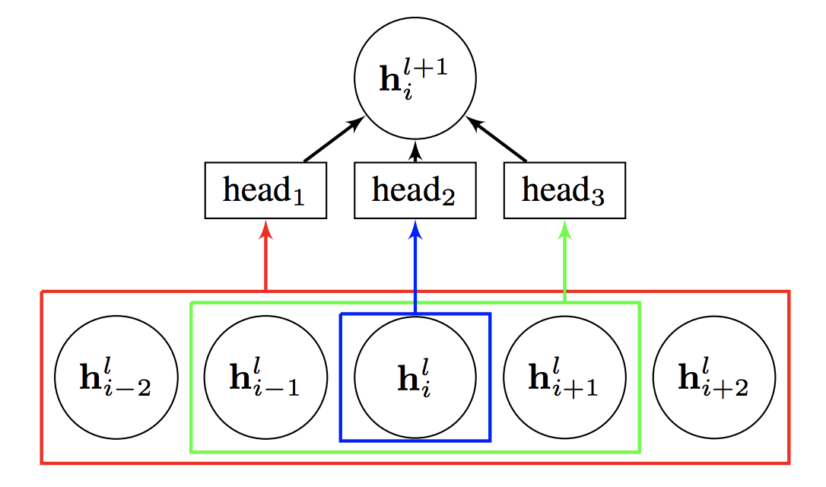
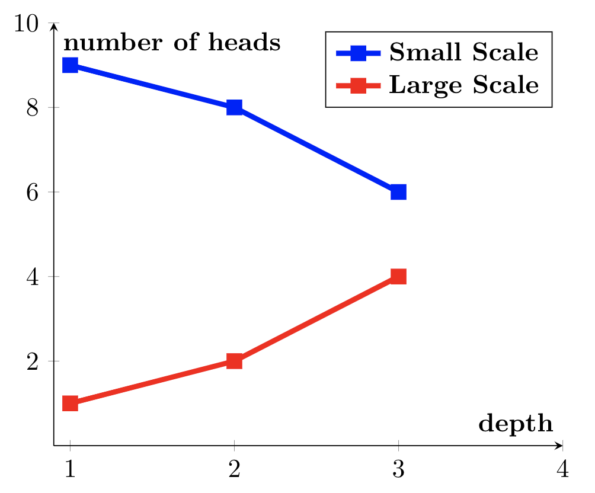
Impact on model design
Different attention heads may work on different scales.
There is a trend of scale over multiple layers.

Slide 7
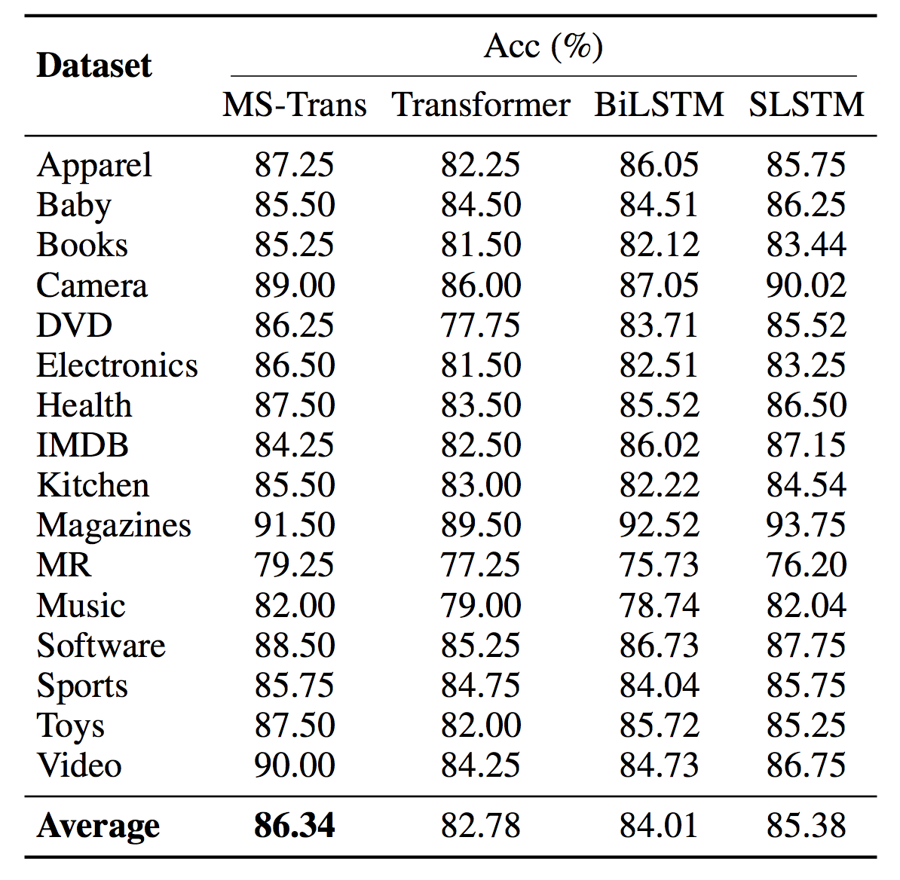
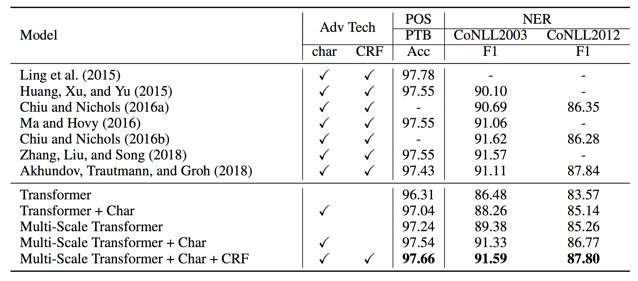
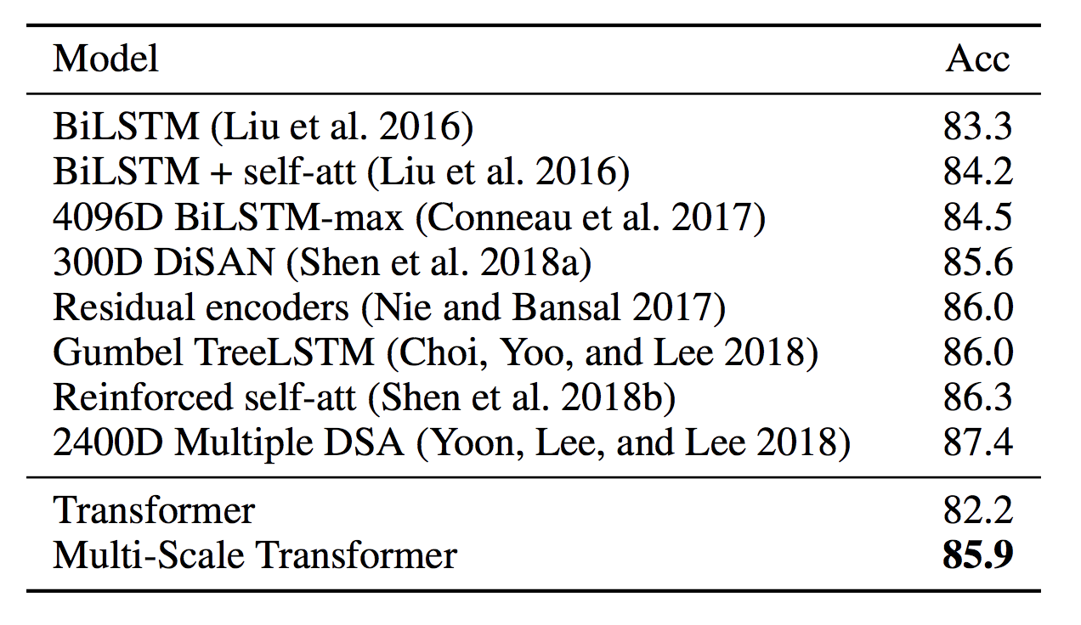
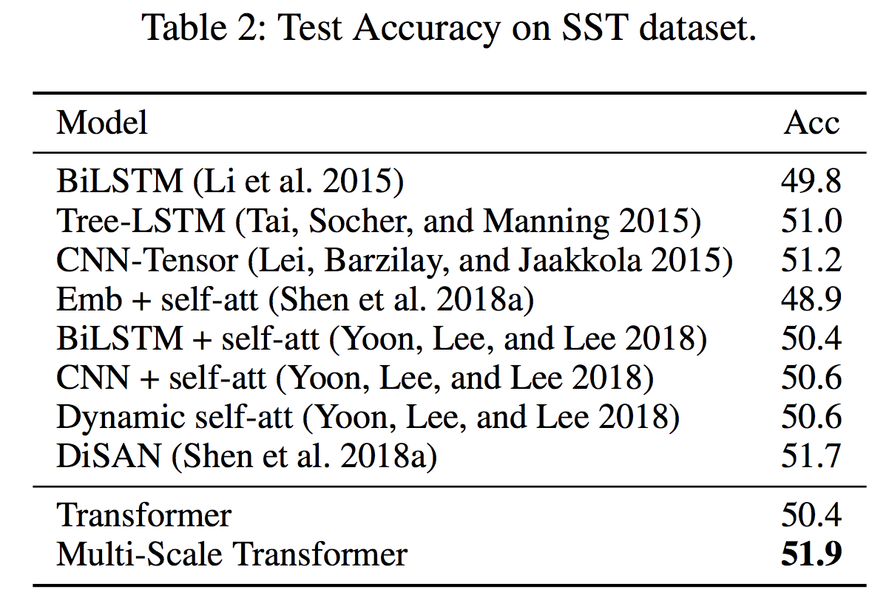
Experiments

Slide 8
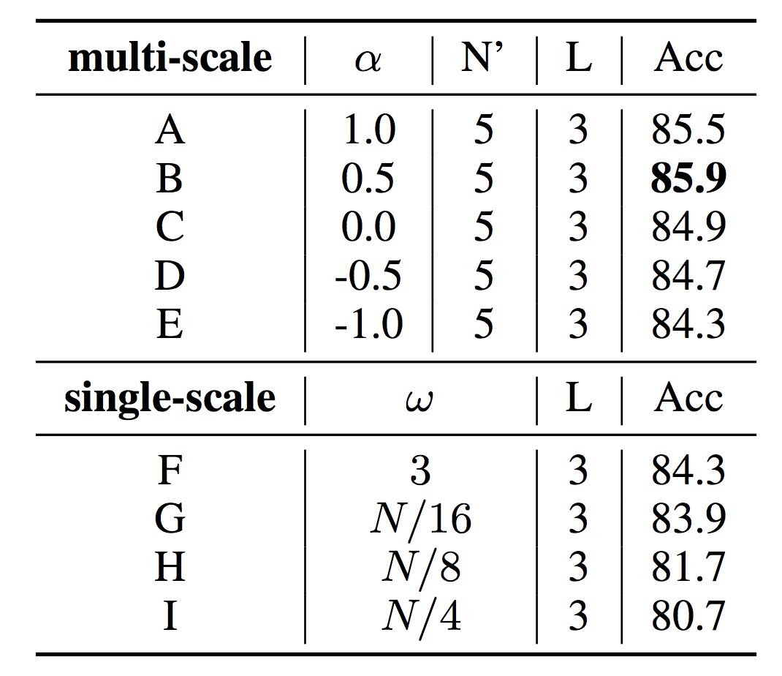
Ablation Study and Hyper-parameters
Single-Scale vs. Multi-Scale
Ascending vs. Descending

Slide 9
Conclusion
Both small- and large-scale are important to language understanding
The observation of BERT provides some guidelines of the model design
The trade-off of scale is non-trivial, our experiments show that multi-scale models outperform than the single-scale

Slide 10
Thank you for listening
Fudan University
AWS Shanghai AI Lab

