Slide 1

Supervised machine Learning - predicting housing prices
M.Colombatti, M.Havlíčková & M. Bazzani

Slide 2
Importing the dataset - Preparation
Grouped features:
Geographical identifier
Features of the listing
Micro ratings
Descriptive variables about the surrounding area
We split the data into 3 datasets:
Training_reduced_large: which includes both micro ratings and descriptive variables about the surrounding area. k = 41 variables.
Training_microrating: with the micro ratings and data about the listing. k = 34 variables.
Training_no_microrating: without the micro-ratings to surpass possible covariance in linear regression. k = 21 variables
Notes:
Geographical identifier they provide information on where the listing is located around Switzerland
Features of the listing they provide additional information about the characteristic of the listing. The predictors in this group provide essential information on the equipment and services available in the listing, more details about the building in which the listing is located, and information regarding the listing itself, like the area
Micro ratings: they provide additional information about the desirability of the listing, when external factors are taken in consideration. Example of external elements are the noise level of the area, the sun exposure of the listing and the distance to the services. Micro ratings help to describe and categorize the area where the listing is located.
Descriptive variables about the surrounding area: similar to the micro ratings, they provide more information about the desirability of a listing, when calculating external factors. They provide a more detailed view, compared to the micro_ratings

Slide 3
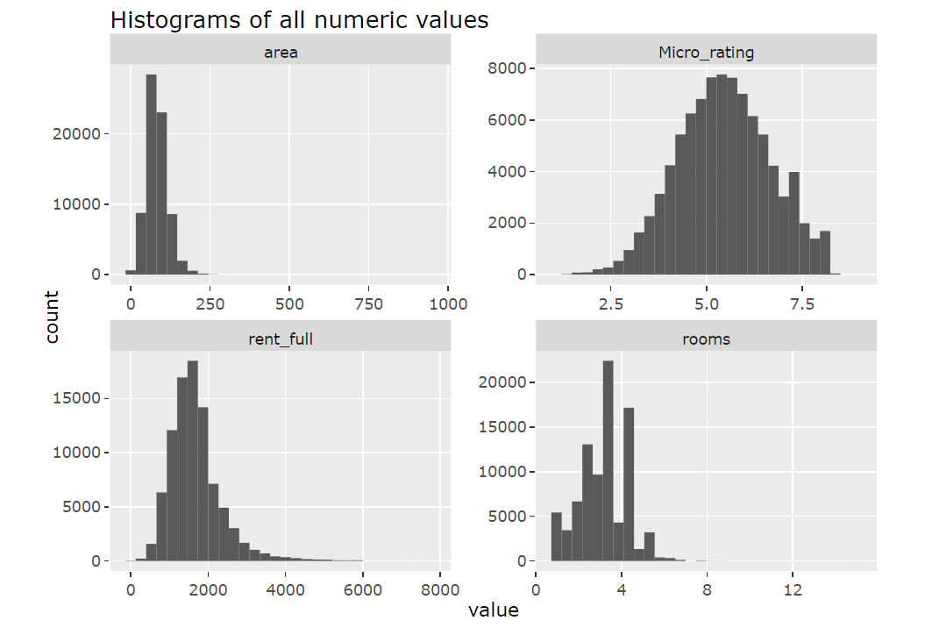
Basic Exploration
Most of them are not evenly distributed, and have either a right- or a left skew
This can be fixed by a log-transformation
After we normalize the data

Slide 4
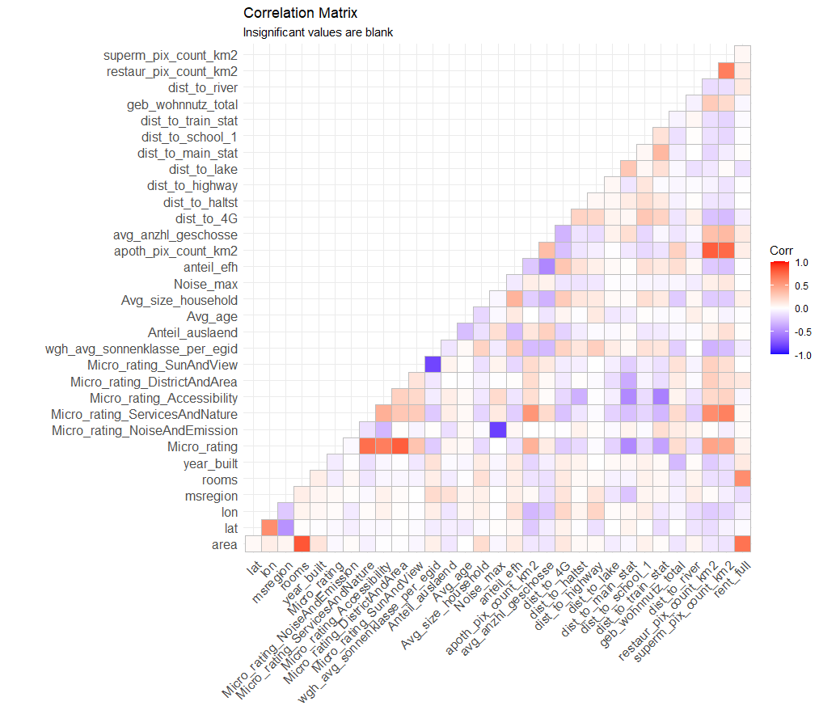
Correlation plot
Some correlation between the regressors, but limited correlation between regressors and the desired outcome: rent.
The highest correlation with the rent : rooms and area

Slide 5
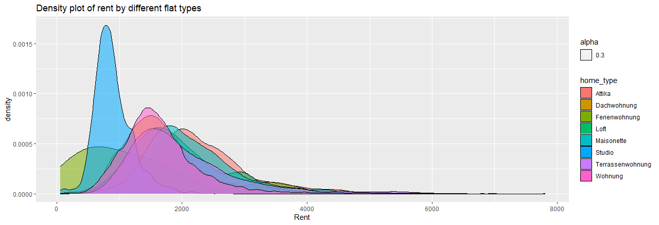
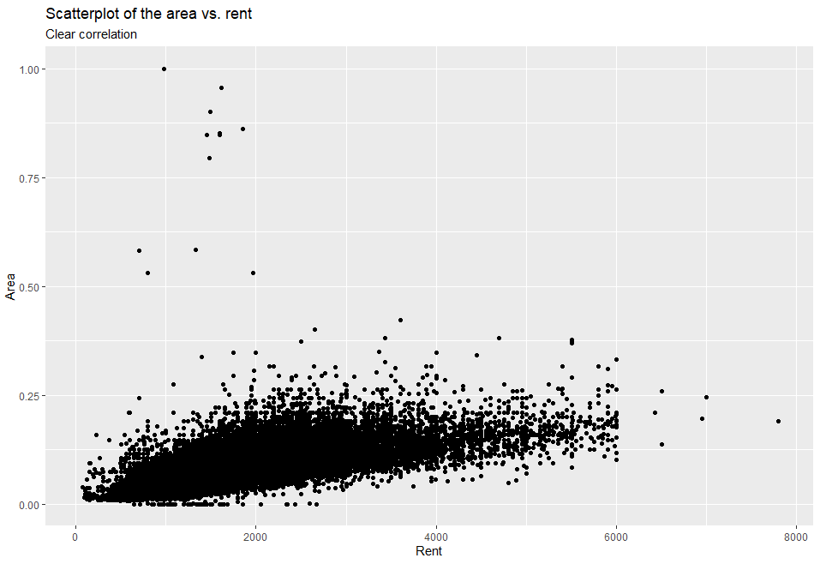
Grouping by flat type
Scatterplot area- rent
We can already see a clear relationship between area and rent, with only few outliers

Slide 6
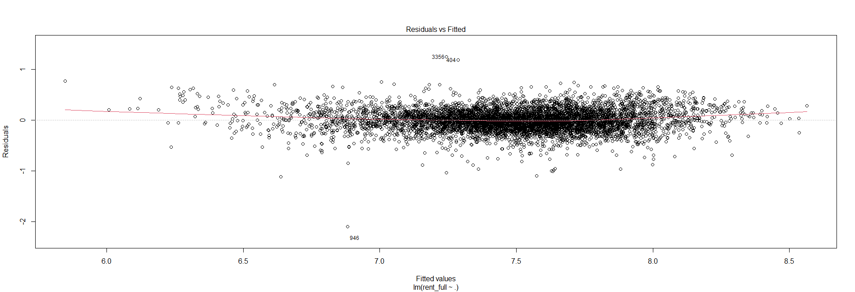
Linear Regression
Two linear regression models:
With standard values RMSE = 466
With log value RMSE = 450

Slide 7
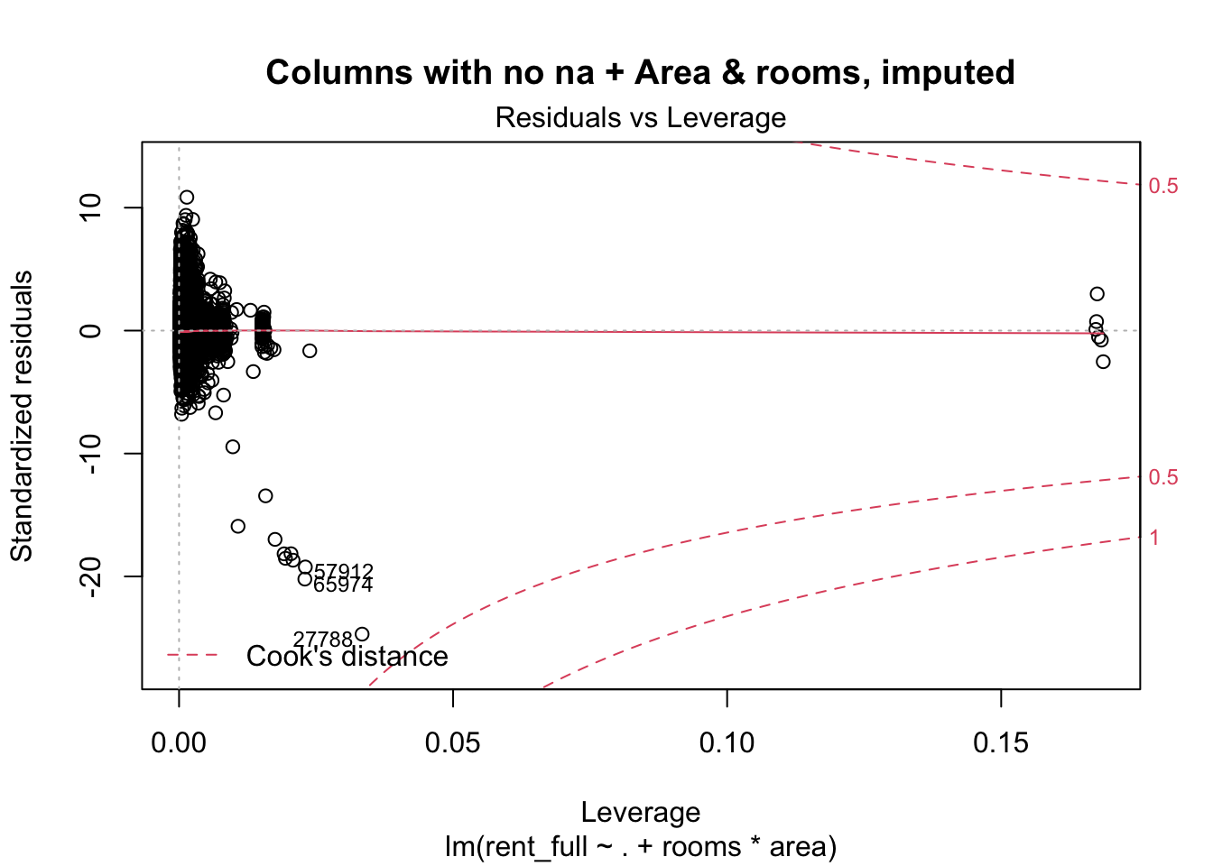
Linear Regression – Imputation
Two linear regression models:
First attempt: impute all regressors RMSE = 1157
Second attempt: impute critical columns like area and rooms + columns without NA RMSE = 391

Slide 8
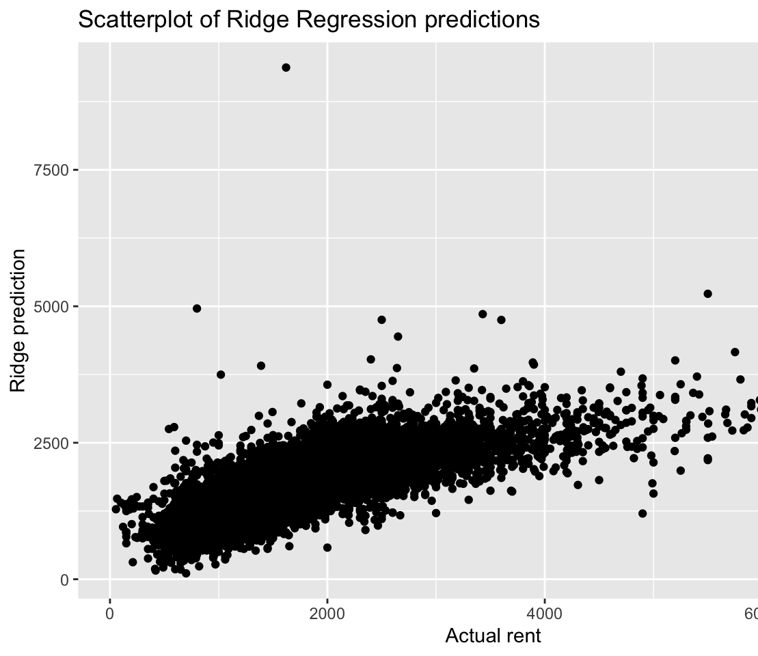
Ridge and Lasso
RMSE = 466

Slide 9
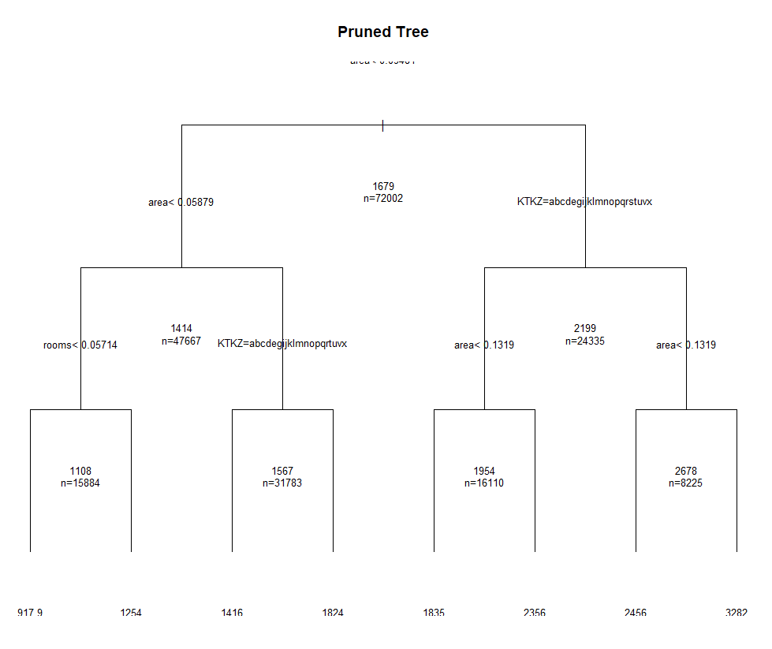
Random Trees
RMSE = 451

Slide 10
Random Trees- Conditional Inference Trees
RMSE = 375

Slide 11
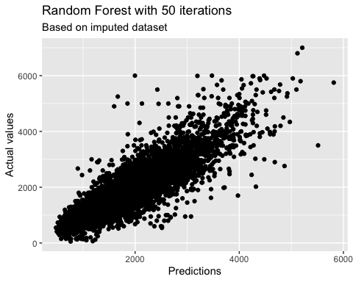
Random forest
Random forest of n = 50 trees
RMSE = 309, the best in our models

Slide 12
Conclusions

