Slide 1
Weekly Report
Wangwon Lee, 2019/02/16
This week | Next week
Audio Classification Previous work 1D-CNN Experiments Batch normalization | Audio Classification To investigate the model more specific 1D, 2D CNN visualization To reduce FC layer
Interesting and new finding
Problems of Fully Connected Layer
Batch normalization
The aim of this month / Discussion
The aim of this month: To study the brain and GLM, To investigate about CNN.
Notes:
I want you to follow this rule

Slide 2
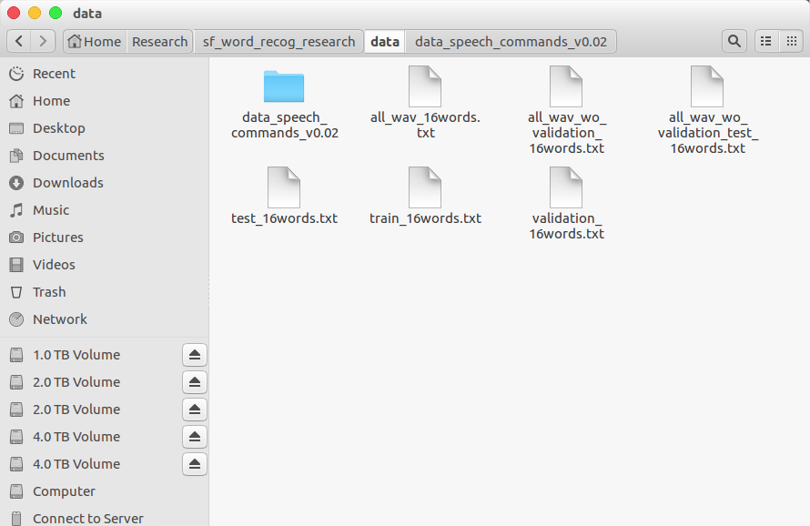
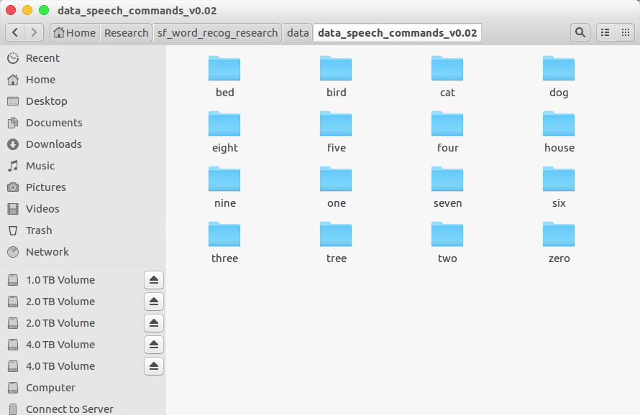
Audio Classification
Data is low-waveform.
sec: 1, sampling rate: 16000, type: float32, channel: mono
16 class data.
'zero', 'one', 'two', 'three', 'four', 'five', 'six', 'seven', 'eight', 'nine', 'bed', 'bird', 'tree', 'cat', 'house', 'dog'
Train: 40851(≒80%), Validation: 4796(≒10%), Test: 5297(≒10%)
- 1 -
Notes:
Supporting facts

Slide 3
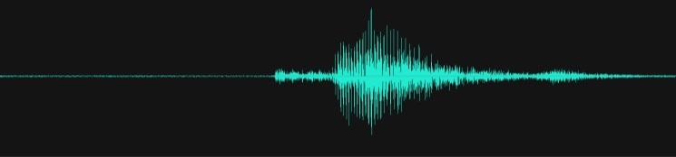

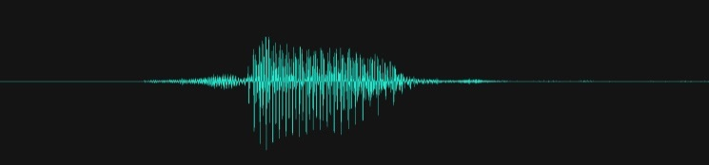

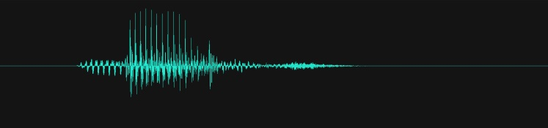

Audio Classification
Convert to spectrogram for using 2D-CNN
Throught the STFT(Short Time Furier Transform)
Window Size: 256, Stride: 128
16000(SR), 1(Ch) -> 99(Freq), 257(Time)
It contain the time information and frequency information at once.
Train: 40851(≒80%), Validation: 4796(≒10%), Test: 5297(≒10%)
“Bird”
Time(T)
Magnitude
“Cat”
“Seven”
Time(T)
Frequency(F)
- 2 -
Notes:
Supporting facts

Slide 4
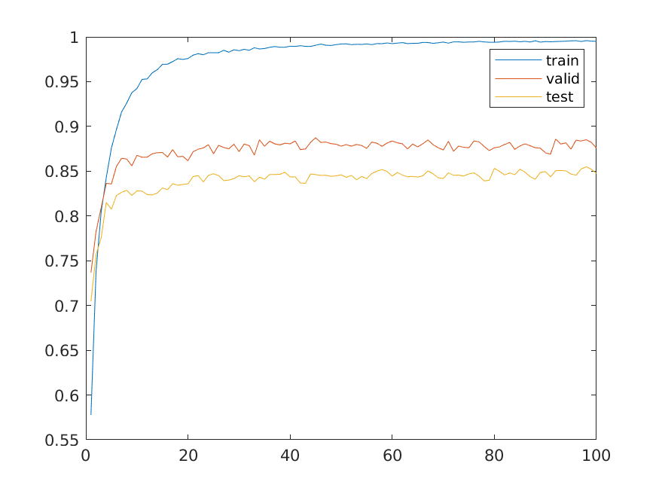
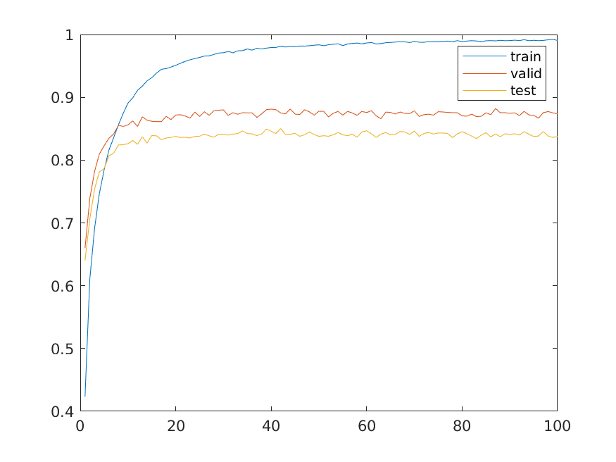
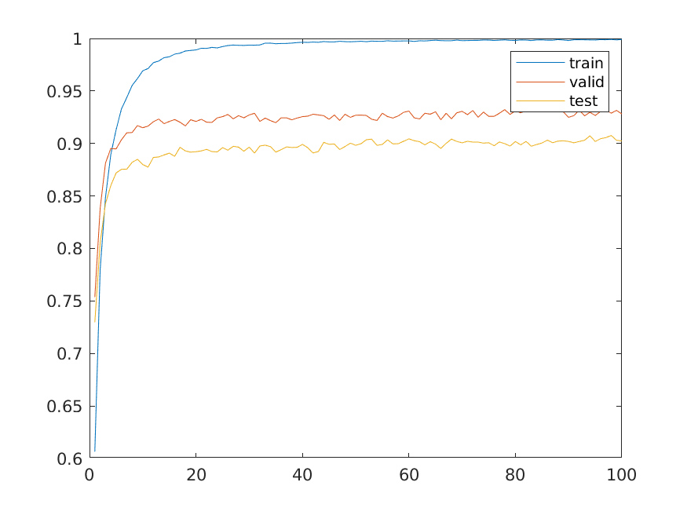
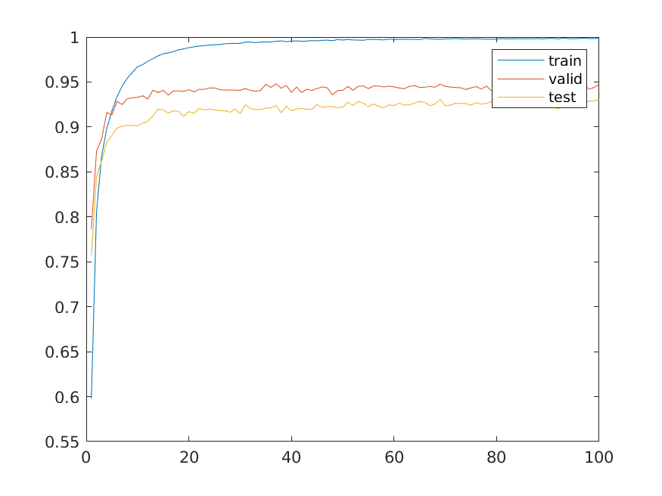
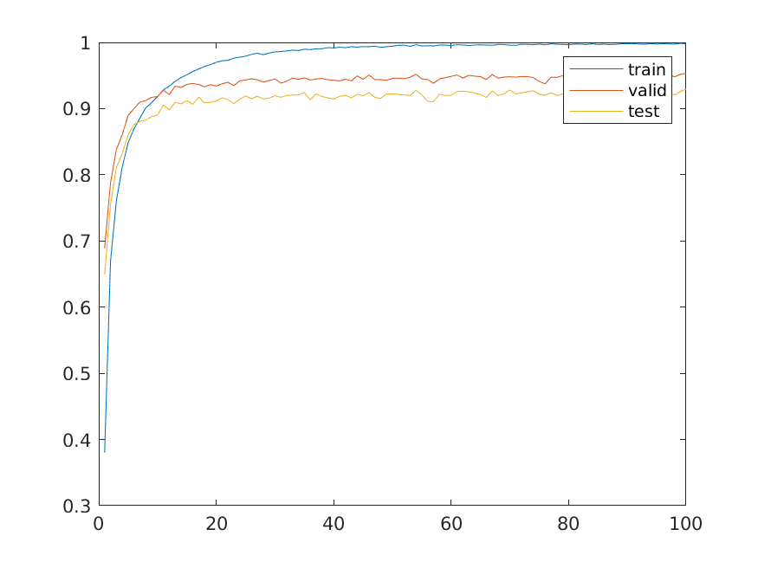
Audio Classification
2D CNN architecture.
1 Conv(5x5, 8), 1 Pool(2x2), 1 FC, 1 DO(0.5) -> Test Acc: 0.8405
1 Conv(5x5, 8), 1 Pool(2x2), 2 FC, 2 DO(0.5) -> Test Acc: 0.8463
2 Conv(5x5, 8), 2 Pool(2x2), 1 FC, 1 DO(0.5) -> Test Acc: 0.8717
…
3 Conv(5x5, 8), 3 Pool(2x2), 1 FC, 1 DO(0.5) -> Test Acc: 0.9119
…
4 Conv(5x5, 8), 4 Pool(2x2), 2 FC, 2 DO(0.5) -> Test Acc: 0.9130
< Each learning curve >
So I decided that my research target is ‘3Conv, 1FC’ model.
Good performance than the other.
Good Depth(?) for research. (Not too shallow and Not too deep)
- 3 -
Notes:
Supporting facts

Slide 5
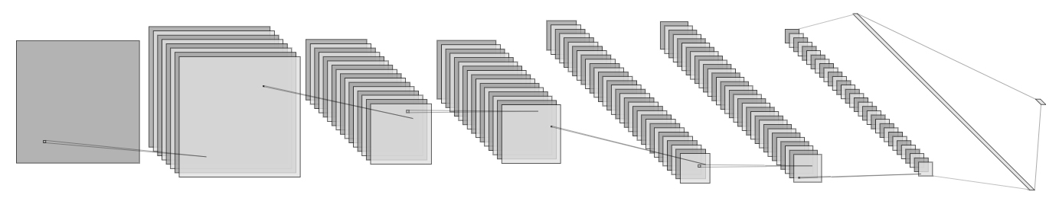
Audio Classification
‘3Conv, 1FC’ model’s detail.
Input: 99x257x1 spectrogram image.
Output:1x16 labeled one hot vector. ('zero', …, 'eight', …, 'house', 'dog')
Loss: cross entropy loss
Obtimizer: Adam
Final accuracy (%)
Train: 0.9978
Validataion: 0.9404
Test: 0.9119
8@96X253
32@22X62
32@18X58
32@9X29
1X1024
1@99X257
16@48X127
16@44X123
1X16
5X5 Conv
2X2 MaxPool
5X5 Conv
2X2 MaxPool
5X5 Conv
2X2 MaxPool
Dense
- 4 -
Notes:
Supporting facts

Slide 6
Audio Classification
1D CNN architecture
For the research, we have to experiment in the same environment.
So it's the same as 2D CNN's architecture.
1 Conv(25, 8), 1 Pool(4), 1 FC, 1 DO(0.5) -> Test Acc: 0.6648
1 Conv(25, 8), 1 Pool(4), 2 FC, 2 DO(0.5) -> Test Acc: 0.7078
2 Conv(25, 8), 2 Pool(4), 1 FC, 1 DO(0.5) -> Test Acc: 0.7688
…
3 Conv(25, 8), 3 Pool(4), 1 FC, 1 DO(0.5) -> Test Acc: 0.8717
3 Conv(25, 8), 3 Pool(4), 2 FC, 2 DO(0.5) -> Test Acc: 0.8702
…
5 Conv(25, 8), 5 Pool(4), 1 FC, 1 DO(0.5) -> Test Acc: 0.9047
5 Conv(25, 8), 5 Pool(4), 2 FC, 2 DO(0.5) -> Test Acc: 0.9090
And… the others are same
Input: 16000X1 low-wavform
Output:1x16 labeled one hot vector. ('zero', …, 'eight', …, 'house', 'dog‘)
Loss: cross entropy loss
Obtimizer: Adam
- 5 -
Notes:
Supporting facts

Slide 7
Audio Classification
Compare 2D CNN and 1D CNN
Every Accuracy is based on minimizing validation loss
Architecture | 2D Acc | 1D Acc
1 Conv(5x5, 8), 1 Pool(2x2), 1 FC, 1 DO(0.5) | 0.8405 | 0.6648
1 Conv(5x5, 8), 1 Pool(2x2), 2 FC, 2 DO(0.5) | 0.8463 | 0.7078
2 Conv(5x5, 8), 2 Pool(2x2), 1 FC, 1 DO(0.5) | 0.8717 | 0.7688
2 Conv(5x5, 8), 2 Pool(2x2), 2 FC, 2 DO(0.5) | 0.8941 | 0.8056
3 Conv(5x5, 8), 3 Pool(2x2), 1 FC, 1 DO(0.5) | 0.9119 | 0.8717
3 Conv(5x5, 8), 3 Pool(2x2), 2 FC, 2 DO(0.5) | 0.9161 | 0.8702
4 Conv(5x5, 8), 4 Pool(2x2), 1 FC, 1 DO(0.5) | 0.9113 | 0.8945
4 Conv(5x5, 8), 4 Pool(2x2), 2 FC, 2 DO(0.5) | 0.9130 | 0.9038
5 Conv(5x5, 8), 5 Pool(2x2), 1 FC, 1 DO(0.5) | X | 0.9047
5 Conv(5x5, 8), 5 Pool(2x2), 2 FC, 2 DO(0.5) | X | 0.9090
- 6 -
Notes:
Supporting facts

Slide 8
Audio Classification
The accuracy is little higher than the other, Is it a good model than the other? No! Because of parameters
Architecture | 2D Acc | Params | 1D Acc | Params
1 Conv(5x5, 8), 1 Pool(2x2), 1 FC, 1 DO(0.5) | 0.8405 | 49,956,064 | 0.6648 | 32,736,480
1 Conv(5x5, 8), 1 Pool(2x2), 2 FC, 2 DO(0.5) | 0.8463 | 50,472,672 | 0.7078 | 33,253,088
2 Conv(5x5, 8), 2 Pool(2x2), 1 FC, 1 DO(0.5) | 0.8717 | 22,368,624 | 0.7688 | 16,290,160
2 Conv(5x5, 8), 2 Pool(2x2), 2 FC, 2 DO(0.5) | 0.8941 | 22,885,232 | 0.8056 | 16,806,768
3 Conv(5x5, 8), 3 Pool(2x2), 1 FC, 1 DO(0.5) | 0.9119 | 8,586,128 | 0.8717 | 7,996,304
3 Conv(5x5, 8), 3 Pool(2x2), 2 FC, 2 DO(0.5) | 0.9161 | 9,102,736 | 0.8702 | 8,512,912
4 Conv(5x5, 8), 4 Pool(2x2), 1 FC, 1 DO(0.5) | 0.9113 | 2,640,848 | 0.8945 | 3,689,424
4 Conv(5x5, 8), 4 Pool(2x2), 2 FC, 2 DO(0.5) | 0.9130 | 3,157,456 | 0.9038 | 4,206,032
5 Conv(5x5, 8), 5 Pool(2x2), 1 FC, 1 DO(0.5) | X | X | 0.9047 | 1,338,448
5 Conv(5x5, 8), 5 Pool(2x2), 2 FC, 2 DO(0.5) | X | X | 0.9090 | 1,855,056
- 7 -
Notes:
Supporting facts

Slide 9
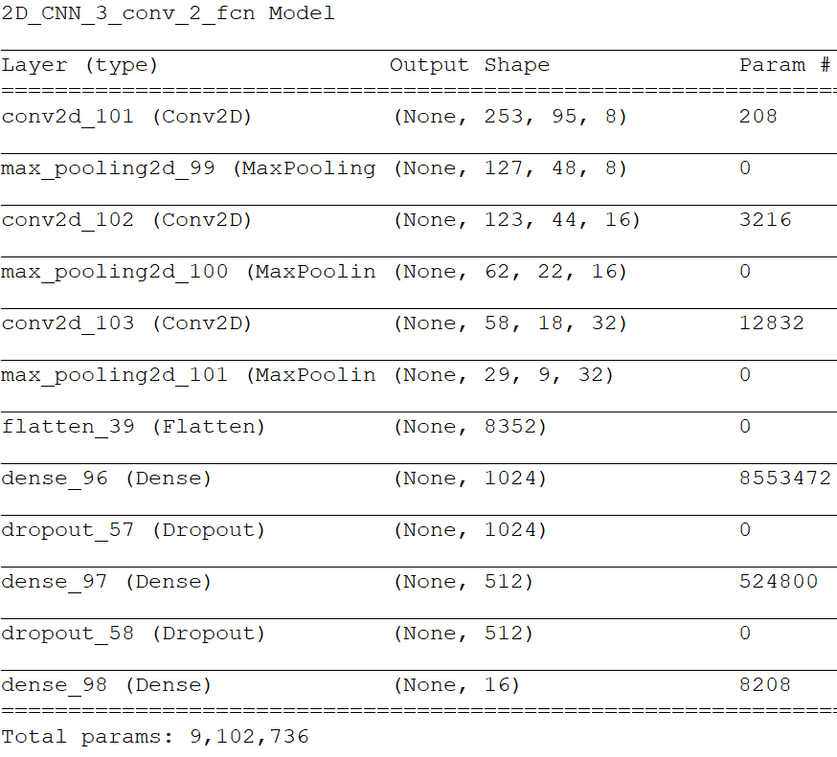
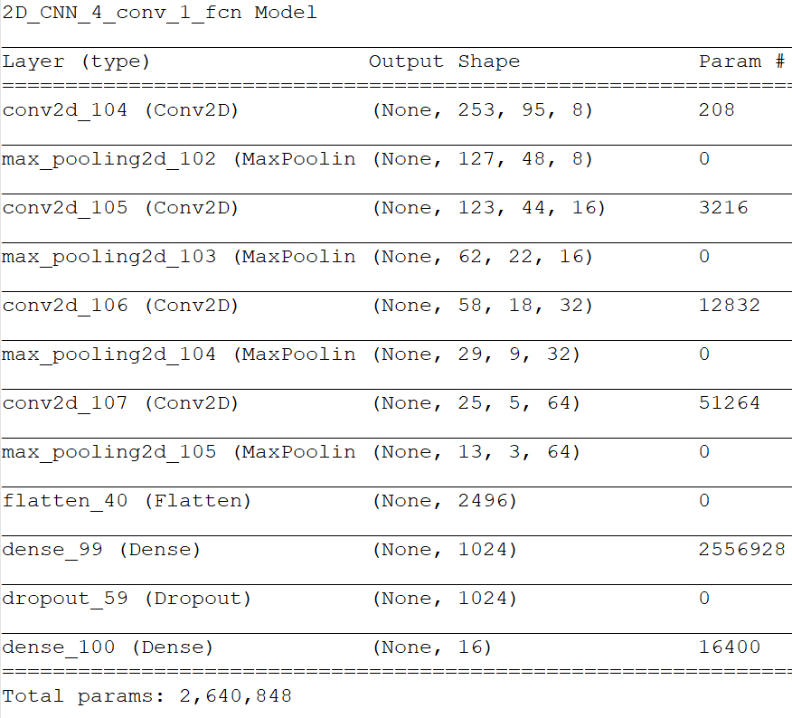
Audio Classification
Most prameters are located on Fully Connected Layer
- 8 -
Notes:
Supporting facts

Slide 10
Audio Classification
Most prameters are located on Fully Connected Layer
It doesn’t help much in the performance of the model
Architecture | 2D Acc | Params | 1D Acc | Params
1 Conv(5x5, 8), 1 Pool(2x2), 1 FC, 1 DO(0.5) | 0.8405 | 49,956,064 | 0.6648 | 32,736,480
1 Conv(5x5, 8), 1 Pool(2x2), 2 FC, 2 DO(0.5) | 0.8463 | 50,472,672 | 0.7078 | 33,253,088
2 Conv(5x5, 8), 2 Pool(2x2), 1 FC, 1 DO(0.5) | 0.8717 | 22,368,624 | 0.7688 | 16,290,160
2 Conv(5x5, 8), 2 Pool(2x2), 2 FC, 2 DO(0.5) | 0.8941 | 22,885,232 | 0.8056 | 16,806,768
3 Conv(5x5, 8), 3 Pool(2x2), 1 FC, 1 DO(0.5) | 0.9119 | 8,586,128 | 0.8717 | 7,996,304
3 Conv(5x5, 8), 3 Pool(2x2), 2 FC, 2 DO(0.5) | 0.9161 | 9,102,736 | 0.8702 | 8,512,912
4 Conv(5x5, 8), 4 Pool(2x2), 1 FC, 1 DO(0.5) | 0.9113 | 2,640,848 | 0.8945 | 3,689,424
4 Conv(5x5, 8), 4 Pool(2x2), 2 FC, 2 DO(0.5) | 0.9130 | 3,157,456 | 0.9038 | 4,206,032
5 Conv(5x5, 8), 5 Pool(2x2), 1 FC, 1 DO(0.5) | X | X | 0.9047 | 1,338,448
5 Conv(5x5, 8), 5 Pool(2x2), 2 FC, 2 DO(0.5) | X | X | 0.9090 | 1,855,056
- 9 -
Notes:
Supporting facts

Slide 11
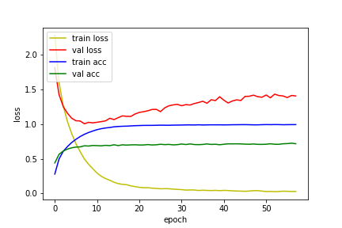
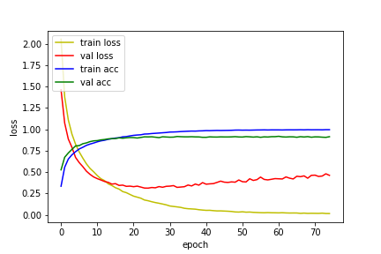
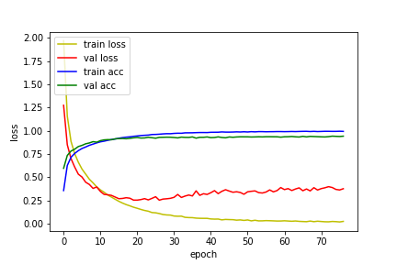
Audio Classification
Most prameters are located on Fully Connected Layer
It doesn’t help much in the performance of the model
The number of FCN parameters more smaller, the model becomes more stable
And I suspect it is the cause of overfit……
1 Conv, 1 FC
3 Conv, 1 FC
5 Conv, 1 FC
- 10 -
Notes:
Supporting facts

Slide 12
Audio Classification
Most prameters are located on Fully Connected Layer
It doesn’t help much in the performance of the model
The number of FCN parameters more smaller, the model becomes more stable
And I suspect it is the cause of overfit……
So I think that FCN should be reduced as much as possible.
1 Conv, 1 FC
3 Conv, 1 FC
5 Conv, 1 FC
- 11 -
Notes:
Supporting facts

Slide 13
Audio Classification
BTW…… why reducing the number of parameter is important?
just because computation complexity? No!
We will investigate neural expression by comparing the DNN and fMRI responses to the same sensory stimuli.
Typically, GLM, …
And, the parameters of CNN are important information about this.
Therefore, If the number of parameters is more bigger, the quality of the information is more sparse.
But, If the number of parameters is more smaller, the quality of the information is more strong.
And, the FCN are almost impossible to analysis
So I think, reducing the parameter of FCN is very important not only just engineering but also our research.
- 12 -
Notes:
Supporting facts

Slide 14
Audio Classification
Because the training had seemed unstable, I tried Batch Nomalization
The depth is more deeper, the performance is more better
As mentioned in the paper, it seems to prevent the internel covariance shift
Architecture | 2D Origin | 2D BN | 1D Origin | 1D BN
1 Conv(5x5, 8), 1 Pool(2x2), 1 FC, 1 DO(0.5) | 0.8405 | 0.8258 | 0.6648 | 0.6540
1 Conv(5x5, 8), 1 Pool(2x2), 2 FC, 2 DO(0.5) | 0.8463 | 0.7988 | 0.7078 | 0.6800
2 Conv(5x5, 8), 2 Pool(2x2), 1 FC, 1 DO(0.5) | 0.8717 | 0.8719 | 0.7688 | 0.7745
2 Conv(5x5, 8), 2 Pool(2x2), 2 FC, 2 DO(0.5) | 0.8941 | 0.8835 | 0.8056 | 0.7666
3 Conv(5x5, 8), 3 Pool(2x2), 1 FC, 1 DO(0.5) | 0.9119 | 0.9144 | 0.8717 | 0.8461
3 Conv(5x5, 8), 3 Pool(2x2), 2 FC, 2 DO(0.5) | 0.9161 | 0.9234 | 0.8702 | 0.8744
4 Conv(5x5, 8), 4 Pool(2x2), 1 FC, 1 DO(0.5) | 0.9113 | 0.9109 | 0.8945 | 0.8970
4 Conv(5x5, 8), 4 Pool(2x2), 2 FC, 2 DO(0.5) | 0.9130 | 0.9205 | 0.9038 | 0.9061
5 Conv(5x5, 8), 5 Pool(2x2), 1 FC, 1 DO(0.5) | X | X | 0.9047 | 0.9169
5 Conv(5x5, 8), 5 Pool(2x2), 2 FC, 2 DO(0.5) | X | X | 0.9090 | 0.9240
- 13 -
Notes:
Supporting facts

Slide 15
Any Question?
Thank you
Notes:
Supporting facts

