Slide 1
Weekly Report
Wangwon Lee, 2019/03/09
This week | Next week
1D-CNN Fine Tuning Previous work Kernel size Channel size Integrate previous result Dropout rate Kernel size like VGG Summary | Audio Classification To visualize 1D-CNN Understanding 1D-CNN model. Mapping our brain data To investigate 1D model more specific
Interesting and new finding
Fine Tuning
The aim of this month / Discussion
The aim of this month: To study the brain and GLM, To investigate about CNN.
Notes:
I want you to follow this rule

Slide 2
Audio Classification
Fine tuning task in 1D-CNN
0. Depth
1. Dropout
2. Batch Normalization
3. D·O + B·N
4. Reduce FC
Previous Work
5. Kernel
6. Channel
7. Summary
Current Work
- 1 -
Notes:
Supporting facts

Slide 3
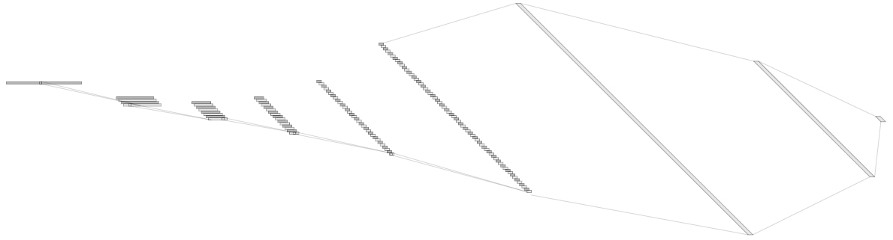
Audio Classification
For example, ‘5Conv, 2FC’ 1D model’s detail.
It just flatten 2D model. (5X5 filter->1X25 filter, 2X2 stride->1X4 stride)
Input: 16000X1 low waveform.
Output:1x16 labeled one hot vector. ('zero', …, 'eight', …, 'house', 'dog')
Loss: cross entropy loss
Obtimizer: Adam
1X1024
128@8
1X512
1@16000
64@55
8@3994
16@993
32@243
Conv(25)
MaxPool(4)
1X16
Conv(25)
MaxPool(4)
Conv(25)
MaxPool(4)
Conv(25)
MaxPool(4)
Conv(25)
MaxPool(4)
Fully-Conncted
Fully-Conncted
[ Baseline Architecture]
- 2 -
Notes:
Supporting facts

Slide 4
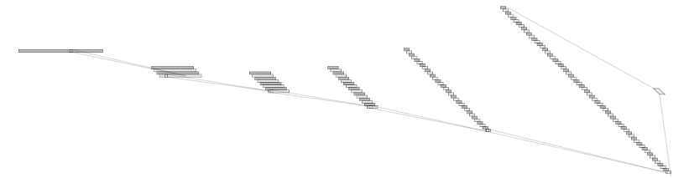
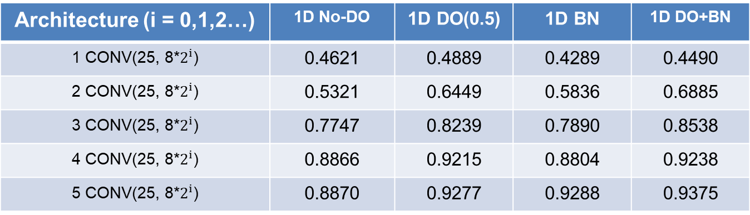
Audio Classification
4th, I think that FC has a lot of problem (FC = Fully Connected)
So I retry the model without FC layer (Now I call this model “only conv”)
FC exists only between the last Conv layer and the output layer (for classfication)
Architecture (i = 0,1,2…) | 1D No-DO | 1D DO(0.5) | 1D BN | 1D DO+BN
1 CONV(25, 8*$2^{i}$) | 0.4621 | 0.4889 | 0.4289 | 0.4490
2 CONV(25, 8*$2^{i}$) | 0.5321 | 0.6449 | 0.5836 | 0.6885
3 CONV(25, 8*$2^{i}$) | 0.7747 | 0.8239 | 0.7890 | 0.8538
4 CONV(25, 8*$2^{i}$) | 0.8866 | 0.9215 | 0.8804 | 0.9238
5 CONV(25, 8*$2^{i}$) | 0.8870 | 0.9277 | 0.9288 | 0.9375
128@8
1@16000
64@55
8@3994
16@993
32@243
Conv(25)
MaxPool(4)
Conv(25)
MaxPool(4)
Conv(25)
MaxPool(4)
Conv(25)
MaxPool(4)
Conv(25)
MaxPool(4)
[ “Only Conv” Architecture]
- 3 -
Notes:
Supporting facts

Slide 5
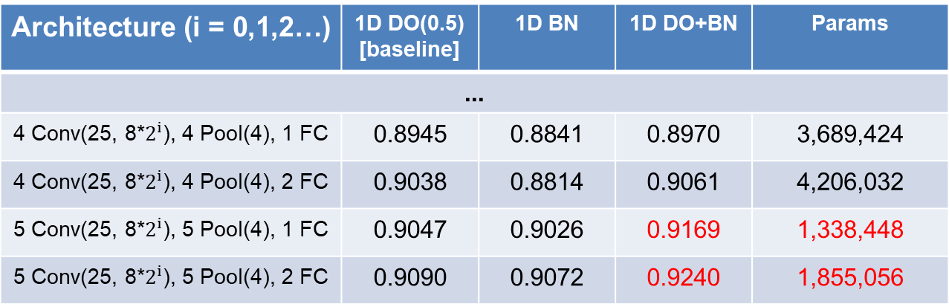
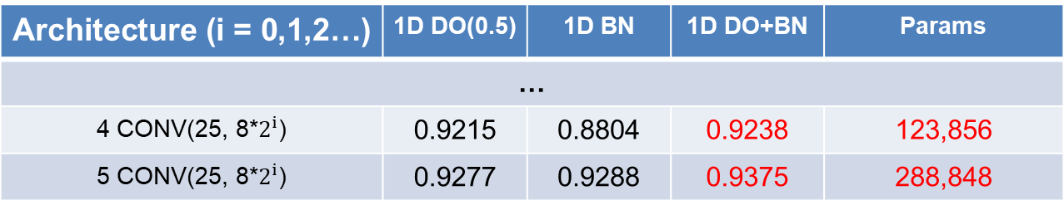
Audio Classification
Compared to the best accuracy, It is increased. (0.9240 → 0.9375)
Compared to the number of parameter, It is greatly decreased. (~90.8%)
It’s a great achievement beyond what I expected.
Architecture (i = 0,1,2…) | 1D DO(0.5) [baseline] | 1D BN | 1D DO+BN | Params
...
4 Conv(25, 8*$2^{i}$), 4 Pool(4), 1 FC | 0.8945 | 0.8841 | 0.8970 | 3,689,424
4 Conv(25, 8*$2^{i}$), 4 Pool(4), 2 FC | 0.9038 | 0.8814 | 0.9061 | 4,206,032
5 Conv(25, 8*$2^{i}$), 5 Pool(4), 1 FC | 0.9047 | 0.9026 | 0.9169 | 1,338,448
5 Conv(25, 8*$2^{i}$), 5 Pool(4), 2 FC | 0.9090 | 0.9072 | 0.9240 | 1,855,056
base
model
Architecture (i = 0,1,2…) | 1D DO(0.5) | 1D BN | 1D DO+BN | Params
…
4 CONV(25, 8*$2^{i}$) | 0.9215 | 0.8804 | 0.9238 | 123,856
5 CONV(25, 8*$2^{i}$) | 0.9277 | 0.9288 | 0.9375 | 288,848
Only
Conv
model
- 4 -
Notes:
Supporting facts

Slide 6
Audio Classification
Fine tuning task in 1D-CNN
0. Depth
1. Dropout
2. Batch Normalization
3. D·O + B·N
4. Reduce FC
Previous Work
5. Kernel Size
6. Channel
7. Summary
Current Work
- 5 -
Notes:
Supporting facts

Slide 7
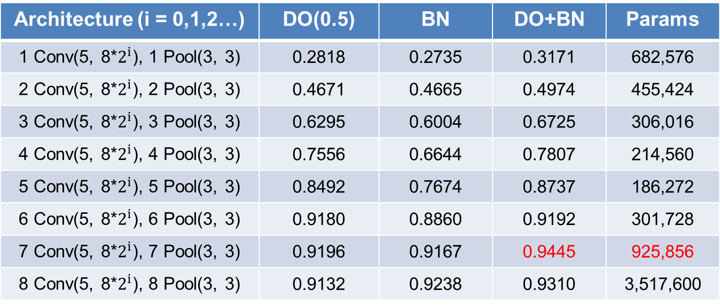
Audio Classification
Change kernel size 25 -> 5
If we reduce the kernel size, we can make the model deeper.
Pooling size is also reduced.
Architecture (i = 0,1,2…) | DO(0.5) | BN | DO+BN | Params
1 Conv(5, 8*$2^{i}$), 1 Pool(3, 3) | 0.2818 | 0.2735 | 0.3171 | 682,576
2 Conv(5, 8*$2^{i}$), 2 Pool(3, 3) | 0.4671 | 0.4665 | 0.4974 | 455,424
3 Conv(5, 8*$2^{i}$), 3 Pool(3, 3) | 0.6295 | 0.6004 | 0.6725 | 306,016
4 Conv(5, 8*$2^{i}$), 4 Pool(3, 3) | 0.7556 | 0.6644 | 0.7807 | 214,560
5 Conv(5, 8*$2^{i}$), 5 Pool(3, 3) | 0.8492 | 0.7674 | 0.8737 | 186,272
6 Conv(5, 8*$2^{i}$), 6 Pool(3, 3) | 0.9180 | 0.8860 | 0.9192 | 301,728
7 Conv(5, 8*$2^{i}$), 7 Pool(3, 3) | 0.9196 | 0.9167 | 0.9445 | 925,856
8 Conv(5, 8*$2^{i}$), 8 Pool(3, 3) | 0.9132 | 0.9238 | 0.9310 | 3,517,600
- 6 -
Notes:
Supporting facts

Slide 8
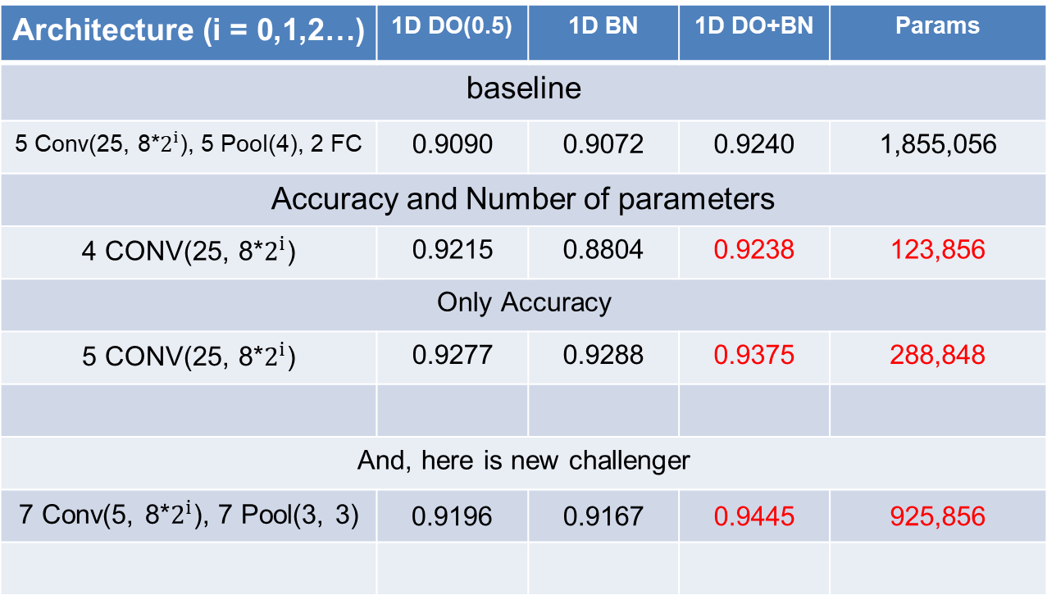
Audio Classification
Summarising this straight. This is current SOTA(State Of The Art) in my research.
Accuracy is more increased. (0.9375 -> 0.9445)
Architecture (i = 0,1,2…) | 1D DO(0.5) | 1D BN | 1D DO+BN | Params
baseline
5 Conv(25, 8*$2^{i}$), 5 Pool(4), 2 FC | 0.9090 | 0.9072 | 0.9240 | 1,855,056
Accuracy and Number of parameters
4 CONV(25, 8*$2^{i}$) | 0.9215 | 0.8804 | 0.9238 | 123,856
Only Accuracy
5 CONV(25, 8*$2^{i}$) | 0.9277 | 0.9288 | 0.9375 | 288,848
And, here is new challenger
7 Conv(5, 8*$2^{i}$), 7 Pool(3, 3) | 0.9196 | 0.9167 | 0.9445 | 925,856
base model
Only Conv
Only Conv
Only Conv
kernel 5
- 7 -
Notes:
Supporting facts

Slide 9
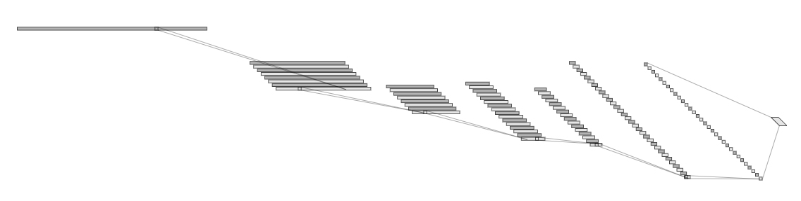
Audio Classification
Change channel size
Start channel size: 32
Architecture | DO(0.5) | BN | DO+BN | Params
1 Conv(25), 1 Pool(3, 3) | 0.4874 | 0.4548 | 0.4453 | 2,727,824
2 Conv(25), 2 Pool(3, 3) | 0.5948 | 0.5913 | 0.6399 | 931,824
3 Conv(25), 3 Pool(3, 3) | 0.7886 | 0.7053 | 0.7782 | 673,968
4 Conv(25), 4 Pool(3, 3) | 0.8953 | 0.8810 | 0.8987 | 371,056
5 Conv(25), 5 Pool(3, 3) | 0.9375 | 0.9279 | 0.9387 | 496,368
6 Conv(25), 6 Pool(3, 3) | 0.9364 | 0.9479 | 0.9479 | 816,240
1@16000
32@5326
128@54
128@10
Conv(25)
MaxPool(3)
32@1768
64@582
64@186
Conv(25)
MaxPool(3)
Conv(25)
MaxPool(3)
Conv(25)
MaxPool(3)
Conv(25)
MaxPool(3)
Conv(25)
MaxPool(3)
- 8 -
Notes:
Supporting facts

Slide 10
Audio Classification
Change channel size
Start channel size: 64
Architecture | DO(0.5) | BN | DO+BN | Params
1 Conv(25), 1 Pool(3, 3) | 0.4962 | 0.3601 | 0.4469 | 6,137,360
2 Conv(25), 2 Pool(3, 3) | 0.6486 | 0.5398 | 0.6361 | 2,141,136
3 Conv(25), 3 Pool(3, 3) | 0.7958 | 0.6139 | 0.7965 | 1,650,512
4 Conv(25), 4 Pool(3, 3) | 0.8945 | 0.8619 | 0.9030 | 1,148,112
5 Conv(25), 5 Pool(3, 3) | 0.9408 | 0.9408 | 0.9466 | 1,788,368
6 Conv(25), 6 Pool(3, 3) | 0.9412 | 0.9547 | 0.9543 | 3,224,784
1@16000
64@5326
256@54
256@10
Conv(25)
MaxPool(3)
64@1768
128@582
128@186
Conv(25)
MaxPool(3)
Conv(25)
MaxPool(3)
Conv(25)
MaxPool(3)
Conv(25)
MaxPool(3)
Conv(25)
MaxPool(3)
- 9 -
Notes:
Supporting facts

Slide 11
Audio Classification
Change channel size
Start channel size: 128
Architecture | DO(0.5) | BN | DO+BN | Params
1 Conv(25), 1 Pool(3, 3) | 0.5148 | 0.4417 | 0.4673 | 10,911,248
2 Conv(25), 2 Pool(3, 3) | 0.6536 | 0.6108 | 0.6928 | 4,034,448
3 Conv(25), 3 Pool(3, 3) | 0.8133 | 0.7502 | 0.7691 | 3,617,424
4 Conv(25), 4 Pool(3, 3) | 0.9024 | 0.8611 | 0.9171 | 3,634,576
5 Conv(25), 5 Pool(3, 3) | 0.9398 | 0.9412 | 0.9462 | 6,593,424
6 Conv(25), 6 Pool(3, 3) | 0.9391 | 0.9526 | 0.9601 | 12,788,112
1@16000
128@5326
512@54
512@10
Conv(25)
MaxPool(3)
128@1768
256@582
256@186
Conv(25)
MaxPool(3)
Conv(25)
MaxPool(3)
Conv(25)
MaxPool(3)
Conv(25)
MaxPool(3)
Conv(25)
MaxPool(3)
- 10 -
Notes:
Supporting facts

Slide 12
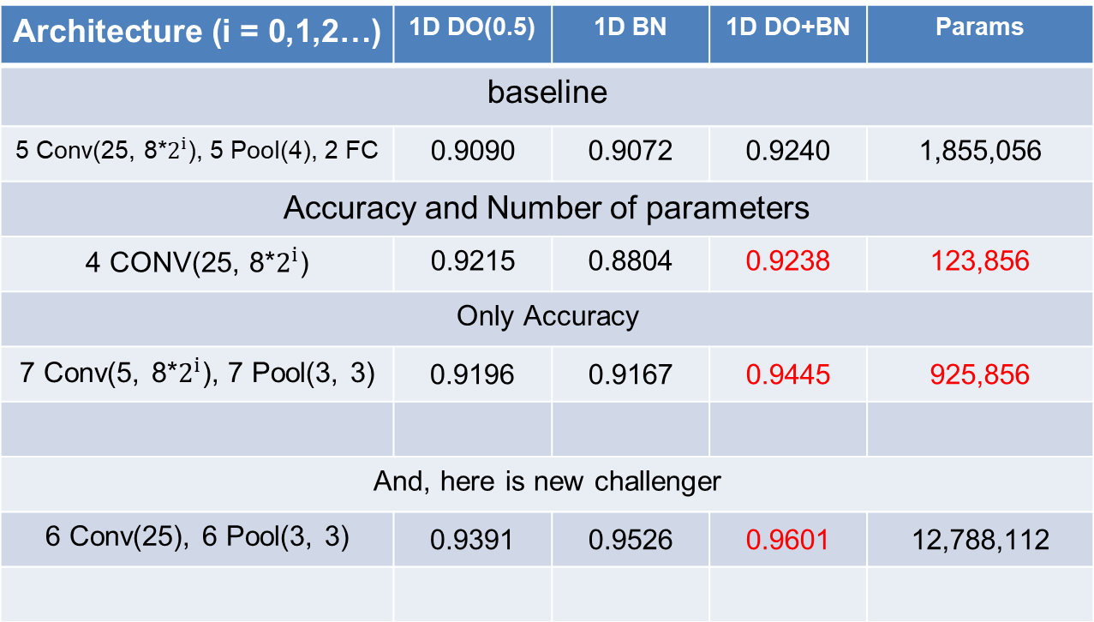
Audio Classification
Summarising this straight. This is current SOTA(State Of The Art) in my research.
Accuracy is more increased. (0.9445 -> 0.9601)
The number of params is ……
Architecture (i = 0,1,2…) | 1D DO(0.5) | 1D BN | 1D DO+BN | Params
baseline
5 Conv(25, 8*$2^{i}$), 5 Pool(4), 2 FC | 0.9090 | 0.9072 | 0.9240 | 1,855,056
Accuracy and Number of parameters
4 CONV(25, 8*$2^{i}$) | 0.9215 | 0.8804 | 0.9238 | 123,856
Only Accuracy
7 Conv(5, 8*$2^{i}$), 7 Pool(3, 3) | 0.9196 | 0.9167 | 0.9445 | 925,856
And, here is new challenger
6 Conv(25), 6 Pool(3, 3) | 0.9391 | 0.9526 | 0.9601 | 12,788,112
base model
Only Conv
Only Conv
Only Conv
channel 128
- 11 -
Notes:
Supporting facts

Slide 13
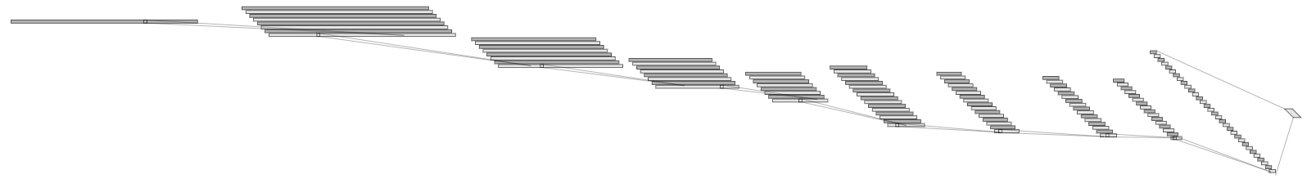
Audio Classification
Finally, I made custom model to integrate previous result.
First, In the case of a “DO, BN, DO+BN”, I tried everything -> because the results were different each time.
Second, In the case of a channel, I tried everything -> because the number of channels and the accuracy are inversely proportional.
Third, In the case of Kernel size, I tried reducing the size -> because reducing the kernel size could make the model deeper. -> pooling size is also reduced. 4 -> 3
So, the architecture below is an example of one of them
1@16000
32@16000
32@5333
128@2
Conv(5)
32@1777
32@592
64@197
64@65
64@21
64@7
Conv(5)
MaxPool(3)
Conv(5)
MaxPool(3)
Conv(5)
MaxPool(3)
Conv(5)
MaxPool(3)
Conv(5)
MaxPool(3)
Conv(5)
MaxPool(3)
Conv(5)
MaxPool(3)
Conv(5)
MaxPool(3)
- 12 -
Notes:
Supporting facts

Slide 14
Audio Classification
I didn’t try early because the results were probably not good.
Start channel size: 32
The performance was close to 0.95 with less than 100,000 parameters.
Architecture | DO(0.5) | BN | DO+BN | Params
1 CONV(5, 32) | X | X | X | X
2 CONV(5, 32) | X | X | X | X
3 CONV(5, 32) | 0.5169 | 0.5119 | 0.5676 | 920,336
4 CONV(5, 32) | 0.6656 | 0.6253 | 0.7376 | 318,768
5 CONV(5, 64) | 0.7605 | 0.7065 | 0.8039 | 227,696
6 CONV(5, 64) | 0.8893 | 0.8278 | 0.8826 | 113,072
7 CONV(5, 64) | 0.9373 | 0.9011 | 0.9293 | 88,560
8 CONV(5, 64) | 0.9477 | 0.9285 | 0.9391 | 94,768
9 CONV(5, 128) | 0.9379 | 0.9268 | 0.9424 | 132,784
- 13 -
Notes:
Supporting facts

Slide 15
Audio Classification
I didn’t try early because the results were probably not good.
Start channel size: 64
I think this is the most appropriate between the number of parameters and accuracy.
Architecture | DO(0.5) | BN | DO+BN | Params
1 CONV(5, 64) | X | X | X | X
2 CONV(5, 64) | X | X | X | X
3 CONV(5, 64) | 0.5844 | 0.4893 | 0.5726 | 1,861,520
4 CONV(5, 64) | 0.7128 | 0.6291 | 0.7333 | 668,752
5 CONV(5, 128) | 0.7732 | 0.7022 | 0.8073 | 507,344
6 CONV(5, 128) | 0.8901 | 0.8233 | 0.8818 | 319,312
7 CONV(5, 128) | 0.9400 | 0.9061 | 0.9302 | 311,504
8 CONV(5, 128) | 0.9560 | 0.9508 | 0.9458 | 365,136
9 CONV(5, 256) | 0.9537 | 0.9464 | 0.9470 | 523,600
- 14 -
Notes:
Supporting facts

Slide 16
Audio Classification
I didn’t try early because the results were probably not good.
Start channel size: 128
Accuracy is high, but the number of parameter is too large.
Architecture | DO(0.5) | BN | DO+BN | Params
1 CONV(5, 128) | X | X | X | X
2 CONV(5, 128) | X | X | X | X
3 CONV(5, 128) | 0.5718 | 0.4521 | 0.5720 | 3,804,944
4 CONV(5, 128) | 0.6766 | 0.6183 | 0.7371 | 1,460,368
5 CONV(5, 256) | 0.7701 | 0.7067 | 0.7985 | 1,219,472
6 CONV(5, 256) | 0.8802 | 0.8588 | 0.8762 | 1,007,248
7 CONV(5, 256) | 0.9387 | 0.9236 | 0.9443 | 1,155,472
8 CONV(5, 256) | 0.9543 | 0.9562 | 0.9562 | 1,426,576
9 CONV(5, 512) | 0.9396 | 0.9632 | 0.9674 | 2,071,184
- 15 -
Notes:
Supporting facts

Slide 17
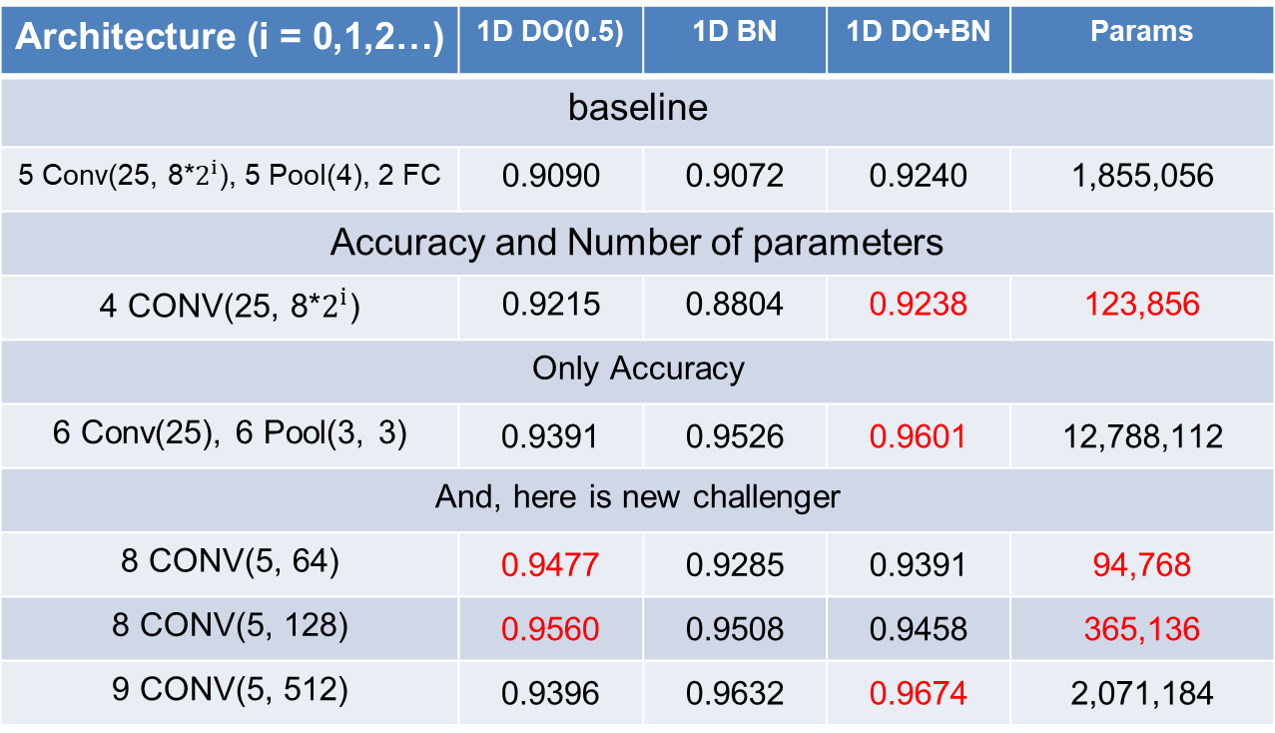
Audio Classification
Summarising this straight. This is current SOTA(State Of The Art) in my research.
Accuracy is more increased. (0.9601 -> 0.9674)
The number of params is decreased. (123,856 -> 94,768 And 0.9238 -> 0.9477)
Architecture (i = 0,1,2…) | 1D DO(0.5) | 1D BN | 1D DO+BN | Params
baseline
5 Conv(25, 8*$2^{i}$), 5 Pool(4), 2 FC | 0.9090 | 0.9072 | 0.9240 | 1,855,056
Accuracy and Number of parameters
4 CONV(25, 8*$2^{i}$) | 0.9215 | 0.8804 | 0.9238 | 123,856
Only Accuracy
6 Conv(25), 6 Pool(3, 3) | 0.9391 | 0.9526 | 0.9601 | 12,788,112
And, here is new challenger
8 CONV(5, 64) | 0.9477 | 0.9285 | 0.9391 | 94,768
8 CONV(5, 128) | 0.9560 | 0.9508 | 0.9458 | 365,136
9 CONV(5, 512) | 0.9396 | 0.9632 | 0.9674 | 2,071,184
base model
Only Conv
Only Conv
channel 128
Custom
channel 32
Custom
channel 64
Custom
channel 128
- 16 -
Notes:
Supporting facts

Slide 18
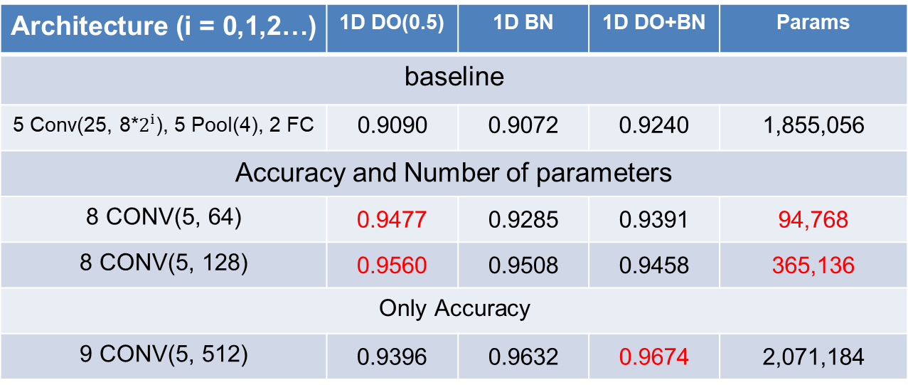
Audio Classification
Summarising this straight. This is current SOTA(State Of The Art) in my research.
Architecture (i = 0,1,2…) | 1D DO(0.5) | 1D BN | 1D DO+BN | Params
baseline
5 Conv(25, 8*$2^{i}$), 5 Pool(4), 2 FC | 0.9090 | 0.9072 | 0.9240 | 1,855,056
Accuracy and Number of parameters
8 CONV(5, 64) | 0.9477 | 0.9285 | 0.9391 | 94,768
8 CONV(5, 128) | 0.9560 | 0.9508 | 0.9458 | 365,136
Only Accuracy
9 CONV(5, 512) | 0.9396 | 0.9632 | 0.9674 | 2,071,184
base model
Custom
channel 32
Custom
channel 64
Custom
channel 128
- 17 -
Notes:
Supporting facts

Slide 19
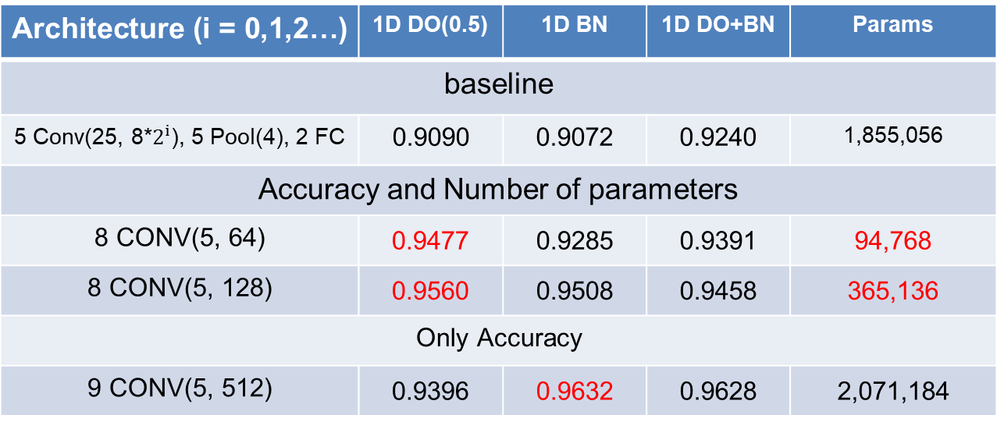
Audio Classification
Summarising this straight. This is current SOTA(State Of The Art) in my research.
Architecture (i = 0,1,2…) | 1D DO(0.5) | 1D BN | 1D DO+BN | Params
baseline
5 Conv(25, 8*$2^{i}$), 5 Pool(4), 2 FC | 0.9090 | 0.9072 | 0.9240 | 1,855,056
Accuracy and Number of parameters
8 CONV(5, 64) | 0.9477 | 0.9285 | 0.9391 | 94,768
8 CONV(5, 128) | 0.9560 | 0.9508 | 0.9458 | 365,136
Only Accuracy
9 CONV(5, 512) | 0.9396 | 0.9632 | 0.9628 | 2,071,184
The previous goal was here…
Frankly, a lot of experiment are more…
base model
Custom
channel 32
Custom
channel 64
Custom
channel 128
- 18 -
Notes:
Supporting facts

Slide 20
Audio Classification
Fine tuning task in 1D-CNN
5. Channel
6. Kernel Size
7. Summary
Previous goal
8. Dropout rate
9. Kernel Size
10. Summary
Added Work
- 19 -
Notes:
Supporting facts

Slide 21
Audio Classification
I tune the dropout’s rate
The accuracy was close to 0.96
Architecture | DO(0.25) | DO(0.25)+BN | DO(0.75) | DO(0.75)+BN
1 CONV(5, 64) | 0.3180 | 0.2069 | 0.3194 | 0.3049
2 CONV(5, 64) | 0.4372 | 0.2760 | 0.4619 | 0.4617
3 CONV(5, 64) | 0.5448 | 0.5639 | 0.6430 | 0.6426
4 CONV(5, 64) | 0.6125 | 0.6625 | 0.7796 | 0.7934
5 CONV(5, 128) | 0.7240 | 0.7653 | 0.8351 | 0.8320
6 CONV(5, 128) | 0.8534 | 0.8633 | 0.9153 | 0.8812
7 CONV(5, 128) | 0.9219 | 0.9269 | 0.9472 | 0.9321
8 CONV(5, 128) | 0.9458 | 0.9512 | 0.9589 | 0.9497
9 CONV(5, 256) | 0.9292 | 0.9578 | 0.9553 | 0.9585
- 20 -
Notes:
Supporting facts

Slide 22
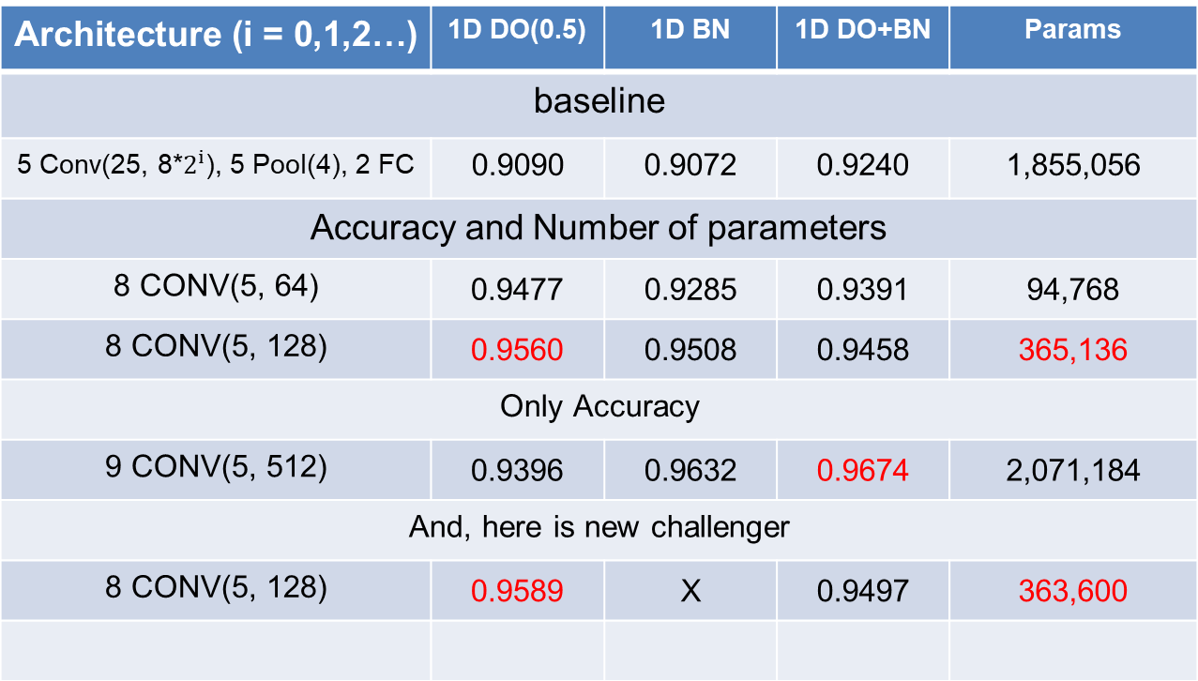
Audio Classification
Summarising this straight. This is current SOTA(State Of The Art) in my research.
The performance is increased. (0.9560 -> 0.9589)
But… I’m not sure it is really better…
Architecture (i = 0,1,2…) | 1D DO(0.5) | 1D BN | 1D DO+BN | Params
baseline
5 Conv(25, 8*$2^{i}$), 5 Pool(4), 2 FC | 0.9090 | 0.9072 | 0.9240 | 1,855,056
Accuracy and Number of parameters
8 CONV(5, 64) | 0.9477 | 0.9285 | 0.9391 | 94,768
8 CONV(5, 128) | 0.9560 | 0.9508 | 0.9458 | 365,136
Only Accuracy
9 CONV(5, 512) | 0.9396 | 0.9632 | 0.9674 | 2,071,184
And, here is new challenger
8 CONV(5, 128) | 0.9589 | X | 0.9497 | 363,600
base model
Custom
channel 32
Custom
channel 64
Custom
channel 128
Custom
channel 64
DO(0.75)
- 21 -
Notes:
Supporting facts

Slide 23
Audio Classification
Change kernel size 1X5 (one layer) -> 1X3 and 1X3 (two layer)
--- From VGG paper… --- such layers have a 7 × 7 effective receptive field.
So what have we gained by using, for instance, a stack of three 3×3 conv layers instead of a single 7×7 layer?
First, we incorporate three non-linear rectification layers instead of a single one, which makes the decision function more discriminative.
---
According to the VGG paper, it is better to replace a large-sized kernel with a combination of 3X3 kernels.
So, I tried.
1@16000
32@16000
32@5333
128@2
Conv(3)
Conv(3)
32@1777
32@592
64@197
64@65
64@21
64@7
Conv(3)
Conv(3)
MaxPool(3)
Conv(3)
Conv(3)
MaxPool(3)
Conv(3)
Conv(3)
MaxPool(3)
Conv(3)
Conv(3)
MaxPool(3)
Conv(3)
Conv(3)
MaxPool(3)
Conv(3)
Conv(3)
MaxPool(3)
Conv(3)
Conv(3)
MaxPool(3)
Conv(3)
Conv(3)
MaxPool(3)
- 22 -
Notes:
Supporting facts

Slide 24
Audio Classification
I tried VGG style
The accuracy exceeded 0.96.
Architecture | 1D DO(0.5) | 1D BN | 1D DO+BN | Params
2 CONV(3, 64), 1 Pool | 0.3877 | 0.3674 | 0.3171 | 16,396,624
4 CONV(3, 64) , 2 Pool | 0.4752 | 0.3668 | 0.3389 | 5,498,320
6 CONV(3, 64) ,3 Pool | 0.5626 | 0.4933 | 0.4984 | 1,881,680
8 CONV(3, 64) , 4 Pool | 0.6719 | 0.6521 | 0.6544 | 692,944
10 CONV(3, 128) , 5 Pool | 0.7666 | 0.7047 | 0.7344 | 564,176
12 CONV(3, 128) , 6 Pool | 0.9018 | 0.8349 | 0.7502 | 392,400
14 CONV(3, 128) , 7 Pool | 0.9427 | 0.9286 | 0.8044 | 400,848
16 CONV(3, 128) , 8 Pool | 0.9630 | 0.9423 | 0.9136 | 470,736
18 CONV(3, 256) , 9 Pool | 0.9350 | 0.9493 | 0.9418 | 760,016
- 23 -
Notes:
Supporting facts

Slide 25
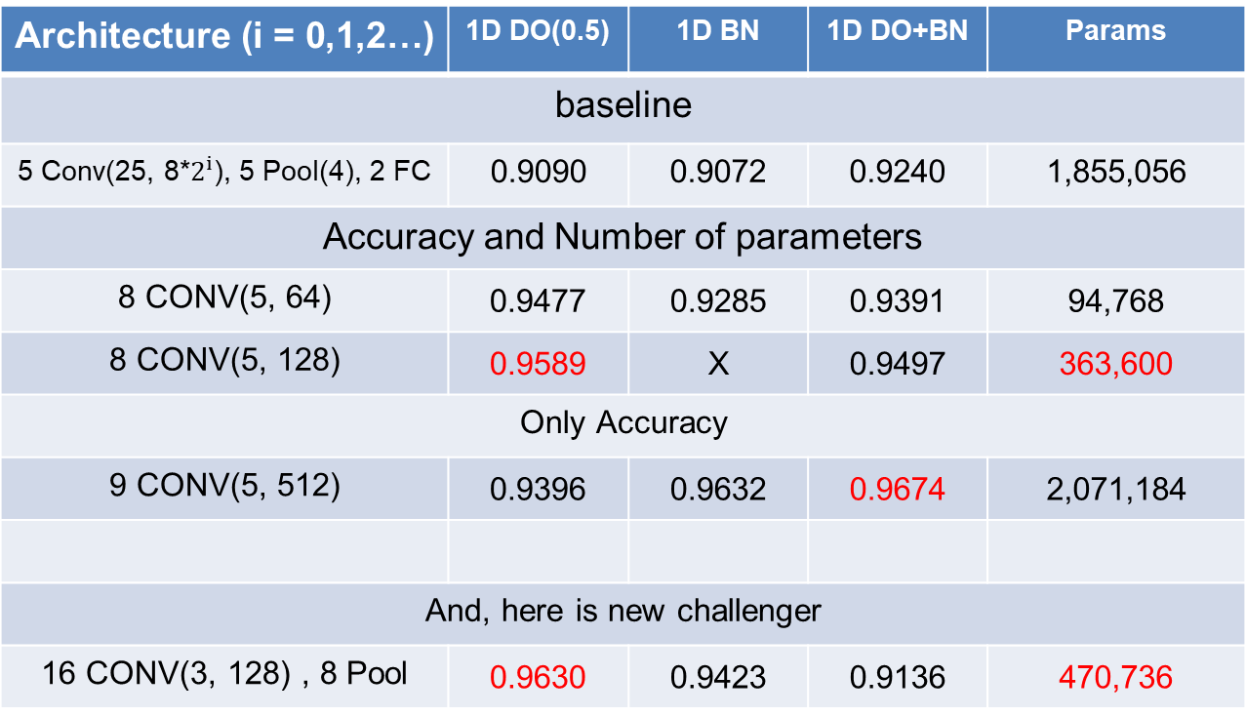
Audio Classification
Summarising this straight. This is current SOTA(State Of The Art) in my research.
The performance was increased. (0.9589 -> 0.9630)
But, Params was also increased. (363,600 -> 470,736)
Architecture (i = 0,1,2…) | 1D DO(0.5) | 1D BN | 1D DO+BN | Params
baseline
5 Conv(25, 8*$2^{i}$), 5 Pool(4), 2 FC | 0.9090 | 0.9072 | 0.9240 | 1,855,056
Accuracy and Number of parameters
8 CONV(5, 64) | 0.9477 | 0.9285 | 0.9391 | 94,768
8 CONV(5, 128) | 0.9589 | X | 0.9497 | 363,600
Only Accuracy
9 CONV(5, 512) | 0.9396 | 0.9632 | 0.9674 | 2,071,184
And, here is new challenger
16 CONV(3, 128) , 8 Pool | 0.9630 | 0.9423 | 0.9136 | 470,736
base model
Custom
channel 32
Custom
channel 64
DO(0.75)
Custom
channel 128
Custom
VGG style
- 24 -
Notes:
Supporting facts

Slide 26
Audio Classification
Summarising this straight. This is current SOTA(State Of The Art) in my research.
The performance was increased. (0.9589 -> 0.9630)
But, Params was also increased. (363,600 -> 470,736)
Architecture (i = 0,1,2…) | 1D DO(0.5) | 1D BN | 1D DO+BN | Params
baseline
5 Conv(25, 8*$2^{i}$), 5 Pool(4), 2 FC | 0.9090 | 0.9072 | 0.9240 | 1,855,056
Accuracy and Number of parameters
8 CONV(5, 64) | 0.9477 | 0.9285 | 0.9391 | 94,768
8 CONV(5, 128) | 0.9589 | X | 0.9497 | 363,600
Only Accuracy
9 CONV(5, 512) | 0.9396 | 0.9632 | 0.9674 | 2,071,184
And, here is new challenger
16 CONV(3, 128) , 8 Pool | 0.9630 | 0.9423 | 0.9136 | 470,736
Frankly, a lot of experiment are more
But, because it didn’t improve more,
I don't talk about some more…
base model
Custom
channel 32
Custom
channel 64
DO(0.75)
Custom
channel 128
Custom
VGG style
- 25 -
Notes:
Supporting facts

Slide 27
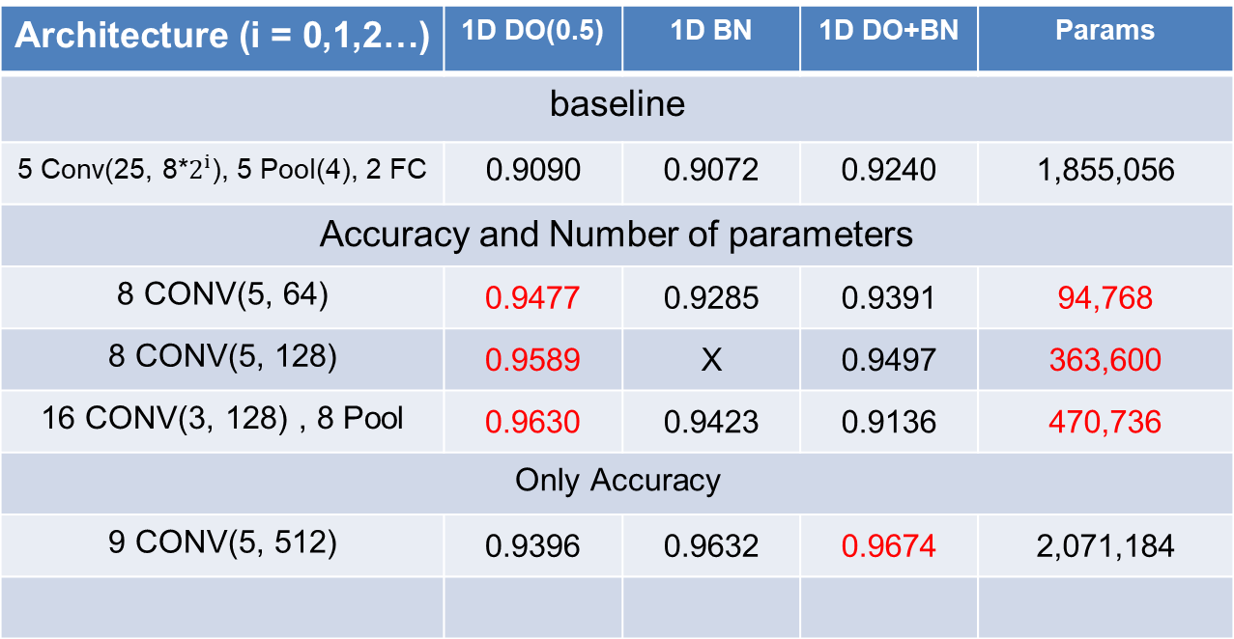
Audio Classification
Finally, This is current SOTA(State Of The Art) in my research.
Architecture (i = 0,1,2…) | 1D DO(0.5) | 1D BN | 1D DO+BN | Params
baseline
5 Conv(25, 8*$2^{i}$), 5 Pool(4), 2 FC | 0.9090 | 0.9072 | 0.9240 | 1,855,056
Accuracy and Number of parameters
8 CONV(5, 64) | 0.9477 | 0.9285 | 0.9391 | 94,768
8 CONV(5, 128) | 0.9589 | X | 0.9497 | 363,600
16 CONV(3, 128) , 8 Pool | 0.9630 | 0.9423 | 0.9136 | 470,736
Only Accuracy
9 CONV(5, 512) | 0.9396 | 0.9632 | 0.9674 | 2,071,184
base model
Custom
channel 32
Custom
channel 64
DO(0.75)
Custom
VGG style
Custom
channel 128
- 26 -
Notes:
Supporting facts

Slide 28
Any Question?
Thank you
Notes:
Supporting facts

