Slide 1
Weekly Report
Wangwon Lee, 2019/03/16
This week | Next week
Server status To check the server status in realtime Made with google-spreadsheet-api Audio Classification Fine tuning in previous work Tune dropout rate in best case Visualize filter | Audio Classification To visualize 1D-CNN Understanding 1D-CNN model. Mapping our brain data To investigate 1D model more specific
Interesting and new finding
Fine Tuning
Filter in DSP (Digital Signal Processing)
The aim of this month / Discussion
The aim of this month: To study the brain and GLM, To investigate about CNN.
Notes:
I want you to follow this rule

Slide 2
Server status
Few days ago…
- 1 -
Notes:
Supporting facts

Slide 3


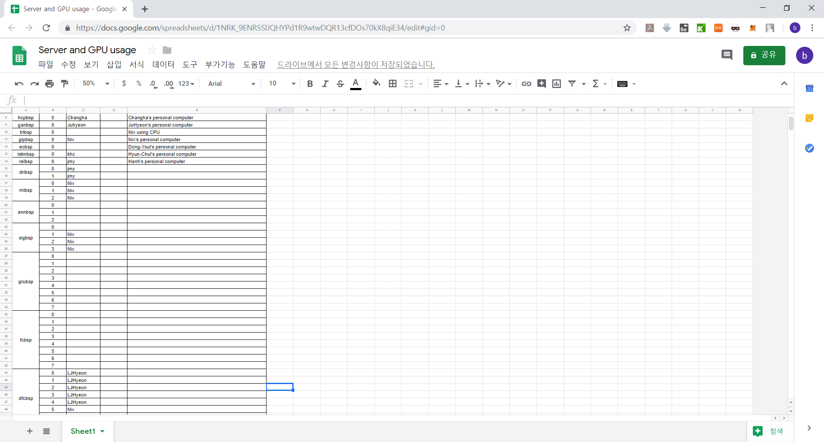
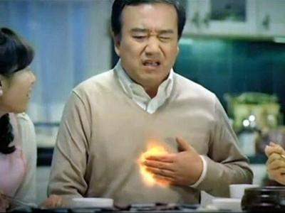
Server status
When the server take a break, then my heart also break.
“Ah... A lot of money take a break......”
- 2 -
Notes:
Supporting facts

Slide 4
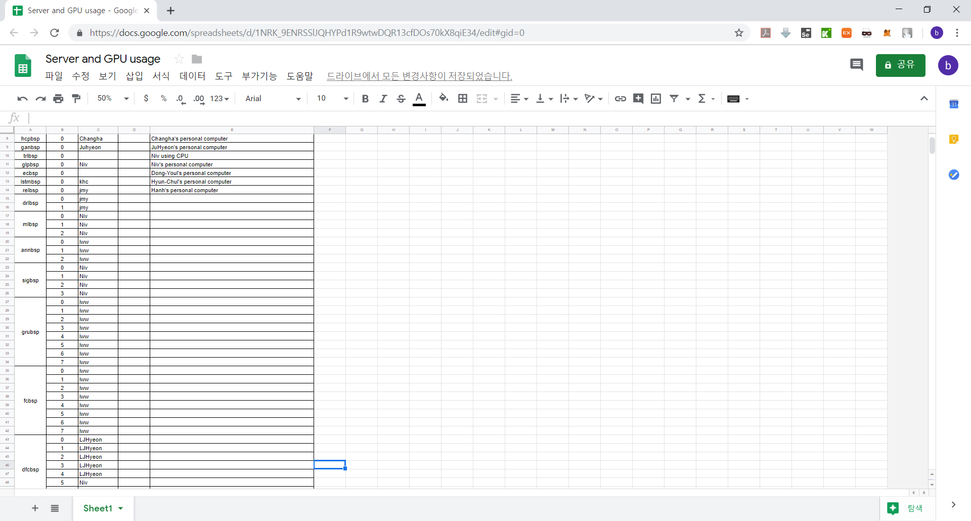
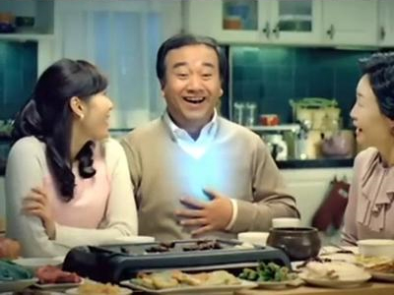
Server status
So I try the experiment as much as possible.
A lot of experiment was tried.
- 3 -
Notes:
Supporting facts

Slide 5
Server status
And few hours later…...
- 4 -
Notes:
Supporting facts

Slide 6

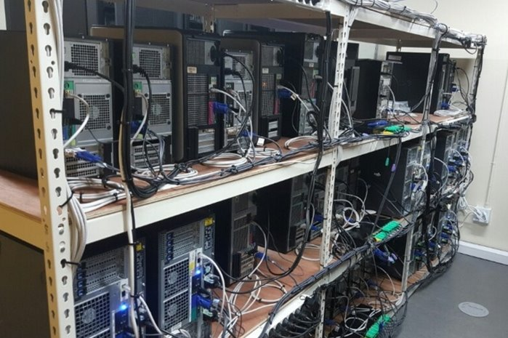
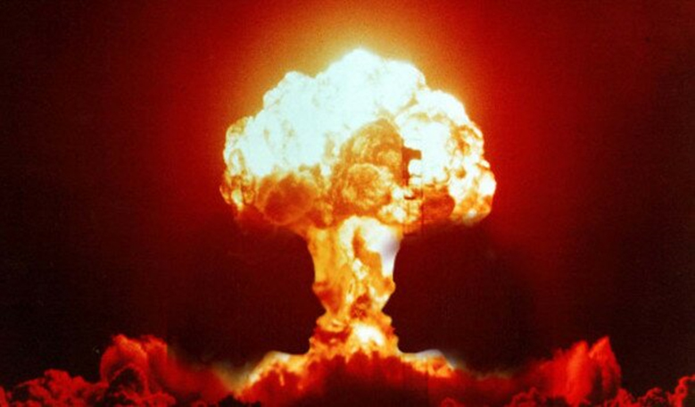
Server status
Some server were downed due to overload.
I say “Don’t take a break”, But he understand only “Don’t take a break”
So, I felt the need to monitor the server status in real time.
- 5 -
Notes:
Supporting facts

Slide 7



Server status
Frankly, many people are afraid of new things.
So if we develop new things, Do not make new one, improve the old one.
What is the old one? → We always check google-spreadsheets for using server
What do we need? → Check server status in realtime
So I add new feature to check server status in realtime in google-sheet.
fcbsp (=gpu)
Ping
…
Ping
Update status
bspl (=homepage)
Ping
Using google-api
…
sdabsp (=Wangwon’s PC)
databsp (=file)
- 6 -
Notes:
Supporting facts

Slide 8
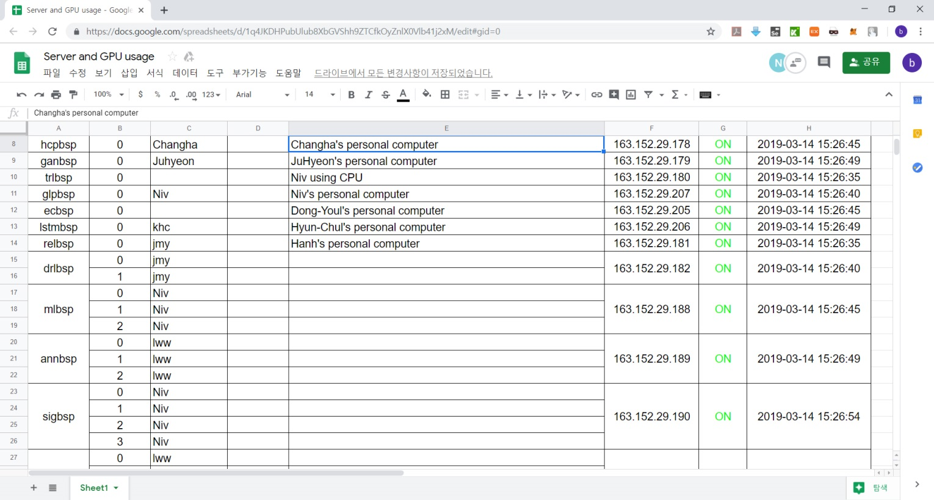
Server status
Now we can check server status in realtime ☺
- 7 -
Notes:
Supporting facts

Slide 9
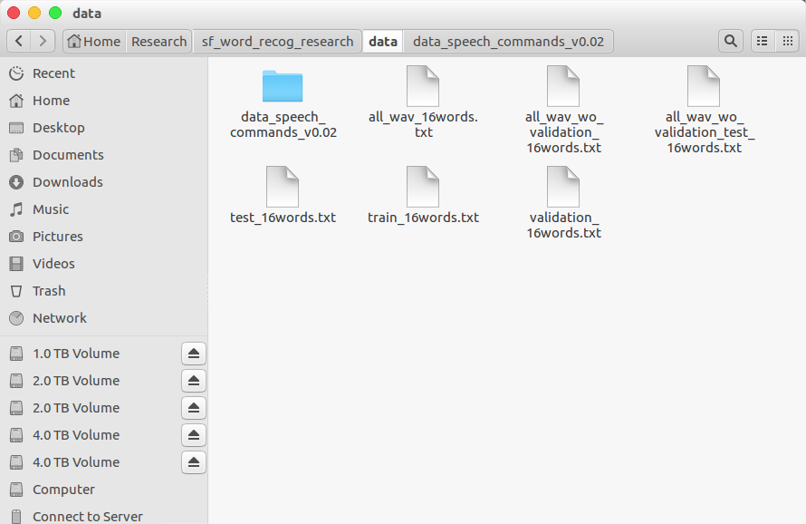
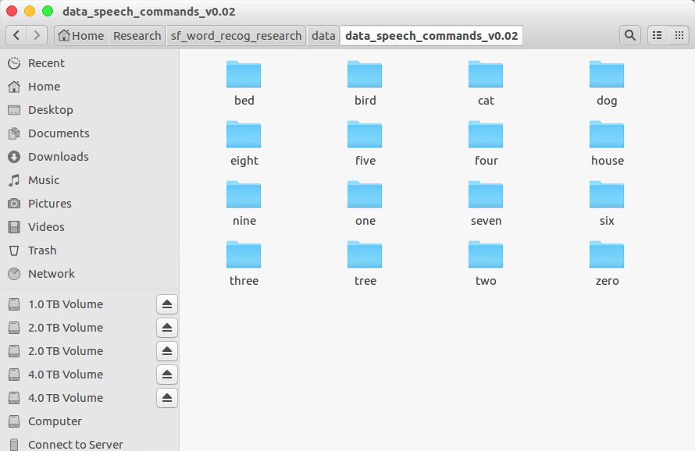
Audio Classification
Data is low-waveform.
sec: 1, sampling rate: 16000, type: float32, channel: mono
16 class data.
'zero', 'one', 'two', 'three', 'four', 'five', 'six', 'seven', 'eight', 'nine', 'bed', 'bird', 'tree', 'cat', 'house', 'dog'
Train: 40851(≒80%), Validation: 4796(≒10%), Test: 5297(≒10%)
- 8 -
Notes:
Supporting facts

Slide 10
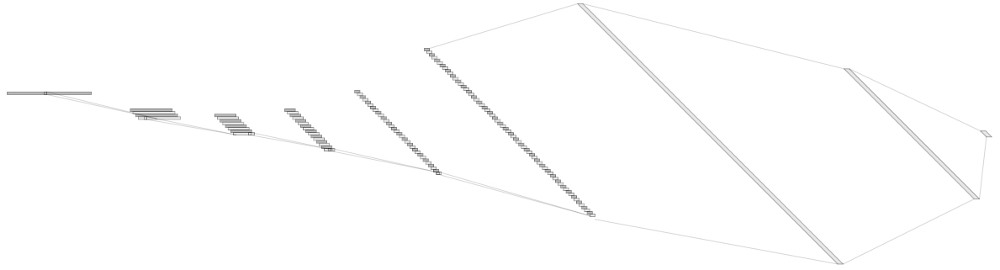
Audio Classification
For example, ‘5Conv, 2FC’ baseline model’s detail.
It just flatten 2D model. (5X5 filter->1X25 filter, 2X2 stride->1X4 stride)
Input: 16000X1 low waveform.
Output:1x16 labeled one hot vector. ('zero', …, 'eight', …, 'house', 'dog')
Loss: cross entropy loss
Obtimizer: Adam
1X1024
128@8
1X512
1@16000
64@55
8@3994
16@993
32@243
Conv(25)
MaxPool(4)
1X16
Conv(25)
MaxPool(4)
Conv(25)
MaxPool(4)
Conv(25)
MaxPool(4)
Conv(25)
MaxPool(4)
Fully-Conncted
Fully-Conncted
[ Baseline Architecture]
- 9 -
Notes:
Supporting facts

Slide 11
Audio Classification
Fine tuning task in 1D-CNN
0. Depth
1. Dropout
2. Batch Normalization
3. D·O + B·N
4. Reduce FC
5. Channel
6. Kernel Size
7. Summary
8. Dropout rate
9. Kernel Size
Previous Work
10. Summary
- 10 -
Notes:
Supporting facts

Slide 12
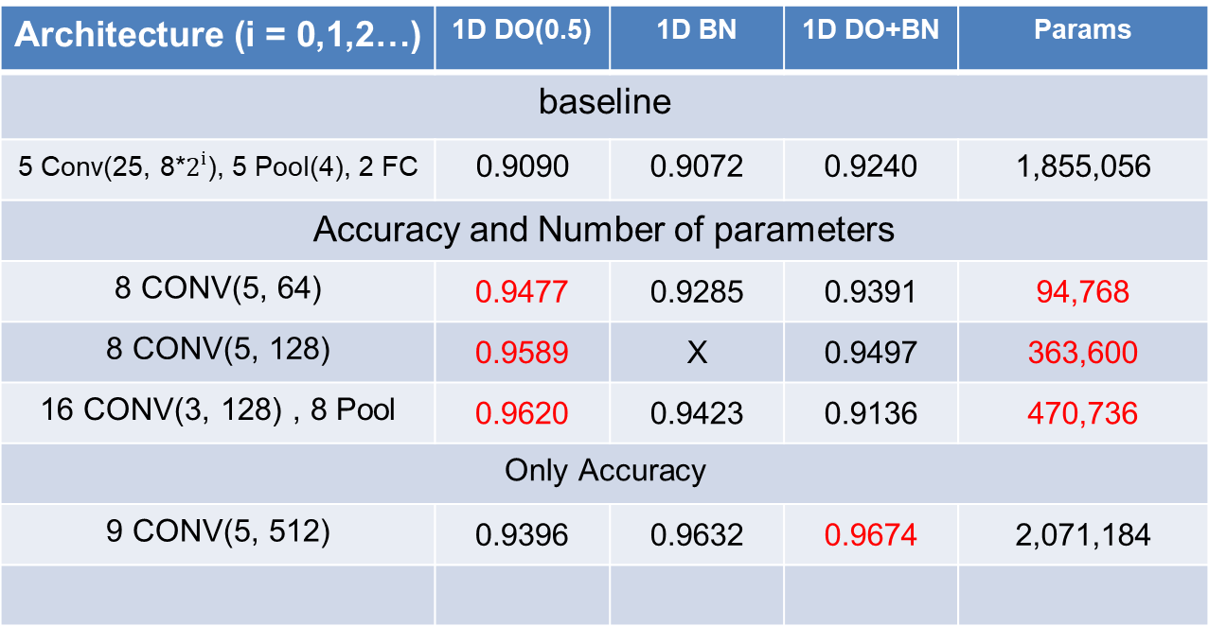
Audio Classification
This is SOTA(State Of The Art) in previous research.
Architecture (i = 0,1,2…) | 1D DO(0.5) | 1D BN | 1D DO+BN | Params
baseline
5 Conv(25, 8*$2^{i}$), 5 Pool(4), 2 FC | 0.9090 | 0.9072 | 0.9240 | 1,855,056
Accuracy and Number of parameters
8 CONV(5, 64) | 0.9477 | 0.9285 | 0.9391 | 94,768
8 CONV(5, 128) | 0.9589 | X | 0.9497 | 363,600
16 CONV(3, 128) , 8 Pool | 0.9620 | 0.9423 | 0.9136 | 470,736
Only Accuracy
9 CONV(5, 512) | 0.9396 | 0.9632 | 0.9674 | 2,071,184
base model
Custom
channel 32
Custom
channel 64
DO(0.75)
Custom
VGG style
DO(0.75)
Custom
channel 128
- 11 -
Notes:
Supporting facts

Slide 13
Audio Classification
Fine tuning task in 1D-CNN
4. Reduce FC
5. Kernel Size
6. Channel
7. Summary
11. Finetuning based on good model
Added Work
- 12 -
Notes:
Supporting facts

Slide 14
Audio Classification
I tune the dropout’s rate in ‘custom ch32’ model
The accuracy was exceeded 0.95
Architecture | DO(0.25) | DO(0.25)+BN | DO(0.75) | DO(0.75)+BN
1 CONV(5, 32) | X | X | X | X
2 CONV(5, 32) | X | X | X | X
3 CONV(5, 32) | 0.5034 | 0.5277 | 0.6260 | 0.6816
4 CONV(5, 32) | 0.6395 | 0.6712 | 0.7983 | 0.8019
5 CONV(5, 64) | 0.7248 | 0.7458 | 0.8432 | 0.8461
6 CONV(5, 64) | 0.8650 | 0.8536 | 0.9101 | 0.8951
7 CONV(5, 64) | 0.9267 | 0.9215 | 0.9425 | 0.9252
8 CONV(5, 64) | 0.9452 | 0.9369 | 0.9533 | 0.9458
9 CONV(5, 128) | 0.9362 | 0.9385 | 0.9506 | 0.9491
- 13 -
Notes:
Supporting facts

Slide 15
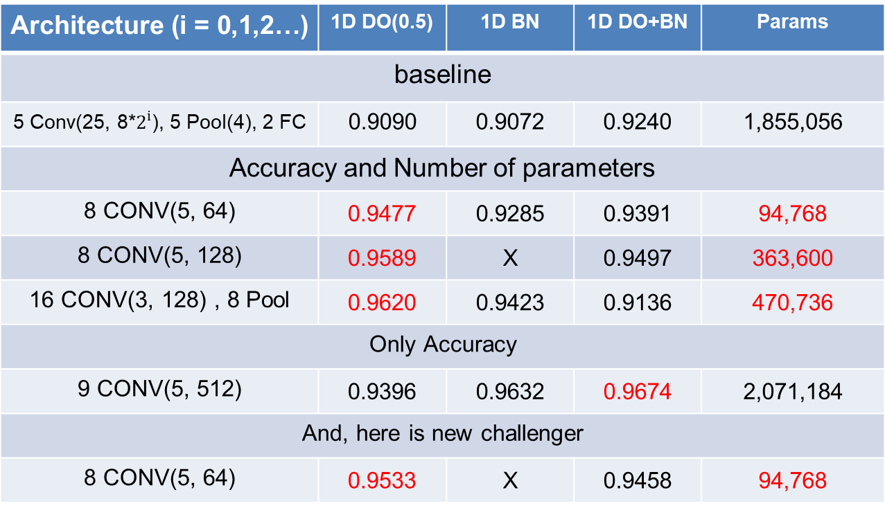
Audio Classification
This is SOTA(State Of The Art) in current research.
Despite less than 100,000 parameters, it was exceeded 0.95.
Architecture (i = 0,1,2…) | 1D DO(0.5) | 1D BN | 1D DO+BN | Params
baseline
5 Conv(25, 8*$2^{i}$), 5 Pool(4), 2 FC | 0.9090 | 0.9072 | 0.9240 | 1,855,056
Accuracy and Number of parameters
8 CONV(5, 64) | 0.9477 | 0.9285 | 0.9391 | 94,768
8 CONV(5, 128) | 0.9589 | X | 0.9497 | 363,600
16 CONV(3, 128) , 8 Pool | 0.9620 | 0.9423 | 0.9136 | 470,736
Only Accuracy
9 CONV(5, 512) | 0.9396 | 0.9632 | 0.9674 | 2,071,184
And, here is new challenger
8 CONV(5, 64) | 0.9533 | X | 0.9458 | 94,768
base model
Custom
channel 32
Custom
channel 64
DO(0.75)
Custom
VGG style
DO(0.75)
Custom
channel 128
Custom
channel 32
DO(0.75)
- 14 -
Notes:
Supporting facts

Slide 16
Audio Classification
Confusion matrix
Compare ‘baseline’ and this model
In ‘Three’ and ‘Tree’ case, it is around two times better.
Actual class
Actual class
Zero
One
Two
Three
Fore
Five
Six
Seven
Eight
Nine
Bed Bird
Cat
Dog
House
Tree
[[367 0 8 0 5 0 0 0 1 1 1 1 0 0 0 1]
[ 1 344 0 0 3 7 0 1 0 6 1 0 0 0 0 1]
[ 5 0 359 0 7 0 0 2 1 1 1 1 1 4 1 1]
[ 1 0 5 333 0 4 2 3 5 1 1 2 0 0 0 20]
[ 3 2 3 2 344 3 0 2 0 0 2 1 0 6 0 0]
[ 1 4 0 4 0 388 1 0 1 4 0 1 1 2 1 0]
[ 0 0 0 1 0 1 367 1 2 1 0 0 1 0 0 0]
[ 4 1 0 1 1 0 5 355 0 4 0 1 4 0 0 0]
[ 0 1 0 5 2 1 3 1 349 4 5 2 3 0 0 0]
[ 0 2 0 1 0 3 0 0 0 364 2 1 0 4 0 0]
[ 2 3 1 1 0 1 4 3 4 0 153 3 8 0 0 0]
[ 1 2 0 2 1 3 0 0 0 5 4 133 1 0 0 1]
[ 0 0 3 0 1 1 0 1 0 1 1 0 157 1 2 0]
[ 1 1 2 0 0 1 0 0 1 4 1 5 0 176 0 0]
[ 0 0 0 0 0 2 1 0 0 1 0 0 3 0 159 1]
[ 1 0 4 32 0 0 0 0 3 1 0 0 0 0 0 122]]
[[369 0 5 1 3 0 1 4 0 1 0 0 1 0 0 0]
[ 1 347 0 0 4 1 1 0 0 7 2 0 0 1 0 0]
[ 8 0 369 2 0 0 0 0 1 0 0 0 2 2 0 0]
[ 1 0 2 356 0 1 1 2 6 0 0 0 0 0 0 8]
[ 2 2 1 1 359 2 0 0 0 0 0 0 1 0 0 0]
[ 0 6 0 3 4 386 0 2 1 3 0 1 2 0 0 0]
[ 0 0 0 3 1 0 366 1 2 0 1 0 0 0 0 0]
[ 3 0 0 0 1 0 2 367 0 0 3 0 0 0 0 0]
[ 1 0 1 2 1 0 0 0 367 0 2 0 1 0 0 1]
[ 0 6 0 0 0 3 0 0 0 364 3 1 0 0 0 0]
[ 1 0 2 0 0 0 0 0 6 0 166 5 2 1 0 0]
[ 0 1 1 1 0 0 2 0 0 2 7 137 0 2 0 0]
[ 0 0 0 0 0 0 0 1 0 0 1 0 161 4 1 0]
[ 0 1 5 0 0 0 0 0 0 1 1 0 2 182 0 0]
[ 0 0 2 0 0 1 1 0 0 1 0 0 5 1 156 0]
[ 2 0 2 15 0 0 1 0 4 1 0 0 0 0 0 138]]
Predict Class
base model
(Acc: 0.9090)
Custom
channel 32
DO(0.75)
(Acc: 0.9533)
- 15 -
Notes:
Supporting facts

Slide 17
Audio Classification
I tune the dropout’s rate in ‘custom ch128’ model
0.97……!?
Architecture | DO(0.25) | DO(0.25)+BN | DO(0.75) | DO(0.75)+BN
1 CONV(5, 128) | X | X | X | X
2 CONV(5, 128) | X | X | X | X
3 CONV(5, 128) | 0.5522 | 0.5124 | 0.6476 | 0.6457
4 CONV(5, 128) | 0.6768 | 0.6866 | 0.7803 | 0.7867
5 CONV(5, 256) | 0.7601 | 0.7445 | 0.8386 | 0.8449
6 CONV(5, 256) | 0.8906 | 0.8789 | 0.9130 | 0.8970
7 CONV(5, 256) | 0.9369 | 0.9171 | 0.9576 | 0.9302
8 CONV(5, 256) | 0.9570 | 0.9547 | 0.9618 | 0.9580
9 CONV(5, 512) | 0.9535 | 0.9701 | 0.9645 | 0.9595
- 16 -
Notes:
Supporting facts

Slide 18
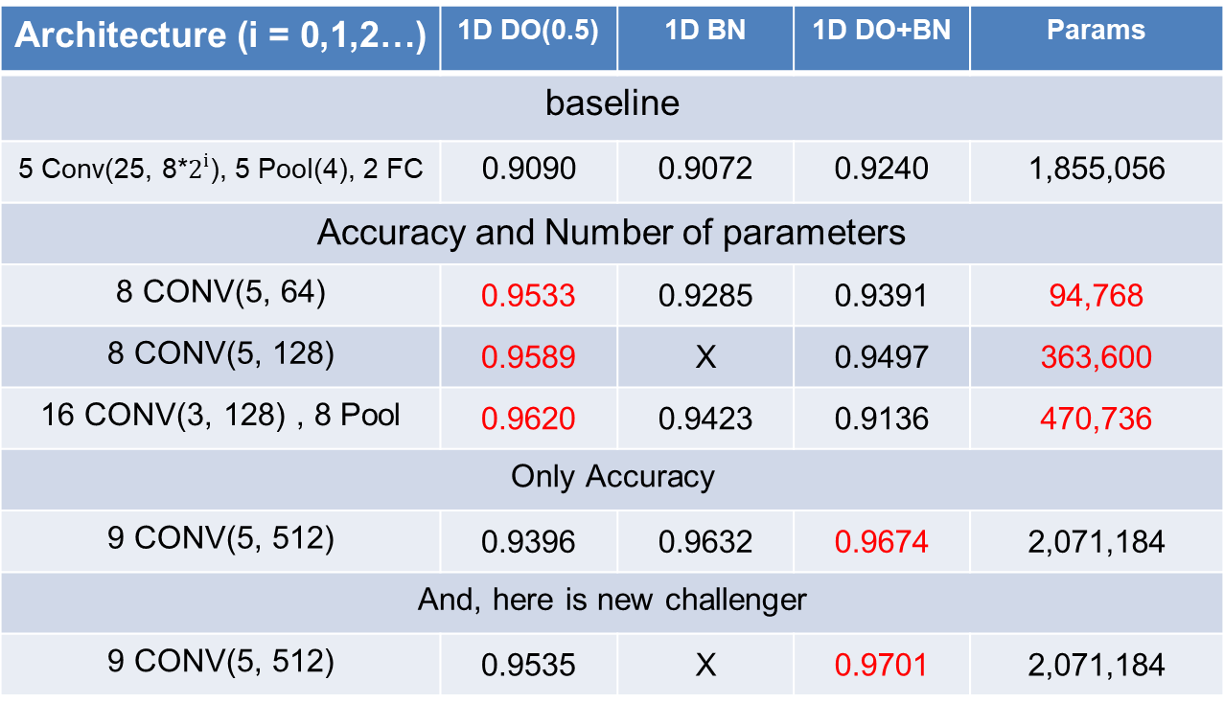
Audio Classification
This is SOTA(State Of The Art) in current research.
The accuracy achieve 0.97
Architecture (i = 0,1,2…) | 1D DO(0.5) | 1D BN | 1D DO+BN | Params
baseline
5 Conv(25, 8*$2^{i}$), 5 Pool(4), 2 FC | 0.9090 | 0.9072 | 0.9240 | 1,855,056
Accuracy and Number of parameters
8 CONV(5, 64) | 0.9533 | 0.9285 | 0.9391 | 94,768
8 CONV(5, 128) | 0.9589 | X | 0.9497 | 363,600
16 CONV(3, 128) , 8 Pool | 0.9620 | 0.9423 | 0.9136 | 470,736
Only Accuracy
9 CONV(5, 512) | 0.9396 | 0.9632 | 0.9674 | 2,071,184
And, here is new challenger
9 CONV(5, 512) | 0.9535 | X | 0.9701 | 2,071,184
base model
Custom
channel 32
DO(0.75)
Custom
channel 64
DO(0.75)
Custom
VGG style
DO(0.75)
Custom
channel 128
Custom
channel 128
DO(0.25)+BN
- 17 -
Notes:
Supporting facts

Slide 19
Audio Classification
Confusion matrix
Compare ‘baseline’ and this model
In ‘Three’ and ‘Tree’ case, it is around two or three times better.
Actual class
Actual class
Zero
One
Two
Three
Fore
Five
Six
Seven
Eight
Nine
Bed Bird
Cat
Dog
House
Tree
[[367 0 8 0 5 0 0 0 1 1 1 1 0 0 0 1]
[ 1 344 0 0 3 7 0 1 0 6 1 0 0 0 0 1]
[ 5 0 359 0 7 0 0 2 1 1 1 1 1 4 1 1]
[ 1 0 5 333 0 4 2 3 5 1 1 2 0 0 0 20]
[ 3 2 3 2 344 3 0 2 0 0 2 1 0 6 0 0]
[ 1 4 0 4 0 388 1 0 1 4 0 1 1 2 1 0]
[ 0 0 0 1 0 1 367 1 2 1 0 0 1 0 0 0]
[ 4 1 0 1 1 0 5 355 0 4 0 1 4 0 0 0]
[ 0 1 0 5 2 1 3 1 349 4 5 2 3 0 0 0]
[ 0 2 0 1 0 3 0 0 0 364 2 1 0 4 0 0]
[ 2 3 1 1 0 1 4 3 4 0 153 3 8 0 0 0]
[ 1 2 0 2 1 3 0 0 0 5 4 133 1 0 0 1]
[ 0 0 3 0 1 1 0 1 0 1 1 0 157 1 2 0]
[ 1 1 2 0 0 1 0 0 1 4 1 5 0 176 0 0]
[ 0 0 0 0 0 2 1 0 0 1 0 0 3 0 159 1]
[ 1 0 4 32 0 0 0 0 3 1 0 0 0 0 0 122]]
[[375 0 3 0 2 0 0 3 0 1 0 0 0 0 0 1]
[ 0 348 0 0 4 1 0 1 1 6 1 0 0 0 1 1]
[ 1 0 375 2 1 0 0 0 0 0 0 0 0 2 1 2]
[ 1 0 5 356 0 0 2 3 1 0 1 0 0 0 0 8]
[ 0 0 0 0 364 1 0 0 0 0 0 1 1 0 0 1]
[ 0 0 0 0 5 399 0 0 1 2 0 0 1 0 0 0]
[ 0 0 0 1 0 0 371 1 0 0 1 0 0 0 0 0]
[ 1 0 0 0 0 0 1 373 1 0 0 0 0 0 0 0]
[ 0 0 4 2 0 0 0 0 362 4 0 2 1 0 0 1]
[ 0 5 0 0 0 3 0 1 0 363 2 3 0 0 0 0]
[ 0 0 1 0 0 0 1 0 1 0 178 1 0 0 0 1]
[ 0 0 0 0 0 0 0 0 0 1 3 147 0 1 0 1]
[ 0 0 0 0 0 0 0 0 0 0 0 0 166 1 1 0]
[ 0 0 2 0 0 0 0 0 0 0 1 1 0 186 0 2]
[ 0 0 0 0 0 0 0 0 2 0 0 1 3 0 161 0]
[ 0 0 1 10 0 0 0 0 4 1 0 0 0 0 0 147]]
Predict Class
base model
(Acc: 0.9090)
Custom
channel 128
DO(0.25)+BN
(Acc: 0.9701)
- 18 -
Notes:
Supporting facts

Slide 20
Audio Classification
Confusion matrix
Compare two best model.
Not much different, but the right model is a little better.
Actual class
Actual class
Zero
One
Two
Three
Fore
Five
Six
Seven
Eight
Nine
Bed Bird
Cat
Dog
House
Tree
[[369 0 5 1 3 0 1 4 0 1 0 0 1 0 0 0]
[ 1 347 0 0 4 1 1 0 0 7 2 0 0 1 0 0]
[ 8 0 369 2 0 0 0 0 1 0 0 0 2 2 0 0]
[ 1 0 2 356 0 1 1 2 6 0 0 0 0 0 0 8]
[ 2 2 1 1 359 2 0 0 0 0 0 0 1 0 0 0]
[ 0 6 0 3 4 386 0 2 1 3 0 1 2 0 0 0]
[ 0 0 0 3 1 0 366 1 2 0 1 0 0 0 0 0]
[ 3 0 0 0 1 0 2 367 0 0 3 0 0 0 0 0]
[ 1 0 1 2 1 0 0 0 367 0 2 0 1 0 0 1]
[ 0 6 0 0 0 3 0 0 0 364 3 1 0 0 0 0]
[ 1 0 2 0 0 0 0 0 6 0 166 5 2 1 0 0]
[ 0 1 1 1 0 0 2 0 0 2 7 137 0 2 0 0]
[ 0 0 0 0 0 0 0 1 0 0 1 0 161 4 1 0]
[ 0 1 5 0 0 0 0 0 0 1 1 0 2 182 0 0]
[ 0 0 2 0 0 1 1 0 0 1 0 0 5 1 156 0]
[ 2 0 2 15 0 0 1 0 4 1 0 0 0 0 0 138]]
[[375 0 3 0 2 0 0 3 0 1 0 0 0 0 0 1]
[ 0 348 0 0 4 1 0 1 1 6 1 0 0 0 1 1]
[ 1 0 375 2 1 0 0 0 0 0 0 0 0 2 1 2]
[ 1 0 5 356 0 0 2 3 1 0 1 0 0 0 0 8]
[ 0 0 0 0 364 1 0 0 0 0 0 1 1 0 0 1]
[ 0 0 0 0 5 399 0 0 1 2 0 0 1 0 0 0]
[ 0 0 0 1 0 0 371 1 0 0 1 0 0 0 0 0]
[ 1 0 0 0 0 0 1 373 1 0 0 0 0 0 0 0]
[ 0 0 4 2 0 0 0 0 362 4 0 2 1 0 0 1]
[ 0 5 0 0 0 3 0 1 0 363 2 3 0 0 0 0]
[ 0 0 1 0 0 0 1 0 1 0 178 1 0 0 0 1]
[ 0 0 0 0 0 0 0 0 0 1 3 147 0 1 0 1]
[ 0 0 0 0 0 0 0 0 0 0 0 0 166 1 1 0]
[ 0 0 2 0 0 0 0 0 0 0 1 1 0 186 0 2]
[ 0 0 0 0 0 0 0 0 2 0 0 1 3 0 161 0]
[ 0 0 1 10 0 0 0 0 4 1 0 0 0 0 0 147]]
Predict Class
Custom
channel 32
DO(0.75)
(Acc: 0.9533)
Custom
channel 128
DO(0.25)+BN
(Acc: 0.9701)
- 19 -
Notes:
Supporting facts

Slide 21
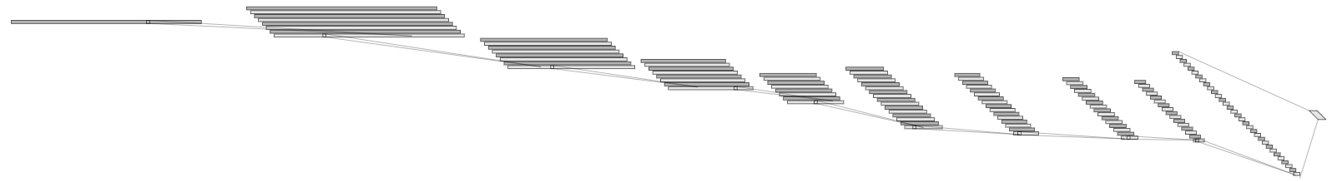
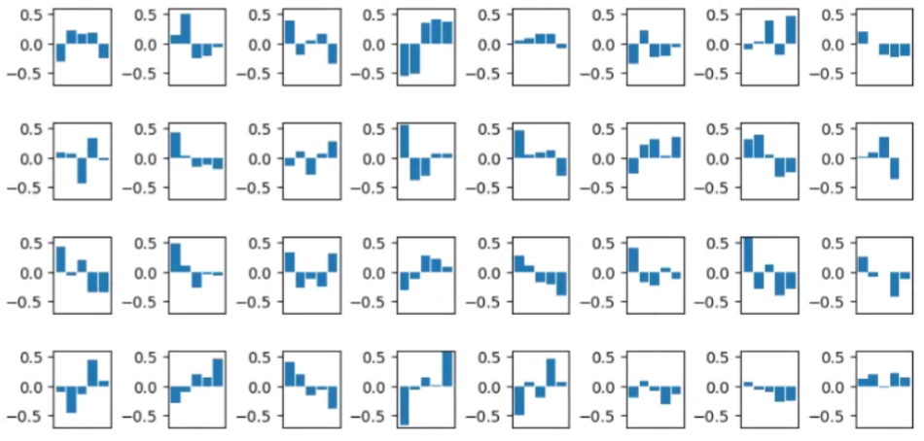
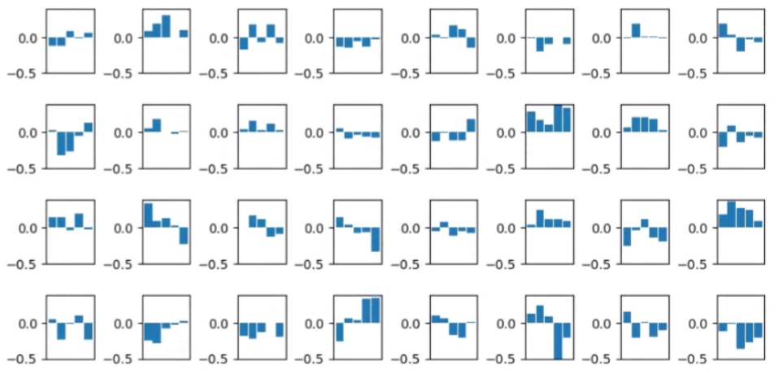
Audio Classification
Visualize the filter map. (Custom channel 32 DO(0.75) Model)
Of course, Small number of parameters is easy to analyze
There was a shape to know, but most of the shape was hard to understand.
Next time, I will prepare the feature map and analyze it more detail.
1@16000
32@16000
32@5333
128@2
Conv(32, 5)
32@1777
32@592
64@197
64@65
64@21
64@7
Conv(32, 5)
MaxPool(3)
Conv(32, 5)
MaxPool(3)
Conv(32, 5)
MaxPool(3)
Conv(64, 5)
MaxPool(3)
Conv(64, 5)
MaxPool(3)
Conv(64, 5)
MaxPool(3)
Conv(64, 5)
MaxPool(3)
Conv(128, 5)
MaxPool(3)
First layer’s filter
Second layer’s filter
- 20 -
Notes:
Supporting facts

Slide 22
Any Question?
Thank you
Notes:
Supporting facts

