Slide 1
Weekly Report
Wangwon Lee, 2019/03/30
This week | Next week
Classification Report Confusion matrix Precision , Recall, F1-score Visualization Filter and Activation map Frequency response Spectrogram | Fine Tuning Change activation function Change filter size Try other reference Visualization Each label The other model CAM(Class Activation Map)
Interesting and new finding
Fine Tuning Visualization
The aim of this month / Discussion
The aim of this month: To study the brain and GLM, To investigate about CNN.
Notes:
I want you to follow this rule

Slide 2
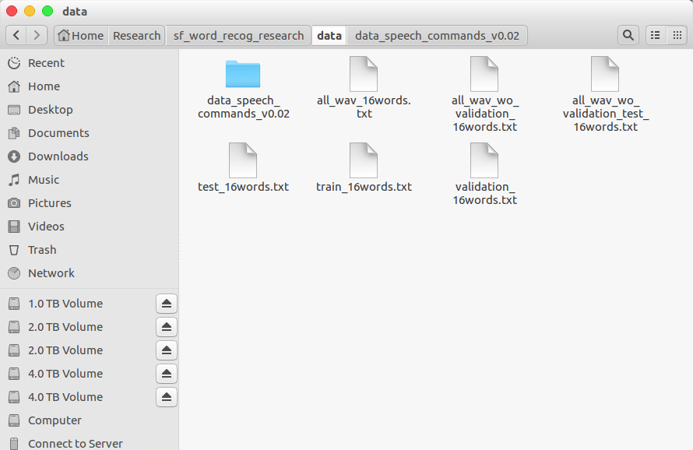
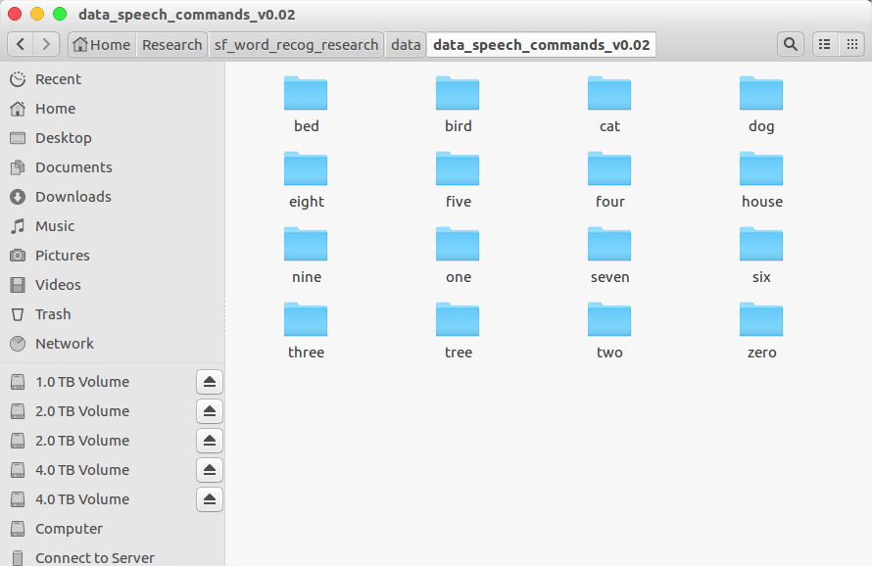
Audio Classification - Previous Work
Data is low-waveform.
sec: 1, sampling rate: 16000, type: float32, channel: mono
16 class data.
'zero', 'one', 'two', 'three', 'four', 'five', 'six', 'seven', 'eight', 'nine', 'bed', 'bird', 'tree', 'cat', 'house', 'dog'
Train: 40851(≒80%), Validation: 4796(≒10%), Test: 5297(≒10%)
- 1 -
Notes:
Supporting facts

Slide 3
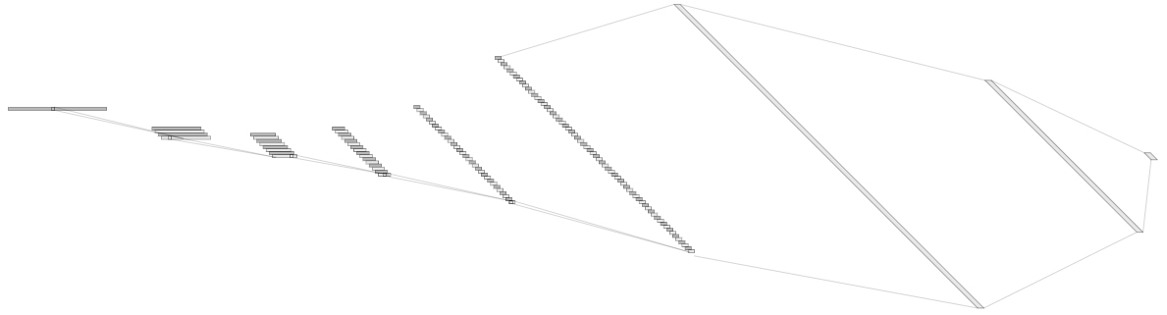
Audio Classification - Previous Work
For example, ‘5Conv, 2FC’ baseline model’s detail.
It just flatten 2D model. (5X5 filter->1X25 filter, 2X2 stride->1X4 stride)
Input: 16000X1 low waveform.
Output:1x16 labeled one hot vector. ('zero', …, 'eight', …, 'house', 'dog')
Loss: cross entropy loss
Obtimizer: Adam
Channel@DataSize
1X1024
128@8
1X512
1@16000
64@55
8@3994
16@993
32@243
Conv(25)
MaxPool(4)
1X16
Conv(25)
MaxPool(4)
Conv(25)
MaxPool(4)
Conv(25)
MaxPool(4)
Conv(25)
MaxPool(4)
Fully-Conncted
Fully-Conncted
[ Baseline Architecture]
- 2 -
Notes:
Supporting facts

Slide 4
Audio Classification - Previous Work
Fine tuning task in 1D-CNN
0. Depth
8. Dropout rate
9. Kernel Size
1. Dropout
2. Batch Normalization
3. D·O + B·N
10. Summary
11. Finetune based on good model
4. Reduce FC
12. Change the channel more steeply
5. Channel
6. Kernel Size
13. Change the channel to become smaller and smaller
7. Summary
Previous Work
- 3 -
Notes:
Supporting facts

Slide 5
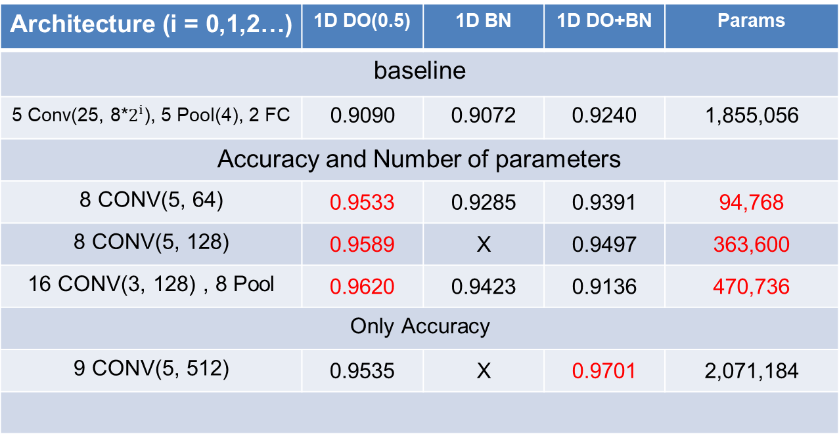
Audio Classification
This is SOTA(State Of The Art) in current research.
Architecture (i = 0,1,2…) | 1D DO(0.5) | 1D BN | 1D DO+BN | Params
baseline
5 Conv(25, 8*$2^{i}$), 5 Pool(4), 2 FC | 0.9090 | 0.9072 | 0.9240 | 1,855,056
Accuracy and Number of parameters
8 CONV(5, 64) | 0.9533 | 0.9285 | 0.9391 | 94,768
8 CONV(5, 128) | 0.9589 | X | 0.9497 | 363,600
16 CONV(3, 128) , 8 Pool | 0.9620 | 0.9423 | 0.9136 | 470,736
Only Accuracy
9 CONV(5, 512) | 0.9535 | X | 0.9701 | 2,071,184
base model
Custom
channel 32
DO(0.75)
Custom
channel 64
DO(0.75)
Custom
VGG style
DO(0.75)
Custom
channel 128
DO(0.25)+BN
- 4 -
Notes:
Supporting facts

Slide 6
Audio Classification
Confusion matrix
Compare two best model.
Not much different, but the right model is a little better.
Actual class
Actual class
Zero
One
Two
Three
Fore
Five
Six
Seven
Eight
Nine
Bed Bird
Cat
Dog
House
Tree
[[369 0 5 1 3 0 1 4 0 1 0 0 1 0 0 0]
[ 1 347 0 0 4 1 1 0 0 7 2 0 0 1 0 0]
[ 8 0 369 2 0 0 0 0 1 0 0 0 2 2 0 0]
[ 1 0 2 356 0 1 1 2 6 0 0 0 0 0 0 8]
[ 2 2 1 1 359 2 0 0 0 0 0 0 1 0 0 0]
[ 0 6 0 3 4 386 0 2 1 3 0 1 2 0 0 0]
[ 0 0 0 3 1 0 366 1 2 0 1 0 0 0 0 0]
[ 3 0 0 0 1 0 2 367 0 0 3 0 0 0 0 0]
[ 1 0 1 2 1 0 0 0 367 0 2 0 1 0 0 1]
[ 0 6 0 0 0 3 0 0 0 364 3 1 0 0 0 0]
[ 1 0 2 0 0 0 0 0 6 0 166 5 2 1 0 0]
[ 0 1 1 1 0 0 2 0 0 2 7 137 0 2 0 0]
[ 0 0 0 0 0 0 0 1 0 0 1 0 161 4 1 0]
[ 0 1 5 0 0 0 0 0 0 1 1 0 2 182 0 0]
[ 0 0 2 0 0 1 1 0 0 1 0 0 5 1 156 0]
[ 2 0 2 15 0 0 1 0 4 1 0 0 0 0 0 138]]
[[375 0 3 0 2 0 0 3 0 1 0 0 0 0 0 1]
[ 0 348 0 0 4 1 0 1 1 6 1 0 0 0 1 1]
[ 1 0 375 2 1 0 0 0 0 0 0 0 0 2 1 2]
[ 1 0 5 356 0 0 2 3 1 0 1 0 0 0 0 8]
[ 0 0 0 0 364 1 0 0 0 0 0 1 1 0 0 1]
[ 0 0 0 0 5 399 0 0 1 2 0 0 1 0 0 0]
[ 0 0 0 1 0 0 371 1 0 0 1 0 0 0 0 0]
[ 1 0 0 0 0 0 1 373 1 0 0 0 0 0 0 0]
[ 0 0 4 2 0 0 0 0 362 4 0 2 1 0 0 1]
[ 0 5 0 0 0 3 0 1 0 363 2 3 0 0 0 0]
[ 0 0 1 0 0 0 1 0 1 0 178 1 0 0 0 1]
[ 0 0 0 0 0 0 0 0 0 1 3 147 0 1 0 1]
[ 0 0 0 0 0 0 0 0 0 0 0 0 166 1 1 0]
[ 0 0 2 0 0 0 0 0 0 0 1 1 0 186 0 2]
[ 0 0 0 0 0 0 0 0 2 0 0 1 3 0 161 0]
[ 0 0 1 10 0 0 0 0 4 1 0 0 0 0 0 147]]
Predict Class
Custom
channel 32
DO(0.75)
(Acc: 0.9533)
Custom
channel 128
DO(0.25)+BN
(Acc: 0.9701)
- 5 -
Notes:
Supporting facts

Slide 7
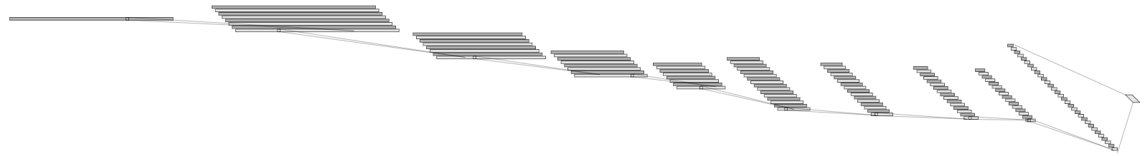
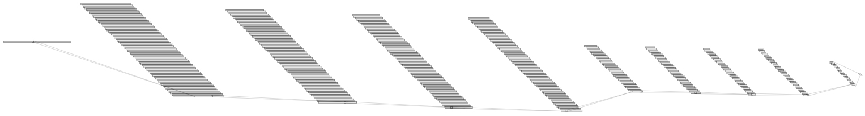
Audio Classification
Change the channel to become smaller and smaller.
The upper is ‘Custom channel 32 DO(0.75) 9 Conv’ model’s detail.
Previous one: 1 → 32 → 32 → 32 → 32 → 64 → 64 → 64 → 64 → 128 Tried one : 1 → 128 → 128 → 128 → 128 → 64 → 64 → 64 → 64 → 32
1@16000
32@16000
32@5333
128@2
Conv(5)
32@1777
32@592
64@197
64@65
64@21
64@7
Conv(5)
MaxPool(3)
Channel@DataSize
Conv(5)
MaxPool(3)
Conv(5)
MaxPool(3)
Conv(5)
MaxPool(3)
Conv(5)
MaxPool(3)
Conv(5)
MaxPool(3)
Conv(5)
MaxPool(3)
[ Previous one ]
Conv(5)
MaxPool(3)
128@16000
128@5333
128@1777
128@592
1@16000
64@197
64@65
64@21
64@7
32@2
Conv(5)
Conv(5)
MaxPool(3)
Conv(5)
MaxPool(3)
Conv(5)
MaxPool(3)
Conv(5)
MaxPool(3)
Conv(5)
MaxPool(3)
Conv(5)
MaxPool(3)
Conv(5)
MaxPool(3)
Conv(5)
MaxPool(3)
[ Tried one ]
- 6 -
Notes:
Supporting facts

Slide 8
Audio Classification
I think this try is very meaningful.
Because this model focus on the feature compression than previous model.
Like autoencoder. ( 16000 → 64(=2*32channel) )
This model is better when use other classifiers after extract the feature from CNN.
1@16000
32@16000
32@5333
128@2
Conv(5)
32@1777
32@592
64@197
64@65
64@21
64@7
Conv(5)
MaxPool(3)
Conv(5)
MaxPool(3)
Conv(5)
MaxPool(3)
Conv(5)
MaxPool(3)
Conv(5)
MaxPool(3)
Conv(5)
MaxPool(3)
Conv(5)
MaxPool(3)
Just feature extraction
Conv(5)
MaxPool(3)
[ Previous one ]
128@16000
128@5333
128@1777
128@592
1@16000
64@197
64@65
64@21
64@7
32@2
Conv(5)
MaxPool(3)
Feature extraction
and more compression
Conv(5)
MaxPool(3)
Conv(5)
MaxPool(3)
Conv(5)
Conv(5)
MaxPool(3)
Conv(5)
MaxPool(3)
Conv(5)
MaxPool(3)
Conv(5)
MaxPool(3)
Conv(5)
MaxPool(3)
[ Tried one ]
- 6 -
Notes:
Supporting facts

Slide 9
Audio Classification
In summary, This is SOTA(State Of The Art) in this research.
Though the performance is lower than the previous model, I think it is meaningful.
The original data size, 16000, was compressed to 32 and the performance was 0.9327.
And the other model compress to 128 and the performance was 0.9628.
What if we use a feature from CNN as input to another model, this model will be very useful.
Architecture (i = 0,1,2…) | 1D DO(0.5) | 1D BN | 1D DO+BN | Params
16000(Input data size) → 2(Length) * 16(Channel) = 32 (Feature size)
9 CONV(5, 16) | 0.9238 | 0.9074 | 0.9327 | 91,712
16000(Input data size) → 2(Length) * 64(Channel) = 128 (Feature Size)
9 CONV(5, 64) | 0.9603 | 0.9572 | 0.9628 | 1,438,544
Feature
extraction
ch 64
Feature
extraction
ch 256
- 7 -
Notes:
Supporting facts

Slide 10
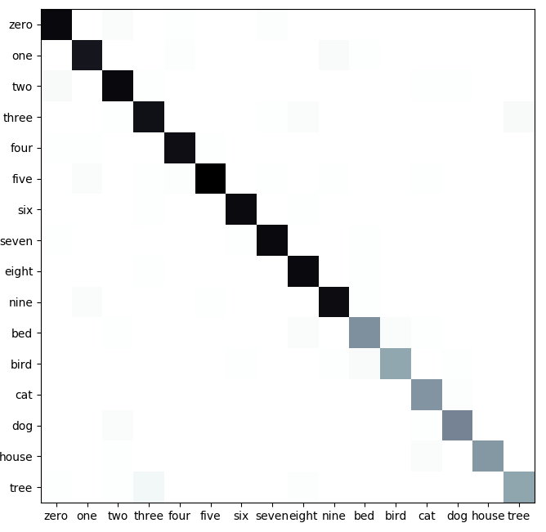
Audio Classification
In previous time, I shown only accuracy and confusion matrix.
But there is a lot of way that I show the model’s performance more efficiently
First, Visualize the number.
Actual class
Zero
One
Two
Three
Fore
Five
Six
Seven
Eight
Nine
Bed Bird
Cat
Dog
House
Tree
[[369 0 5 1 3 0 1 4 0 1 0 0 1 0 0 0]
[ 1 347 0 0 4 1 1 0 0 7 2 0 0 1 0 0]
[ 8 0 369 2 0 0 0 0 1 0 0 0 2 2 0 0]
[ 1 0 2 356 0 1 1 2 6 0 0 0 0 0 0 8]
[ 2 2 1 1 359 2 0 0 0 0 0 0 1 0 0 0]
[ 0 6 0 3 4 386 0 2 1 3 0 1 2 0 0 0]
[ 0 0 0 3 1 0 366 1 2 0 1 0 0 0 0 0]
[ 3 0 0 0 1 0 2 367 0 0 3 0 0 0 0 0]
[ 1 0 1 2 1 0 0 0 367 0 2 0 1 0 0 1]
[ 0 6 0 0 0 3 0 0 0 364 3 1 0 0 0 0]
[ 1 0 2 0 0 0 0 0 6 0 166 5 2 1 0 0]
[ 0 1 1 1 0 0 2 0 0 2 7 137 0 2 0 0]
[ 0 0 0 0 0 0 0 1 0 0 1 0 161 4 1 0]
[ 0 1 5 0 0 0 0 0 0 1 1 0 2 182 0 0]
[ 0 0 2 0 0 1 1 0 0 1 0 0 5 1 156 0]
[ 2 0 2 15 0 0 1 0 4 1 0 0 0 0 0 138]]
Predict Class
Custom
channel 32
DO(0.75)
(Acc: 0.9533)
- 8 -
Notes:
Supporting facts

Slide 11
Audio Classification
To validate the model, We can use measure such as precision, recall, f1-score.
We find out that It does not confuse between ‘three’ and ‘tree’.
It just confuses ‘tree’ as ‘three’.
And It also confuse between ‘Bed’ and ‘Bird’.
Actual class
Precision Recall F1-score Support
zero 0.95 0.96 0.95 385
one 0.96 0.95 0.95 364
two 0.95 0.96 0.95 384
three 0.93 0.94 0.94 377
four 0.96 0.98 0.97 368
five 0.98 0.95 0.96 408
six 0.98 0.98 0.98 374
seven 0.97 0.98 0.97 376
eight 0.95 0.98 0.96 376
nine 0.96 0.97 0.96 377
bed 0.89 0.91 0.90 183
bird 0.95 0.90 0.92 153
cat 0.91 0.96 0.93 168
dog 0.94 0.95 0.95 192
house 0.99 0.93 0.96 167
tree 0.94 0.85 0.89 163
weighted avg 0.95 0.95 0.95 4815
Zero
One
Two
Three
Fore
Five
Six
Seven
Eight
Nine
Bed Bird
Cat
Dog
House
Tree
[[369 0 5 1 3 0 1 4 0 1 0 0 1 0 0 0]
[ 1 347 0 0 4 1 1 0 0 7 2 0 0 1 0 0]
[ 8 0 369 2 0 0 0 0 1 0 0 0 2 2 0 0]
[ 1 0 2 356 0 1 1 2 6 0 0 0 0 0 0 8]
[ 2 2 1 1 359 2 0 0 0 0 0 0 1 0 0 0]
[ 0 6 0 3 4 386 0 2 1 3 0 1 2 0 0 0]
[ 0 0 0 3 1 0 366 1 2 0 1 0 0 0 0 0]
[ 3 0 0 0 1 0 2 367 0 0 3 0 0 0 0 0]
[ 1 0 1 2 1 0 0 0 367 0 2 0 1 0 0 1]
[ 0 6 0 0 0 3 0 0 0 364 3 1 0 0 0 0]
[ 1 0 2 0 0 0 0 0 6 0 166 5 2 1 0 0]
[ 0 1 1 1 0 0 2 0 0 2 7 137 0 2 0 0]
[ 0 0 0 0 0 0 0 1 0 0 1 0 161 4 1 0]
[ 0 1 5 0 0 0 0 0 0 1 1 0 2 182 0 0]
[ 0 0 2 0 0 1 1 0 0 1 0 0 5 1 156 0]
[ 2 0 2 15 0 0 1 0 4 1 0 0 0 0 0 138]]
Predict Class
Custom
channel 32
DO(0.75)
(Acc: 0.9533)
- 9 -
Notes:
Supporting facts

Slide 12
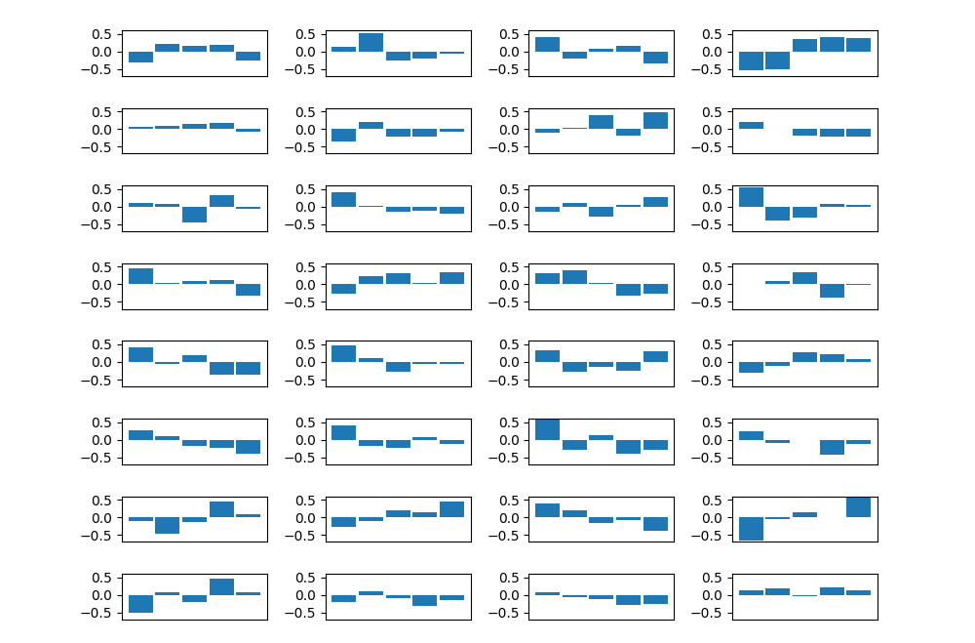
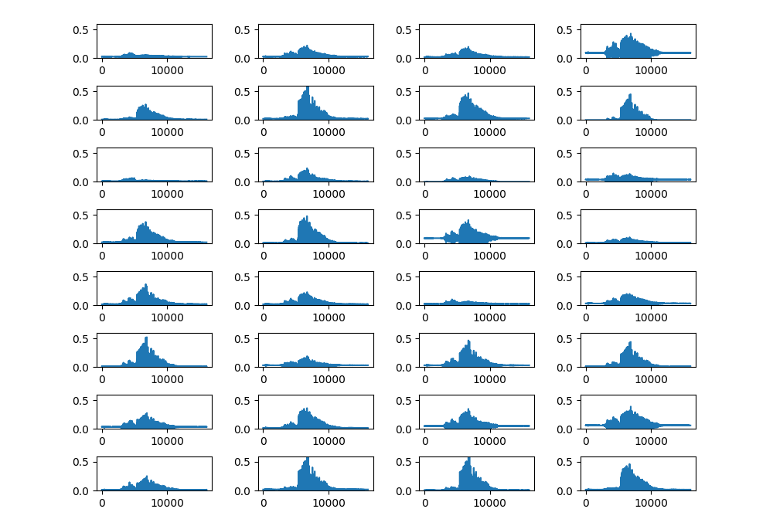
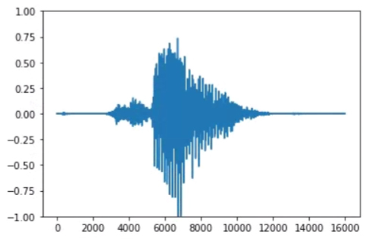
Audio Classification
Visualize the filter map. (Custom channel 32 DO(0.75) Model)
Less than zero of the waveform is removed because of ‘Relu’
Because of this problem, it is difficult to analysis from the point of view of Signal Processing.
So, I consider to use ‘tanh’ function.
1@16000
32@16000
32@5333
128@2
Conv(32, 5)
32@1777
32@592
64@197
64@65
64@21
64@7
Conv(32, 5)
MaxPool(3)
Conv(32, 5)
MaxPool(3)
Conv(32, 5)
MaxPool(3)
Conv(64, 5)
MaxPool(3)
Conv(64, 5)
MaxPool(3)
Conv(64, 5)
MaxPool(3)
Conv(64, 5)
MaxPool(3)
Conv(128, 5)
MaxPool(3)
0
1
2
3
32
33
34
35
0
32
4
36
8
40
12
44
16
48
20
52
24
56
28
60
- 10 -
Notes:
Supporting facts

Slide 13
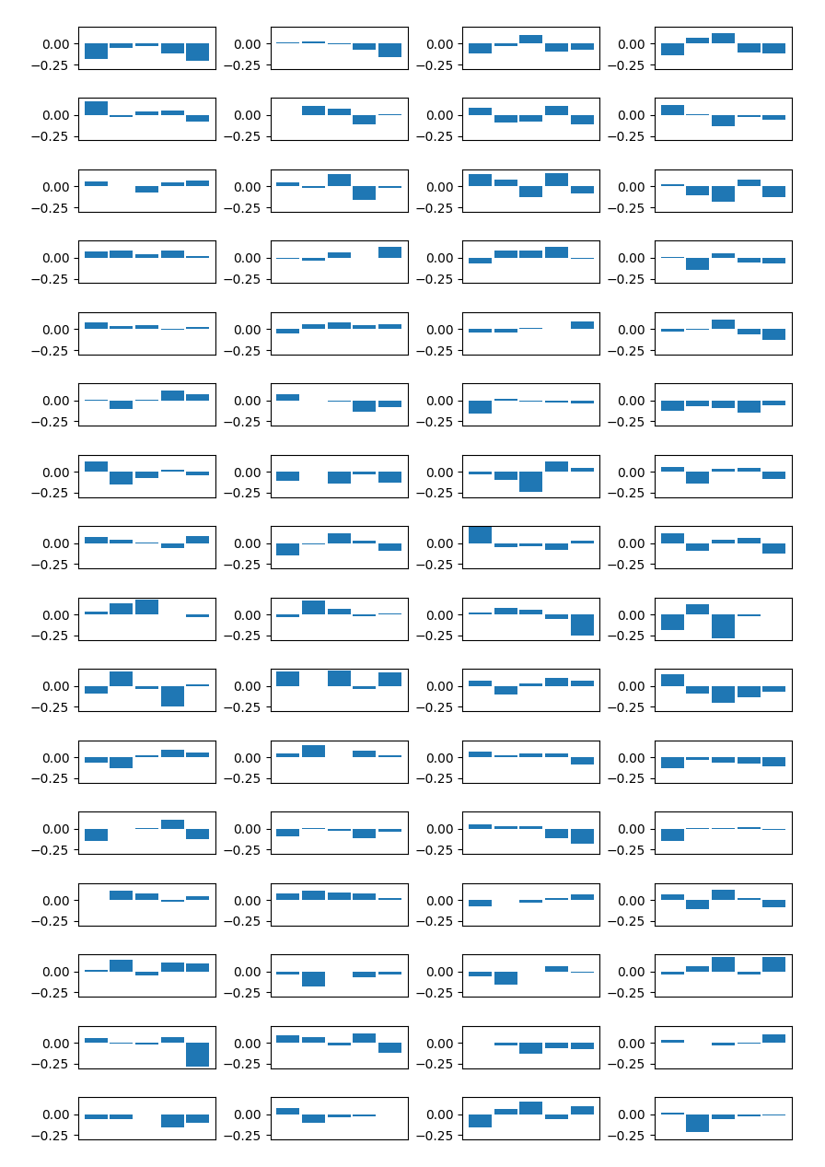
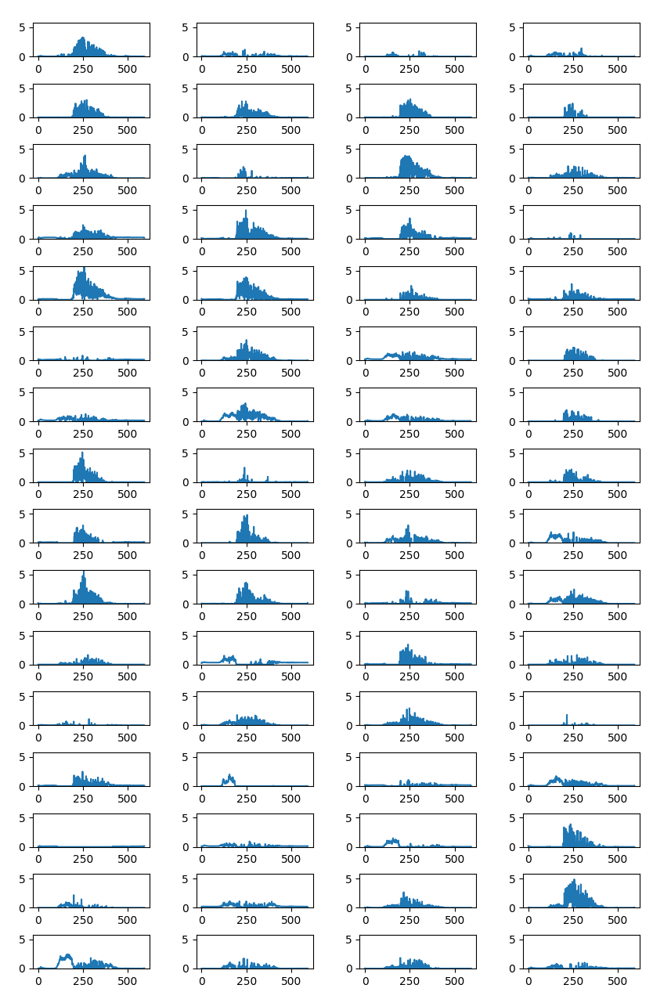

Audio Classification
Visualize the filter map. (Custom channel 32 DO(0.75) Model)
Going through the filter, the information is disappearing more and more.
0
1
2
3
64
65
66
67
0
64
4
68
8
72
12
76
16
80
20
84
24
88
28
92
32
96
36
100
40
104
44
108
48
112
52
116
56
120
60
124
Original input
5th Layer - Filter
5th Layer – Activation map
- 11 -
Notes:
Supporting facts

Slide 14
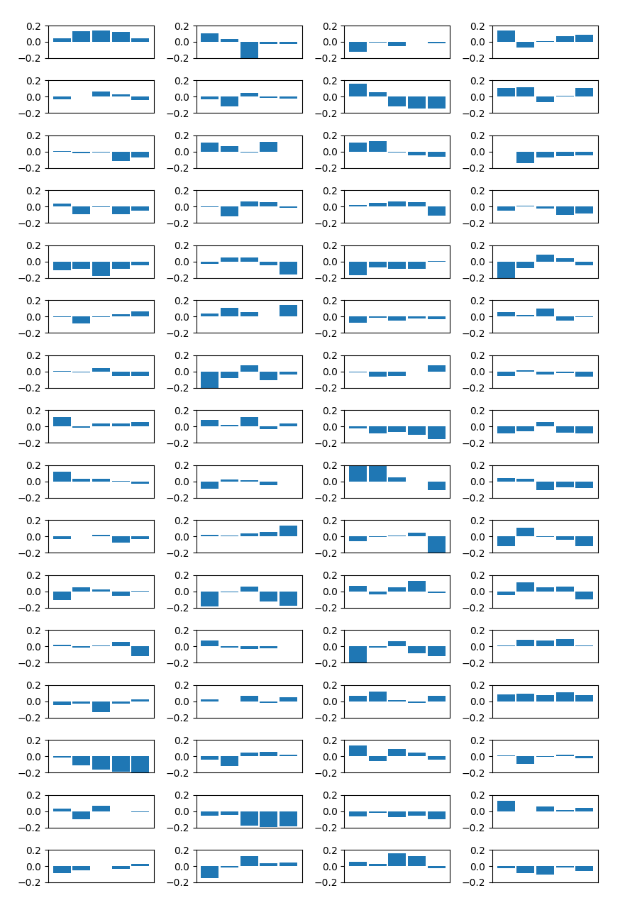
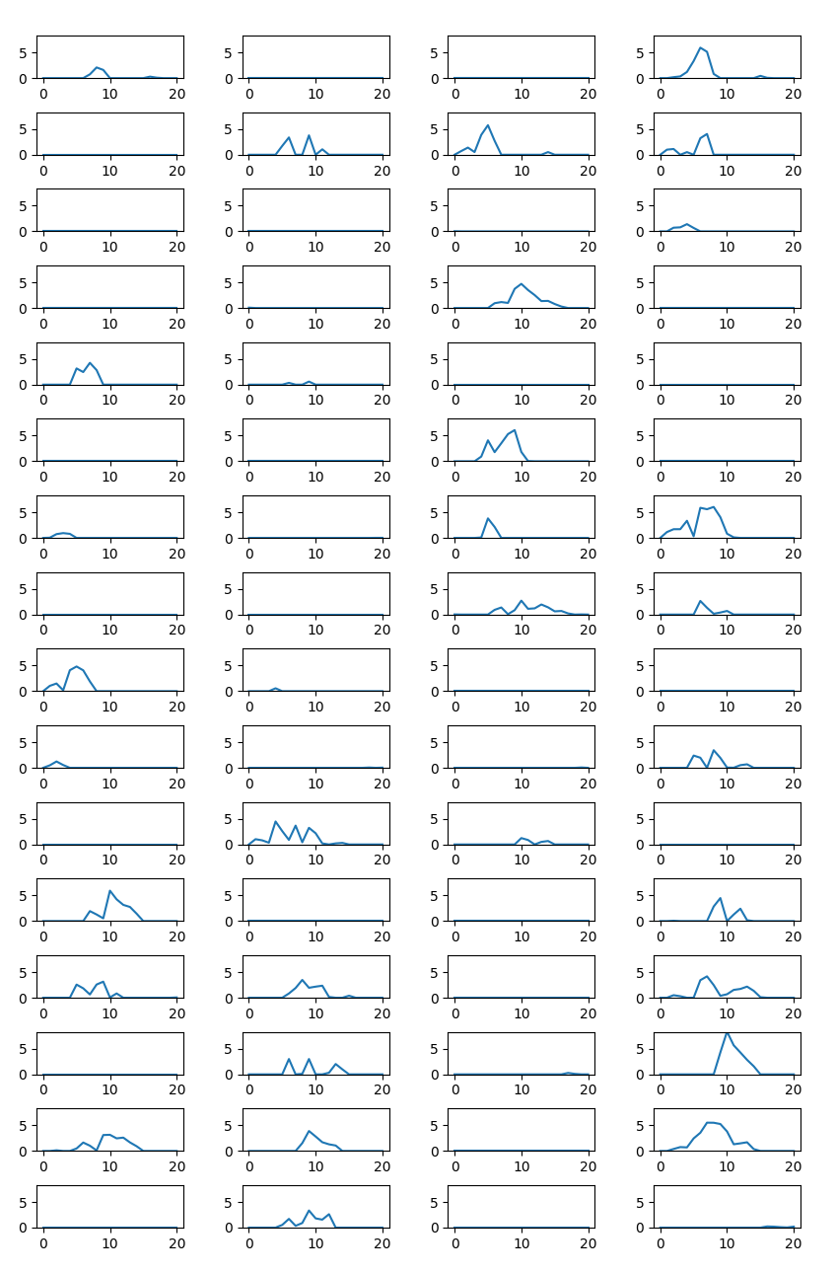
Audio Classification
About half is gone away...
I don’t know whether each label has a place for feature extraction or it is originally empty
0
1
2
3
64
65
66
67
0
64
4
68
8
72
12
76
16
80
20
84
24
88
28
92
32
96
36
100
40
104
44
108
48
112
52
116
56
120
60
124
Original input
8th Layer - Filter
8th Layer – Activation map
- 12 -
Notes:
Supporting facts

Slide 15
Audio Classification
The most of Signal Processing analysis assume that Linear Time Invariant(LTI) System.
Because of ‘Relu’ function is non-linear function, So, CNN is also non-linear system.
But, how about before the first Relu?
I think we can apply the Signal Processing technique before the first Relu layer.
Layer (type) Output Shape Param #
=================================================================
conv1d_67 (Conv1D) (None, 16000, 32) 192
_________________________________________________________________
activation_67 (Activation) (None, 16000, 32) 0
_________________________________________________________________
conv1d_68 (Conv1D) (None, 16000, 32) 5152
_________________________________________________________________
activation_68 (Activation) (None, 16000, 32) 0
_________________________________________________________________
max_pooling1d_55 (MaxPooling (None, 5333, 32) 0
_________________________________________________________________
conv1d_69 (Conv1D) (None, 5333, 32) 5152
_________________________________________________________________
activation_69 (Activation) (None, 5333, 32) 0
_________________________________________________________________
max_pooling1d_56 (MaxPooling (None, 1777, 32) 0
_________________________________________________________________
conv1d_70 (Conv1D) (None, 1777, 32) 5152
_________________________________________________________________
activation_70 (Activation) (None, 1777, 32) 0
_________________________________________________________________
max_pooling1d_57 (MaxPooling (None, 592, 32) 0
_________________________________________________________________
conv1d_71 (Conv1D) (None, 592, 64) 10304
_________________________________________________________________
activation_71 (Activation) (None, 592, 64) 0
_________________________________________________________________
max_pooling1d_58 (MaxPooling (None, 197, 64) 0
_________________________________________________________________
conv1d_72 (Conv1D) (None, 197, 64) 20544
_________________________________________________________________
activation_72 (Activation) (None, 197, 64) 0
_________________________________________________________________
max_pooling1d_59 (MaxPooling (None, 65, 64) 0
_________________________________________________________________
conv1d_73 (Conv1D) (None, 65, 64) 20544
_________________________________________________________________
activation_73 (Activation) (None, 65, 64) 0
_________________________________________________________________
max_pooling1d_60 (MaxPooling (None, 21, 64) 0
_________________________________________________________________
conv1d_74 (Conv1D) (None, 21, 64) 20544
_________________________________________________________________
activation_74 (Activation) (None, 21, 64) 0
_________________________________________________________________
max_pooling1d_61 (MaxPooling (None, 7, 64) 0
_________________________________________________________________
flatten_12 (Flatten) (None, 448) 0
_________________________________________________________________
dropout_12 (Dropout) (None, 448) 0
_________________________________________________________________
dense_12 (Dense) (None, 16) 7184
=================================================================
- 13 -
Notes:
Supporting facts

Slide 16
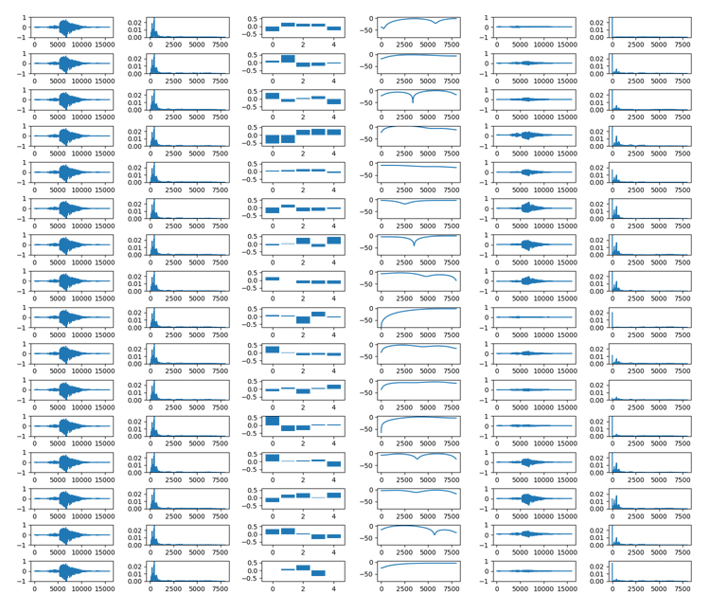
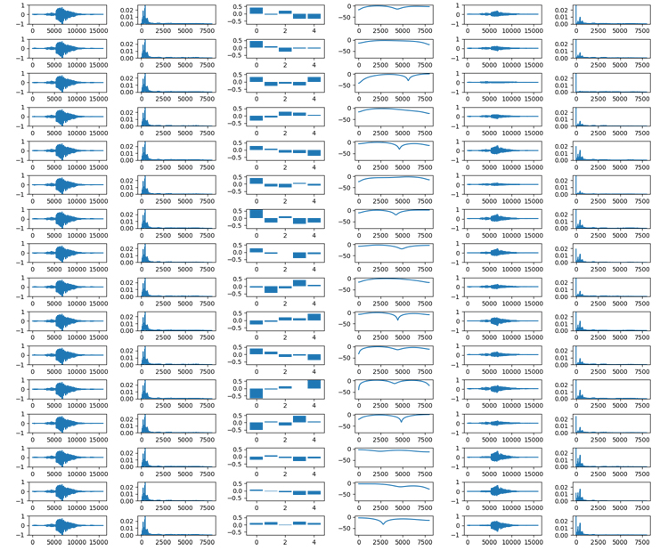
Audio Classification
I want to know what does each filter to do.
So I tried to analysis in frequency area.
But, Fast Fourior Transform (FFT) is not good to analysis speech signal……
Input
Input
(FFT)
Filter
Filter
(frequency
response)
Output
Output
(FFT)
0
16
- 14 -
Notes:
Supporting facts

Slide 17
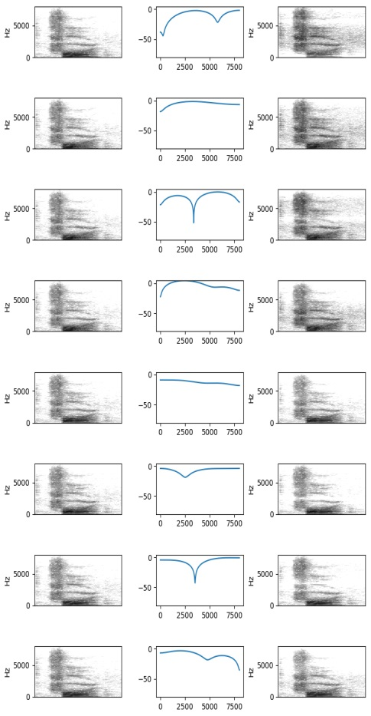
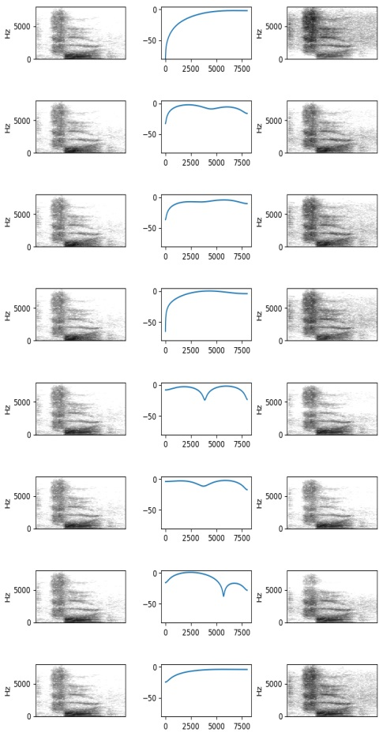
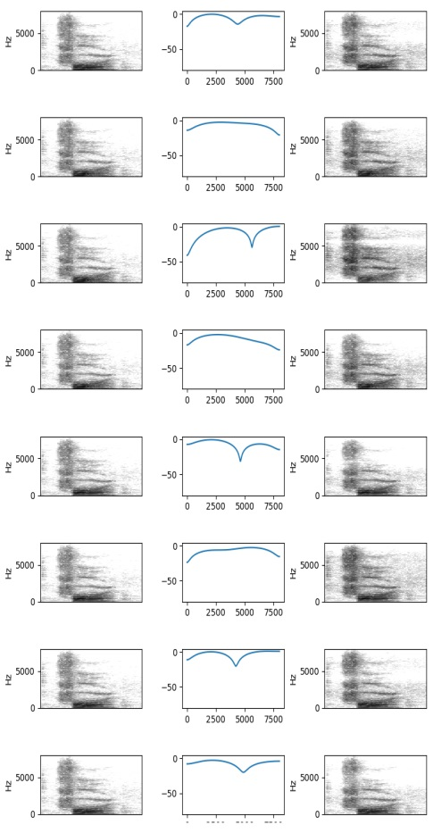
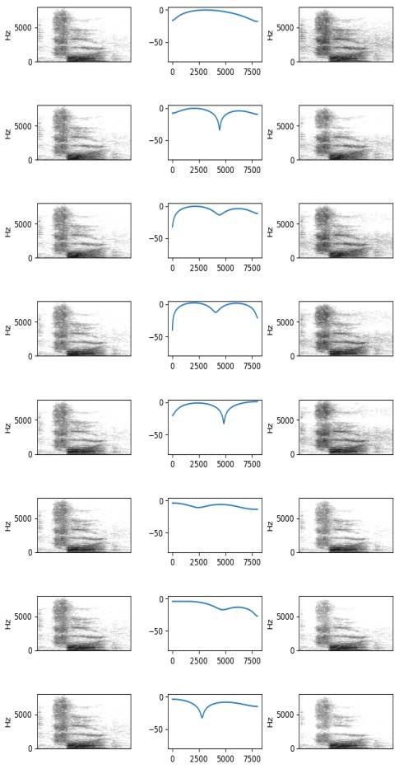
Audio Classification
So I created spectrogram by Short Time Fourier Transform (STFT).
Window Size: 512, Stride: 128
We can see that it is applied to the shape of frequency response.
0
8
16
24
- 15 -
Notes:
Supporting facts

Slide 18
Any Question?
Thank you
Notes:
Supporting facts

