Slide 1
Weekly Report
Wangwon Lee, 2019/03/23
This week | Next week
New try in architecture Change the channel more steeply What if the channel become smaller and smaller? Summary | Audio Classification Understanding 1D-CNN model. Mapping our brain data Investigate 1D model more specific Visualization Filter and Feature map In frequency area CAM(Class Activation Map)
Interesting and new finding
Fine Tuning Feature Extraction
The aim of this month / Discussion
The aim of this month: To study the brain and GLM, To investigate about CNN.
Notes:
I want you to follow this rule

Slide 2
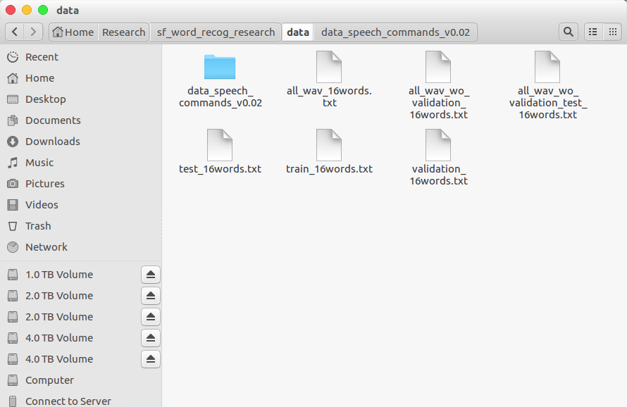
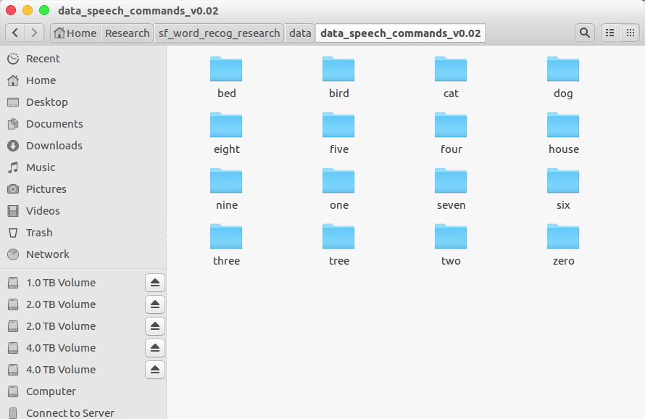
Audio Classification - Previous Work
Data is low-waveform.
sec: 1, sampling rate: 16000, type: float32, channel: mono
16 class data.
'zero', 'one', 'two', 'three', 'four', 'five', 'six', 'seven', 'eight', 'nine', 'bed', 'bird', 'tree', 'cat', 'house', 'dog'
Train: 40851(≒80%), Validation: 4796(≒10%), Test: 5297(≒10%)
- 1 -
Notes:
Supporting facts

Slide 3
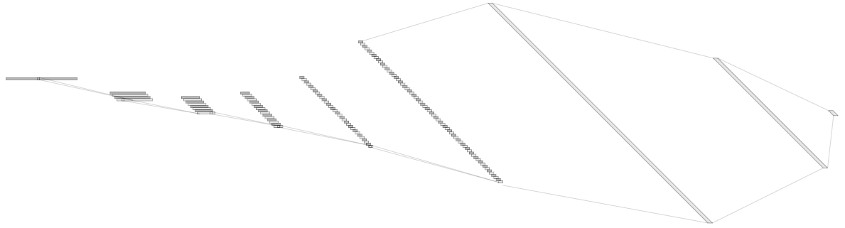
Audio Classification - Previous Work
For example, ‘5Conv, 2FC’ baseline model’s detail.
It just flatten 2D model. (5X5 filter->1X25 filter, 2X2 stride->1X4 stride)
Input: 16000X1 low waveform.
Output:1x16 labeled one hot vector. ('zero', …, 'eight', …, 'house', 'dog')
Loss: cross entropy loss
Obtimizer: Adam
Channel@DataSize
1X1024
128@8
1X512
1@16000
64@55
8@3994
16@993
32@243
Conv(25)
MaxPool(4)
1X16
Conv(25)
MaxPool(4)
Conv(25)
MaxPool(4)
Conv(25)
MaxPool(4)
Conv(25)
MaxPool(4)
Fully-Conncted
Fully-Conncted
[ Baseline Architecture]
- 2 -
Notes:
Supporting facts

Slide 4
Audio Classification - Previous Work
Fine tuning task in 1D-CNN
0. Depth
1. Dropout
2. Batch Normalization
3. D·O + B·N
4. Reduce FC
5. Channel
6. Kernel Size
11. Finetuning based on good model
7. Summary
8. Dropout rate
9. Kernel Size
10. Summary
- 10 -
Notes:
Supporting facts

Slide 5
Audio Classification - Previous Work
Fine tuning task in 1D-CNN
0. Depth
8. Dropout rate
9. Kernel Size
1. Dropout
2. Batch Normalization
3. D·O + B·N
10. Summary
11. Finetuning based on good model
4. Reduce FC
5. Channel
6. Kernel Size
7. Summary
- 3 -
Notes:
Supporting facts

Slide 6
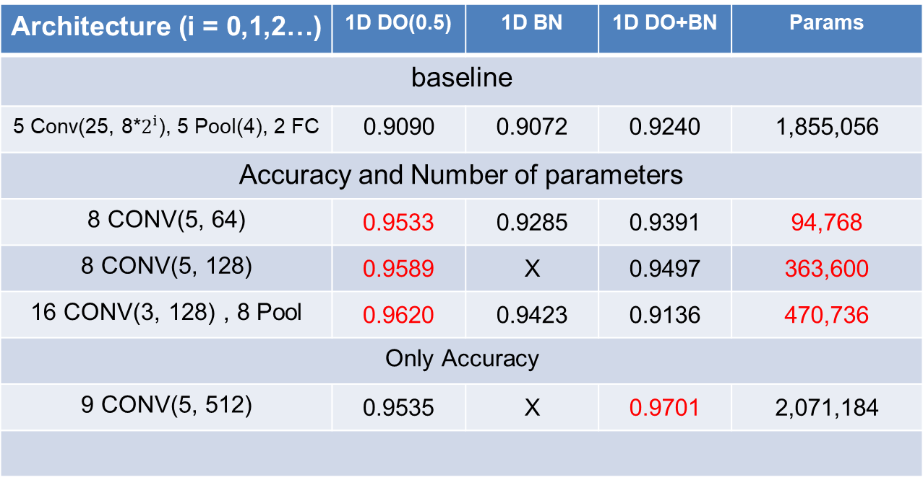
Audio Classification
This is SOTA(State Of The Art) in current research.
Architecture (i = 0,1,2…) | 1D DO(0.5) | 1D BN | 1D DO+BN | Params
baseline
5 Conv(25, 8*$2^{i}$), 5 Pool(4), 2 FC | 0.9090 | 0.9072 | 0.9240 | 1,855,056
Accuracy and Number of parameters
8 CONV(5, 64) | 0.9533 | 0.9285 | 0.9391 | 94,768
8 CONV(5, 128) | 0.9589 | X | 0.9497 | 363,600
16 CONV(3, 128) , 8 Pool | 0.9620 | 0.9423 | 0.9136 | 470,736
Only Accuracy
9 CONV(5, 512) | 0.9535 | X | 0.9701 | 2,071,184
base model
Custom
channel 32
DO(0.75)
Custom
channel 64
DO(0.75)
Custom
VGG style
DO(0.75)
Custom
channel 128
DO(0.25)+BN
- 4 -
Notes:
Supporting facts

Slide 7
Audio Classification
Confusion matrix
Compare two best model.
Not much different, but the right model is a little better.
Actual class
Actual class
Zero
One
Two
Three
Fore
Five
Six
Seven
Eight
Nine
Bed Bird
Cat
Dog
House
Tree
[[369 0 5 1 3 0 1 4 0 1 0 0 1 0 0 0]
[ 1 347 0 0 4 1 1 0 0 7 2 0 0 1 0 0]
[ 8 0 369 2 0 0 0 0 1 0 0 0 2 2 0 0]
[ 1 0 2 356 0 1 1 2 6 0 0 0 0 0 0 8]
[ 2 2 1 1 359 2 0 0 0 0 0 0 1 0 0 0]
[ 0 6 0 3 4 386 0 2 1 3 0 1 2 0 0 0]
[ 0 0 0 3 1 0 366 1 2 0 1 0 0 0 0 0]
[ 3 0 0 0 1 0 2 367 0 0 3 0 0 0 0 0]
[ 1 0 1 2 1 0 0 0 367 0 2 0 1 0 0 1]
[ 0 6 0 0 0 3 0 0 0 364 3 1 0 0 0 0]
[ 1 0 2 0 0 0 0 0 6 0 166 5 2 1 0 0]
[ 0 1 1 1 0 0 2 0 0 2 7 137 0 2 0 0]
[ 0 0 0 0 0 0 0 1 0 0 1 0 161 4 1 0]
[ 0 1 5 0 0 0 0 0 0 1 1 0 2 182 0 0]
[ 0 0 2 0 0 1 1 0 0 1 0 0 5 1 156 0]
[ 2 0 2 15 0 0 1 0 4 1 0 0 0 0 0 138]]
[[375 0 3 0 2 0 0 3 0 1 0 0 0 0 0 1]
[ 0 348 0 0 4 1 0 1 1 6 1 0 0 0 1 1]
[ 1 0 375 2 1 0 0 0 0 0 0 0 0 2 1 2]
[ 1 0 5 356 0 0 2 3 1 0 1 0 0 0 0 8]
[ 0 0 0 0 364 1 0 0 0 0 0 1 1 0 0 1]
[ 0 0 0 0 5 399 0 0 1 2 0 0 1 0 0 0]
[ 0 0 0 1 0 0 371 1 0 0 1 0 0 0 0 0]
[ 1 0 0 0 0 0 1 373 1 0 0 0 0 0 0 0]
[ 0 0 4 2 0 0 0 0 362 4 0 2 1 0 0 1]
[ 0 5 0 0 0 3 0 1 0 363 2 3 0 0 0 0]
[ 0 0 1 0 0 0 1 0 1 0 178 1 0 0 0 1]
[ 0 0 0 0 0 0 0 0 0 1 3 147 0 1 0 1]
[ 0 0 0 0 0 0 0 0 0 0 0 0 166 1 1 0]
[ 0 0 2 0 0 0 0 0 0 0 1 1 0 186 0 2]
[ 0 0 0 0 0 0 0 0 2 0 0 1 3 0 161 0]
[ 0 0 1 10 0 0 0 0 4 1 0 0 0 0 0 147]]
Predict Class
Custom
channel 32
DO(0.75)
(Acc: 0.9533)
Custom
channel 128
DO(0.25)+BN
(Acc: 0.9701)
- 5 -
Notes:
Supporting facts

Slide 8
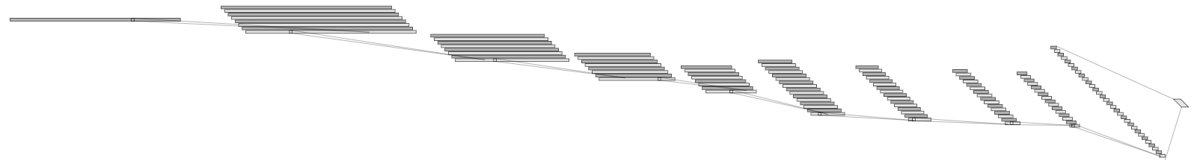
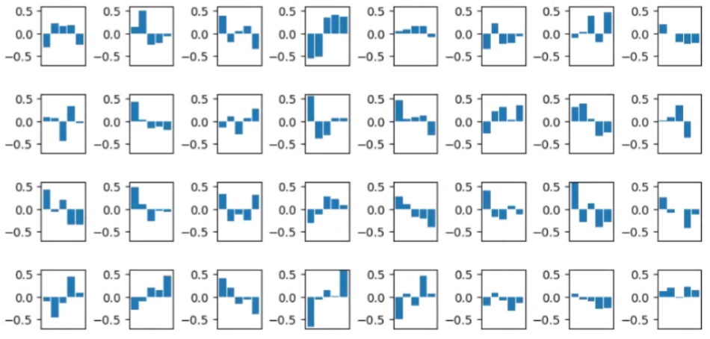
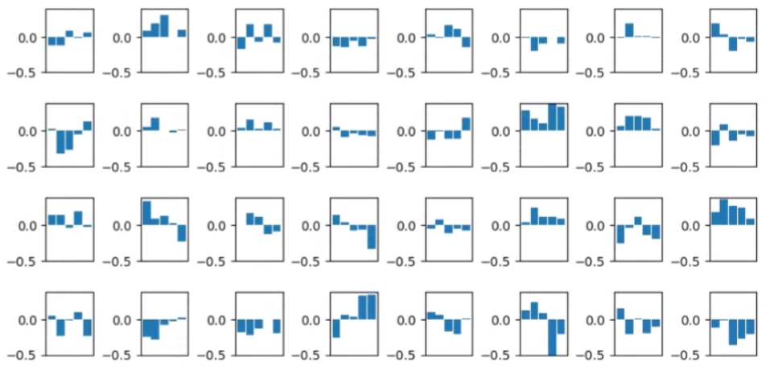
Audio Classification
Visualize the filter map. (Custom channel 32 DO(0.75) Model)
Of course, Small number of parameters is easy to analyze
There was a shape to know, but most of the shape was hard to understand.
Next time, I will prepare the feature map and analyze it more detail.
1@16000
32@16000
32@5333
128@2
Conv(32, 5)
32@1777
32@592
64@197
64@65
64@21
64@7
Conv(32, 5)
MaxPool(3)
Conv(32, 5)
MaxPool(3)
Conv(32, 5)
MaxPool(3)
Conv(64, 5)
MaxPool(3)
Conv(64, 5)
MaxPool(3)
Conv(64, 5)
MaxPool(3)
Conv(64, 5)
MaxPool(3)
Conv(128, 5)
MaxPool(3)
First layer’s filter
Second layer’s filter
- 6 -
Notes:
Supporting facts

Slide 9
Audio Classification - Previous Work
Fine tuning task in 1D-CNN
0. Depth
8. Dropout rate
9. Kernel Size
1. Dropout
2. Batch Normalization
3. D·O + B·N
10. Summary
11. Finetuning based on good model
4. Reduce FC
12. Change the channel more steeply
5. Channel
6. Kernel Size
13. Change the channel to become smaller and smaller
7. Summary
Added Work
- 7 -
Notes:
Supporting facts

Slide 10
Audio Classification - Added Work
Fine tuning task in 1D-CNN
8. Dropout rate
9. Kernel Size
10. Summary
Previous Work
11. Finetuning based on good model
12. Change the channel more steeply
13. Change the channel to become smaller and smaller
Added Work
- 7 -
Notes:
Supporting facts

Slide 11
Audio Classification
Change the channel more steeply
The upper is ‘Custom channel 32 DO(0.75) 9 Conv’ model’s detail.
Previous one: 1 → 32 → 32 → 32 → 32 → 64 → 64 → 64 → 64 → 128 Tried one : 1 → 32 → 32 → 32 → 64 → 64 → 64 → 128 →128 → 128
1@16000
32@16000
32@5333
128@2
Conv(5)
32@1777
32@592
64@197
64@65
64@21
64@7
Conv(5)
MaxPool(3)
Channel@DataSize
Conv(5)
MaxPool(3)
Conv(5)
MaxPool(3)
Conv(5)
MaxPool(3)
Conv(5)
MaxPool(3)
Conv(5)
MaxPool(3)
Conv(5)
MaxPool(3)
[ Previous one ]
Conv(5)
MaxPool(3)
1@16000
32@16000
32@5333
128@2
Conv(5)
32@1777
64@592
64@197
64@65
128@21
128@7
Conv(5)
MaxPool(3)
Conv(5)
MaxPool(3)
Conv(5)
MaxPool(3)
Conv(5)
MaxPool(3)
Conv(5)
MaxPool(3)
Conv(5)
MaxPool(3)
Conv(5)
MaxPool(3)
[ Tried one ]
Conv(5)
MaxPool(3)
- 8 -
Notes:
Supporting facts

Slide 12
Audio Classification
I didn’t try early case because the results were probably not good.
Start channel size: 32
Architecture | DO(0.5) | BN | DO+BN | Params
1 CONV(5, 32) | X | X | X | X
2 CONV(5, 32) | X | X | X | X
3 CONV(5, 32) | X | X | X | X
4 CONV(5, 64) | 0.6339 | 0.6021 | 0.6982 | 627,024
5 CONV(5, 64) | 0.7701 | 0.7020 | 0.8027 | 243,088
6 CONV(5, 64) | 0.8856 | 0.8224 | 0.8739 | 128,464
7 CONV(5, 128) | 0.9319 | 0.9034 | 0.9242 | 146,000
8 CONV(5, 128) | 0.9479 | 0.9267 | 0.9452 | 199,376
9 CONV(5, 128) | 0.9406 | 0.9294 | 0.9458 | 271,184
- 9 -
Notes:
Supporting facts

Slide 13
Audio Classification
Start channel size: 64
The performance is not getting better with only a lot of channel.
Smooth expansion of the layer is better for feature extraction.
Architecture | DO(0.5) | BN | DO+BN | Params
1 CONV(5, 64) | X | X | X | X
2 CONV(5, 64) | X | X | X | X
3 CONV(5, 64) | X | X | X | X
4 CONV(5, 128) | 0.6540 | 0.6108 | 0.4974 | 1,294,992
5 CONV(5, 128) | 0.7724 | 0.7007 | 0.8108 | 568,080
6 CONV(5, 128) | 0.8862 | 0.8336 | 0.8719 | 379,792
7 CONV(5, 256) | 0.9327 | 0.9259 | 0.9250 | 496,784
8 CONV(5, 256) | 0.9470 | 0.9504 | 0.9516 | 767,376
9 CONV(5, 256) | 0.9402 | 0.9551 | 0.9626 | 1,074,832
- 10 -
Notes:
Supporting facts

Slide 14
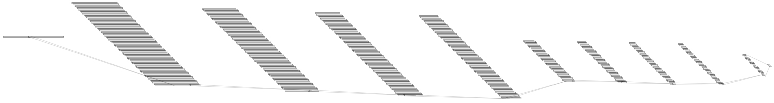
Audio Classification
Change the channel to become smaller and smaller.
The upper is ‘Custom channel 32 DO(0.75) 9 Conv’ model’s detail.
Previous one: 1 → 32 → 32 → 32 → 32 → 64 → 64 → 64 → 64 → 128 Tried one : 1 → 128 → 128 → 128 → 128 → 64 → 64 → 64 → 64 → 32
1@16000
32@16000
32@5333
128@2
Conv(5)
32@1777
32@592
64@197
64@65
64@21
64@7
Conv(5)
MaxPool(3)
Channel@DataSize
Conv(5)
MaxPool(3)
Conv(5)
MaxPool(3)
Conv(5)
MaxPool(3)
Conv(5)
MaxPool(3)
Conv(5)
MaxPool(3)
Conv(5)
MaxPool(3)
[ Previous one ]
Conv(5)
MaxPool(3)
128@16000
128@5333
128@1777
128@592
1@16000
64@197
64@65
64@21
64@7
32@2
Conv(5)
Conv(5)
MaxPool(3)
Conv(5)
MaxPool(3)
Conv(5)
MaxPool(3)
Conv(5)
MaxPool(3)
Conv(5)
MaxPool(3)
Conv(5)
MaxPool(3)
Conv(5)
MaxPool(3)
Conv(5)
MaxPool(3)
[ Tried one ]
- 11 -
Notes:
Supporting facts

Slide 15
Audio Classification
I think this try is very meaningful.
Because this model focus on the feature compression than previous model.
Like autoencoder. ( 16000 → 64(=2*32channel) )
This model is better when use other classifiers after extract the feature from CNN.
1@16000
32@16000
32@5333
128@2
Conv(5)
32@1777
32@592
64@197
64@65
64@21
64@7
Conv(5)
MaxPool(3)
Conv(5)
MaxPool(3)
Conv(5)
MaxPool(3)
Conv(5)
MaxPool(3)
Conv(5)
MaxPool(3)
Conv(5)
MaxPool(3)
Conv(5)
MaxPool(3)
Just feature extraction
Conv(5)
MaxPool(3)
[ Previous one ]
128@16000
128@5333
128@1777
128@592
1@16000
64@197
64@65
64@21
64@7
32@2
Conv(5)
MaxPool(3)
Feature extraction
and more compression
Conv(5)
MaxPool(3)
Conv(5)
MaxPool(3)
Conv(5)
Conv(5)
MaxPool(3)
Conv(5)
MaxPool(3)
Conv(5)
MaxPool(3)
Conv(5)
MaxPool(3)
Conv(5)
MaxPool(3)
[ Tried one ]
- 12 -
Notes:
Supporting facts

Slide 16
Audio Classification
I didn’t try early case because the results were probably not good.
Start channel size: 64
Architecture | DO(0.5) | BN | DO+BN | Params
1 CONV(5, 64) | X | X | X | 18,432,528
2 CONV(5, 64) | X | X | X | 6,164,816
3 CONV(5, 64) | X | X | X | 2,088,976
4 CONV(5, 64) | X | X | X | 744,528
5 CONV(5, 32) | X | X | X | 186,352
6 CONV(5, 32) | 0.8897 | 0.8085 | 0.8667 | 115,536
7 CONV(5, 32) | 0.9259 | 0.8854 | 0.9121 | 95,408
8 CONV(5, 32) | 0.9464 | 0.9205 | 0.9321 | 92,560
9 CONV(5, 16) | 0.9238 | 0.9074 | 0.9327 | 91,712
- 13 -
Notes:
Supporting facts

Slide 17
Audio Classification
I didn’t try early case because the results were probably not good.
Start channel size: 128
Architecture | DO(0.5) | BN | DO+BN | Params
1 CONV(5, 128) | X | X | X | 32,768,784
2 CONV(5, 128) | X | X | X | 11,004,816
3 CONV(5, 128) | X | X | X | 3,804,176
4 CONV(5, 128) | X | X | X | 1,459,344
5 CONV(5, 64) | X | X | X | 489,680
6 CONV(5, 64) | 0.8995 | 0.8474 | 0.8829 | 384,656
7 CONV(5, 64) | 0.9421 | 0.9043 | 0.9202 | 354,640
8 CONV(5, 64) | 0.9516 | 0.9360 | 0.9450 | 359,184
9 CONV(5, 32) | 0.9425 | 0.9379 | 0.9458 | 362,608
- 14 -
Notes:
Supporting facts

Slide 18
Audio Classification
I didn’t try early case because the results were probably not good.
Start channel size: 256
Architecture | DO(0.5) | BN | DO+BN | Params
1 CONV(5, 256) | X | X | X | 65,537,552
2 CONV(5, 256) | X | X | X | 22,173,456
3 CONV(5, 256) | X | X | X | 7,936,016
4 CONV(5, 256) | X | X | X | 3,410,192
5 CONV(5, 128) | X | X | X | 1,552,784
6 CONV(5, 128) | 0.8866 | 0.8517 | 0.8964 | 1,364,496
7 CONV(5, 128) | 0.9423 | 0.9315 | 0.9346 | 1,356,432
8 CONV(5, 128) | 0.9583 | 0.9502 | 0.9605 | 1,409,808
9 CONV(5, 64) | 0.9603 | 0.9572 | 0.9628 | 1,438,544
- 15 -
Notes:
Supporting facts

Slide 19
Audio Classification
So I summarise previous try.
Change the channel more steeply and to become more smaller and smaller
The upper is ‘Custom channel 32 DO(0.75) 9 Conv’ model’s detail.
1@16000
32@16000
32@5333
128@2
Conv(5)
32@1777
32@592
64@197
64@65
64@21
64@7
Conv(5)
MaxPool(3)
Channel@DataSize
Conv(5)
MaxPool(3)
Conv(5)
MaxPool(3)
Conv(5)
MaxPool(3)
Conv(5)
MaxPool(3)
Conv(5)
MaxPool(3)
Conv(5)
MaxPool(3)
[ Previous one ]
Conv(5)
MaxPool(3)
128@16000
128@5333
128@1777
64@592
1@16000
64@197
64@65
32@21
32@7
32@2
Conv(5)
Conv(5)
MaxPool(3)
Conv(5)
MaxPool(3)
Conv(5)
MaxPool(3)
Conv(5)
MaxPool(3)
Conv(5)
MaxPool(3)
Conv(5)
MaxPool(3)
Conv(5)
MaxPool(3)
Conv(5)
MaxPool(3)
[ Tried one ]
- 16 -
Notes:
Supporting facts

Slide 20
Audio Classification
I didn’t try early case because the results were probably not good.
Start channel size: 64
Architecture | DO(0.5) | BN | DO+BN | Params
1 CONV(5, 64) | X | X | X | 16,384,400
2 CONV(5, 64) | X | X | X | 5,481,936
3 CONV(5, 64) | X | X | X | 1,861,136
4 CONV(5, 32) | 0.6816 | 0.6426 | 0.7277 | 354,864
5 CONV(5, 32) | 0.8019 | 0.7373 | 0.8075 | 157,776
6 CONV(5, 32) | 0.8933 | 0.8363 | 0.8766 | 95,344
7 CONV(5, 16) | 0.9190 | 0.8654 | 0.9128 | 70,016
8 CONV(5, 16) | 0.9211 | 0.9022 | 0.9223 | 67,728
9 CONV(5, 16) | 0.9053 | 0.9067 | 0.9094 | 67,744
- 17 -
Notes:
Supporting facts

Slide 21
Audio Classification
I didn’t try early case because the results were probably not good.
Start channel size: 128
Architecture | DO(0.5) | BN | DO+BN | Params
1 CONV(5, 128) | X | X | X | 32,768,784
2 CONV(5, 128) | X | X | X | 11,004,816
3 CONV(5, 128) | X | X | X | 3,804,176
4 CONV(5, 64) | 0.6814 | 0.6557 | 0.7242 | 812,112
5 CONV(5, 64) | 0.8012 | 0.7497 | 0.8010 | 428,176
6 CONV(5, 64) | 0.8887 | 0.8355 | 0.8725 | 313,552
7 CONV(5, 32) | 0.9385 | 0.9007 | 0.9161 | 268,016
8 CONV(5, 32) | 0.9402 | 0.9240 | 0.9373 | 266,000
9 CONV(5, 32) | 0.9381 | 0.9259 | 0.9408 | 268,592
- 18 -
Notes:
Supporting facts

Slide 22
Audio Classification
I didn’t try early case because the results were probably not good.
Start channel size: 256
Architecture | DO(0.5) | BN | DO+BN | Params
1 CONV(5, 256) | X | X | X | 65,537,552
2 CONV(5, 256) | X | X | X | 22,173,456
3 CONV(5, 256) | X | X | X | 7,936,016
4 CONV(5, 128) | 0.6982 | 0.6505 | 0.7425 | 2,033,808
5 CONV(5, 128) | 0.7859 | 0.7065 | 0.8201 | 1,306,896
6 CONV(5, 128) | 0.8947 | 0.8467 | 0.8721 | 1,118,608
7 CONV(5, 64) | 0.9381 | 0.9047 | 0.9196 | 1,048,016
8 CONV(5, 64) | 0.9572 | 0.9522 | 0.9458 | 1,054,224
9 CONV(5, 64) | 0.9472 | 0.9431 | 0.9589 | 1,069,648
- 19 -
Notes:
Supporting facts

Slide 23
Audio Classification
In summary, This is SOTA(State Of The Art) in this research.
Though the performance is lower than the previous model, I think it is meaningful.
The original data size, 16000, was compressed to 32 and the performance was 0.9327.
And the other model compress to 128 and the performance was 0.9628.
What if we use a feature from CNN as input to another model, this model will be very useful.
Architecture (i = 0,1,2…) | 1D DO(0.5) | 1D BN | 1D DO+BN | Params
16000(Input data size) → 2(Length) * 16(Channel) = 32 (Feature size)
9 CONV(5, 16) | 0.9238 | 0.9074 | 0.9327 | 91,712
16000(Input data size) → 2(Length) * 64(Channel) = 128 (Feature Size)
9 CONV(5, 64) | 0.9603 | 0.9572 | 0.9628 | 1,438,544
Feature
extraction
ch 64
Feature
extraction
ch 256
- 20 -
Notes:
Supporting facts

Slide 24
Any Question?
Thank you
Notes:
Supporting facts

