Slide 1
Weekly Report
Wangwon Lee, 2019/04/05
This week | Next week
Fine Tuning Change activation function to tanh Try large filter size He initializer | Fine Tuning Change tanh model’s channel Change activation function to RLelu Filter initializer Visualization The other model(tanh, long filter) The other label Activation Maximization CAM(Class Activation Map)
Interesting and new finding
Fine Tuning Visualization
The aim of this month / Discussion
The aim of this month: To investigate about CNN and visualization.
Notes:
I want you to follow this rule

Slide 2
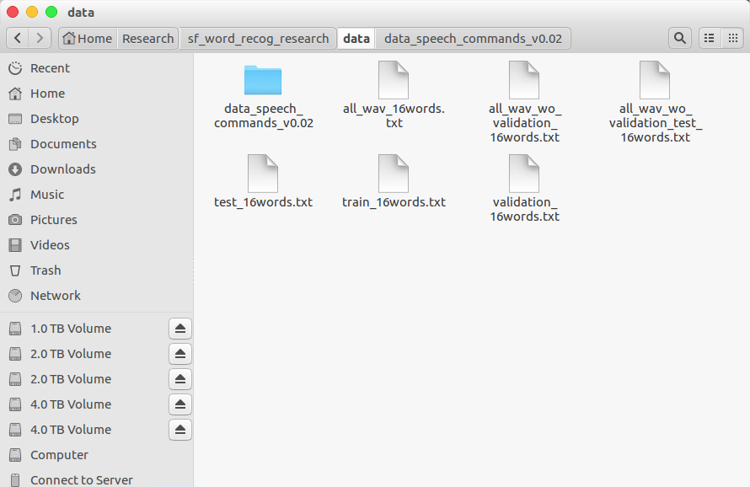
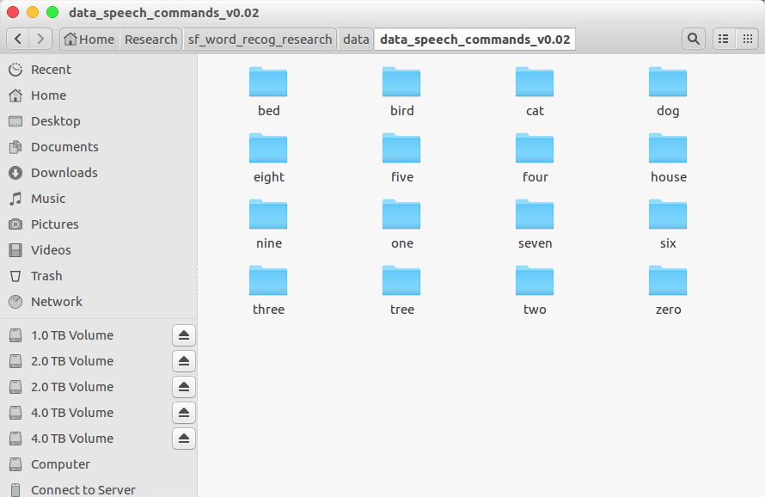
Audio Classification - Previous Work
Data is low-waveform.
sec: 1, sampling rate: 16000, type: float32, channel: mono
16 class data.
'zero', 'one', 'two', 'three', 'four', 'five', 'six', 'seven', 'eight', 'nine', 'bed', 'bird', 'tree', 'cat', 'house', 'dog'
Train: 40851(≒80%), Validation: 4796(≒10%), Test: 5297(≒10%)
- 2 -
Notes:
Supporting facts

Slide 3
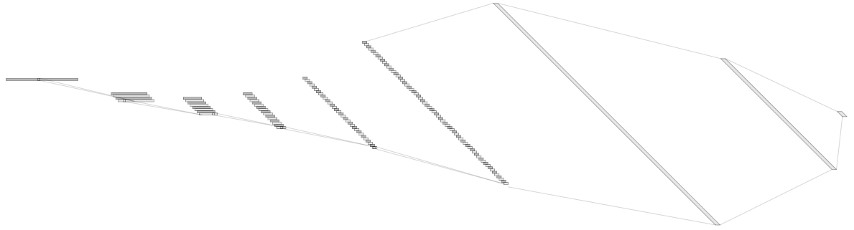
Audio Classification - Previous Work
For example, ‘5Conv, 2FC’ baseline model’s detail.
It just flatten 2D model. (5X5 filter->1X25 filter, 2X2 stride->1X4 stride)
Input: 16000X1 low waveform.
Output:1x16 labeled one hot vector. ('zero', …, 'eight', …, 'house', 'dog')
Loss: cross entropy loss
Obtimizer: Adam
Channel@DataSize
1X1024
128@8
1X512
1@16000
64@55
8@3994
16@993
32@243
Conv(25)
MaxPool(4)
1X16
Conv(25)
MaxPool(4)
Conv(25)
MaxPool(4)
Conv(25)
MaxPool(4)
Conv(25)
MaxPool(4)
Fully-Conncted
Fully-Conncted
[ Baseline Architecture]
- 3 -
Notes:
Supporting facts

Slide 4
Audio Classification - Previous Work
Fine tuning task in 1D-CNN
0. Depth
8. Dropout rate
9. Kernel Size
1. Dropout
2. Batch Normalization
3. D·O + B·N
10. Summary
11. Finetune based on good model
4. Reduce FC
12. Change the channel more steeply
5. Channel
6. Kernel Size
13. Change the channel to become smaller and smaller
7. Summary
Previous Work
- 4 -
Notes:
Supporting facts

Slide 5
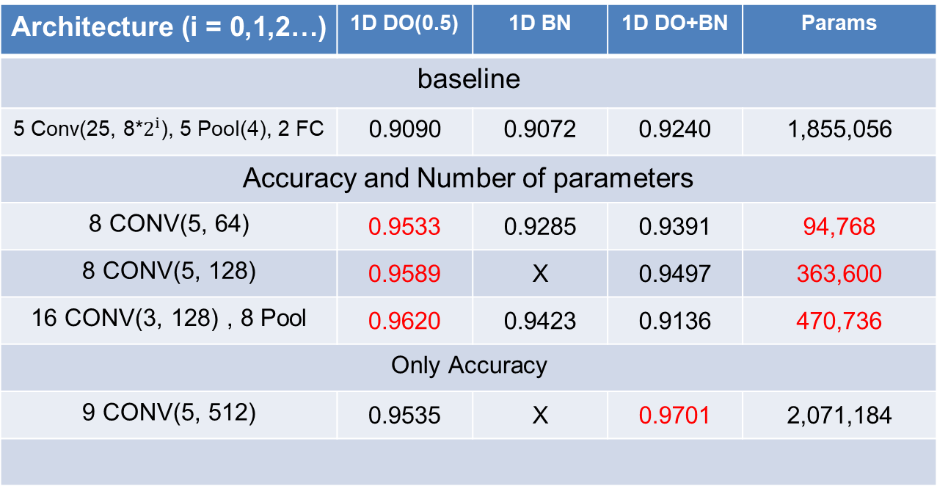
Audio Classification - Previous Work
This is SOTA(State Of The Art) in current research.
Architecture (i = 0,1,2…) | 1D DO(0.5) | 1D BN | 1D DO+BN | Params
baseline
5 Conv(25, 8*$2^{i}$), 5 Pool(4), 2 FC | 0.9090 | 0.9072 | 0.9240 | 1,855,056
Accuracy and Number of parameters
8 CONV(5, 64) | 0.9533 | 0.9285 | 0.9391 | 94,768
8 CONV(5, 128) | 0.9589 | X | 0.9497 | 363,600
16 CONV(3, 128) , 8 Pool | 0.9620 | 0.9423 | 0.9136 | 470,736
Only Accuracy
9 CONV(5, 512) | 0.9535 | X | 0.9701 | 2,071,184
base model
Custom
channel 32
DO(0.75)
Custom
channel 64
DO(0.75)
Custom
VGG style
DO(0.75)
Custom
channel 128
DO(0.25)+BN
- 5 -
Notes:
Supporting facts

Slide 6
Audio Classification - Previous Work
To validate the model, We can use measure such as precision, recall, f1-score.
We find out that It does not confuse between ‘three’ and ‘tree’.
It just confuses ‘tree’ as ‘three’.
And It also confuse between ‘Bed’ and ‘Bird’.
Actual class
Precision Recall F1-score Support
zero 0.95 0.96 0.95 385
one 0.96 0.95 0.95 364
two 0.95 0.96 0.95 384
three 0.93 0.94 0.94 377
four 0.96 0.98 0.97 368
five 0.98 0.95 0.96 408
six 0.98 0.98 0.98 374
seven 0.97 0.98 0.97 376
eight 0.95 0.98 0.96 376
nine 0.96 0.97 0.96 377
bed 0.89 0.91 0.90 183
bird 0.95 0.90 0.92 153
cat 0.91 0.96 0.93 168
dog 0.94 0.95 0.95 192
house 0.99 0.93 0.96 167
tree 0.94 0.85 0.89 163
weighted avg 0.95 0.95 0.95 4815
Zero
One
Two
Three
Fore
Five
Six
Seven
Eight
Nine
Bed Bird
Cat
Dog
House
Tree
[[369 0 5 1 3 0 1 4 0 1 0 0 1 0 0 0]
[ 1 347 0 0 4 1 1 0 0 7 2 0 0 1 0 0]
[ 8 0 369 2 0 0 0 0 1 0 0 0 2 2 0 0]
[ 1 0 2 356 0 1 1 2 6 0 0 0 0 0 0 8]
[ 2 2 1 1 359 2 0 0 0 0 0 0 1 0 0 0]
[ 0 6 0 3 4 386 0 2 1 3 0 1 2 0 0 0]
[ 0 0 0 3 1 0 366 1 2 0 1 0 0 0 0 0]
[ 3 0 0 0 1 0 2 367 0 0 3 0 0 0 0 0]
[ 1 0 1 2 1 0 0 0 367 0 2 0 1 0 0 1]
[ 0 6 0 0 0 3 0 0 0 364 3 1 0 0 0 0]
[ 1 0 2 0 0 0 0 0 6 0 166 5 2 1 0 0]
[ 0 1 1 1 0 0 2 0 0 2 7 137 0 2 0 0]
[ 0 0 0 0 0 0 0 1 0 0 1 0 161 4 1 0]
[ 0 1 5 0 0 0 0 0 0 1 1 0 2 182 0 0]
[ 0 0 2 0 0 1 1 0 0 1 0 0 5 1 156 0]
[ 2 0 2 15 0 0 1 0 4 1 0 0 0 0 0 138]]
Predict Class
Custom
channel 32
DO(0.75)
(Acc: 0.9533)
- 6 -
Notes:
Supporting facts

Slide 7
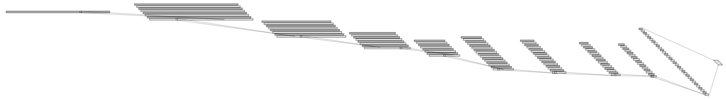
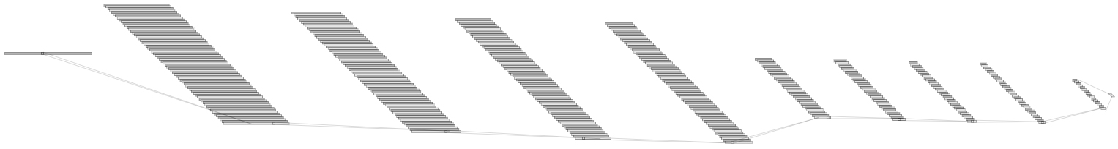
Audio Classification - Previous Work
I think this try is very meaningful.
Because this model focus on the feature compression than previous model.
Like autoencoder. ( 16000 → 64(=2*32channel) )
This model is better when use other classifiers after extract the feature from CNN.
1@16000
32@16000
32@5333
128@2
Conv(5)
32@1777
32@592
64@197
64@65
64@21
64@7
Conv(5)
MaxPool(3)
Conv(5)
MaxPool(3)
Conv(5)
MaxPool(3)
Conv(5)
MaxPool(3)
Conv(5)
MaxPool(3)
Conv(5)
MaxPool(3)
Conv(5)
MaxPool(3)
Just feature extraction
Conv(5)
MaxPool(3)
[ Previous one ]
128@16000
128@5333
128@1777
128@592
1@16000
64@197
64@65
64@21
64@7
32@2
Conv(5)
MaxPool(3)
Feature extraction
and more compression
Conv(5)
MaxPool(3)
Conv(5)
MaxPool(3)
Conv(5)
Conv(5)
MaxPool(3)
Conv(5)
MaxPool(3)
Conv(5)
MaxPool(3)
Conv(5)
MaxPool(3)
Conv(5)
MaxPool(3)
[ Tried one ]
- 7 -
Notes:
Supporting facts

Slide 8
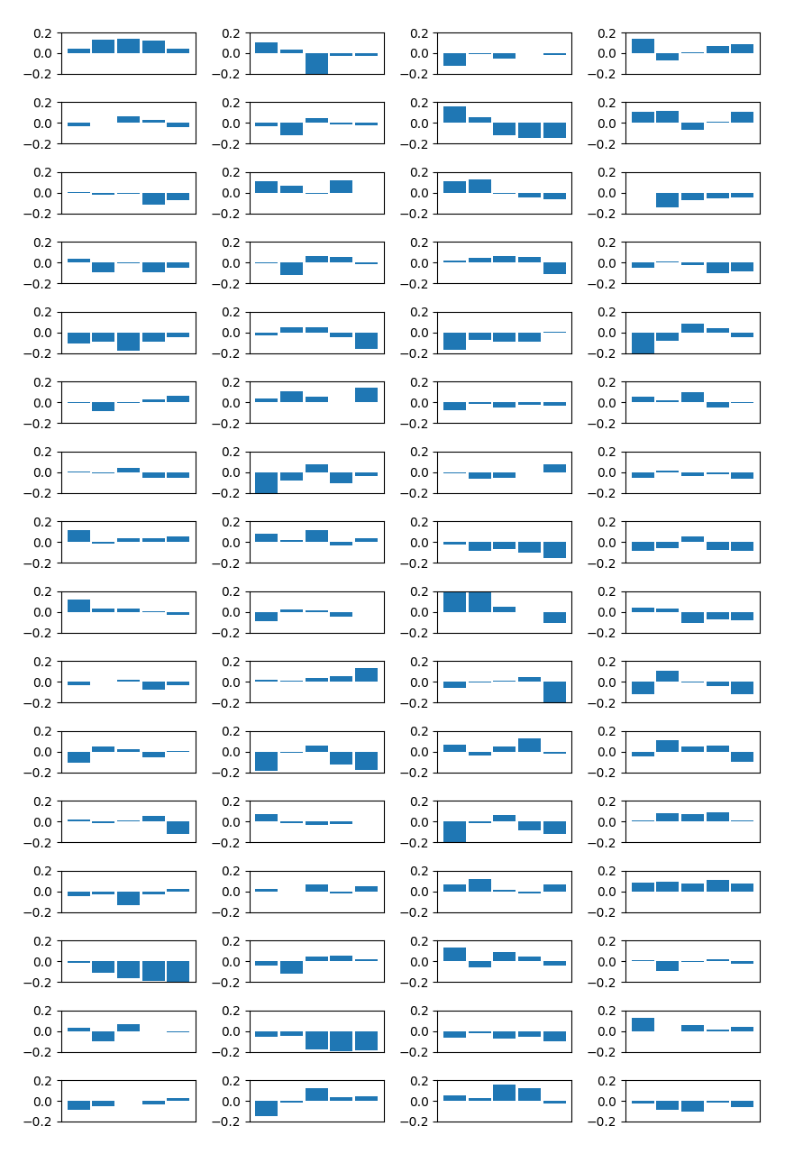
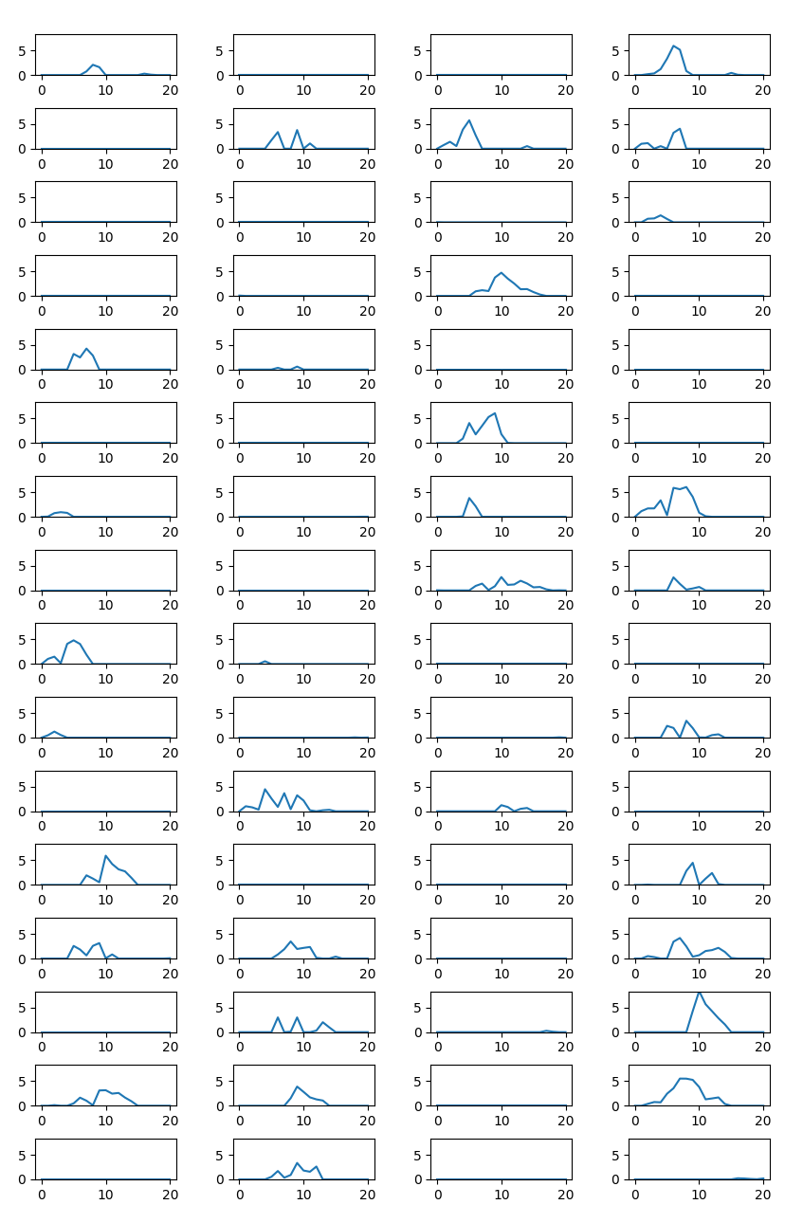
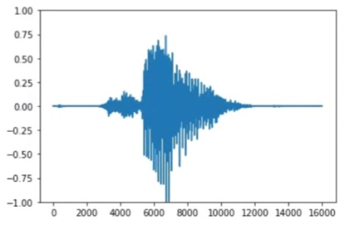
Audio Classification - Previous Work
About half is gone away...
I don’t know whether each label has a place for feature extraction or it is originally empty
0
1
2
3
64
65
66
67
0
64
4
68
8
72
12
76
16
80
20
84
24
88
28
92
32
96
36
100
40
104
44
108
48
112
52
116
56
120
60
124
Original input
8th Layer - Filter
8th Layer – Activation map
- 8 -
Notes:
Supporting facts

Slide 9
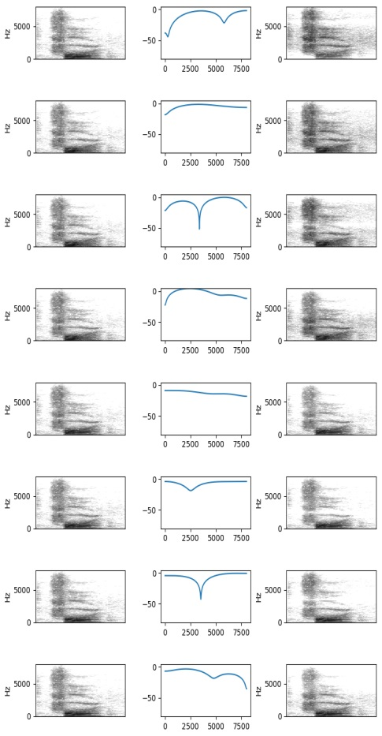
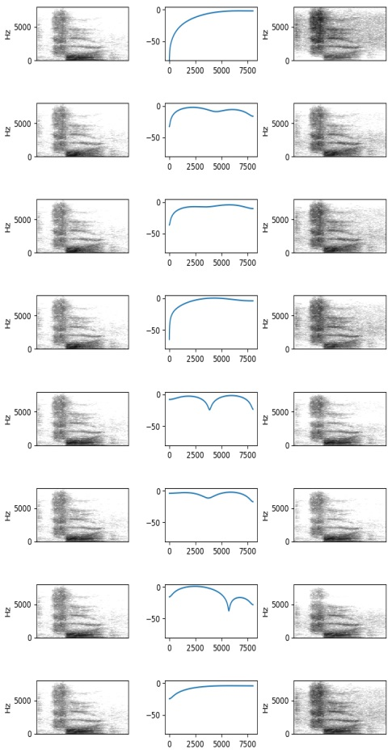
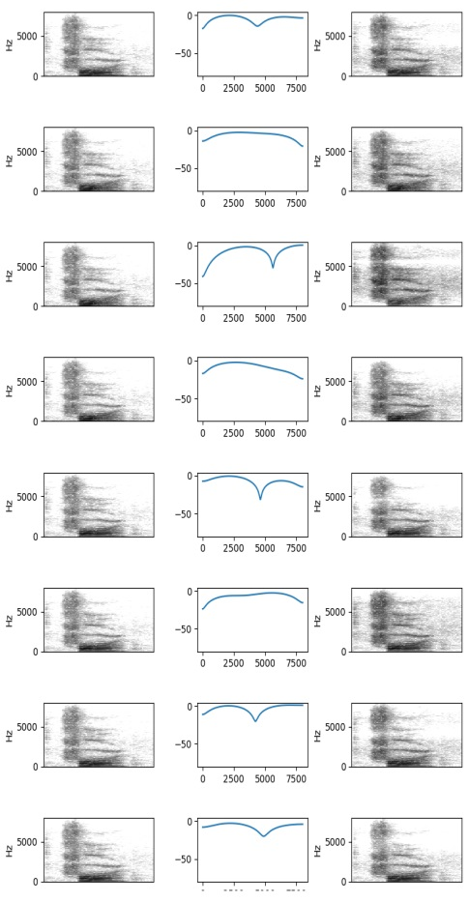
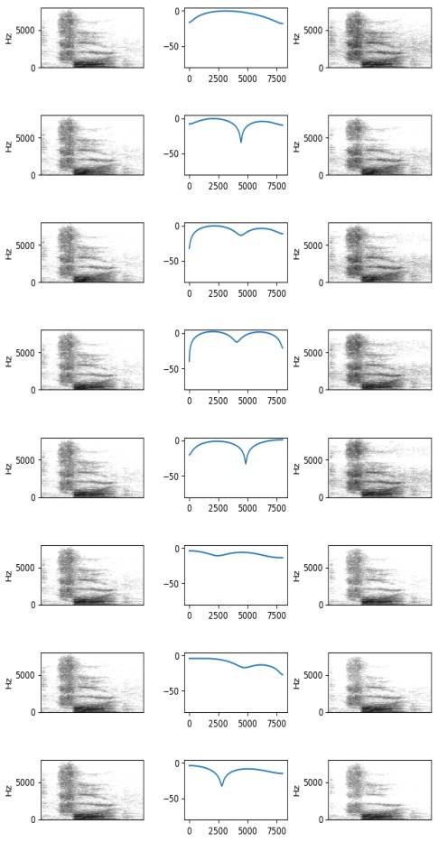
Audio Classification - Previous Work
So I created spectrogram by Short Time Fourier Transform (STFT).
Window Size: 512, Stride: 128
We can see that it is applied to the shape of frequency response.
Input
(STFT)
Filter
(frequency
response)
Output
(STFT)
0
8
16
24
- 9 -
Notes:
Supporting facts

Slide 10
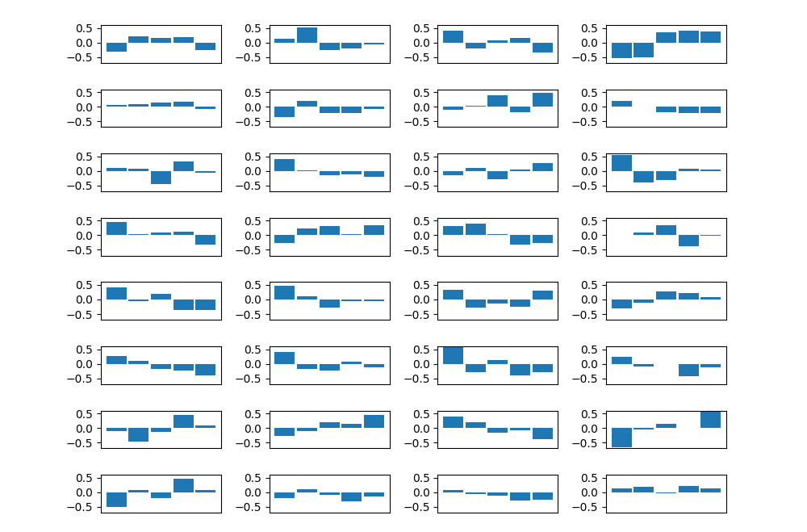
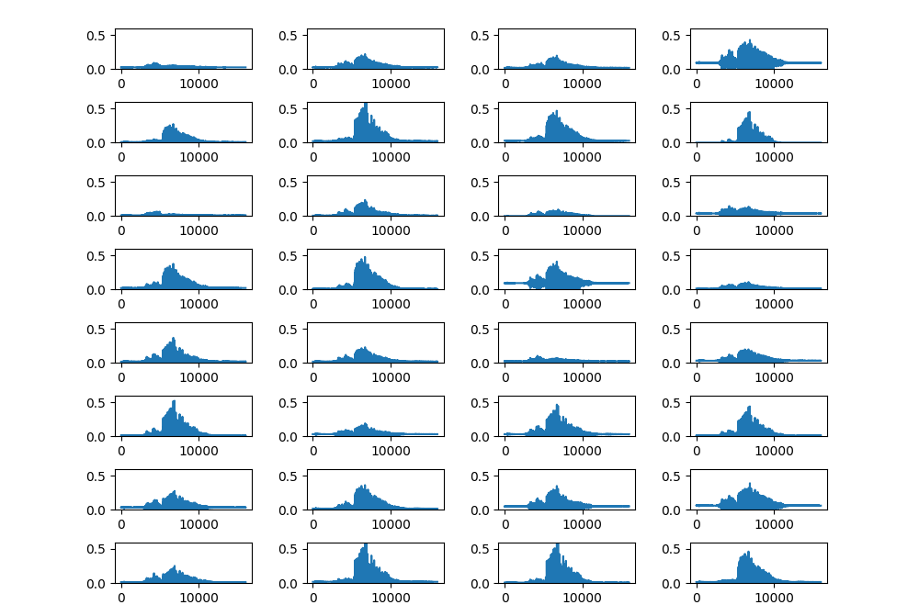

Audio Classification - Previous Work
Visualize the filter map. (Custom channel 32 DO(0.75) Model)
Less than zero of the waveform is removed because of ‘Relu’
Because of this problem, it is difficult to analysis from the point of view of Signal Processing.
So, I consider to use ‘tanh’ function.
1@16000
32@16000
32@5333
128@2
Conv(32, 5)
32@1777
32@592
64@197
64@65
64@21
64@7
Conv(32, 5)
MaxPool(3)
Conv(32, 5)
MaxPool(3)
Conv(32, 5)
MaxPool(3)
Conv(64, 5)
MaxPool(3)
Conv(64, 5)
MaxPool(3)
Conv(64, 5)
MaxPool(3)
Conv(64, 5)
MaxPool(3)
Conv(128, 5)
MaxPool(3)
- 10 -
Notes:
Supporting facts

Slide 11
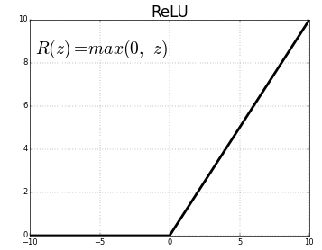
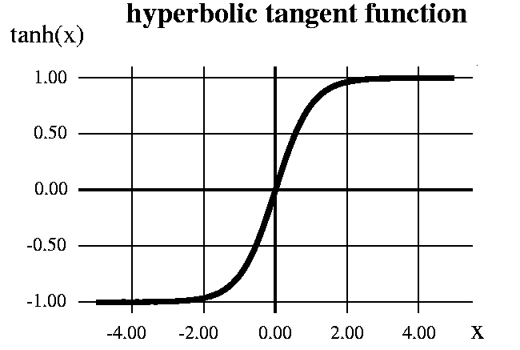
Audio Classification
Less than zero of the waveform is removed because of ‘Relu’
So, I tried to change ‘Relu’ to ‘tanh’
First of all, It is impossible to apply all of my previous task.
Dropout
Batch Normalization
Dropout + Batch Normalization
VGG style
Droptout rate
Channel size (First, I fix the base channel size to 64)
etc… (Maybe next time…)
So, I tried a few task to see the results as soon as possible.
- 11 -
Notes:
Supporting facts

Slide 12
Audio Classification
First, I applied the ‘custom CH64’ model.
Architecture | DO(0.5) | BN | DO+BN | Params
1 CONV(5, 64) | 0.0953 | 0.0976 | 0.1111 | 16,384,400
2 CONV(5, 64) | 0.3421 | 0.2517 | 0.2675 | 5,481,936
3 CONV(5, 64) | 0.5001 | 0.5076 | 0.5350 | 1,861,136
4 CONV(5, 64) | 0.6370 | 0.5518 | 0.6422 | 668,240
5 CONV(5, 128) | 0.7423 | 0.6066 | 0.7082 | 506,576
6 CONV(5, 128) | 0.8455 | 0.7583 | 0.7859 | 318,288
7 CONV(5, 128) | 0.9192 | 0.8827 | 0.8687 | 310,224
8 CONV(5, 128) | 0.9433 | 0.9269 | 0.9252 | 363,600
9 CONV(5, 256) | 0.9477 | 0.9377 | 0.9479 | 521,552
- 12 -
Notes:
Supporting facts

Slide 13
Audio Classification
Second, I tune the dropout’s rate
As with previous results, high dropout rate model has a good performance.
The high dropout rate contribute to the generalization of the model.
Architecture | DO(0.25) | DO(0.25)+BN | DO(0.75) | DO(0.75)+BN
1 CONV(5, 64) | 0.1051 | 0.1020 | 0.1040 | 0.1011
2 CONV(5, 64) | 0.3429 | 0.3246 | 0.3524 | 0.2569
3 CONV(5, 64) | 0.4987 | 0.4295 | 0.5088 | 0.5624
4 CONV(5, 64) | 0.6278 | 0.6079 | 0.7148 | 0.6550
5 CONV(5, 128) | 0.7310 | 0.6947 | 0.7707 | 0.7146
6 CONV(5, 128) | 0.8582 | 0.8150 | 0.8417 | 0.7763
7 CONV(5, 128) | 0.9215 | 0.8922 | 0.9111 | 0.8617
8 CONV(5, 128) | 0.9441 | 0.9169 | 0.9485 | 0.9229
9 CONV(5, 256) | 0.9472 | 0.9439 | 0.9543 | 0.9441
- 13 -
Notes:
Supporting facts

Slide 14
Audio Classification
3th, I tried VGG style
Architecture | DO(0.5) | BN | DO+BN | Params
2 CONV(3, 64), 1 Pool | 0.1001 | 0.1047 | 0.1032 | 16,396,624
4 CONV(3, 64) , 2 Pool | 0.3421 | 0.2692 | 0.2721 | 5,498,320
6 CONV(3, 64) ,3 Pool | 0.5333 | 0.3192 | 0.3927 | 1,881,680
8 CONV(3, 64) , 4 Pool | 0.6908 | 0.5333 | 0.5952 | 692,944
10 CONV(3, 128) , 5 Pool | 0.7659 | 0.5034 | 0.7481 | 564,176
12 CONV(3, 128) , 6 Pool | 0.8627 | 0.7570 | 0.7666 | 392,400
14 CONV(3, 128) , 7 Pool | 0.9246 | 0.8839 | 0.8681 | 400,848
16 CONV(3, 128) , 8 Pool | 0.9487 | 0.9406 | 0.9364 | 470,736
18 CONV(3, 256) , 9 Pool | 0.9516 | 0.9464 | 0.9439 | 760,016
- 14 -
Notes:
Supporting facts

Slide 15
Audio Classification
4th, I tune the dropout’s rate
In this result, ‘custom’ model is better than ‘VGG like’ model
Compared to Relu, overall performance dropped by 1-2%.
Architecture | DO(0.25) | DO(0.25)+BN | DO(0.75) | DO(0.75)+BN
2 CONV(3, 64), 1 Pool | X | X | X | X
4 CONV(3, 64) , 2 Pool | X | X | X | X
6 CONV(3, 64) ,3 Pool | 0.5157 | 0.4347 | 0.5736 | 0.5753
8 CONV(3, 64) , 4 Pool | 0.6474 | 0.6565 | 0.7410 | 0.7279
10 CONV(3, 128) , 5 Pool | 0.7564 | 0.7248 | 0.7848 | 0.7607
12 CONV(3, 128) , 6 Pool | 0.8677 | 0.7780 | 0.8696 | 0.7896
14 CONV(3, 128) , 7 Pool | 0.9277 | 0.9001 | 0.9304 | 0.8924
16 CONV(3, 128) , 8 Pool | 0.9487 | 0.9304 | 0.9404 | 0.9269
18 CONV(3, 256) , 9 Pool | 0.9475 | 0.9489 | 0.9522 | 0.9448
- 15 -
Notes:
Supporting facts

Slide 16
Audio Classification
I tune the filter size more bigger.
Filter size: 192 → 96 → 48 → 24 → 12 → 6 → 3 → …
1@16000
32@16000
32@5333
128@2
Conv(5)
32@1777
32@592
64@197
64@65
64@21
64@7
Conv(5)
MaxPool(3)
Conv(5)
MaxPool(3)
Conv(5)
MaxPool(3)
Conv(5)
MaxPool(3)
Conv(5)
MaxPool(3)
Conv(5)
MaxPool(3)
Conv(5)
MaxPool(3)
[ Previous one ]
Conv(5)
MaxPool(3)
1@16000
32@16000
32@5333
128@2
Conv(192)
32@1777
32@592
64@197
64@65
64@21
64@7
Conv(96)
MaxPool(3)
Conv(48)
MaxPool(3)
Conv(24)
MaxPool(3)
Conv(12)
MaxPool(3)
Conv(6)
MaxPool(3)
Conv(3)
MaxPool(3)
Conv(3)
MaxPool(3)
Conv(3)
MaxPool(3)
[ Tried one ]
- 16 -
Notes:
Supporting facts

Slide 17
Audio Classification
I didn’t try early case because the results were probably not good.
Start channel size: 32
Architecture | DO(0.5) | BN | DO+BN | Params
1 CONV(192, 32) | X | X | X | X
2 CONV(96, 32) | X | X | X | X
3 CONV(48, 32) | 0.7765 | 0.5678 | 0.7506 | 1,063,536
4 CONV(24, 32) | 0.8249 | 0.7329 | 0.8424 | 481,424
5 CONV(12, 64) | 0.8758 | 0.8042 | 0.8856 | 404,688
6 CONV(6, 64) | 0.9213 | 0.8785 | 0.9302 | 294,160
7 CONV(3, 64) | 0.9340 | 0.9115 | 0.9385 | 261,456
8 CONV(3, 64) | 0.9483 | 0.9292 | 0.9468 | 259,472
9 CONV(3, 128) | 0.9445 | 0.9466 | 0.9398 | 281,104
- 17 -
Notes:
Supporting facts

Slide 18
Audio Classification
Start channel size: 64
If filter size is more bigger, model become more heavy.
It take a lot of time… So, I will prepare the other case until the next time.
Architecture | DO(0.5) | BN | DO+BN | Params
1 CONV(192, 64) | X | X | X | X
2 CONV(96, 64) | X | X | X | X
3 CONV(48, 64) | 0.7886 | 0.5346 | 0.7117 | 2,421,968
4 CONV(24, 64) | 0.8482 | 0.7423 | 0.8656 | 1,306,896
5 CONV(12, 128) | 0.8760 | 0.8258 | 0.9094 | 1,202,576
6 CONV(6, 128) | 0.9225 | 0.9088 | 0.9202 | 1,030,672
7 CONV(3, 128) | 0.9350 | 0.9321 | 0.9524 | 989,840
8 CONV(3, 128) | 0.9489 | 0.9472 | 0.9535 | 1,010,448
9 CONV(3, 256) | 0.9479 | 0.9516 | 0.9570 | 1,102,864
- 18 -
Notes:
Supporting facts

Slide 19
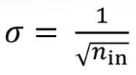
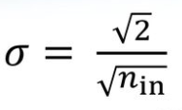
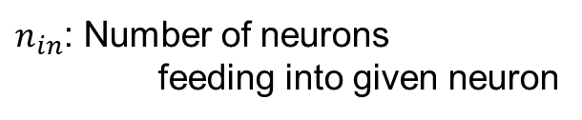
Audio Classification
In last lab seminar, we know that ‘he_uniform initializer’ has good performance
So, I found the paper of ‘he initializer’
‘He initializer’ is improvement of ‘xavier initializer’.
They said, If we use ‘relu’ function, it is more better than ‘xavier initializer’.
$n_{in}$: Number of neurons
feeding into given neuron
< Xavier >
< He >
Xavier:
Glorot, Xavier, and Yoshua Bengio. "Understanding the difficulty of training deep feedforward neural networks."
Proceedings of the thirteenth international conference on artificial intelligence and statistics. 2010.
He:
He, Kaiming, et al. "Delving deep into rectifiers: Surpassing human-level performance on imagenet classification."
Proceedings of the IEEE international conference on computer vision. 2015.
In tensorflow, Conv1D ‘s default initializer is ‘xavier initializer’.
So I tried ‘he initializer’ to my model.
- 19 -
Notes:
Supporting facts

Slide 20
Audio Classification
Compare to previous result.
The Most of case is improved a little.
I think ‘He initializer’ is little better than ‘Xavier initializer’.
Architecture | DO(0.5) | BN | DO+BN |  | DO(0.5) | BN | DO+BN
1 CONV(5, 64) | X | X | X |  | X | X | X
2 CONV(5, 64) | X | X | X |  | X | X | X
3 CONV(5, 64) | 0.5844 | 0.4893 | 0.5726 |  | 0.5904 | 0.4773 | 0.6033
4 CONV(5, 64) | 0.7128 | 0.6291 | 0.7333 |  | 0.7221 | 0.6145 | 0.7329
5 CONV(5, 128) | 0.7732 | 0.7022 | 0.8073 |  | 0.7859 | 0.6872 | 0.8019
6 CONV(5, 128) | 0.8901 | 0.8233 | 0.8818 |  | 0.8928 | 0.8087 | 0.8802
7 CONV(5, 128) | 0.9400 | 0.9061 | 0.9302 |  | 0.9433 | 0.9126 | 0.9252
8 CONV(5, 128) | 0.9560 | 0.9508 | 0.9458 |  | 0.9587 | 0.9383 | 0.9531
9 CONV(5, 256) | 0.9537 | 0.9464 | 0.9470 |  | 0.9541 | 0.9524 | 0.9529
< custom model >
< Xavier >
< He >
- 20 -
Notes:
Supporting facts

Slide 21
Audio Classification
Compare to previous result.
It works well for a few cases, but in some cases it is not effective.
Is it effective when the filter size is large?
Architecture | DO(0.5) | BN | DO+BN |  | DO(0.5) | BN | DO+BN
2 CONV(3, 64), 1 Pool | X | X | X |  | X | X | X
4 CONV(3, 64) , 2 Pool | X | X | X |  | X | X | X
6 CONV(3, 64) ,3 Pool | 0.5844 | 0.4893 | 0.5726 |  | 0.5680 | 0.5047 | 0.5755
8 CONV(3, 64) , 4 Pool | 0.7128 | 0.6291 | 0.7333 |  | 0.6793 | 0.6442 | 0.7080
10 CONV(3, 128) , 5 Pool | 0.7732 | 0.7022 | 0.8073 |  | 0.7759 | 0.6947 | 0.8027
12 CONV(3, 128) , 6 Pool | 0.8901 | 0.8233 | 0.8818 |  | 0.8831 | 0.8368 | 0.8939
14 CONV(3, 128) , 7 Pool | 0.9400 | 0.9061 | 0.9302 |  | 0.9458 | 0.9178 | 0.9418
16 CONV(3, 128) , 8 Pool | 0.9581 | 0.9508 | 0.9458 |  | 0.9593 | 0.9398 | 0.9543
18 CONV(3, 256) , 9 Pool | 0.9537 | 0.9464 | 0.9470 |  | 0.9533 | 0.9387 | 0.9506
< VGG like model >
< Xavier >
< He >
- 21 -
Notes:
Supporting facts

Slide 22
Audio Classification
There is a more initializer (ex. xavier_normal, he_normal, etc)
What if I apply another initializer at the same previous task?
Because ‘he initializer’ shown such better performance, I expect about it.
Previous model
with xavier
Current SOTA
Previous model
with another initializer
Previous
tuning task
???
- 22 -
Notes:
Supporting facts

Slide 23
Any Question?
Thank you
Notes:
Supporting facts

