Slide 1
Weekly Report
Wangwon Lee, 2019/05/18
This week | Next week
Deconvolution Network What is DeconvNet Apply VGG16 in Keras Compare to CAM Training 2D-Model for visualization | Deconvolution Network Apply to 2D (our data) To improve performance Fine tuning (simply) Augmentation Apply to 1D (our data)
Interesting and new finding
DeconvNet
The aim of this month / Discussion
The aim of this month: To study brain data.
Notes:
I want you to follow this rule

Slide 2
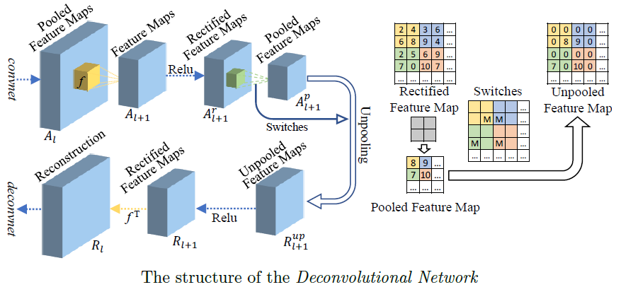
What is DeconNet?
Visualize each filter or layer (how to see the data)
To target certain filter(Conv) or certain layer(Dense, Softmax)
- 2 -
Notes:
Supporting facts

Slide 3
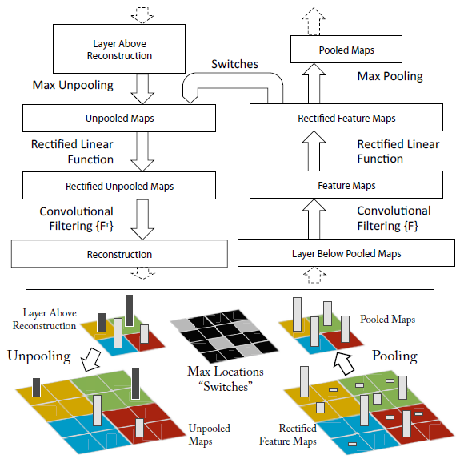
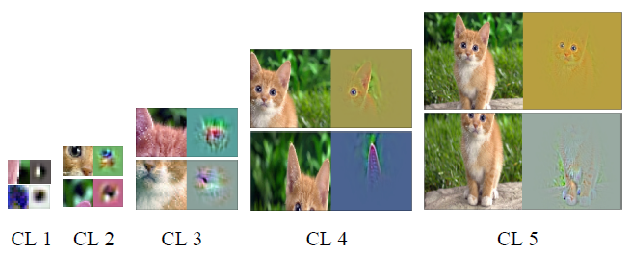
What is DeconNet?
Visualize each filter or layer (how to see the data)
To target certain filter(Conv) or certain layer(Dense, Softmax)
Left: input image
Right: visualization of each filter
< The architecture >
< Visualization of Convolution layer >
- 3 -
Notes:
Supporting facts

Slide 4
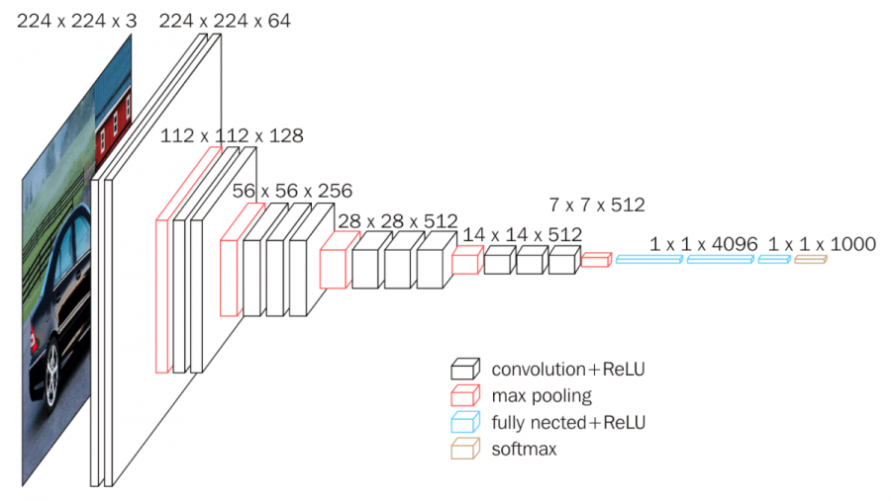
Apply VGG16 in Keras
It’s hard to validate whether DeconvNet is implemented well in 1D-CNN Because we can not understand the result of DeconvNet visually
So, Test in 2D-Model first (Target model: pretrained VGG16 provided by Keras)
- 4 -
Notes:
Supporting facts

Slide 5
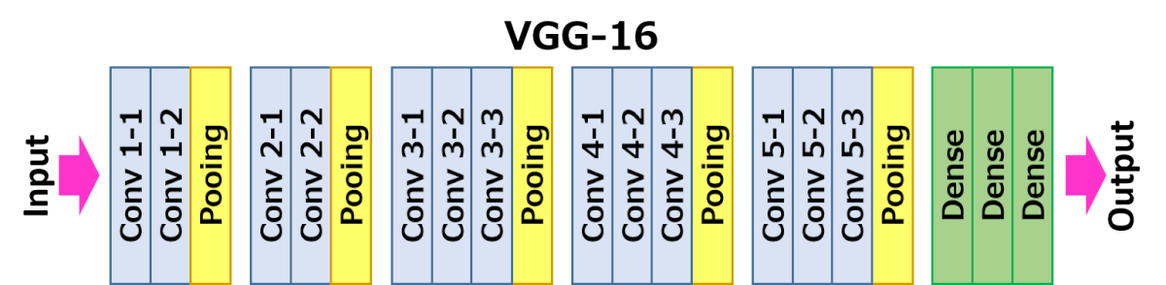
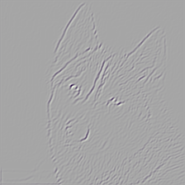
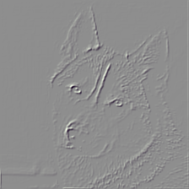
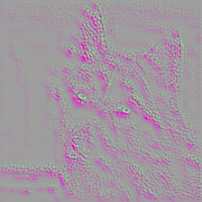
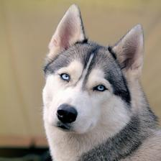
Apply VGG16 in Keras (based on 0th filter)
<Input Image>
In the 0th filter of the front layer, the model focus on the edge or texture
Although there is no exist in the slide, each filter focus on individual feature.
Front layer see the data entirely
- 5 -
Notes:
Supporting facts

Slide 6
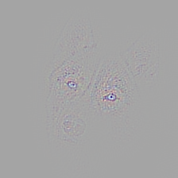
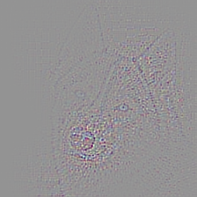

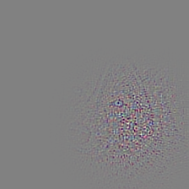
Apply VGG16 in Keras (based on 0th filter)
But, In the 0th filter of the backward layer, the model focus on certain area(eyes, nose, ear)
Backward layer see the data partially
<Input Image>
- 6 -
Notes:
Supporting facts

Slide 7
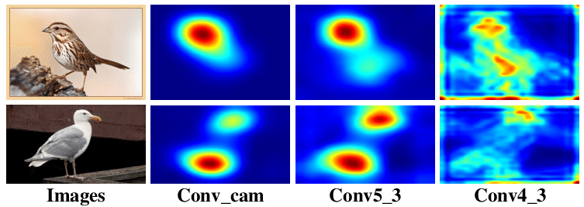
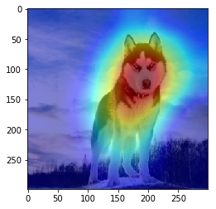
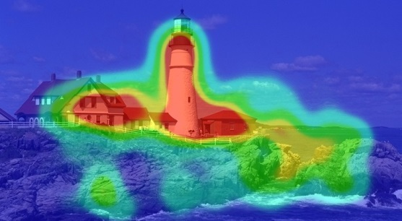
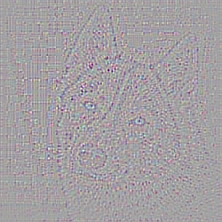
Compare to CAM(Class Activation Map)
CAM visualize the model where to see
DeconvNet visualize the model how to see
- 7 -
Notes:
Supporting facts

Slide 8
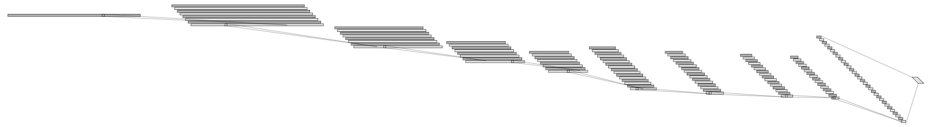
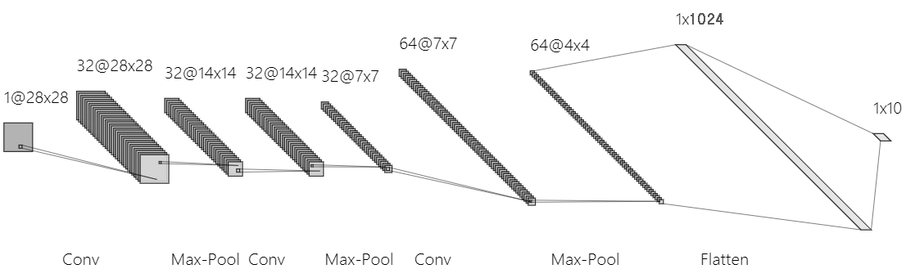
Training 2D-Model for visualization (MNIST)
Change (Because of input data’s shape) Input: 16000X1 → 28X28X1, Output: 16 → 10 (0 ~ 9) filter size: 1X5 → 3X3, pool size: 1X3 → 2X2, number of conv layer: 8 → 3
Train: 40000, Val: 20000, Test:10000
1@16000
32@16000
32@5333
128@2
Conv(5)
32@1777
32@592
64@197
64@65
64@21
64@7
Conv(5)
MaxPool(3)
<1D Model>
Conv(5)
MaxPool(3)
Conv(5)
MaxPool(3)
Conv(5)
MaxPool(3)
Conv(5)
MaxPool(3)
Conv(5)
MaxPool(3)
Conv(5)
MaxPool(3)
Conv(5)
MaxPool(3)
<2D Model>
- 8 -
Notes:
Supporting facts

Slide 9
Training 2D-Model for visualization (MNIST)
To find best fit model, Tuning the start channel(16, 32) and dropout rate(0.5, 0.75)
When the number of convolution filter is 3, performance is best.
Architecture | CH16+DO0.5 | CH16+DO0.75 | CH32+DO0.5 | CH32+DO0.75
1 CONV(3X3) | 0.9835 | 0.9828 | 0.9837 | 0.9839
2 CONV(3X3) | 0.9893 | 0.9875 | 0.9891 | 0.9901
3 CONV(3X3) | 0.9901 | 0.9902 | 0.9921 | 0.9934
4 CONV(3X3) | 0.9892 | 0.9891 | 0.9917 | 0.9900
5 CONV(3X3) | 0.9863 | 0.9910 | 0.9901 | 0.9904
<Best Architecture>
- 9 -
Notes:
Supporting facts

Slide 10
Training 2D-Model for visualization (MNIST)
In the best architecture, It seems that the model classify well
So, I will visualize this as DeconvNet in next week.
Actual class
[[ 975 0 1 0 0 0 2 1 1 0]
[ 0 1133 1 1 0 0 0 0 0 0]
[ 1 0 1028 0 1 0 0 1 0 1]
[ 0 0 0 1008 0 1 0 0 1 0]
[ 0 0 0 0 975 0 0 0 1 6]
[ 1 0 0 3 0 887 1 0 0 0]
[ 4 1 0 0 2 1 946 0 4 0]
[ 0 3 4 0 0 0 0 1019 1 1]
[ 0 0 0 1 1 0 0 0 969 3]
[ 0 0 1 0 5 4 0 4 1 994]]
precision recall f1-score support
0 0.99 0.99 0.99 980
1 1.00 1.00 1.00 1135
2 0.99 1.00 0.99 1032
3 1.00 1.00 1.00 1010
4 0.99 0.99 0.99 982
5 0.99 0.99 0.99 892
6 1.00 0.99 0.99 958
7 0.99 0.99 0.99 1028
8 0.99 0.99 0.99 974
9 0.99 0.99 0.99 1009
weighted avg 0.99 0.99 0.99 10000
Predict Class
<Best Architecture>
(Acc: 0.9934)
- 10 -
Notes:
Supporting facts

Slide 11
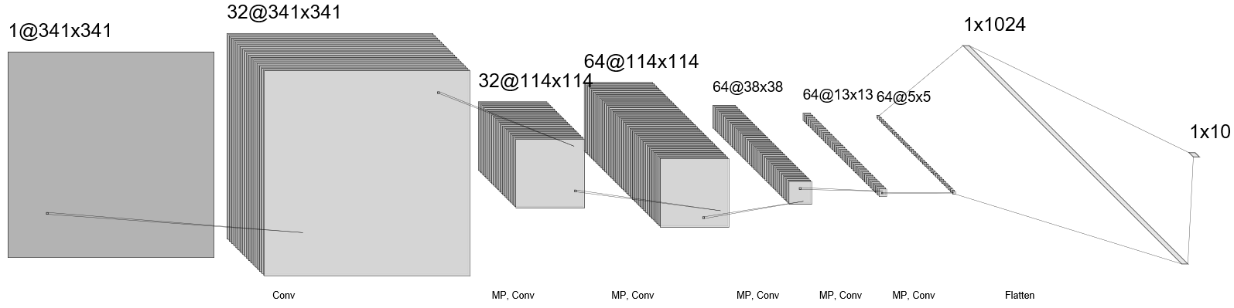
Training 2D-Model for visualization (Imagenet)
Change (Because of input data’s shape) Input: 16000X1 → 341X341X3, Output: 16 → 6 ('bed', 'bird', 'cat', 'dog', 'house', 'tree') filter size: 1X5 → 5X5, pool size: 1X3 → 3X3, number of conv layer: 8 → 5
Train: 4680(60%), Val: 1560(20%), Test: 1560(20%)
1@16000
32@16000
32@5333
128@2
Conv(5)
32@1777
32@592
64@197
64@65
64@21
64@7
<1D Model>
Conv(5)
MaxPool(3)
Conv(5)
MaxPool(3)
Conv(5)
MaxPool(3)
Conv(5)
MaxPool(3)
Conv(5)
MaxPool(3)
Conv(5)
MaxPool(3)
Conv(5)
MaxPool(3)
Conv(5)
MaxPool(3)
<2D Model>
- 11 -
Notes:
Supporting facts

Slide 12
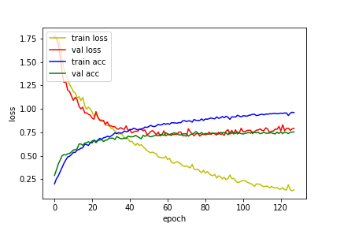
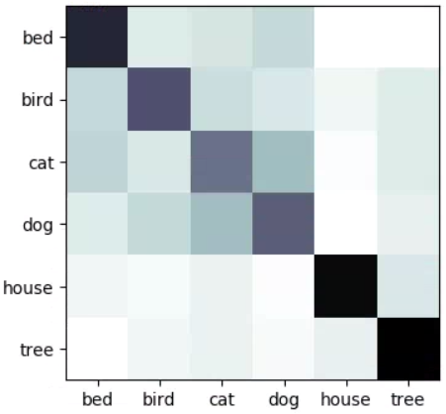
Training 2D-Model for visualization (Imagenet)
It is still training now… For the report, I use only 30% of each set.
Train: 1404(20%), Val: 468(6%), Test: 468(6%)
Despite val loss increase, It seems that val accuracy increase.
Maybe It is caused by a lack of data. I will try again as more data.
Actual class
[[53 6 8 11 0 0]
[11 41 10 7 3 6]
[12 7 34 18 1 6]
[ 6 11 18 38 0 5]
[ 3 2 4 1 61 7]
[ 0 3 4 2 5 64]]
Predict Class
precision recall f1-score support
0 0.62 0.68 0.65 78
1 0.59 0.53 0.55 78
2 0.44 0.44 0.44 78
3 0.49 0.49 0.49 78
4 0.87 0.78 0.82 78
5 0.73 0.82 0.77 78
weighted avg 0.62 0.62 0.62 468
< Accuracy: 0.6217 >
- 12 -
Notes:
Supporting facts

Slide 13
Any Question?
Thank you
Notes:
Supporting facts

