Slide 1
Weekly Report
Wangwon Lee, 2019/05/25
This week | Next week
Training 2D CNN Our imagenet data Fine tuning (simply) Visualization Deconvolution Network (our data) | Visualization Apply another visualization method Apply to 1D (our data) Training 2D CNN Retrain cleaned data
Interesting and new finding
Visualization Data Cleaning
The aim of this month / Discussion
The aim of this month: To study brain data.
Notes:
I want you to follow this rule

Slide 2
Training 2D CNN - Data
Data is very imbalanced
Train: 235111, Val: 3183
Training is based on undersampling
Label | Train | Val
Bed | 2690 | 30
Bird | 72641 | 1050
Cat | 6500 | 78
Dog | 149006 | 1940
House | 1611 | 34
Tree | 2663 | 51
- 2 -
Notes:
Supporting facts

Slide 3
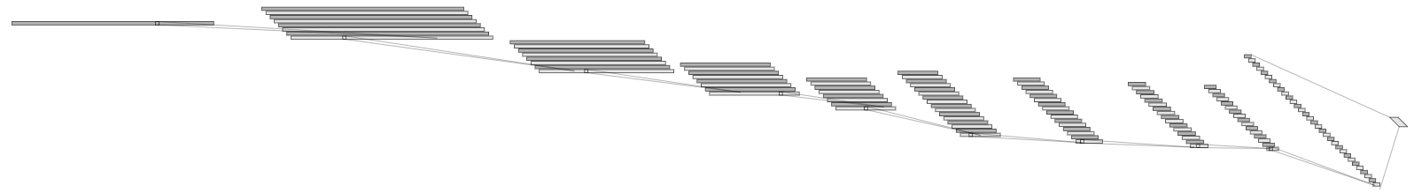
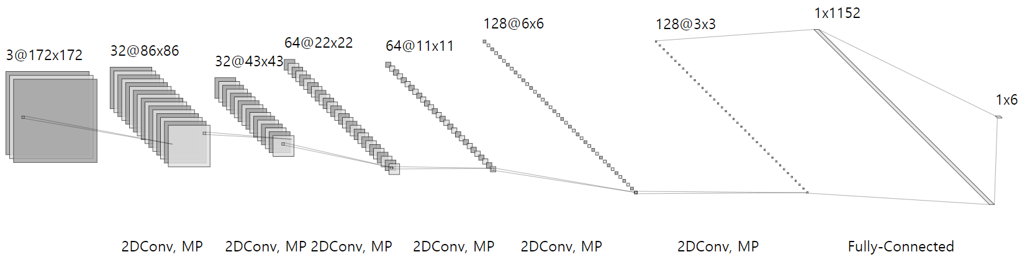
Training 2D CNN - Change
Change (Because of input data’s shape) Input: 16000X1 → 172X172X3, Output: 16 → 6 ('bed', 'bird', 'cat', 'dog', 'house', 'tree') filter size: 1X5 → 5X5, pool size: 1X3 → 2X2, number of conv: 8 → 7(Best Fit)
1@16000
32@16000
32@5333
128@2
Conv(5)
32@1777
32@592
64@197
64@65
64@21
64@7
Conv(5)
MaxPool(3)
<1D Model>
Conv(5)
MaxPool(3)
Conv(5)
MaxPool(3)
Conv(5)
MaxPool(3)
Conv(5)
MaxPool(3)
Conv(5)
MaxPool(3)
Conv(5)
MaxPool(3)
Conv(5)
MaxPool(3)
<2D Model>
(Ex. 6Conv)
- 3 -
Notes:
Supporting facts

Slide 4
Training 2D CNN - Result
To find best fit model, Tuning the depth and start channel(32, 64)
Most of case, 0.75 dropout rate show better performance than 0.5. But, To train more faster, Setting the dropout rate as 0.5.
I think ‘CH32, DO0.5, 6 Conv’ model is best, for this task.
Architecture | CH32+DO0.5 | Params | CH64+DO0.5 | Params
1 CONV(5X5) | X | 1,422,470 | X | 2,844,934
2 CONV(5X5) | X | 383,078 | X | 817,350
3 CONV(5X5) | 0.7338 | 265,190 | 0.8325 | 683,974
4 CONV(5X5) | 0.8130 | 228,262 | 0.8998 | 814,918
5 CONV(5X5) | 0.8014 | 414,374 | 0.9258 | 1,596,742
6 CONV(5X5) | 0.9044 | 803,366 | 0.9242 | 3,193,926
7 CONV(5X5) | 0.8881 | 1,622,054 | 0.9359 | 6,469,702
- 4 -
Notes:
Supporting facts

Slide 5
Training 2D CNN - Result
In the best architecture, It seems pretty good. except confusing cat as dog……
Maybe It’s because the model is not complicated enough.
Actual class
precision recall f1-score support
bed 0.76 0.93 0.84 30
bird 0.97 0.89 0.93 1050
cat 0.41 0.79 0.54 78
dog 0.95 0.94 0.95 1940
house 0.89 0.94 0.91 34
tree 0.75 0.92 0.82 51
weighted avg 0.93 0.92 0.93 3183
[[ 28 0 1 1 0 0]
[ 5 932 12 85 2 14]
[ 0 3 62 13 0 0]
[ 4 29 75 1831 0 1]
[ 0 0 0 1 32 1]
[ 0 1 0 1 2 47]]
Predict Class
<Best Architecture>
(Acc: 0.9044)
- 5 -
Notes:
Supporting facts

Slide 6

Training 2D-Model for visualization (MNIST)
Change (Because of input data’s shape) Input: 16000X1 → 28X28X1, Output: 16 → 10 (0 ~ 9) filter size: 1X5 → 3X3, pool size: 1X3 → 2X2, number of conv layer: 8 → 3
Train: 40000, Val: 20000, Test:10000
At the last time…
1@16000
32@16000
32@5333
128@2
Conv(5)
32@1777
32@592
64@197
64@65
64@21
64@7
Conv(5)
MaxPool(3)
<1D Model>
Conv(5)
MaxPool(3)
Conv(5)
MaxPool(3)
Conv(5)
MaxPool(3)
Conv(5)
MaxPool(3)
Conv(5)
MaxPool(3)
Conv(5)
MaxPool(3)
Conv(5)
MaxPool(3)
<2D Model>
- 6 -
Notes:
Supporting facts

Slide 7
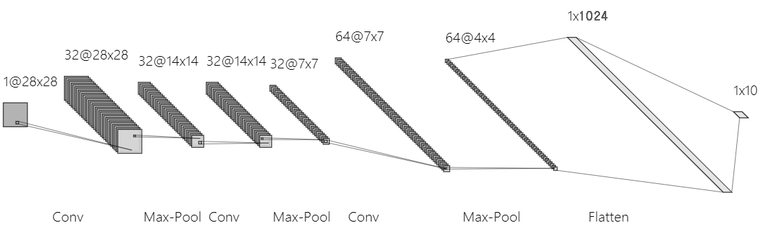
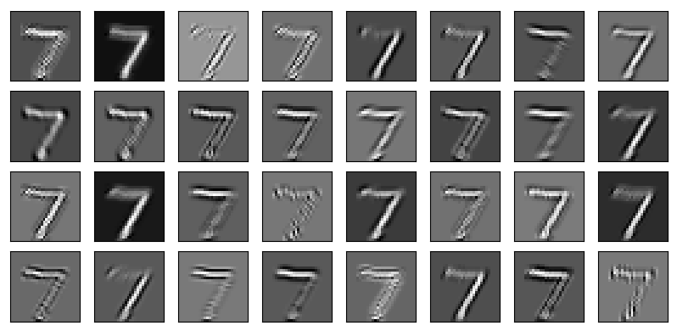
Visualization – mnist (1st Conv)
1
9
17
25
- 7 -
Notes:
Supporting facts

Slide 8
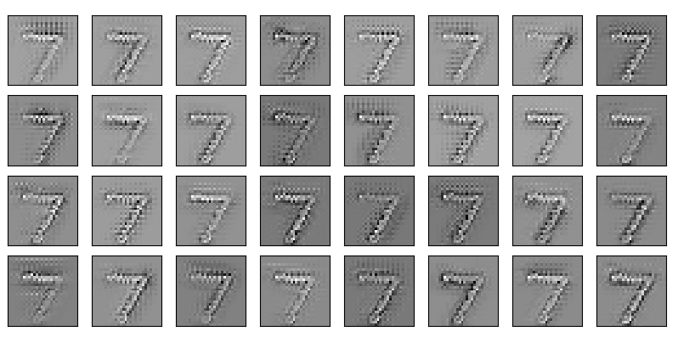
Visualization – mnist (2nd Conv)
1
9
17
25
- 8 -
Notes:
Supporting facts

Slide 9
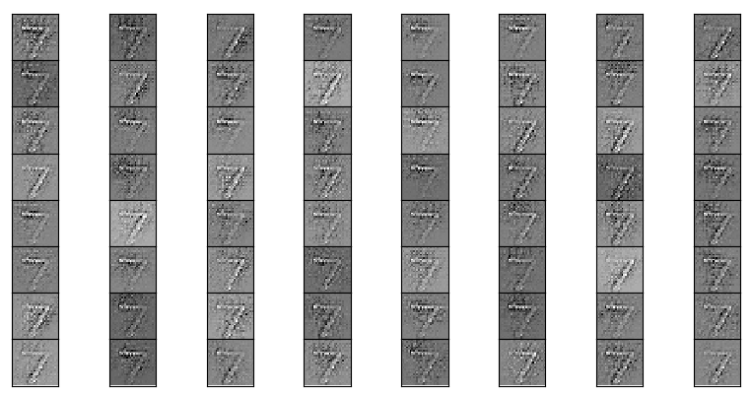
Visualization – mnist (3rd Conv)
1
9
17
25
33
41
49
57
- 9 -
Notes:
Supporting facts

Slide 10
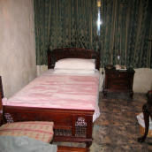
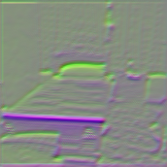
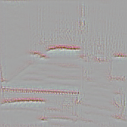
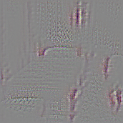
Visualization – Imagenet (Bed)
In the front of layers, the model see the overall outline.
< Input >
- 10 -
Notes:
Supporting facts

Slide 11
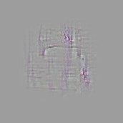
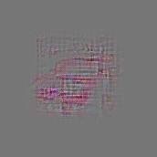
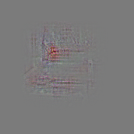
Visualization – Imagenet (Bed)
In the backward of layers, the model see the detail object(ex.pillow).
< Input >
- 11 -
Notes:
Supporting facts

Slide 12
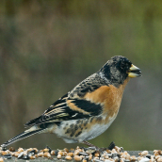
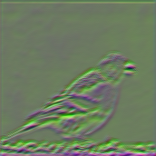
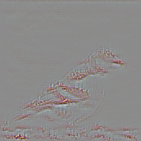
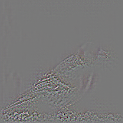
Visualization – Imagenet (Bird)
In the front of layers, the model especially see the wing(ex. shape, pattern)
< Input >
- 12 -
Notes:
Supporting facts

Slide 13
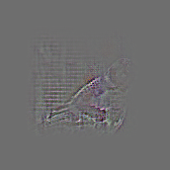
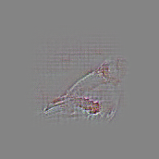
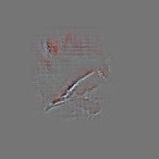
Visualization – Imagenet (Bird)
In the backward of layers, the model also see the wing.
The wing is important feature to classify whether it is bird or not.
< Input >
- 13 -
Notes:
Supporting facts

Slide 14
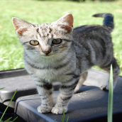
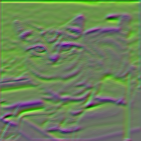
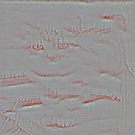
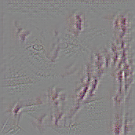
Visualization – Imagenet (Cat)
In the second of layers, the model see the eyes and nose.
In the third of layers, the model see the ears and tail.
< Input >
- 14 -
Notes:
Supporting facts

Slide 15
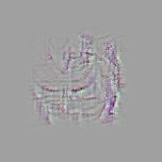
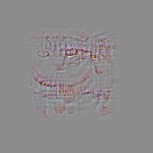
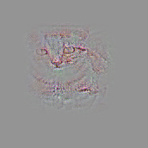
Visualization – Imagenet (Cat)
In the backward of layers, the model see the overall face.
Maybe this model see the nose to classify whether it is animal or not. (remind that this model confuse cat and dog)
< Input >
- 15 -
Notes:
Supporting facts

Slide 16
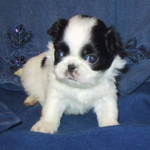
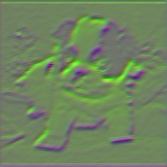
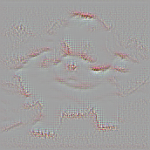
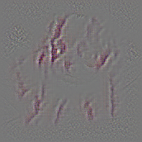
Visualization – Imagenet (Dog)
In the second of layers, the model see the overall outline.
In the third of layers, the model see the eyes and nose.
< Input >
- 16 -
Notes:
Supporting facts

Slide 17
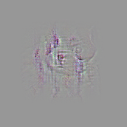
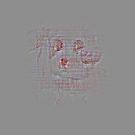
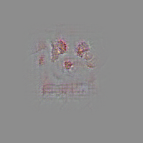
Visualization – Imagenet (Dog)
In the backward of layers, the model see the overall face. (eyes, nose)
And… the nose of cat and dog are very similar… I think…
< Input >
- 17 -
Notes:
Supporting facts

Slide 18
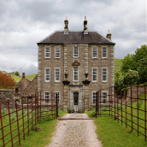
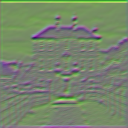
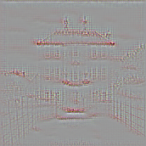
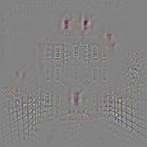
Visualization – Imagenet (House)
In the front of layers, the model see the object of house (proof, window, fence, door)
< Input >
- 18 -
Notes:
Supporting facts

Slide 19
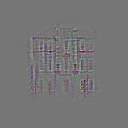
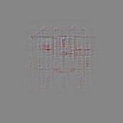
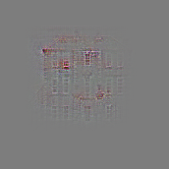
Visualization – Imagenet (House)
In the backward layers, the model especially see the windows.
The window is good feature to classify whether it is a house or not
< Input >
- 19 -
Notes:
Supporting facts

Slide 20
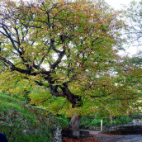
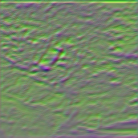
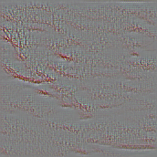
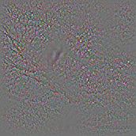
Visualization – Imagenet (Tree)
In the second of layers, the model see the overall branch.
In the third of layers, the model see the overall leaves.
< Input >
- 20 -
Notes:
Supporting facts

Slide 21
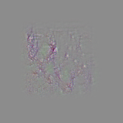

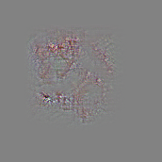
Visualization – Imagenet (Tree)
In the backward of layers, the model see the branch and leaves both.
< Input >
- 21 -
Notes:
Supporting facts

Slide 22
Any Question?
Thank you
Notes:
Supporting facts

