Slide 1
Weekly Report
Wangwon Lee, 2019/03/02
This week | Next week
Audio Classification Previous work 1D-CNN Experiments Fine tuning process | Audio Classification To investigate 1D model more specific 1D, 2D CNN visualization
Interesting and new finding
Fine Tuning
The aim of this month / Discussion
The aim of this month: To study the brain and GLM, To investigate about CNN.
Notes:
I want you to follow this rule

Slide 2
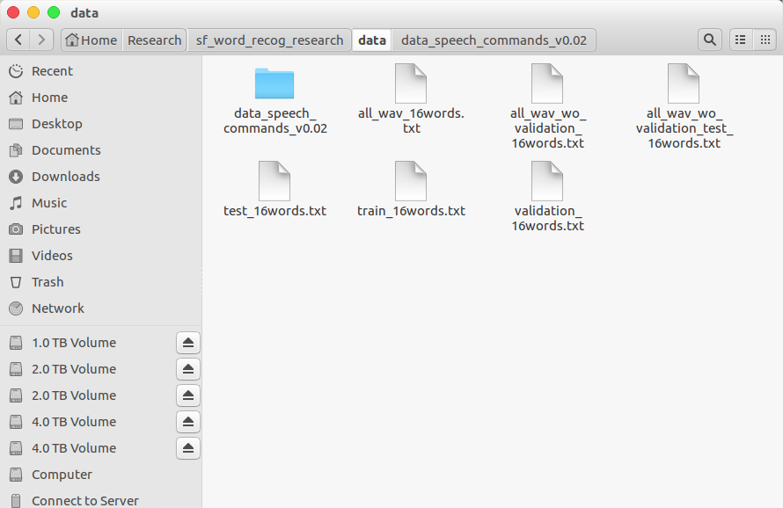
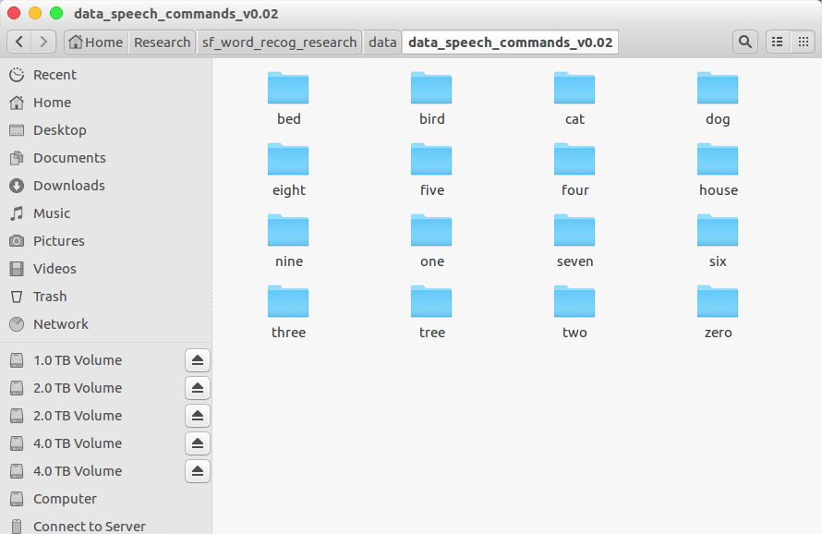
Audio Classification
Data is low-waveform.
sec: 1, sampling rate: 16000, type: float32, channel: mono
16 class data.
'zero', 'one', 'two', 'three', 'four', 'five', 'six', 'seven', 'eight', 'nine', 'bed', 'bird', 'tree', 'cat', 'house', 'dog'
Train: 40851(≒80%), Validation: 4796(≒10%), Test: 5297(≒10%)
- 1 -
Notes:
Supporting facts

Slide 3
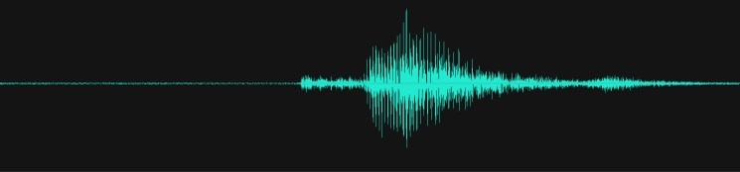

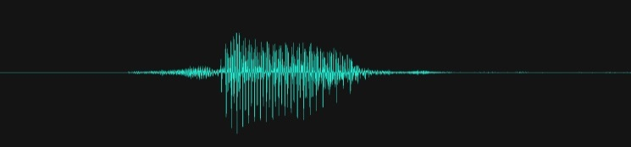

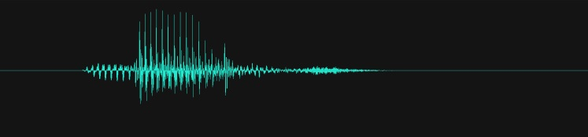

Audio Classification
Convert to spectrogram for using 2D-CNN
Throught the STFT(Short Time Furier Transform)
Window Size: 256, Stride: 128
16000(SR), 1(Ch) -> 99(Freq), 257(Time)
It contain the time information and frequency information at once.
Train: 40851(≒80%), Validation: 4796(≒10%), Test: 5297(≒10%)
“Bird”
Time(T)
Magnitude
“Cat”
“Seven”
Time(T)
Frequency(F)
- 2 -
Notes:
Supporting facts

Slide 4
Audio Classification
Validate task in 1D-CNN
0. Depth
1. Dropout
2. Batch Normalization
3. D·O + B·N
4. Reduce FC
5. Kernel Size
6. Channel
7. Summary
- 2 -
Notes:
Supporting facts

Slide 5
Audio Classification
Validate task in 1D-CNN
0. Depth
Previous Work
1. Dropout
2. Batch Normalization
3. D·O + B·N
4. Reduce FC
Current Work
5. Kernel Size
6. Channel
7. Summary
Future Work
- 2 -
Notes:
Supporting facts

Slide 6
Audio Classification
Validate task in 1D-CNN
0. Depth
Previous Work
1. Dropout
2. Batch Normalization
3. D·O + B·N
4. Reduce FC
Current Work
5. Kernel Size
6. Channel
7. Summary
Future Work
- 3 -
Notes:
Supporting facts

Slide 7
Audio Classification
Each model was trained while changing the depth.
I found out that the number of parameter is important as well as accuracy
And I asserted that FC should be reduced as much as possible
Architecture | 2D Acc | Params | 1D Acc | Params
1 Conv(5x5, 8), 1 Pool(2x2), 1 FC, 1 DO(0.5) | 0.8405 | 49,956,064 | 0.6648 | 32,736,480
1 Conv(5x5, 8), 1 Pool(2x2), 2 FC, 2 DO(0.5) | 0.8463 | 50,472,672 | 0.7078 | 33,253,088
2 Conv(5x5, 8), 2 Pool(2x2), 1 FC, 1 DO(0.5) | 0.8717 | 22,368,624 | 0.7688 | 16,290,160
2 Conv(5x5, 8), 2 Pool(2x2), 2 FC, 2 DO(0.5) | 0.8941 | 22,885,232 | 0.8056 | 16,806,768
3 Conv(5x5, 8), 3 Pool(2x2), 1 FC, 1 DO(0.5) | 0.9119 | 8,586,128 | 0.8717 | 7,996,304
3 Conv(5x5, 8), 3 Pool(2x2), 2 FC, 2 DO(0.5) | 0.9161 | 9,102,736 | 0.8702 | 8,512,912
4 Conv(5x5, 8), 4 Pool(2x2), 1 FC, 1 DO(0.5) | 0.9113 | 2,640,848 | 0.8945 | 3,689,424
4 Conv(5x5, 8), 4 Pool(2x2), 2 FC, 2 DO(0.5) | 0.9130 | 3,157,456 | 0.9038 | 4,206,032
5 Conv(5x5, 8), 5 Pool(2x2), 1 FC, 1 DO(0.5) | X | X | 0.9047 | 1,338,448
5 Conv(5x5, 8), 5 Pool(2x2), 2 FC, 2 DO(0.5) | X | X | 0.9090 | 1,855,056
- 4 -
Notes:
Supporting facts

Slide 8
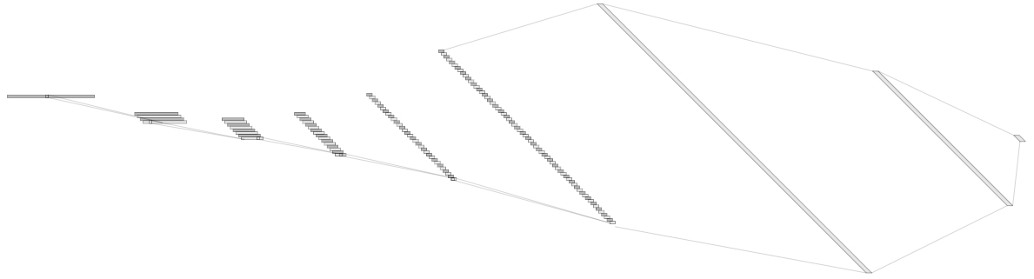
Audio Classification
For example, ‘5Conv, 2FC’ 1D model’s detail.
It just flatten 2D model. (5X5 filter->1X25 filter, 2X2 stride->1X4 stride)
Input: 16000X1 low waveform.
Output:1x16 labeled one hot vector. ('zero', …, 'eight', …, 'house', 'dog')
Loss: cross entropy loss
Obtimizer: Adam
1X1024
128@8
1X512
1@16000
64@55
8@3994
16@993
32@243
Conv(25)
MaxPool(4)
1X16
Conv(25)
MaxPool(4)
Conv(25)
MaxPool(4)
Conv(25)
MaxPool(4)
Conv(25)
MaxPool(4)
Fully-Conncted
Fully-Conncted
[ Baseline Architecture]
- 5 -
Notes:
Supporting facts

Slide 9
Audio Classification
Validate task in 1D-CNN
0. Depth
Previous Work
1. Dropout
2. Batch Normalization
3. D·O + B·N
4. Reduce FC
Current Work
5. Kernel Size
6. Channel
7. Summary
Future Work
- 6 -
Notes:
Supporting facts

Slide 10
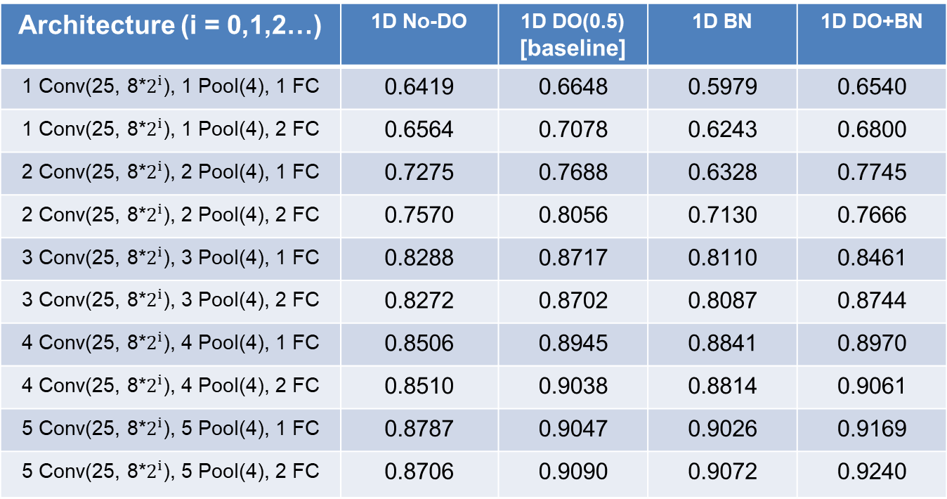
Audio Classification
Verify ‘Dropout(D·O)’ and ‘Batch Normalization(B·N)’
To verify the D·O and B·N, make the model without each part and compare each case
Of course, if the model is more deeper, the model is more better
Architecture (i = 0,1,2…) | 1D No-DO | 1D DO(0.5) [baseline] | 1D BN | 1D DO+BN
1 Conv(25, 8*$2^{i}$), 1 Pool(4), 1 FC | 0.6419 | 0.6648 | 0.5979 | 0.6540
1 Conv(25, 8*$2^{i}$), 1 Pool(4), 2 FC | 0.6564 | 0.7078 | 0.6243 | 0.6800
2 Conv(25, 8*$2^{i}$), 2 Pool(4), 1 FC | 0.7275 | 0.7688 | 0.6328 | 0.7745
2 Conv(25, 8*$2^{i}$), 2 Pool(4), 2 FC | 0.7570 | 0.8056 | 0.7130 | 0.7666
3 Conv(25, 8*$2^{i}$), 3 Pool(4), 1 FC | 0.8288 | 0.8717 | 0.8110 | 0.8461
3 Conv(25, 8*$2^{i}$), 3 Pool(4), 2 FC | 0.8272 | 0.8702 | 0.8087 | 0.8744
4 Conv(25, 8*$2^{i}$), 4 Pool(4), 1 FC | 0.8506 | 0.8945 | 0.8841 | 0.8970
4 Conv(25, 8*$2^{i}$), 4 Pool(4), 2 FC | 0.8510 | 0.9038 | 0.8814 | 0.9061
5 Conv(25, 8*$2^{i}$), 5 Pool(4), 1 FC | 0.8787 | 0.9047 | 0.9026 | 0.9169
5 Conv(25, 8*$2^{i}$), 5 Pool(4), 2 FC | 0.8706 | 0.9090 | 0.9072 | 0.9240
- 7 -
Notes:
Supporting facts

Slide 11
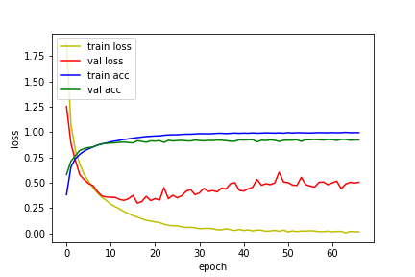
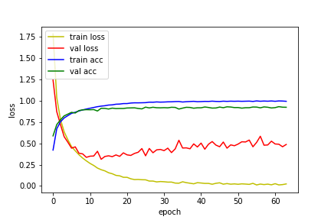
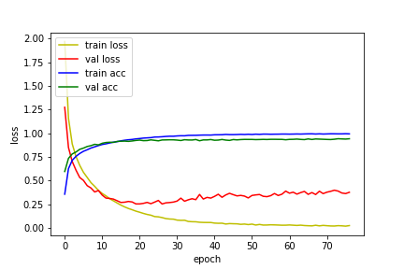
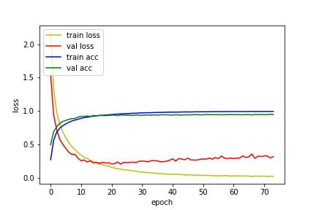
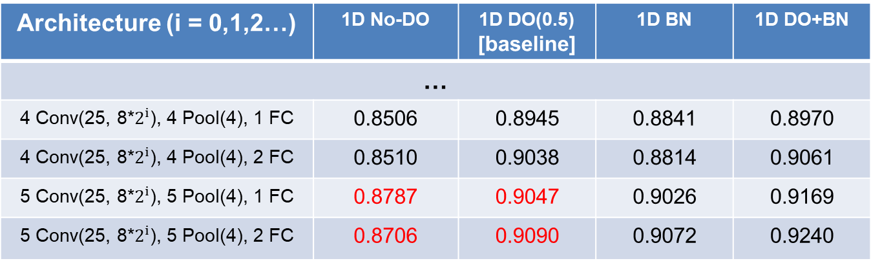
Audio Classification
First, I have a question “Does ‘dropout’ work well?”
To verify this, I trained the model without D·O
Through accuracy and learning curve, D·O makes the model better and more stable
Architecture (i = 0,1,2…) | 1D No-DO | 1D DO(0.5) [baseline] | 1D BN | 1D DO+BN
…
4 Conv(25, 8*$2^{i}$), 4 Pool(4), 1 FC | 0.8506 | 0.8945 | 0.8841 | 0.8970
4 Conv(25, 8*$2^{i}$), 4 Pool(4), 2 FC | 0.8510 | 0.9038 | 0.8814 | 0.9061
5 Conv(25, 8*$2^{i}$), 5 Pool(4), 1 FC | 0.8787 | 0.9047 | 0.9026 | 0.9169
5 Conv(25, 8*$2^{i}$), 5 Pool(4), 2 FC | 0.8706 | 0.9090 | 0.9072 | 0.9240
- 8 -
Notes:
Supporting facts

Slide 12
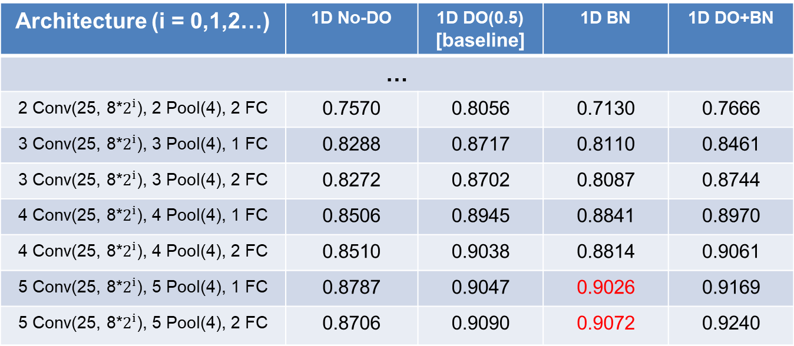
Audio Classification
Second, I tried ‘Batch Normalization’
As mentioned in the paper, B·N makes the model more stable by prevent the internal covariate shift
Compared to the No-D·O model, B·N also makes the model better
Compared to the D·O model, It is effective when the model is deep.
Architecture (i = 0,1,2…) | 1D No-DO | 1D DO(0.5) [baseline] | 1D BN | 1D DO+BN
…
2 Conv(25, 8*$2^{i}$), 2 Pool(4), 2 FC | 0.7570 | 0.8056 | 0.7130 | 0.7666
3 Conv(25, 8*$2^{i}$), 3 Pool(4), 1 FC | 0.8288 | 0.8717 | 0.8110 | 0.8461
3 Conv(25, 8*$2^{i}$), 3 Pool(4), 2 FC | 0.8272 | 0.8702 | 0.8087 | 0.8744
4 Conv(25, 8*$2^{i}$), 4 Pool(4), 1 FC | 0.8506 | 0.8945 | 0.8841 | 0.8970
4 Conv(25, 8*$2^{i}$), 4 Pool(4), 2 FC | 0.8510 | 0.9038 | 0.8814 | 0.9061
5 Conv(25, 8*$2^{i}$), 5 Pool(4), 1 FC | 0.8787 | 0.9047 | 0.9026 | 0.9169
5 Conv(25, 8*$2^{i}$), 5 Pool(4), 2 FC | 0.8706 | 0.9090 | 0.9072 | 0.9240
- 9 -
Notes:
Supporting facts

Slide 13
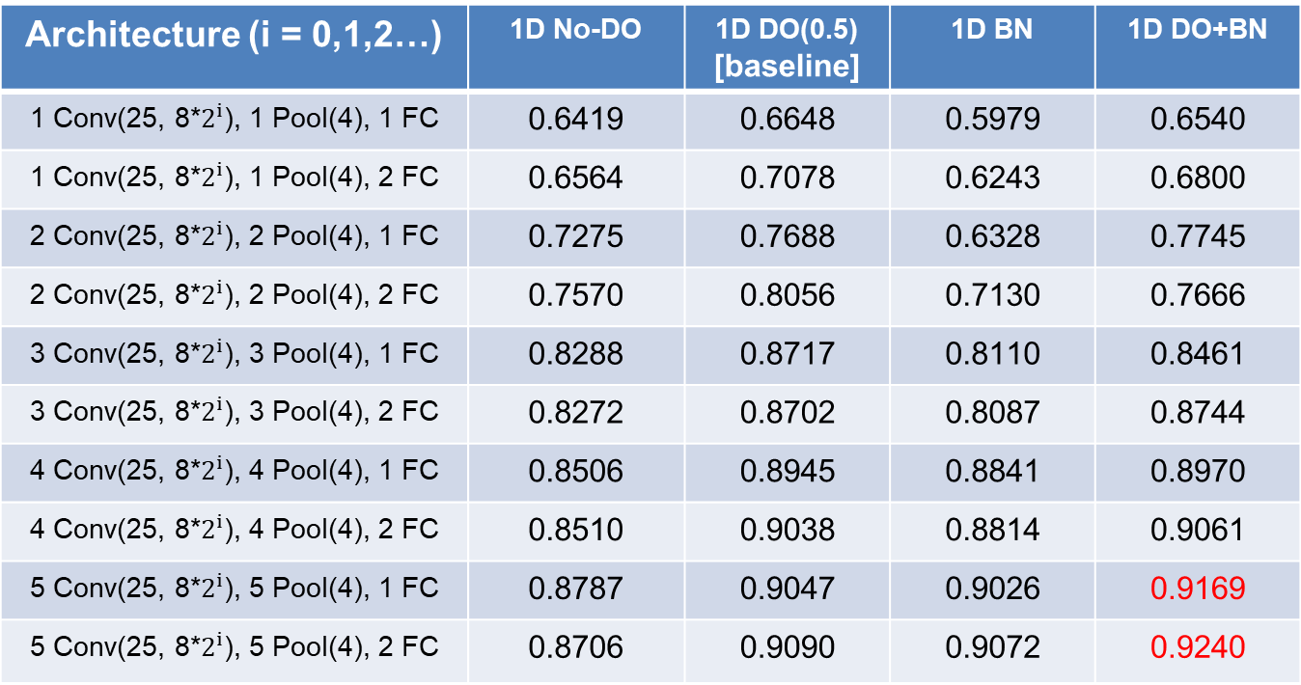
Audio Classification
Third, A lot of people use D·O and B·N together
It is the best performance than the other
Architecture (i = 0,1,2…) | 1D No-DO | 1D DO(0.5) [baseline] | 1D BN | 1D DO+BN
1 Conv(25, 8*$2^{i}$), 1 Pool(4), 1 FC | 0.6419 | 0.6648 | 0.5979 | 0.6540
1 Conv(25, 8*$2^{i}$), 1 Pool(4), 2 FC | 0.6564 | 0.7078 | 0.6243 | 0.6800
2 Conv(25, 8*$2^{i}$), 2 Pool(4), 1 FC | 0.7275 | 0.7688 | 0.6328 | 0.7745
2 Conv(25, 8*$2^{i}$), 2 Pool(4), 2 FC | 0.7570 | 0.8056 | 0.7130 | 0.7666
3 Conv(25, 8*$2^{i}$), 3 Pool(4), 1 FC | 0.8288 | 0.8717 | 0.8110 | 0.8461
3 Conv(25, 8*$2^{i}$), 3 Pool(4), 2 FC | 0.8272 | 0.8702 | 0.8087 | 0.8744
4 Conv(25, 8*$2^{i}$), 4 Pool(4), 1 FC | 0.8506 | 0.8945 | 0.8841 | 0.8970
4 Conv(25, 8*$2^{i}$), 4 Pool(4), 2 FC | 0.8510 | 0.9038 | 0.8814 | 0.9061
5 Conv(25, 8*$2^{i}$), 5 Pool(4), 1 FC | 0.8787 | 0.9047 | 0.9026 | 0.9169
5 Conv(25, 8*$2^{i}$), 5 Pool(4), 2 FC | 0.8706 | 0.9090 | 0.9072 | 0.9240
- 10 -
Notes:
Supporting facts

Slide 14
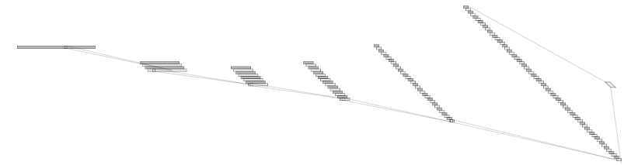
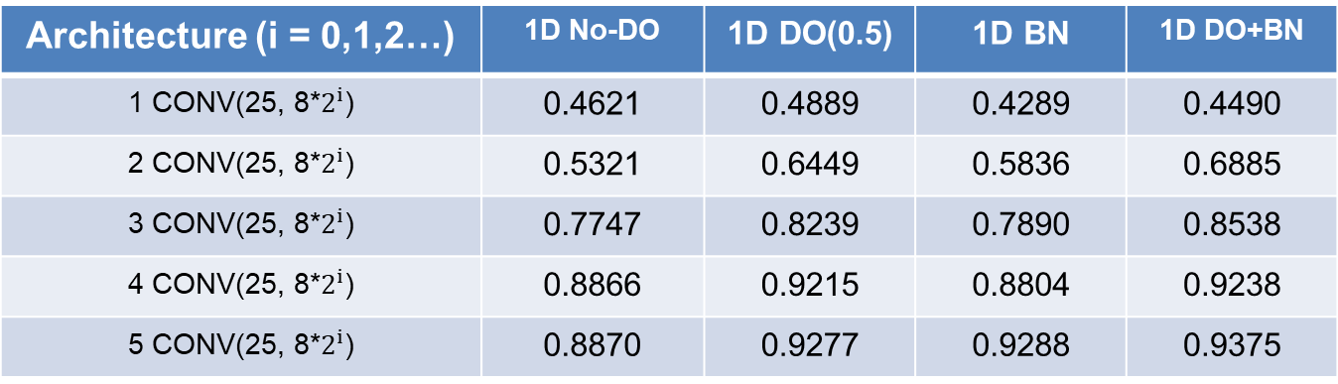
Audio Classification
4th, I think that FC has a lot of problem (FC = Fully Connected)
So I retry the model without FC layer (Now I call this model “only conv”)
FC exists only between the last Conv layer and the output layer (for classfication)
Architecture (i = 0,1,2…) | 1D No-DO | 1D DO(0.5) | 1D BN | 1D DO+BN
1 CONV(25, 8*$2^{i}$) | 0.4621 | 0.4889 | 0.4289 | 0.4490
2 CONV(25, 8*$2^{i}$) | 0.5321 | 0.6449 | 0.5836 | 0.6885
3 CONV(25, 8*$2^{i}$) | 0.7747 | 0.8239 | 0.7890 | 0.8538
4 CONV(25, 8*$2^{i}$) | 0.8866 | 0.9215 | 0.8804 | 0.9238
5 CONV(25, 8*$2^{i}$) | 0.8870 | 0.9277 | 0.9288 | 0.9375
128@8
1@16000
64@55
8@3994
16@993
32@243
Conv(25)
MaxPool(4)
Conv(25)
MaxPool(4)
Conv(25)
MaxPool(4)
Conv(25)
MaxPool(4)
Conv(25)
MaxPool(4)
[ “Only Conv” Architecture]
- 11 -
Notes:
Supporting facts

Slide 15
Audio Classification
This model was also tested for each case.
And also shown the best performance in ‘D·O+B·N’ model
Architecture (i = 0,1,2…) | 1D No-DO | 1D DO(0.5) | 1D BN | 1D DO+BN
1 CONV(25, 8*$2^{i}$) | 0.4621 | 0.4889 | 0.4289 | 0.4490
2 CONV(25, 8*$2^{i}$) | 0.5321 | 0.6449 | 0.5836 | 0.6885
3 CONV(25, 8*$2^{i}$) | 0.7747 | 0.8239 | 0.7890 | 0.8538
4 CONV(25, 8*$2^{i}$) | 0.8866 | 0.9215 | 0.8804 | 0.9238
5 CONV(25, 8*$2^{i}$) | 0.8870 | 0.9277 | 0.9288 | 0.9375
128@8
1@16000
64@55
8@3994
16@993
32@243
Conv(25)
MaxPool(4)
Conv(25)
MaxPool(4)
Conv(25)
MaxPool(4)
Conv(25)
MaxPool(4)
Conv(25)
MaxPool(4)
[ “Only Conv” Architecture]
- 12 -
Notes:
Supporting facts

Slide 16
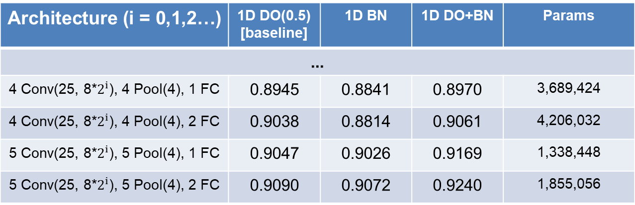
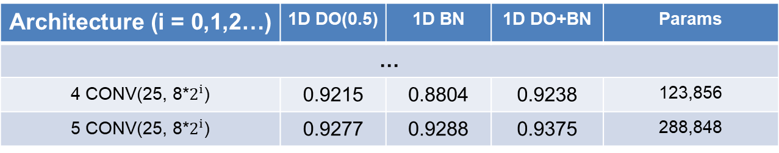
Audio Classification
Compare both
Let’s focus on the accuracy and the number of parameters.
Architecture (i = 0,1,2…) | 1D DO(0.5) [baseline] | 1D BN | 1D DO+BN | Params
...
4 Conv(25, 8*$2^{i}$), 4 Pool(4), 1 FC | 0.8945 | 0.8841 | 0.8970 | 3,689,424
4 Conv(25, 8*$2^{i}$), 4 Pool(4), 2 FC | 0.9038 | 0.8814 | 0.9061 | 4,206,032
5 Conv(25, 8*$2^{i}$), 5 Pool(4), 1 FC | 0.9047 | 0.9026 | 0.9169 | 1,338,448
5 Conv(25, 8*$2^{i}$), 5 Pool(4), 2 FC | 0.9090 | 0.9072 | 0.9240 | 1,855,056
base
model
Architecture (i = 0,1,2…) | 1D DO(0.5) | 1D BN | 1D DO+BN | Params
…
4 CONV(25, 8*$2^{i}$) | 0.9215 | 0.8804 | 0.9238 | 123,856
5 CONV(25, 8*$2^{i}$) | 0.9277 | 0.9288 | 0.9375 | 288,848
Only
Conv
model
- 13 -
Notes:
Supporting facts

Slide 17
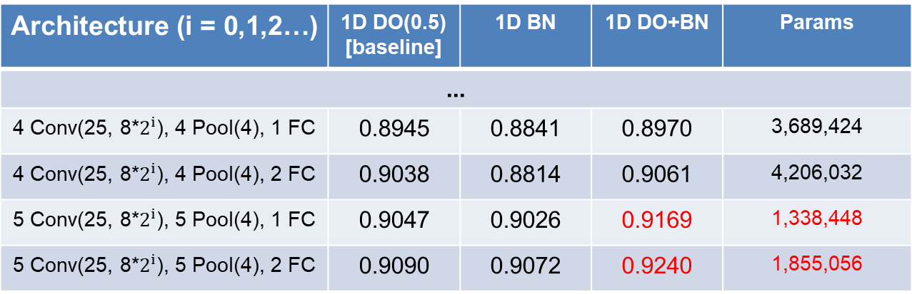
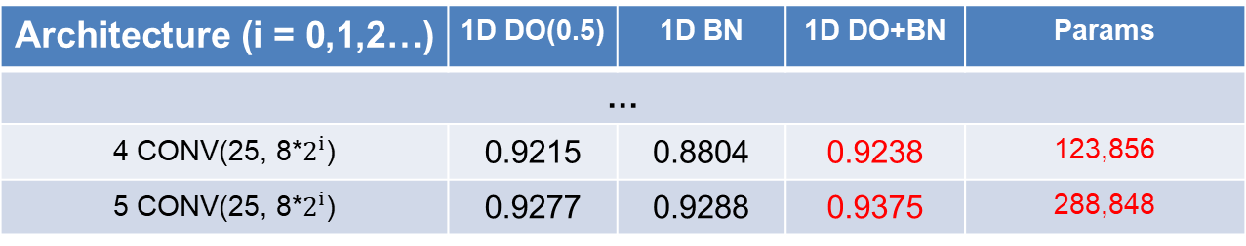
Audio Classification
Compared to the best accuracy, It is increased. (0.9240 → 0.9375)
Compared to the number of parameter, It is greatly decreased. (~90.8%)
It’s a great achievement beyond what I expected.
Architecture (i = 0,1,2…) | 1D DO(0.5) [baseline] | 1D BN | 1D DO+BN | Params
...
4 Conv(25, 8*$2^{i}$), 4 Pool(4), 1 FC | 0.8945 | 0.8841 | 0.8970 | 3,689,424
4 Conv(25, 8*$2^{i}$), 4 Pool(4), 2 FC | 0.9038 | 0.8814 | 0.9061 | 4,206,032
5 Conv(25, 8*$2^{i}$), 5 Pool(4), 1 FC | 0.9047 | 0.9026 | 0.9169 | 1,338,448
5 Conv(25, 8*$2^{i}$), 5 Pool(4), 2 FC | 0.9090 | 0.9072 | 0.9240 | 1,855,056
base
model
Architecture (i = 0,1,2…) | 1D DO(0.5) | 1D BN | 1D DO+BN | Params
…
4 CONV(25, 8*$2^{i}$) | 0.9215 | 0.8804 | 0.9238 | 123,856
5 CONV(25, 8*$2^{i}$) | 0.9277 | 0.9288 | 0.9375 | 288,848
Only
Conv
model
- 14 -
Notes:
Supporting facts

Slide 18
Audio Classification
Validate task in 1D-CNN
0. Depth
Previous Work
1. Dropout
2. Batch Normalization
3. D·O + B·N
4. Reduce FC
Current Work
5. Kernel Size
6. Channel
7. Summary
Future Work
- 15 -
Notes:
Supporting facts

Slide 19
Any Question?
Thank you
Notes:
Supporting facts

