Slide 1

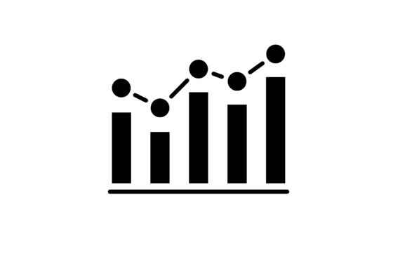



DATA MINING PROJECT USING COVID-19 DATASET
Adem Oğuz Bozçalar
Berkay Bakaç
Ali Teke

Slide 2

In this project, we analyzed a COVID-19 dataset to find patterns and effectively handle missing data.
Because proper data quality and preprocessing are crucial for accurate analysis and modeling, which is vital in understanding the impact of COVID-19.

Slide 3
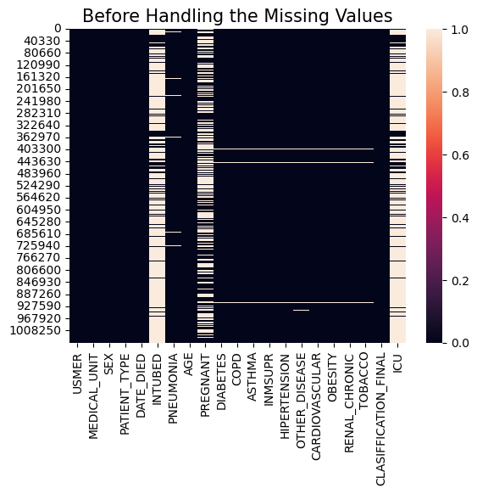
Before handling the missing values

Slide 4
Initially, we checked for duplicate entries and examined the data types of each column to understand the dataset's structure.
After that,we identified missing data by checking for NaN values and specific placeholder values like 97, 98, and 99.
These placeholder values were replaced with NaN to mark them as missing.
We visualized the missing data using a heatmap to understand the extent of the issue before and after handling it.
Additionally, we converted invalid dates and corrected specific categorical feature values.

Slide 5
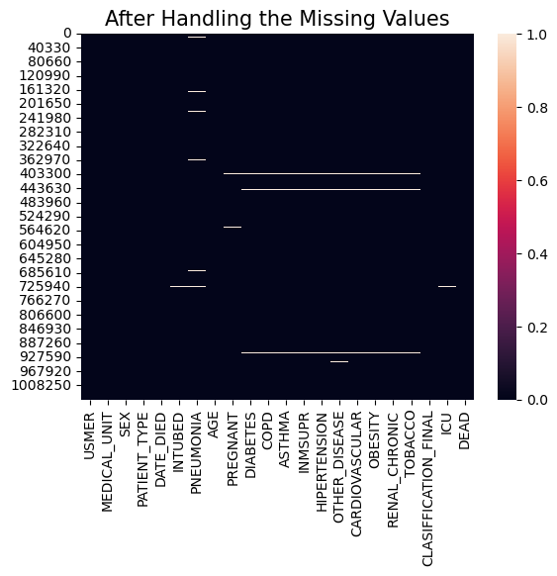
After some processes, we successfully handled the missing values

Slide 6

With the missing values handled, our focus now shifts to analyzing the dataset.
We will delve into the data to extract meaningful insights and patterns related to COVID-19 patient demographics and treatment outcomes.

Slide 7
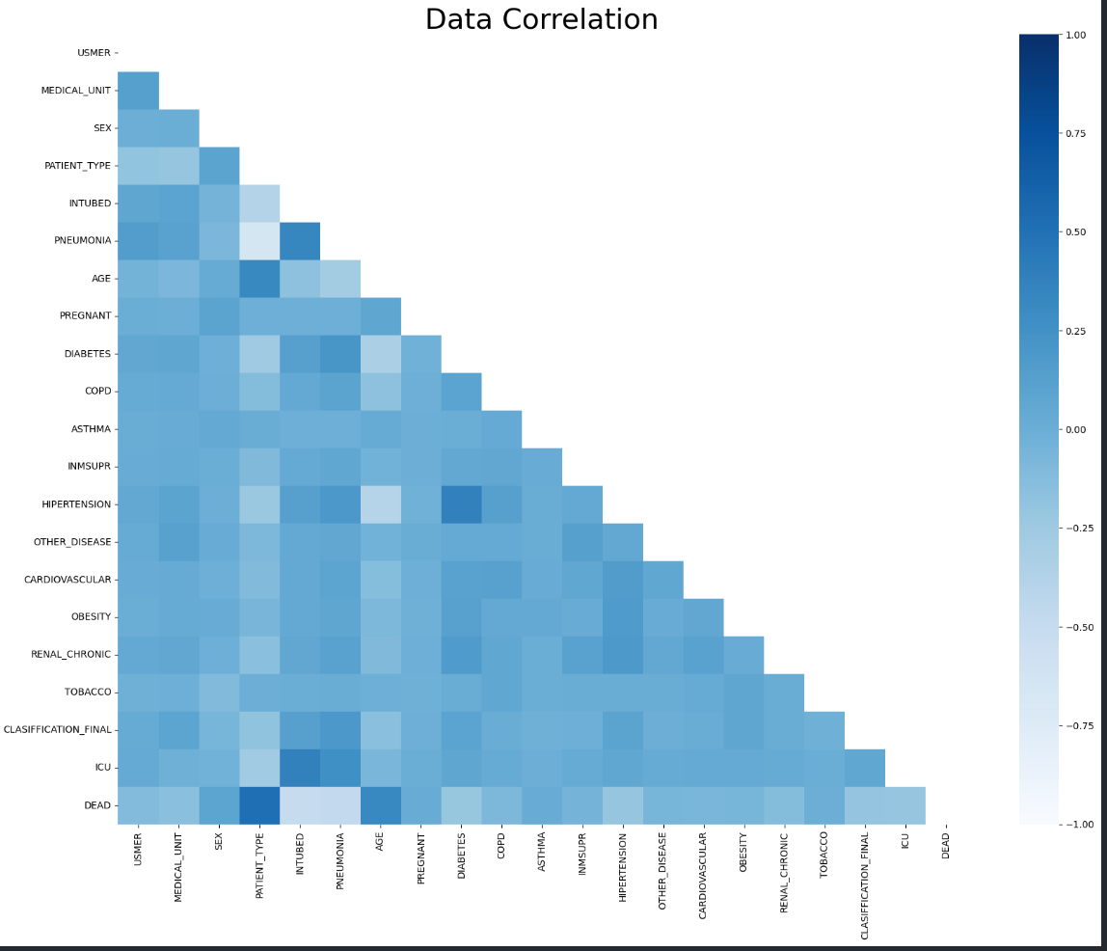
Data Correlation Visualization
The graph displays a heatmap illustrating the correlations between variables in the dataset. Correlation values are numerically indicated within the cells, and the colors range from shades of blue, representing values from -1 to 1.

Slide 8
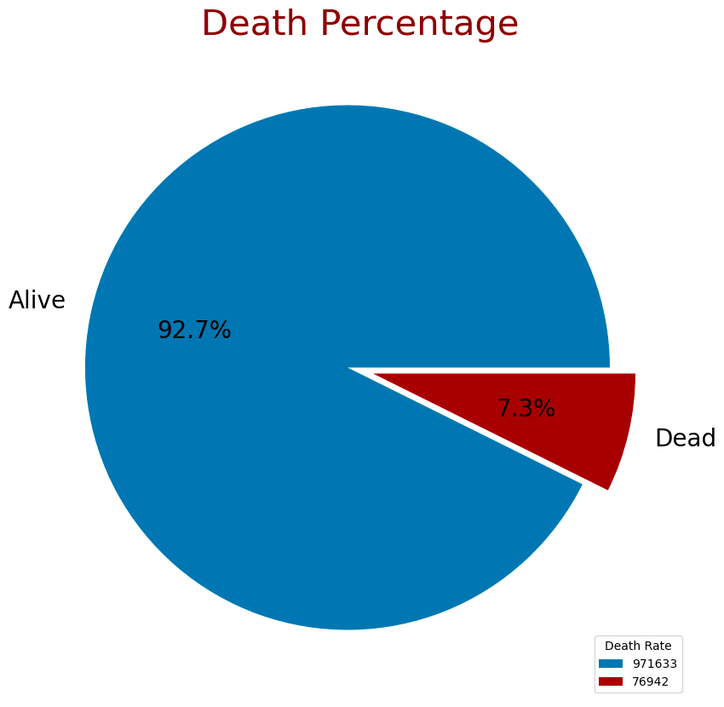
Death Percentage Visualization
The pie chart visualizes the percentage of "Alive" and "Dead" individuals in the dataset. Numeric values are shown within the chart segments, and a legend displays the count of each category.

Slide 9
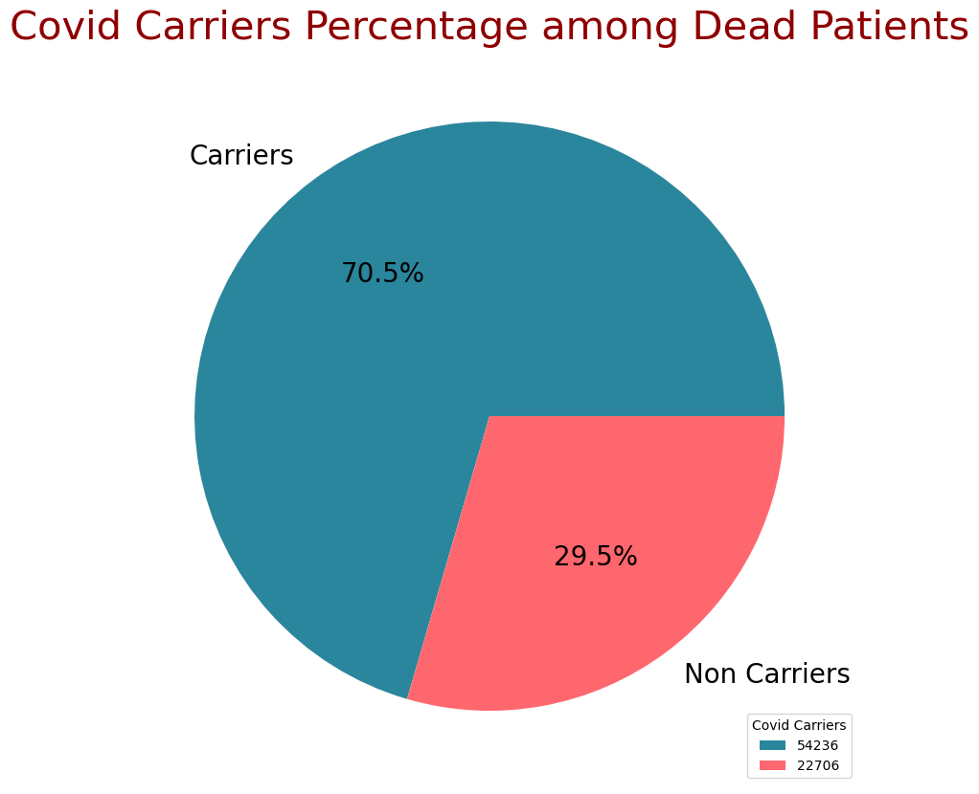
Covid Carrier Percentage Visualization
The pie chart illustrates the percentage of "Carriers" and "Non Carriers" among deceased patients due to COVID-19. Numeric values are displayed within the segments, and a legend indicates the count of each category.

Slide 10
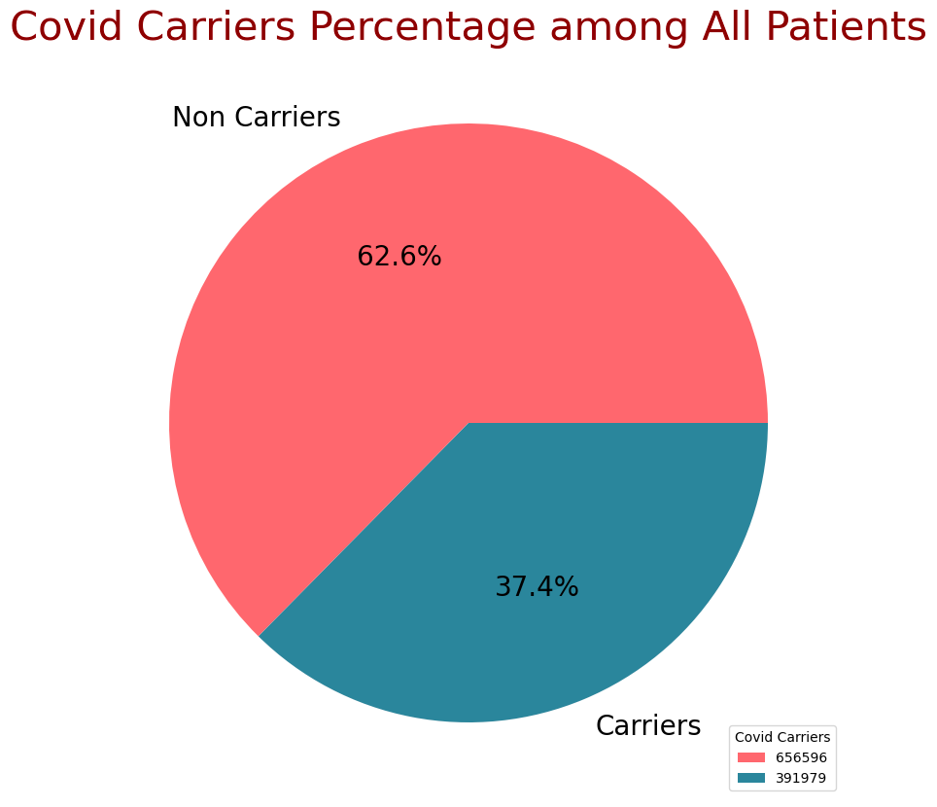
Covid Carrier
The pie chart displays the percentage of COVID-19 "Non Carriers" and "Carriers" among all patients. Numeric values are included within the segments, and a legend denotes the count of each category.

Slide 11
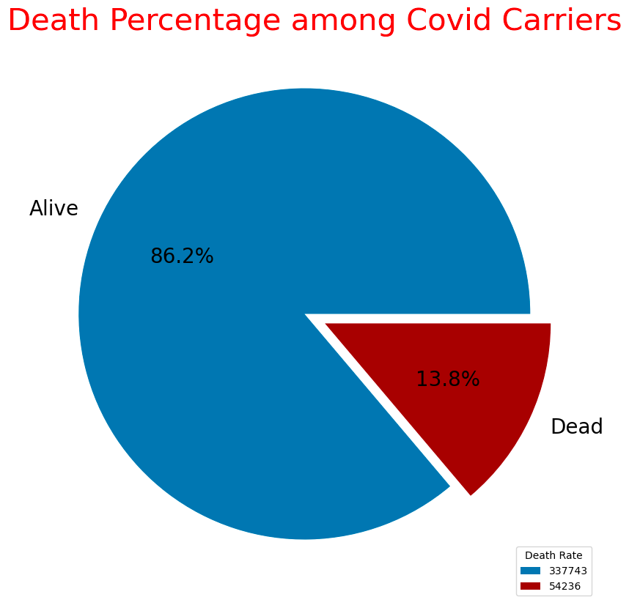
The pie chart depicts the percentage of "Alive" and "Dead" individuals among COVID-19 carriers. Numeric values are embedded within the segments, and a legend indicates the count of each category.

Slide 12
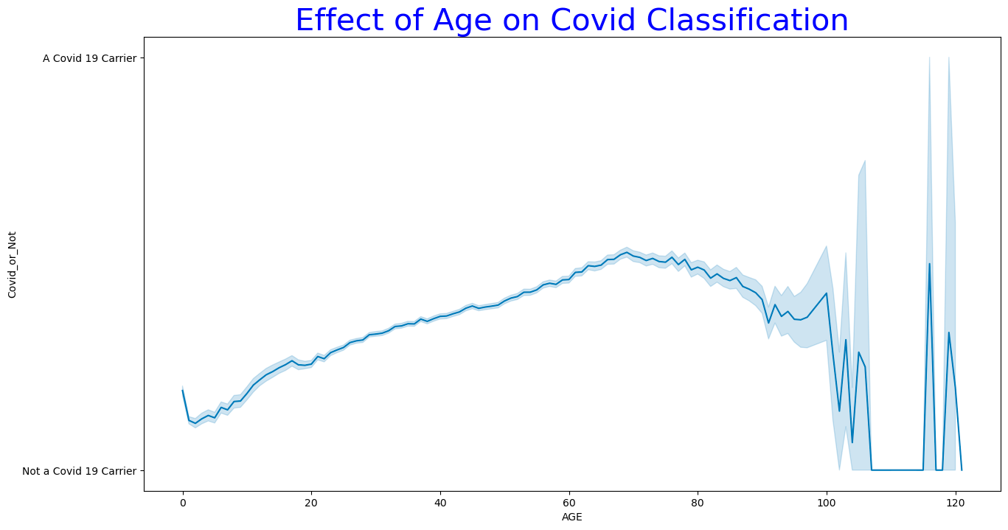
The visual depicts the relationship between age and COVID-19 classification. As age increases, it explores how the likelihood of being classified as COVID-19 positive or negative changes.

Slide 13
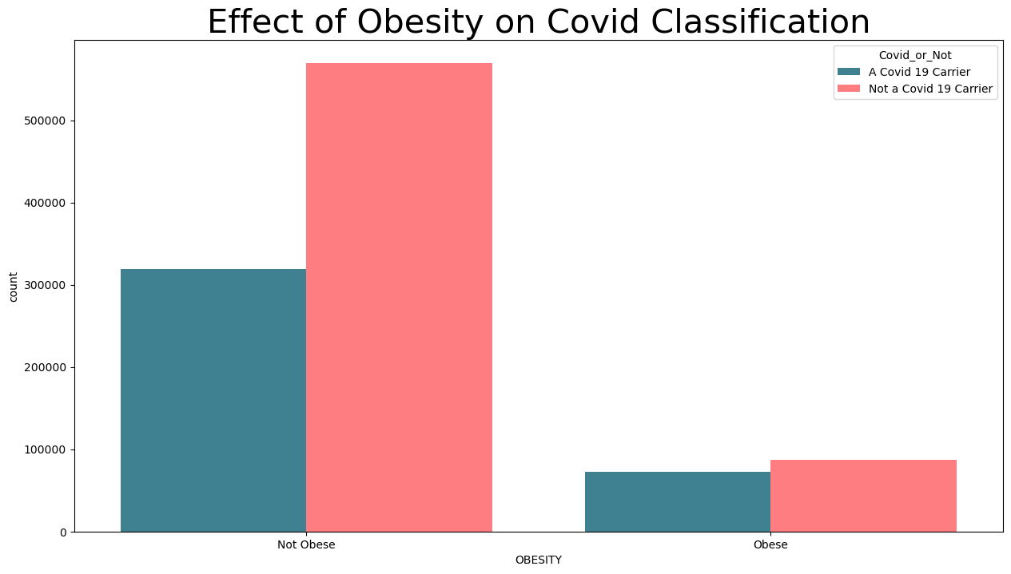
The visualization illustrates the impact of obesity on COVID-19 classification. It compares the distribution of COVID-19 positive and negative cases among individuals categorized as obese and non-obese. The different colors represent the COVID-19 classification outcomes, while the x-axis displays the obesity status.

Slide 14
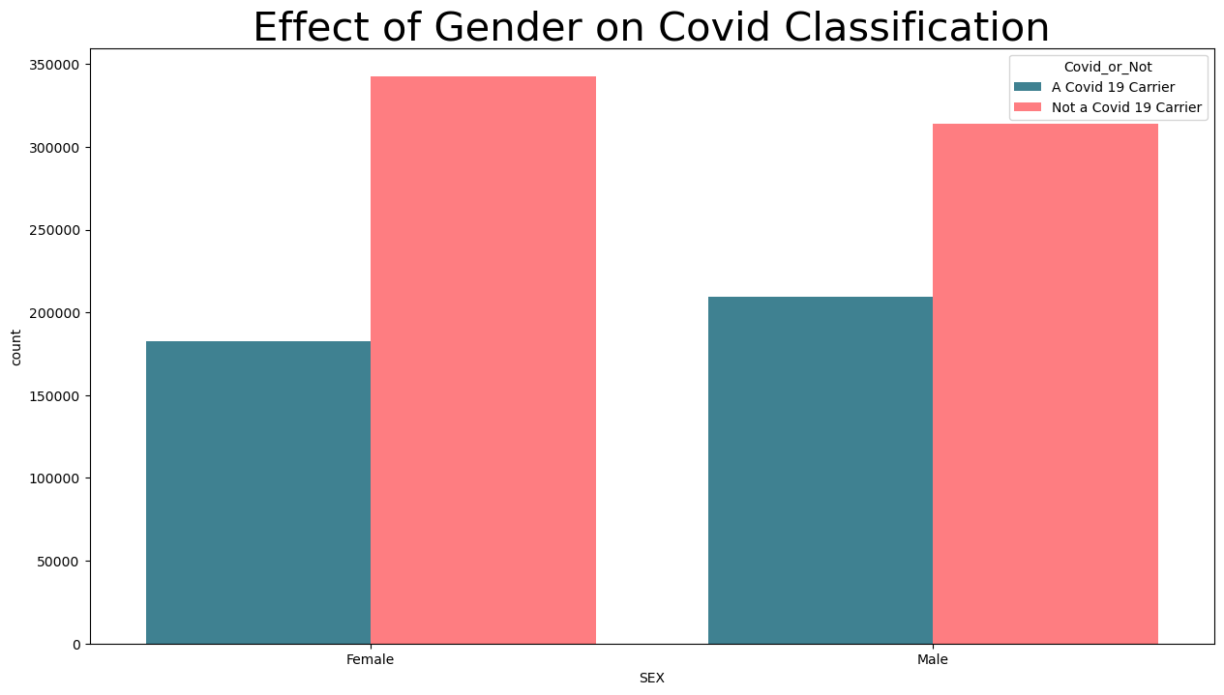





















The visualization depicts the relationship between gender and COVID-19 classification. It compares the distribution of COVID-19 positive and negative cases among different genders. The x-axis represents the gender categories, while the colors indicate the COVID-19 classification outcomes.

Slide 15
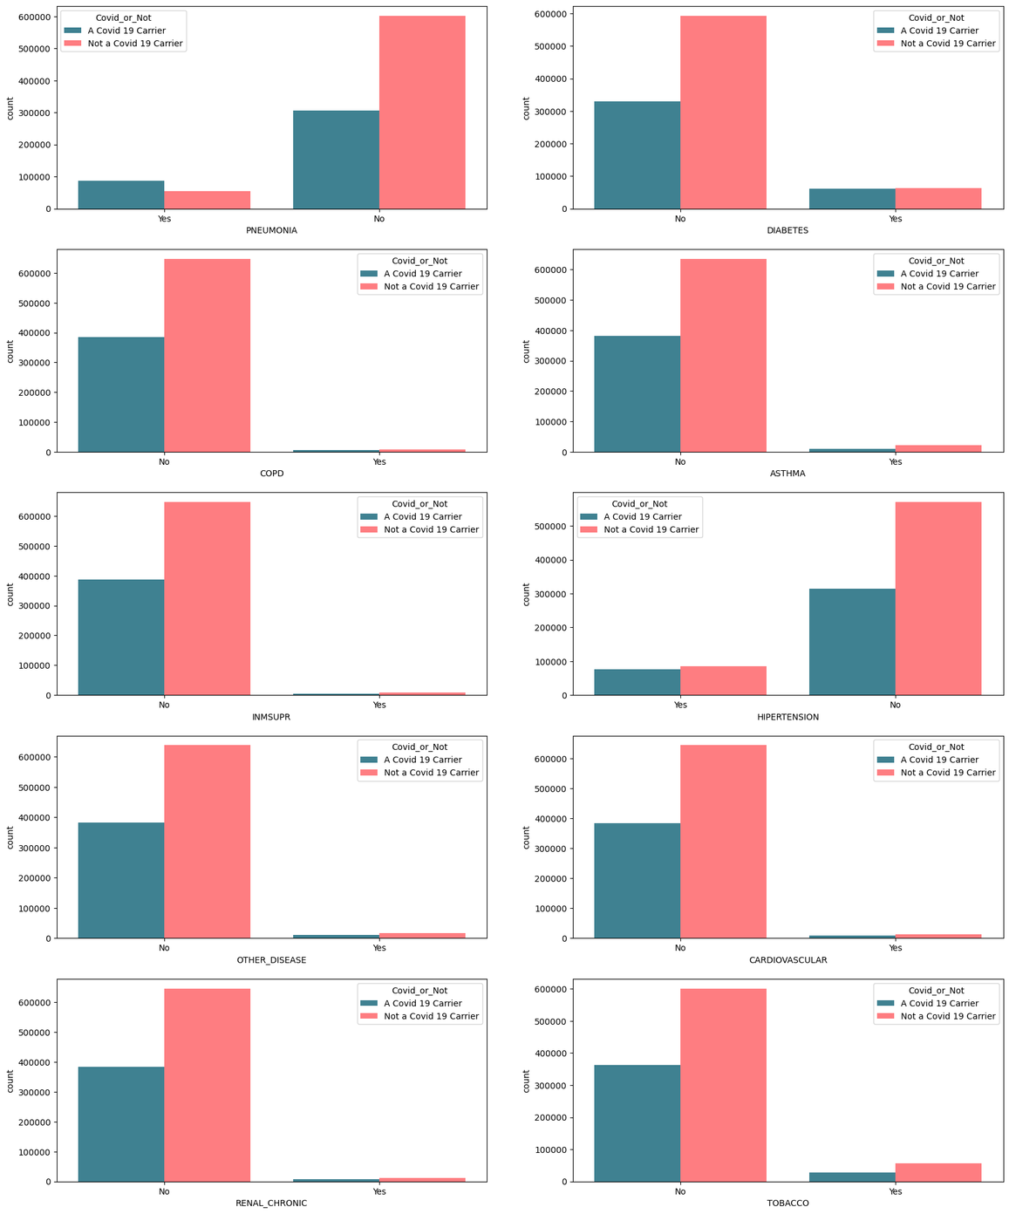
The visual depicts the impact of various medical conditions on COVID-19 carrier status. Each subplot compares whether individuals with specific medical conditions are carriers or not, categorized as "Yes" or "No". Blue bars represent non-carriers, while red bars represent carriers. The visualization helps us understand the relationship between different medical conditions and COVID-19 carrier status.

Slide 16
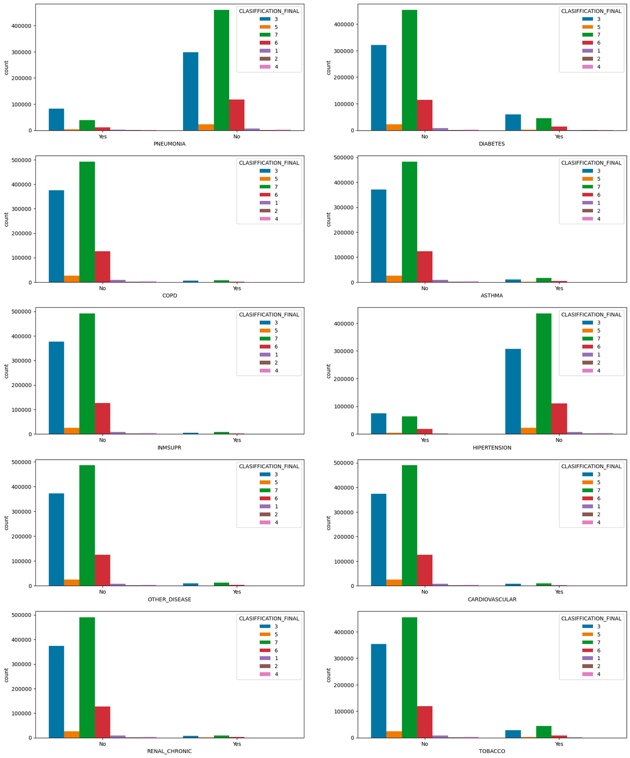
The visualization shows the distribution of different medical conditions among different final classifications (CLASIFFICATION_FINAL). Each subplot corresponds to a specific medical condition, and the bars are grouped by the final classification. It helps analyze how these medical conditions are associated with the final classifications.

Slide 17
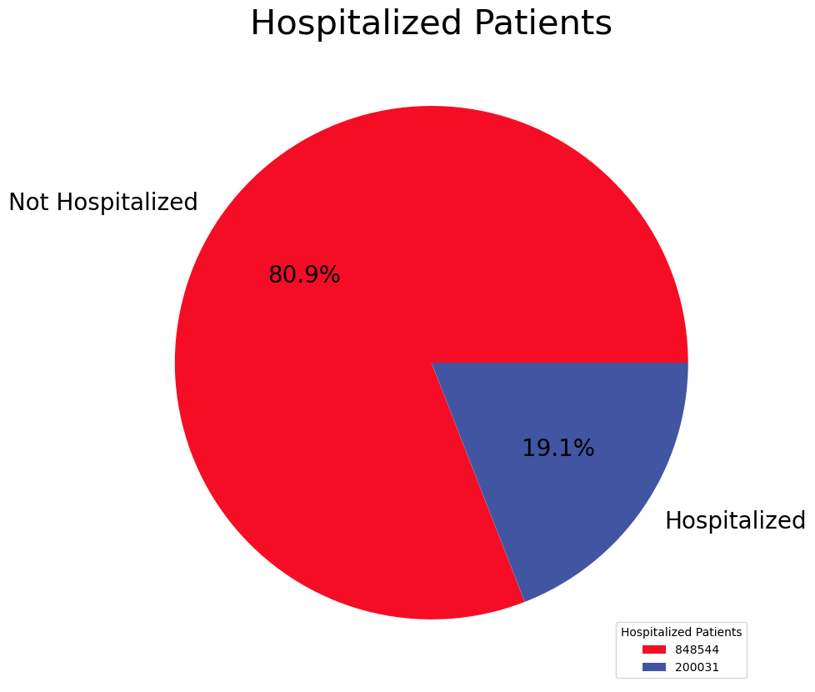
The visualization presents the distribution of patient types in the dataset. It categorizes patients into two groups: "Hospitalized" and "Not Hospitalized." The pie chart indicates the proportion of each patient type, allowing a quick understanding of the hospitalization status among the patients.

Slide 18
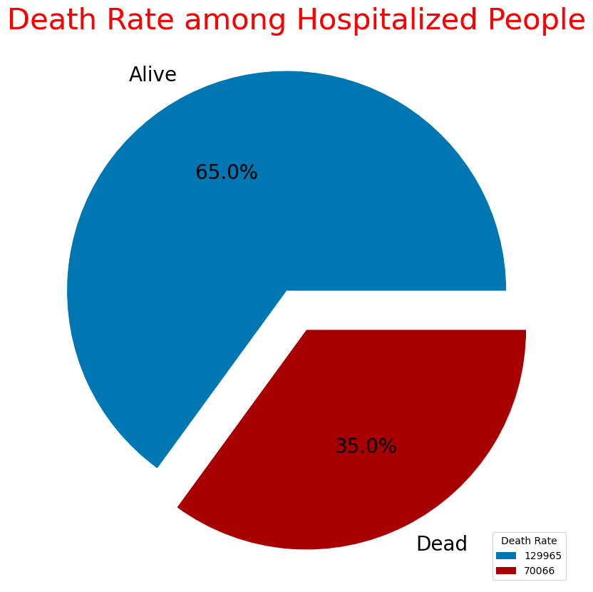
The visualization illustrates the death rate among hospitalized individuals. It categorizes them into two groups: "Alive" and "Dead," showcasing the percentage of each category through a pie chart. The chart's colors emphasize the distinction between alive and deceased patients, facilitating a clear understanding of the mortality rate within the hospitalized population.

Slide 19
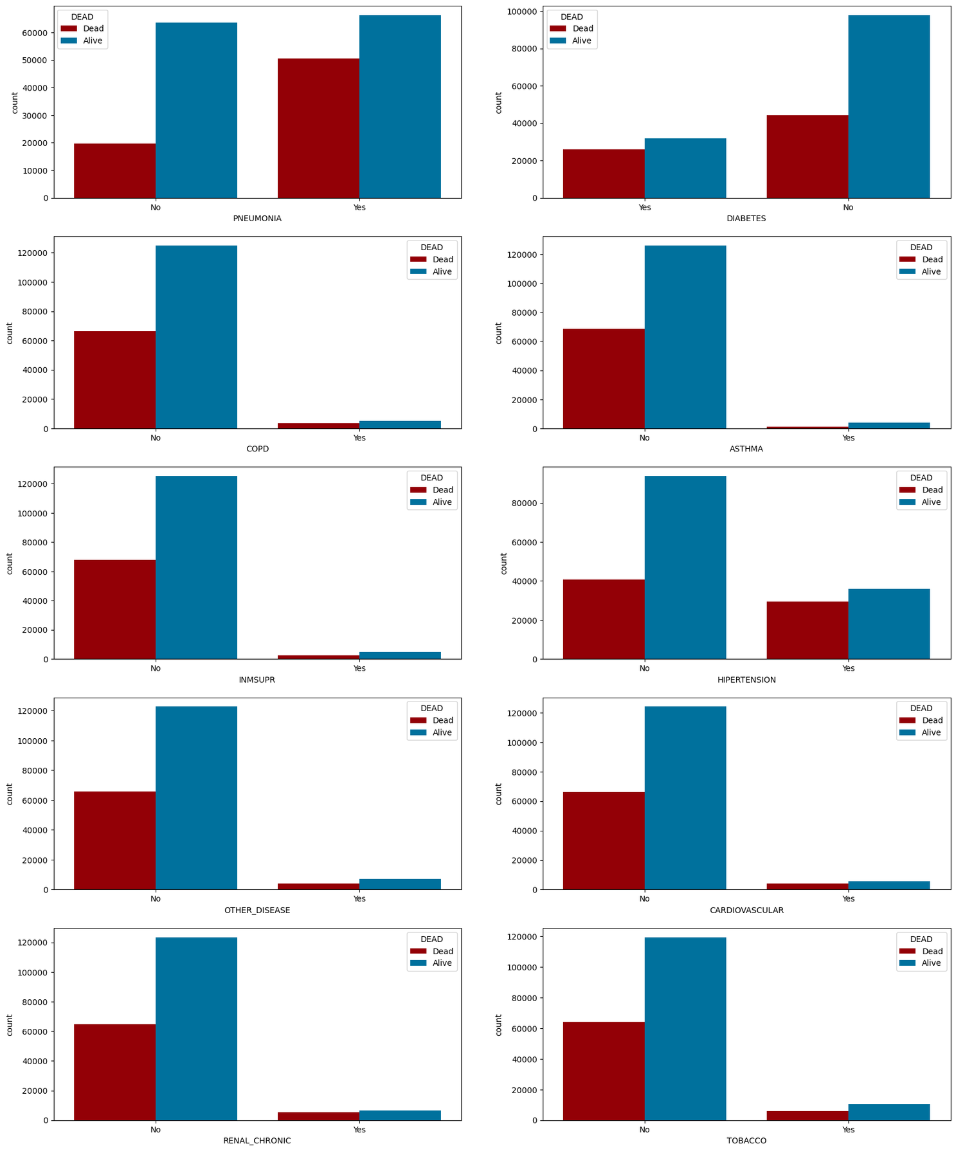
The visualization depicts the distribution of various diseases among hospitalized patients, categorized by their mortality status (alive or deceased). Each subplot represents a different disease, showing the count of patients with and without that particular condition. The colors differentiate between alive and deceased individuals, providing insights into the prevalence of diseases among hospitalized patients and their association with mortality.

Slide 20
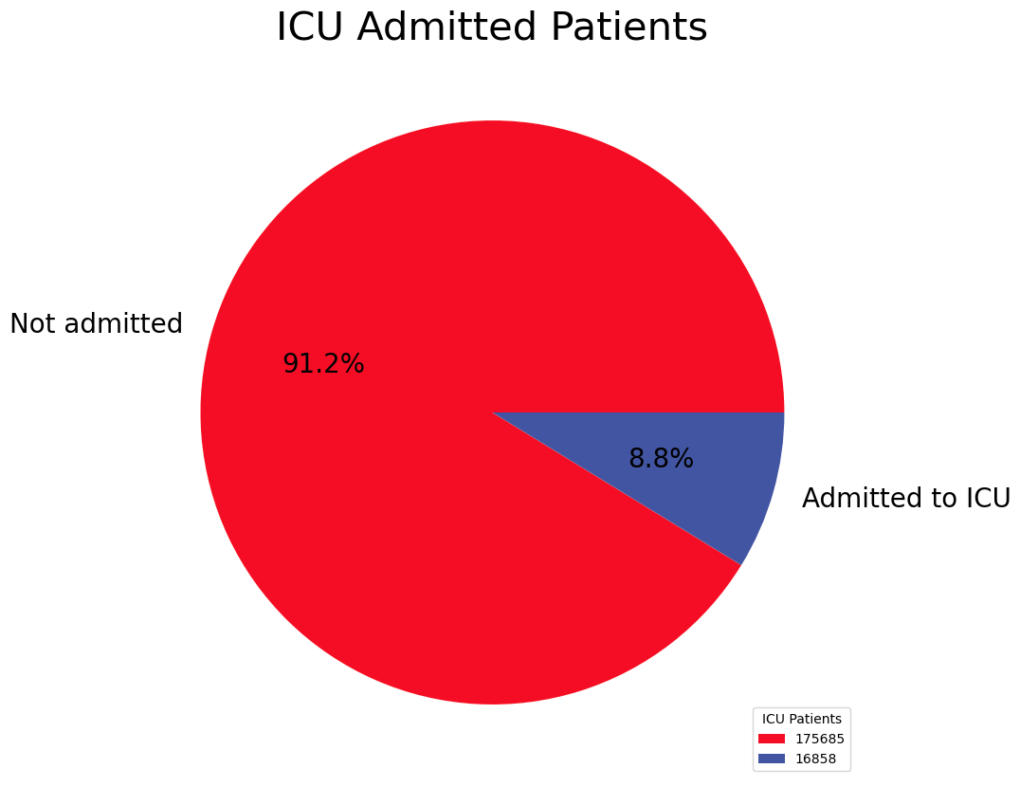
This chart presents two categories: "Not admitted" for patients who were not admitted to the ICU, and "Admitted to ICU" for those who were.

Slide 21
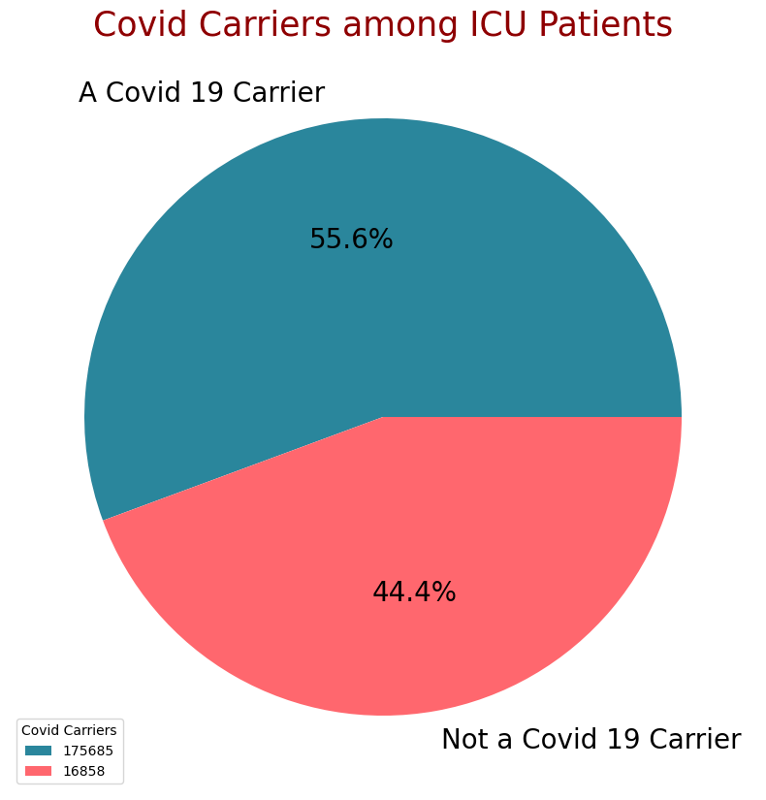
The visualization illustrates the distribution of deceased patients based on their hospitalization status. It shows the percentage of patients who were hospitalized versus those who were not hospitalized at the time of death. The chart provides insight into the proportion of hospitalized patients among the deceased population, highlighting the importance of hospital care in managing severe cases of illness.

Slide 22
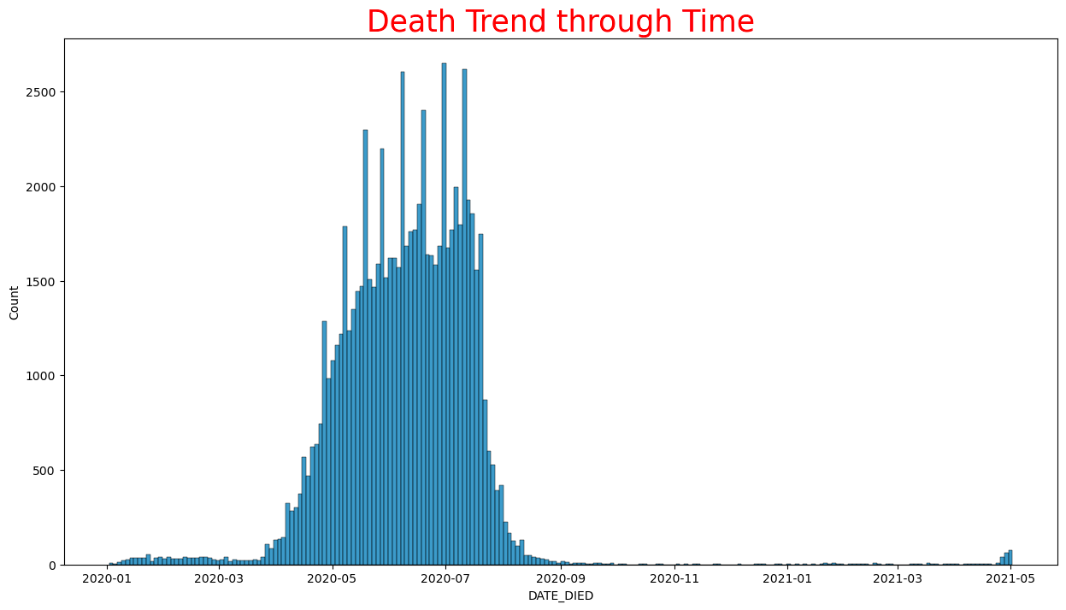
The visualization depicts the trend of deaths over time. By plotting the variable "DATE_DIED" on the x-axis, it shows how the number of deaths has changed throughout the observed period. This analysis provides insights into the temporal distribution of fatalities related to the COVID-19 pandemic.

Slide 23
Logistic Regression
Logistic Regression is a linear model and is used to estimate the probabilities between two classes.
Training Result | Accuracy = 0.90 | Train = 0.9056 | Test = 0.8995
Macro Average | Precision: 0.70 | Recall: 0.91 | F1-score: 0.75
Weighted Average | Precision: 0.95 | Recall: 0.90 | F1-score: 0.92

Slide 24
Decision Tree
The Decision Tree model is a simple yet powerful predictive model that uses a tree-like structure of decisions and their possible consequences. It splits the data into branches based on feature values, helping to make decisions that are easy to interpret and visualize, making it effective for both classification and regression tasks.
Training Result | Accuracy = 0.92 | Train = 0.9527 | Test = 0.9158
Macro Average | Precision: 0.71 | Recall: 0.85 | F1-score: 0.76
Weighted Average | Precision: 0.94 | Recall: 0.92 | F1-score: 0.93

Slide 25
Random Forest
Random Forest is an ensemble method that solves classification and regression problems by combining multiple decision trees.
Training Result | Accuracy = 0.92 | Train = 0.9517 | Test = 0.9155
Macro Average | Precision: 0.71 | Recall: 0.85 | F1-score: 0.76
Weighted Average | Precision: 0.94 | Recall: 0.92 | F1-score: 0.93

Slide 26
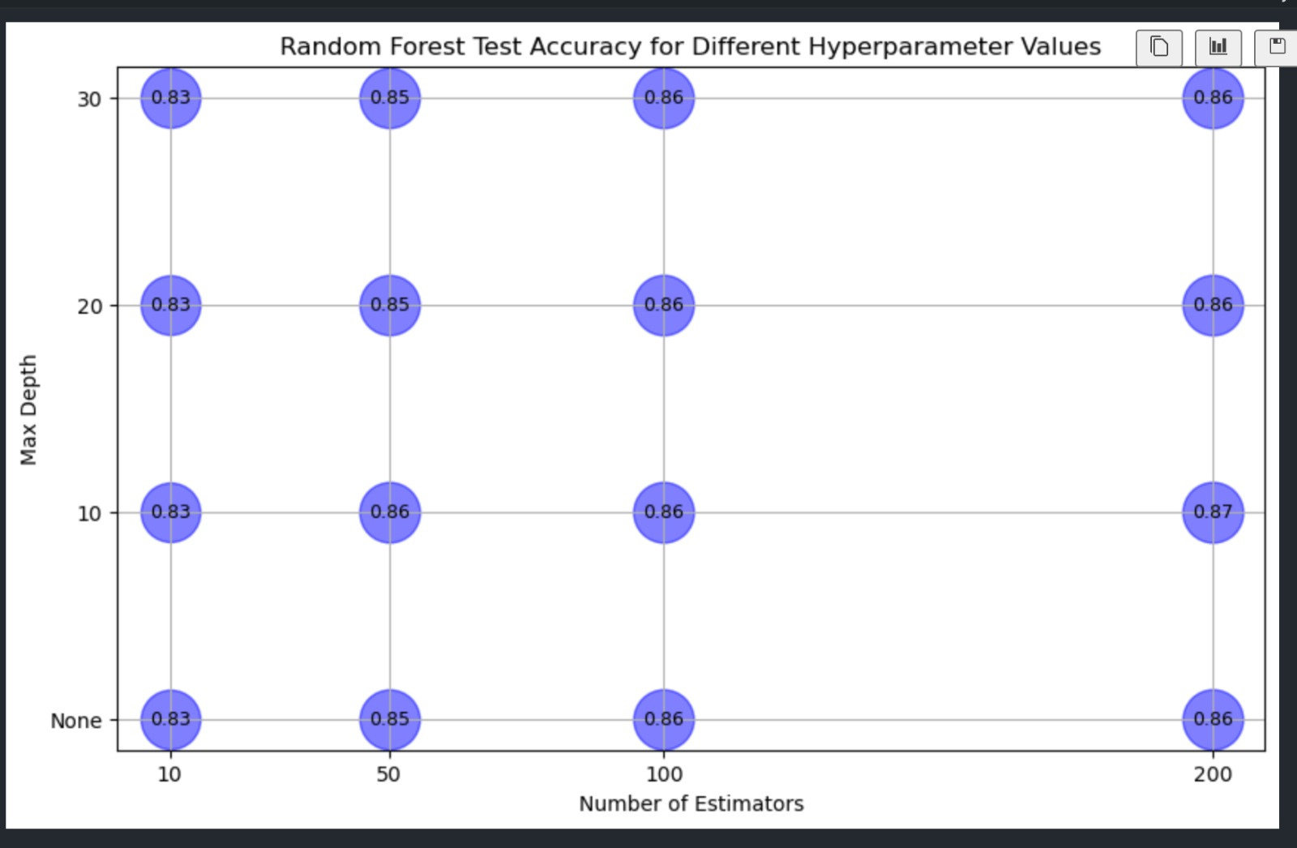

Slide 27
Naive Bayes
Naive Bayes is a probabilistic classification algorithm and works especially fast on large data sets.
Training Result | Accuracy = 0.90 | Train = 0.8786 | Test = 0.9032
Macro Average | Precision: 0.70 | Recall: 0.88 | F1-score: 0.75
Weighted Average | Precision: 0.95 | Recall: 0.90 | F1-score: 0.92

Slide 28
XGBoost
XGBoost is an algorithm that provides high accuracy and speed using the gradient boosting framework.
Training Result | Accuracy = 0.91 | Train = 0.9345 | Test = 0.9072
Macro Average | Precision: 0.71 | Recall: 0.91 | F1-score: 0.76
Weighted Average | Precision: 0.95 | Recall: 0.91 | F1-score: 0.92

Slide 29
ANN
The Artificial Neural Network (ANN) model is a computational model inspired by the structure and function of the human brain, consisting of interconnected layers of neurons that learn to recognize patterns and make predictions through backpropagation and optimization techniques, making it highly effective for complex tasks in classification, regression, and beyond."
Training Result | Accuracy = 0.90 | Train = 0.91 | Test = 0.90
Macro Average | Precision: 0.71 | Recall: 0.91 | F1-score: 0.76
Weighted Average | Precision: 0.95 | Recall: 0.90 | F1-score: 0.92

Slide 30
KNN
The k-Nearest Neighbors (KNN) model is a simple, instance-based learning algorithm that classifies data points based on the majority class of their 'k' nearest neighbors in the feature space, making it intuitive and effective for both classification and regression tasks
Training Result | Accuracy = 0.94 | Train = 0.85 | Test = 0.93
Macro Average | Precision: 0.77 | Recall: 0.78 | F1-score: 0.77
Weighted Average | Precision: 0.94 | Recall: 0.94 | F1-score: 0.94

Slide 31
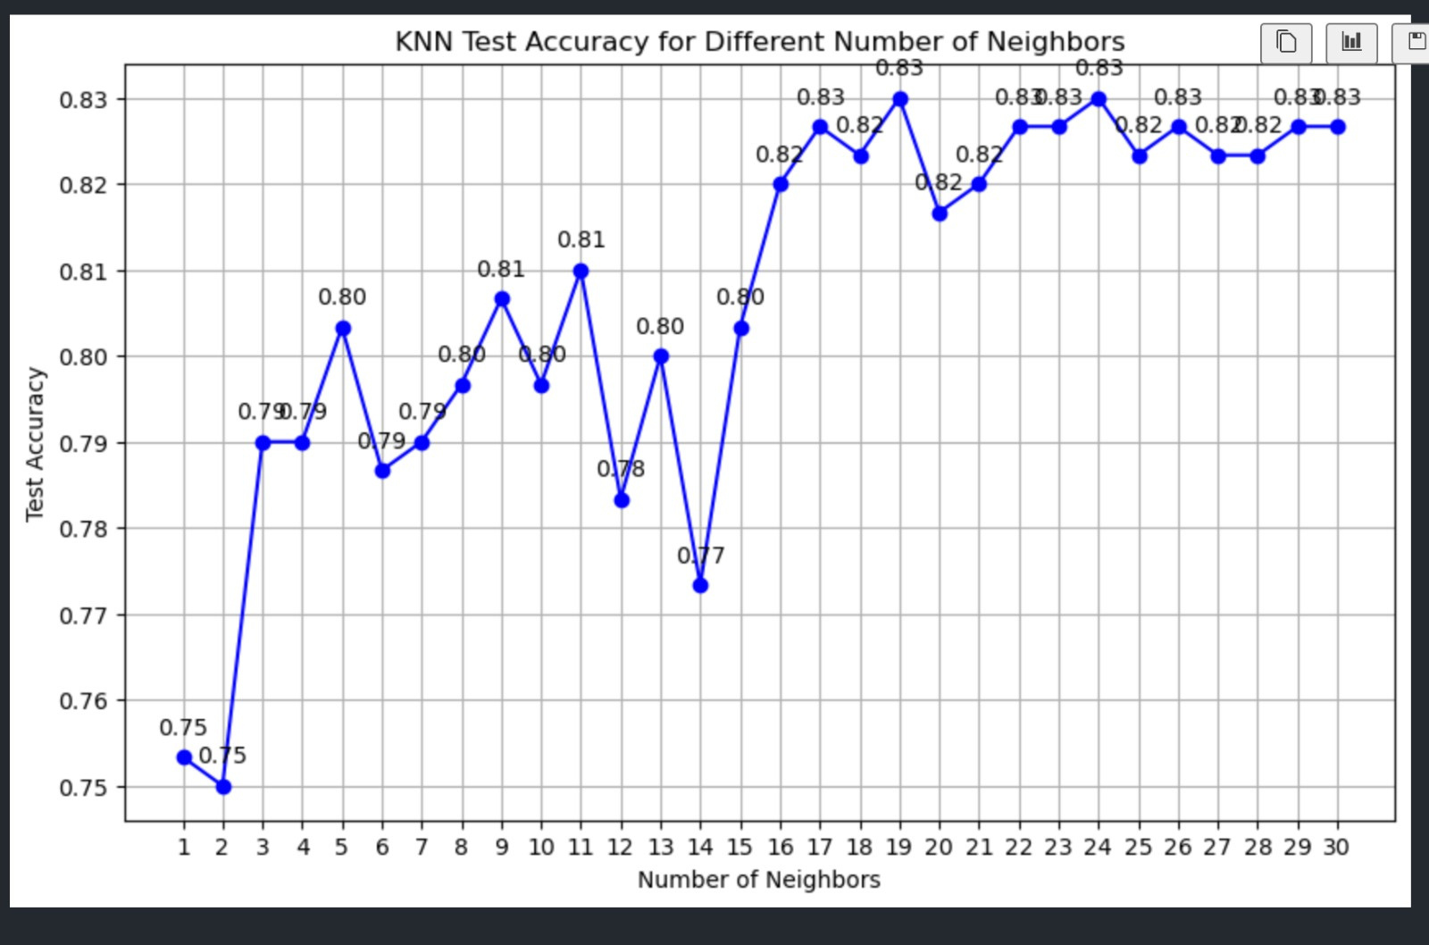

Slide 32
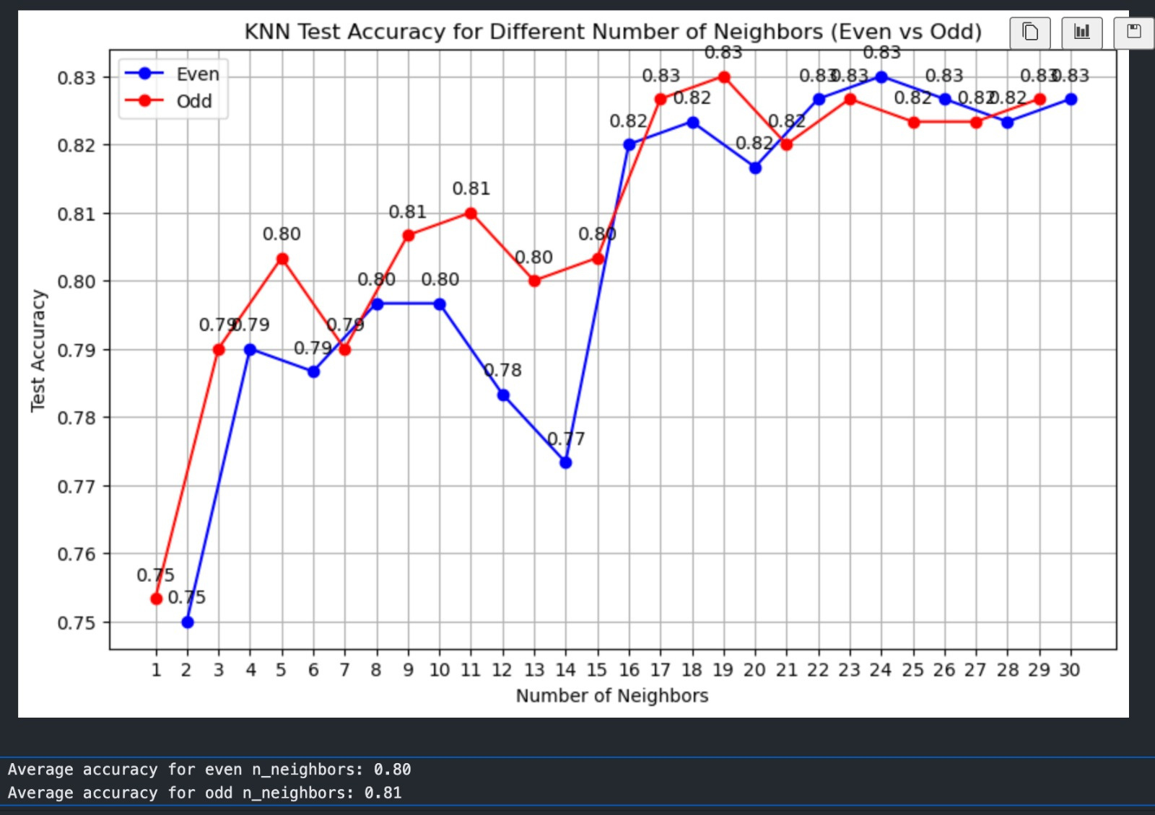

Slide 33

ALGORITHMS | ACCURACY | PRECISION | RECALL | F1-SCORE
LOGISTIC REGRESSION | 0.90 | 0.95 | 0.90 | 0.92
DECISION TREE | 0.92 | 0.94 | 0.92 | 0.93
RANDOM FOREST | 0.92 | 0.94 | 0.92 | 0.93
NAIVE BAYES | 0.90 | 0.95 | 0.90 | 0.92
XGBOOST | 0.91 | 0.95 | 0.91 | 0.92
ANN | 0.90 | 0.95 | 0.90 | 0.92
KNN | 0.94 | 0.94 | 0.94 | 0.94

Slide 34
THANK YOU FOR LISTENING

